Slide 1
Gender Inequality and Sports
Deepali Nigam
Asstt. Prof. Dept. of Physical Education
M.M.V.P.G.College, Kanpur

Slide 2
LACK OF MEDIA ATTENTION
Women are making great sporting achievements, yet the media attention to back it up unlike male sporting achievements is very minimal. This lack of media coverage is a major issue for the sports industry and not just the female athletes involved in sport. Not to mention they are usually objectified and sexualized.

Slide 3
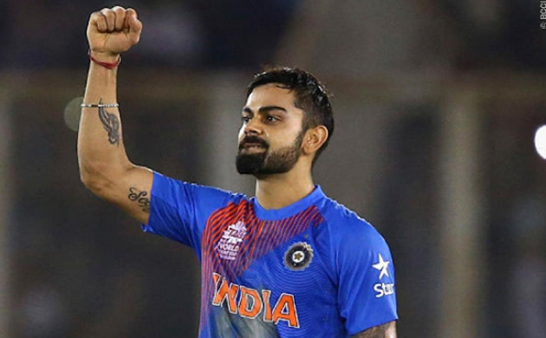
Virat Kohli
Virat Kohli is an Indian international cricketer who currently captains the India national team. Currently he won the test series against Bangladesh and this has been covered extensively in the media (including a lengthy interview for so many channels
.

Slide 4
Mithali Raj
Mithali Raj is an elegant batswoman who was the former captain of the women’s cricket team.
With her brilliant and consistent performances, Mithali has surpassed New Zealand’s Martin Guptill, the highest T20 run-scorer amongst men cricketers. As a guiding light. she’s either ignored or relegated to a single sentence, as if her achievements are not even worth covering. “Women’s player of the year”

Slide 5
This lack of media attention on Women’s sporting achievements, means that there is significantly fewer sportswomen idols out there who young women can aspire to be like.
This issue of minimal media coverage must be addressed especially in sports such as cricket where the potential of significant growth is evident, as female teams have been playing since the 19th century.

Slide 6
SPORTING SALARIES/PRIZE MONEY
The gender gap of salary and wages in sport is improving yet still clearly existent.
In the next slides only cricketers and 5 top female athlete of India compared, Let us see the list of some sportspersons of India who are wealthy …………

Slide 7
1. Sachin Tendulkar
The God of Cricket does not require any introduction. But for the layman, he is a former Indian international cricketer and a former captain of the Indian national team and one of the greatest batsmen of all time.
His net worth is of $118 million.

Slide 8
2. Mahendra Singh Dhoni
Mahendra Singh Dhoni captained the Indian national team in limited-overs formats from 2007 to 2016 and in Test cricket from 2008 to 2014. His net worth is of $ 111 million. Dhoni endorses brands like Reebok, Pepsi, GE Money and TVS Motors.

Slide 9
3. Virat Kohli
Virat Kohli is an Indian international cricketer who currently captains the India national team. His estimated net worth is $60 million, recently he is included in Forbes list as highest paid brand endorsements athletes in India.

Slide 10
4.Virender Sehwag
Virender Sehwag is a former Indian aggressive batsman from Delhi, who has made it to the list of richest sportspersons in India because of his huge net worth of $ 40 million

Slide 11
5. Yuvraj Singh
Yuvraj is an Indian international cricketer, who plays all forms of the game. He has battled against cancer to come back strong as a successful sportsman. He endorses the brand with big names like Puma and Microsoft, which makes him one of the richest sportspersons in India.
His net worth is $35 million

Slide 12
1. PV Sindhu
In a top-ten list of Forbes highest-earning female athletes, a certain PV Sindhu (with annual earnings of $8.5 million) rocked the spectators by emerging seventh on the charts. This came as a real achievement since she surpassed World No. 1 Simona Halep.

Slide 13
2. Sania Mirza
Sania Mirza carved a niche for herself and an example for the world as India’s leading female tennis player – one that remains unchallenged to this day. With her popularizing forehand groundstrokes, Sania Mirza was the first Indian woman to get through the top 20 rankings in World Tennis Association for singles and top 10 for doubles. According to the WTA, Sania’s estimated worth is around $6 million.

Slide 14
3. Saina Nehwal
Saina Nehwal is an Indian badminton champion who holds the holds No.1 rank in the World Women’s Singles. The estimated net worth of Saina is a whopping amount of $4 million (20 crores). She is ranked 29 in the Forbes Top 100 Celebrities List, making it a money rank to 43.

Slide 15
4. Mithali Raj
Mithali Dorai Raj with a whopping amount of $1 million net worth is placed at the 4th position in the highest earning woman athletes in India. Mithali is an elegant batswoman who was the former captain of the women’s cricket team.

Slide 16
5. Mary Kom
Mary’s career and name need no introduction and her achievements define her. Mary is currently leading the Indian contingency strongly at the Women’s World Boxing Championships.
With a whopping net worth estimated close to 3.32 crores

Slide 17
Now have a compact comparison of top 5 male and female athlete of India on their net worth
Sachin Tendulkar=$118 million
M. S. Dhoni=$ 111 million
Virat Kohli=$60 million
Virender Sehwag=$ 40 million
Yuvraj=$ 35 million
TOTAL=364 million
(2548 Crore)
PV Sindhu=$8.5 million
Sania Mirza=$6 million
Saina Nehwal=$4 million
Mithali Dorai Raj=$1 million
Mary Kom= $ .5 million
TOTAL=$ 20 million
(14 Crore)

Slide 18
Thank You

