Slide 1
Gravimetric Analysis
Introduction
1.) Gravimetric Analysis:
(i) A technique in which the amount of an analyte in a sample is
determined by converting the analyte to some product
Mass of product can be easily measured
(ii) Analyte: the compound or species to be analyzed in a sample
(iii) Overall, gravimetry sounds simple.
Advantages - when done correctly is highly accurate (most accurate of all time); requires minimal equipment
Disadvantage - requires skilled operator, slow.
Convert analyte into a solid, filter, weigh, calculate via a mole map
Notes:
Njcds

Slide 2
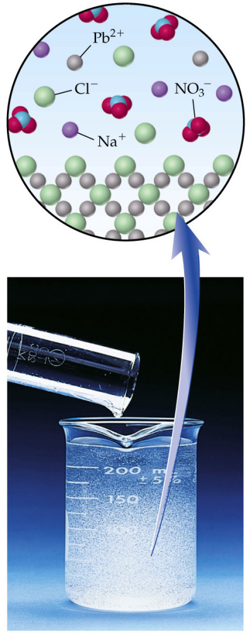
Gravimetric Analysis
Principle:
1.) Gravimetric Analysis: aA + rR ---------► AaRr
(iii) Example:
Determination of lead (Pb⁺²) in water
Pb⁺ + 2Cl⁻ → PbCl₂(s)
By adding excess Cl⁻ to the sample, essentially all of the Pb⁺² will precipitate as PbCl₂.
Mass of PbCl₂ is then determined.
- used to calculate the amount of Pb⁺² in original solution
Ex: Determination of Ca by precipitation as Calcium oxalate and ignition of oxalate to Calcium oxide.:
Ca⁺⁺ + C₂O₄ ²⁻ ---------► CaC₂O₄ (S)
CaC₂O₄ (S) ---------► CaO + CO₂ ⁭ + CO ⁭
Generally excess of Reagent is added to repress the solubility of precipitate.
Analyte
Reagent
Solid Product

Slide 3
Gravimetric Analysis
Introduction 1.) Gravimetric Analysis:
(v) Example: 0.4852 g sample of iron ore is dissolved in acid and iron is oxidised to the +3 state and then precipitated as hydrous oxide, Fe₂O₃. xH₂O . The ppt. is filtered, washed & ignited to Fe₂O₃ which is found to be 0.2481 g. Calculate the % of iron in sample.
2Fe^{3+ ---------►} Fe₂O₃.x H₂O ^{---------►} Fe₂O₃ (S)
Since 2 mol of Fe³⁺ produce 1 mol of Fe₂O₃
Gravimetric Factor: = 2 FW of Fe / FW of Fe₂O₃ = 2 x 55.85/159.69 = 0.6994.
% of Fe = wt. of analyte x G.F. x100/ wt. of sample
= 0.2481 x 0.6994 x 100 / 0.4852 = 35.76%
Seperation processes should be sufficiently complete so that quantity of analyte left unprecipitated is 0.1 mg or even less.
Substance weighed should have definite composition and should be pure.
Precipitate formed should be filterable.

Slide 4
Gravimetric Analysis
Precipitation Process and Particle size
1.) Principle:
(i)
Reagent + Analyte Solid Product (collect and measure mass)
(ii) Desired Properties of Solid Product
Should be very insoluble
Easily filterable (i.e., large crystals)
Very Pure
Known and constant composition
Few precipitates have all of these properties, but in most cases appropriate techniques can help optimize these qualities

Slide 5
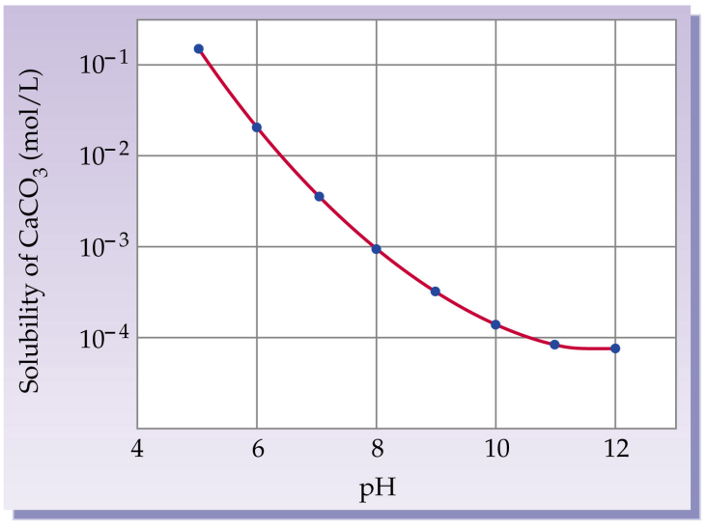
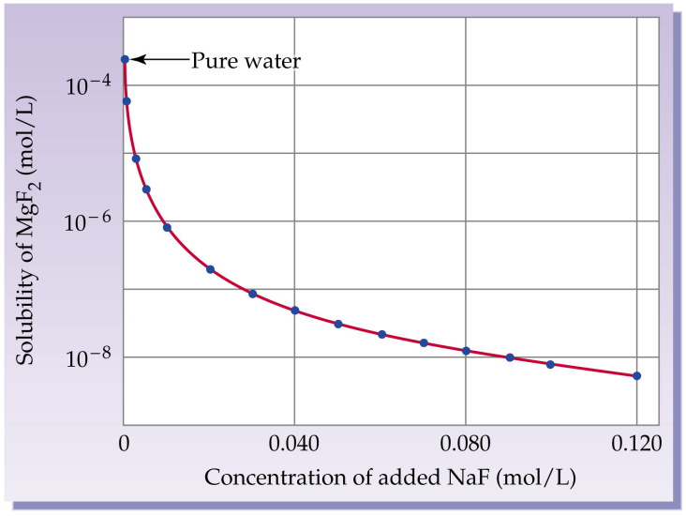
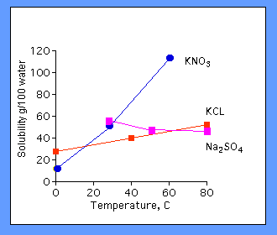
Gravimetric Analysis
Precipitation Analysis
2.) Solubility:
(i) The solubility of a precipitate can be decreased by:
Decreasing temperature of solution
Using a different solvent
- usually a less polar or organic solvent (like dissolves like)
Solubility vs. pH
Solubility vs. Common Ion Effect
Solubility vs. Temperature

Slide 6
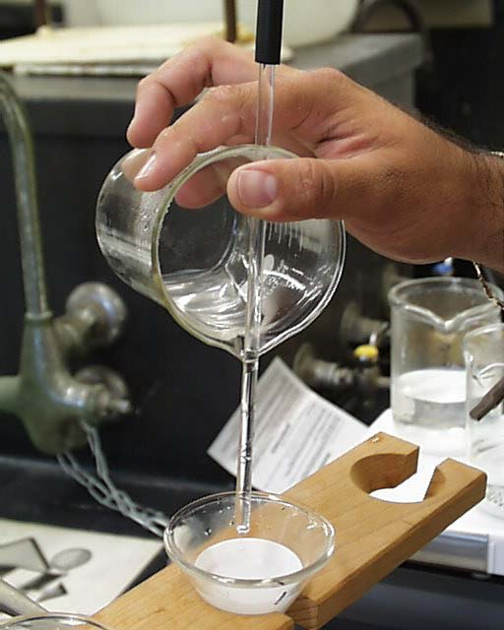
Gravimetric Analysis
Precipitation Analysis
3.) Filterability:
(i) Want product to be large enough to collect on filter:
Doesn’t clog filter
Doesn’t pass through filter
(ii) Best Case: Pure Crystals
Worst Case: Colloidal suspension
Difficult to filter due to small size
Tend to stay in solution indefinitely → suspended by Brownian motion
- usually 1-100 nm in size
Brownian Motion
Whether crystals or colloids are obtained depends on conditions used in the precipitation

Slide 7
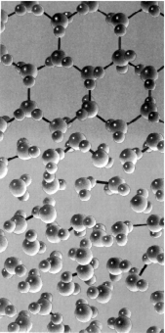
Gravimetric Analysis
Precipitation Analysis
4.) Process of Crystal Growth:
(i) Two Phases in Crystal Growth
Nucleation – molecules in solution come together randomly and form
small aggregates
Particle growth – addition of molecules to a nucleus to form a crystal
Crystal Growth

Slide 8
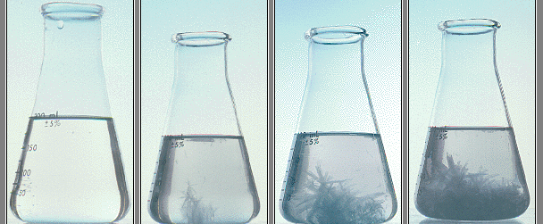
Gravimetric Analysis
4.) Process of Crystal Growth:
(ii) Nucleation and Particle growth always compete for molecules/ions
being precipitated.
If nucleation is faster than particle growth:
- a large number of small aggregates occur giving colloidal suspensions
If particle growth is faster than nucleation:
- only a few, large particles form giving pure crystals
Want to
Convert to
Colloidal suspension
Crystal formation

Slide 9
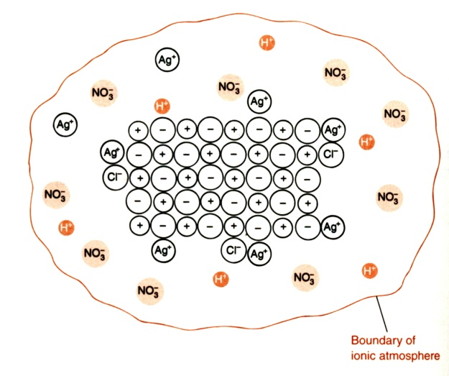
Gravimetric Analysis
4.) Process of Crystal Growth:
(iii) Rate of nucleation vs. particle growth depends on:
Amount of precipitating solute present
Described by a quantity known as the Relative Supersaturation (R)
(iv) If R is large,
Large relative amount of solute in solution
Favors nucleation and colloid formation
(v) In gravimetry based on precipitations, a small value of R (~1.0) is desired in order to favor large crystal growth
S = concentration of solute in solution at equilibrium
Q = actual concentration of solute added to solution
Colloidal Particle

Slide 10
Gravimetric Analysis
4.) Process of Crystal Growth:
(vi) Methods for Minimizing R
1. Increase temperature of solution
- increases S
- increase amount of solute that can be in solution at equilibrium
2. Add precipitating reagent (precipitant) slowly while vigorously mixing solution
- avoids local high concentrations of solution
- avoid nucleation and colloid formation
3. Keep volume of solution large
- keep concentration of analyte and precipitating reagent low
4. Control S through chemical means
- by adjusting pH
- adding complexing agents
- example: precipitation of Ca²⁺ with C₂O₄²⁻
C₂O₄²⁻ + 2H⁺ H₂C₂O₄⁻
Ca²⁺ + C₂O₄²⁻ CaC₂O₄(s)
Note: As pH ([H⁺]) changes, the solubility of CaC₂O₄ changes
K_{sp}

Slide 11
Colloidal state:
Certain range of particle size : 0.1 µm & 1 nm
1 µm = 10⁻³ mm 1 nm = 10⁻⁶ mm 1A⁰ = 10⁻¹⁰ m = 10^{-7mm} = 0.1nm
Colloidal state behaves like true solution (10⁻⁸ cm or 0.1nm)
The colloidal particles in the solution exhibit tyndall effect shown by John T.
Tyndall effect: Phenomenon of scattering light by colloidal suspension.
Colloids are classified into two types:
Lyophobic B) Lyophilic
Lyophobic : Dispersions (sols) slightly viscous, sols of metals, AgX, M⁺S etc.
Minute conc. Of an electrolyte results in flocculation. Change is irreversible. Water has no effect on flocculated solid. These have definite electric charge. Under ultra microscope these are seen as bright particles in vigorous motion. (Brownian Movement)
Lyophilic : These are viscous, set to jelly like masses known as gels. Eg.: sol of silicic acid, Mn (IV) oxide, gelatin.
Large conc. Of electrolyte results in precipitation (salting out), Change is reversible, & reversal is effected by addition of solvent (water).
Change their charge readily (+vely charged in acidic medium & -vely charged in basic medium. ) Diffuse light cone is exhibited under ultra microscope.

Slide 12
Peptization
Process of dispersing an insoluble material into a liquid as a colloid is Peptization
Coagulation of colloidal dispersion is brought about by ions other than those ions that precipitates it off.
If these ions are dissolved when a ppt is washed, solid particles will go back into colloidal dispersion & pass thru the filter.
Ions of same charge repel each other. So multivalent ion salt is added to solution for flocculation.
By adding electrolyte that reduces the repulsion of particles & particles remain as flocs that are easy to filter.

Slide 13
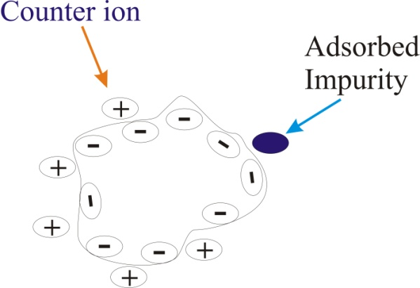
Gravimetric Analysis
(i) Most ionic compounds are precipitated in the presence of some added electrolyte
e.g. 0.1 M HNO₃
Allows the small nucleation aggregates to better overcome any charge repulsion and promotes particle growth
(ii) Impurities may also be present in the crystal
Known as co-precipitation (contamination by substances which are generally soluble in mother liqor)
Creates errors in gravimetric analysis
(iii) Types of Impurities/co-precipitation
a)
Impurities adsorbed to crystal surface
Surface adsorption is greatest for
Gelatinous precipitates & least for
Macrocrystalline partcles.

Slide 14
Panath fajans Hahn adsorption rule: # states that ion that is most strongly adsorbed by an ionic substance (crystal lattice) is that ion which forms the least soluble salt. Eg: On sparingly soluble SO₄⁻⁻ , Ca++ are most readily adsorbed compared to Mg++. Because Ca++ are less soluble . Deformability of adsorbed ions & electrolytic dissociation of adsorbed compound plays important role.
Lesser is the dissociation of a compound greater is the adsorption.
Ex: H₂S is a weak electrolyte and is highly adsorbed by metallic sulphides.
b) Occlusion :
During the building up of precipitates from primary particles.
Primary particles are subjected to some amount of surface adsorption.
During the coalescence the impurities may be
Partially eliminated if large single crystals are formed & process should take place slowly.
cont…

Slide 15
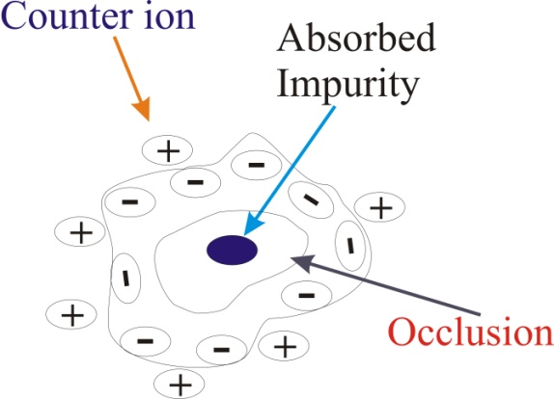
Gravimetric Analysis
2. Or if coalescence is fast, large crystals composed of loosely bound small crystals may be produced & some of the impurities may be entrained within the walls of large crystals.

Slide 16
Post Precipitation:
Occurs on the surface of 1st precipitate after its formation.
occurs with sparingly soluble substance which form supersaturated solutions.
Usually they have ion in common with the primary ppt.
eg: In precipitation of Ca as oxalate in presence of Mg, Mg-oxalate also separates gradually upon Ca-oxalate .
Longer the ppts is allowed to stand in contact with solution greater is the error.

Slide 17
Differences between Co-precipitation & Post precipitation
Post precipitation | Co-precipitation
Contamination ↑ with time that the ppt is left in contact with mother liquor. | ↓ses
Contamination ↑, The faster the solution is agitated by either mechanical / thermal means | ↓ses
Magnitude of contamination ↑ | Low
@

Slide 18
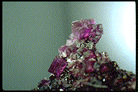
Gravimetric Analysis
Miscellaneous Notes on Precipitation:
Impurities are undesirable
Change the chemical composition of the precipitate
Causes errors in the analysis
Ways to Minimize Impurities
Keep R small
- large pure crystals decrease occlusions and adsorbed impurities
Digestion allowing precipitate to stand in mother liquor (precipitating solution), usually while being heated
- promotes removal of impurities from crystal
- increases size of crystals
3. Wash precipitate, redissolve the precipitate in fresh solvent and reprecipitate
- helps decrease all types of impurities
4. Add a masking agent to solution
- keeps impurities from precipitating, but not analyte
Color → Impurity
Mg²⁺ + CPCH → Solid product
Mn²⁺ + 6CN⁻ → Mn(CN)₆⁴⁻
Masking agent
precipitant

Slide 19
Gravimetric Analysis
Digestion:
Precipitates are allowed to stand for 12-24 hrs at R.Temp. or by warming the ppt for some time in contact with liq from which was formed.
- Complete ppt . Bigger particles of ppt are formed easy to filter.
- Smaller particles of ppt goes to solution & then reposit on bigger
- Co-pptn is minimised, it takes in smaller particles.
- Reduces co-pptn & ↑ses the size of particles easy to filter.

Slide 20
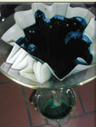
Washing of Precipitates
Object: To remove the surface impurities as much as possible
Composition of wash liquid depends on:
solubility & chemical property of ppt.
Tendency of ppt to undergo peptization
Impurities to be removed
Influence of traces of wash liquid on ppt before weighing
Pure water is generally not used, it produces partial peptization of ppt.
Peptization is opposite of coagulation. Ppt will go to colloidal
Precipitates from ionic compounds
- need electrolyte in wash solution
- keep precipitate from breaking up and redissolving (peptization)
Electrolyte should be volatile
- removed by drying - HNO₃, HCl, NH₄, NO₃, etc.
Example: AgCl(s) should not be washed with H₂O, instead wash with dilute HNO₃

Slide 21
Classes of Wash Liquids
1. Solutions which prevent precipitate from becoming colloidal & passing thru filter:
Ex: dil. NH₄NO₃ solution for washing Fe(OH)₃/ Hydrated Fe₂O₃
1% HNO₃ for washing AgCl.
Such tendency is observed with gelatinous/flocculated ppt. not with crystalline ppt.
2. Solutions which reduce solubility of ppts:
Wash solution contains a moderate conc. Of compd. With one ion in common with ppt.
Substances tend to be less soluble in presence of slight excess of common ion.
Organic solvents can sometimes be used for washing.
Ex: 100ml of H₂O at 25⁰C will dissolve 0.7 mg of CaC₂O₄, but same volume of dilute (NH4)₂C₂O₄ dissolves negligible amount of salt.
3. Solutions which prevent hydrolysis of salts of weak acids & bases:
If ppt. is salt of weak acid & is slightly soluble it will try to hydrolyse into soluble product base. So wash liq.--- Basic.
Sol. Loses minimized ---- less wash liq. Every time than washing with large qty of wash liq.

Slide 22
Filteration
Separation of ppt. from Mother liquor.
Filtering Mediums are used
Filter paper
Filter mats of purified asbestos (Gooch crucibles) or Platinum (munroe crucible)
Porous fritted plates of resistant glass (pyrex) (sintered glass filtering crucibles) (silica or of porcelain)
Filter Paper: Quantitative filter papers with small ash content.
such filter papers are made when during mfg washing of paper is done with HCl & HF.
Sizes: circles- of 7,9,11,12.5 cm diameter.
Ash content of 11 cm circle should not be more than 0.0001g
Hardened FP made by further treatment with acid. These have extremely small ash values.

Slide 23
Filter papers
More resistant to acids & alkalies
Used in quantitative work
Whatman Quantitative FP
Size of FP: depends on bulk of ppt to be filtered not volume to be filtered.
Folded FP extended to with in 1-2 cm of top of funnel.
2. Crucible: Filter crucibles
Used to collect the ppt in which they can be directly weighed
Gooch crucibles made of porcelain, silica & platinum
Base is pierced with no. of small holes. Holes are covered by pad of asbestos, produced by sucking a slurry of asbestos fibres in water thru crucible under reduced pressure

Slide 24
Gooch crucibles
Sintered glass crucibles: made of resistant glass
Have porous disc of sintered ground glass fused into the body of crucibles.
Filter disc have varying porosities- from 0 (coarsest) to 5 (finest)
IGNITION:
Temp. below 250⁰C – Drying (Drying oven)
Temp. above 250⁰C to more than 1200⁰C – Muffle furnace
In gravimetry- seperated substance must be converted to a form suitable for weighing (pure, stable, definite composition)
Ignition at elevated temp. is required for complete removal of water that is occluded or very strongly adsorbed & complete conversion to desired compound.
Eg. Ignition of CaC₂O₄ to CaO , Chemical change requires ↑ Temp

Slide 25
IGNITION
Errors:
Incomplete removal of water, volatile electrolytes, Reduction of ppts by carbon when filter paper is used
Incineration of Filter paper in presence of ppt.:
Silica crucible- ignited to const. weight (with in 0.0002 g) at which the ppt is to be heated.
Packet of ppt placed in crucible
Place the crucible on pipe clay silica triangle on a ring stand. Incline the crucible, half covered, introduce flame slowly increase flame.
carbonize the paper
Paper should not be put to flames or else small particles of ppt during combustion may be lost.

Slide 26
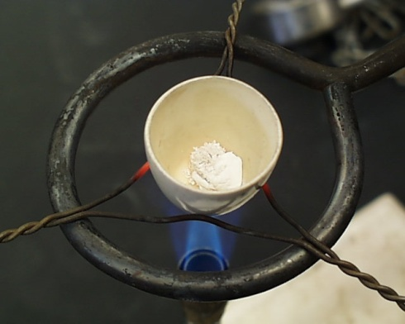
IGNITION
20 minutes to char paper
30 to 60 minutes for complete ignition
After 1-2 min crucible & lid put in dessicator
cool for 25-30 min
weigh the crucible & lid
crucible & lid again ignited at same temp for 10-20 min
repeat same procedure till constant weight obtained
empty crucible & lid subjected to same procedure

Slide 27
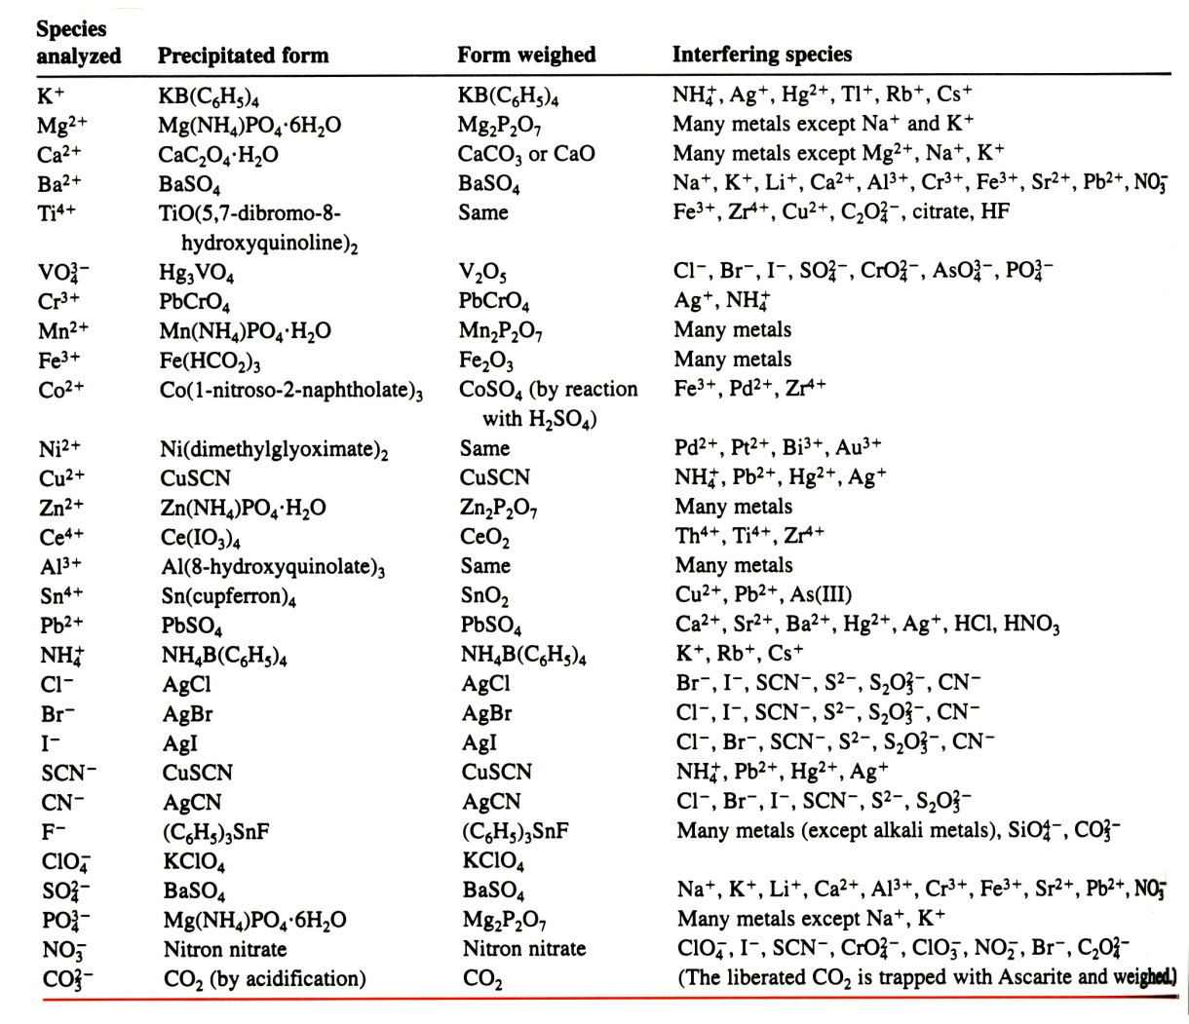
Gravimetric Analysis
Scope of Gravimetric Analysis
1.) Accurate
2.) Inexpensive
Only major equipment is balance
3.) Method is more tedious than other approaches
must carefully consider how to minimize potential interferences

