Slide 1
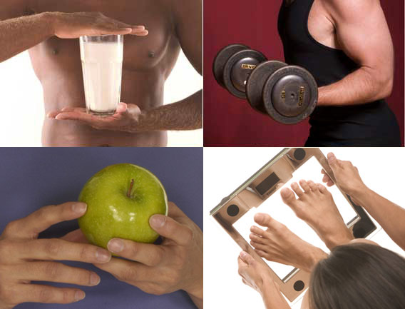
Health and wellness
Deepali Nigam
Asstt. Professor, Dept. of Physical Education,
Mahila Mahavidyalaya P.G.College, Kanpur, U.P.

Slide 2
What is health
According to the World Health Organization (WHO)
Health is "a state of complete physical, mental, and social well-being and not merely the absence of disease".
Physical is about the body. Mental is about how people think and feel.

Slide 3
Types OF Health
Mental and
Physical health
These are probably the two most frequently discussed types of health.
Spiritual, emotional, and financial health also contribute to overall health. Medical experts have linked these to lower stress levels and improved mental and physical well-being.

Slide 4
Physical health
A person who has good physical health is likely to have bodily functions and processes working at their peak.
This is not only due to an absence of disease. Regular exercise, balanced nutrition, and adequate rest all contribute to good health.

Slide 5
Mental health
Good mental health is not only categorized by the absence of depression, anxiety, or another disorder. It also depends on a person’s ability to:
enjoy life
bounce back after difficult experiences and adapt to adversity
balance different elements of life, such as family and finances
feel safe and secure
achieve their full potential

Slide 6
WHAT IS Wellness
Everything we do and every emotion we feel relates to our well-being. In turn, our well-being directly affects our actions and emotions. ...
Therefore, it is important for everyone to achieve optimal wellness in order to subdue stress, reduce the risk of illness and ensure positive interactions.

Slide 7
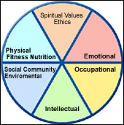
Dimensions of Wellness
There are five main aspects of personal health: physical, emotional, social, spiritual, and intellectual.

