Slide 1
High Performance Liquid Chromatography (HPLC)
What is HPLC?
Types of Separations
Columns and Stationary Phases
Mobile Phases and Their Role in Separations
Injection in HPLC
Detection in HPLC
Variations on Traditional HPLC
Ion Chromatography
Size Exclusion Chromatography

Slide 2
High Performance Liquid Chromatography (HPLC)

Slide 3
What is HPLC?
High Performance Liquid Chromatography
High Pressure Liquid Chromatography (usually true]
Hewlett Packard Liquid Chromatography (a joke)
High Priced Liquid Chromatography (no joke)
HPLC is really the automation of traditional liquid chromatography under conditions which provide for enhanced separations during shorter periods of time!
Probably the most widely practiced form of quantitative, analytical chromatography practiced today due to the wide range of molecule types and sizes which can be separated using HPLC or variants of HPLC!!

Slide 6
solvent
pump
injector
column
detector

Slide 7
Types of HPLC Separations (partial list)
Normal Phase: Separation of polar analytes by partitioning onto a polar, bonded stationary phase.
Reversed Phase: Separation of non-polar analytes by partitioning onto a non-polar, bonded stationary phase.
Adsorption: In Between Normal and Reversed. Separation of moderately polar analytes using adsorption onto a pure stationary phase (e.g. alumina or silica)
Ion Chromatography: Separation of organic and inorganic ions by their partitioning onto ionic stationary phases bonded to a solid support.
Size Exclusion Chromatography: Separation of large molecules based in the paths they take through a “maze” of tunnels in the stationary phase.

Slide 8
TLC vs High Performance Liquid Chromatography (HPLC)HPLC Optimization

Slide 9
HIGH PERFORMANCE LIQUID CHROMATOGRAPHY
(TLC vs Normal Phase and Reverse Phase HPLC)

Slide 10
Normal Phase vs. Reverse Phase HPLC

Slide 11
Columns and Stationary Phases.
HPLC is largely the domain of packed columns
some research into microbore/capillary columns is going on.
Molecules move too slowly to be able to reach and therefore “spend time in” the stationary phase of an open tubular column in HPLC.
In solution, not the gas phase
Larger molecules in HPLC vs. GC (generally)
Stationary phases are particles which are usually about 1 to 20 μm in average diameter (often irregularly shaped)
In Adsorption chromatography, there is no additional phase on the stationary phase particles (silica, alumina, Fluorosil).
In Partition chromatography, the stationary phase is coated on to (often bonded) a solid support (silica, alumina, divinylbenzene resin)

Slide 12
Stationary Phases
Polar (“Normal” Phase):
Silica, alumina
Cyano, amino or diol terminations on the bonded phase
Non-Polar (“Reversed Phase”)
C18 to about C8 terminations on the bonded phase
Phenyl and cyano terminations on the bonded phase
Mixtures of functional groups can be used!!
Packed particles in a column require:
Frits at the ends of the column to keep the particles in
Filtering of samples to prevent clogging with debris
High pressure pumps and check-valves
Often a “Guard Column” to protect the analytical column

Slide 13
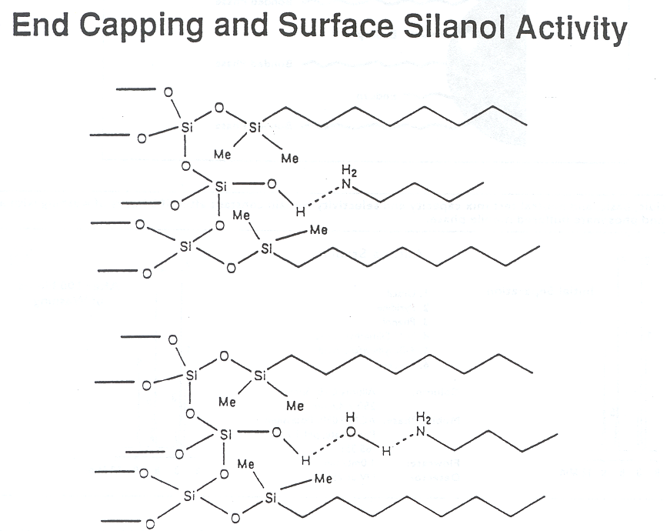
Reverse Phase HPLC

Slide 14
RP-HPLC – Effect of Stationary Phase

Slide 17
What does the analyst do?
Select the correct type of separation for the analyte(s) of interest, based on the sample type (among other factors).
Select an appropriate column (stationary phase) and mobile phase
Select an appropriate detector based on whether universal or compound-specific detection is required or available
Optimize the separation using standard mixtures
Analyze the standards and sample

Slide 18
Optimization of Separations in HPLC
Correct choice of mobile phase
Decision on the type of mobile phase composition
constant composition = isocratic
varying composition = gradient elution
Determination of flow rate should be constant
usually it is
Decision on heating the column
heating HPLC columns can influence the above equilibrium….

Slide 19
Method Development in HPLC
Systematic approach to HPLC method development
Information on sample
Number of compounds present in the sample
Chemical nature of the compounds, functionalities present
Molecular weight of the compounds
pKa values of the compounds
UV spectra of the compounds
Concentration range of compounds in samples
Sample solubility

Slide 20
What are the separation goals
Is the primary goal qualitative analysis, quantitative analysis, isolation of pure compound
Is it necessary to resolve all compounds or a specific compound is of interest
Number of samples to be analyzed at a particular time
Sample pretreatment
Solids, Liquids, Gases
Detectors
What detector type

Slide 21
Developing a Separation

Slide 22
Preferred HPLC methods
Reverse Phase Water-Organic MP C18, C8, phenyl, cyano | First choice for neutral samples soluble in water organic mixtures
Ion-Pair Water-Organic MP, Buffer Ion-pair reagent, C18, C8, cyano | For ionic and ionizable compounds, especially bases or cations
Normal Phase Organic MP Cyano, diol, amine, silica | Second choice when RP and IPC are ineffective, first choice for lipophillic samples

Slide 23
Preferred Initial Conditions for HPLC
Column
Dimensions 25 x 0.46 cm
Particle Size 5 μm
Stationary Phases C-8 or C-18
Mobile Phase
Solvents A and B Buffer-Acetonitrile
% B 80 – 100%
Buffer 25 μM pot. phosphate
Flow rate 1.0 – 2.0 ml/min
Temperature Ambient
Sample Size
Sample weight < 100 μg
Sample Volume < 100 μL

Slide 24
What is desirable from initial runs?
Resolution 1.5
Time 5 – 10 min
Pressure 150 bar (~ 2100 psi) desirable
Peak height Sharp peaks are desirable
Solvent Minimum mobile phase
Repeatability Each chromatogram should be repeatable
Equilibration Sufficient time for equilibration between method development runs (10 – 20 column volumes)

