Slide 1
High Performance Liquid Chromatography (HPLC)
What is HPLC?
Types of Separations
Columns and Stationary Phases
Mobile Phases and Their Role in Separations
Injection in HPLC
Detection in HPLC
Variations on Traditional HPLC
  Ion Chromatography
  Size Exclusion Chromatography

Slide 2
Theory of HPLC
20% of compds. Can be analyzed by GC. Because of non-volatility & thermal instability.
HPLC is not limited by sample volatility, Thermal stability. It can separate macromolecules, ionic sp., labile natural products, polymeric mat., high mol. Wt. polyfn., compds.,
Separation is due to specific interaction of sample mol., with stationary & mobile phase.

Slide 3
Chromatographic terms
poor resolution
Eluent peak; dead volume
Peak fronting
Tailing
Shoulder
Injection monitoring
Baseline drift
Peak width
at half-height
Peak wide
Baseline
Baseline noise

Slide 4
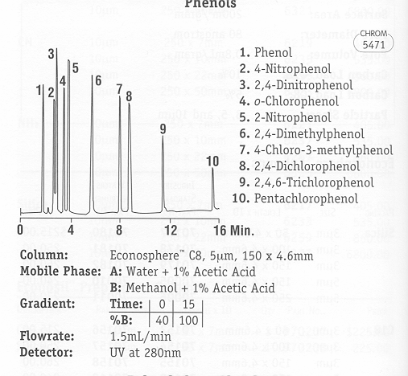
RP-HPLC – Variables
Alltech Chromatography Sourcebook, 2004-04 catalog

Slide 5
Peak shape
T= Asymmetry
Reason for bad peak shape
⇨ bad column - caves, channels
⇨ dead volume - void in column, external dead volume
⇨ column overload
asymmetric peak shape
k´ changes with sample volume
⇨ chemical tailing
polar compounds strongly interact with stat. Phase (often amines on C-18)

Slide 6
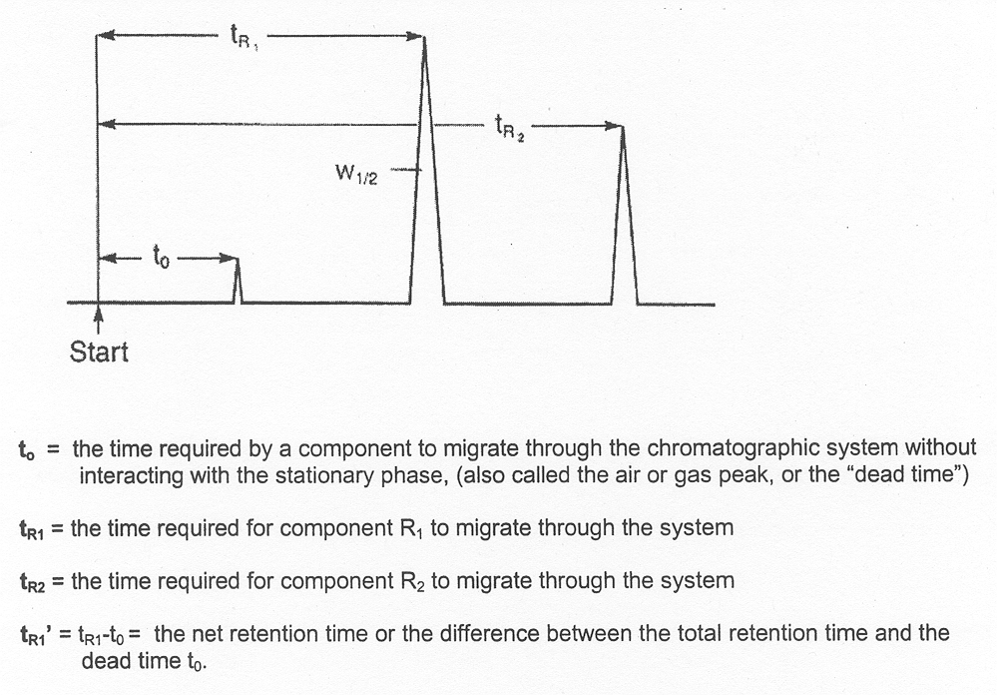
Schematic Presentation of a Chromatogram

Slide 7
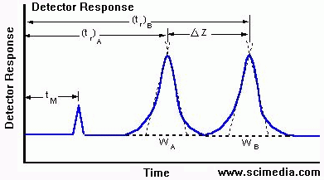

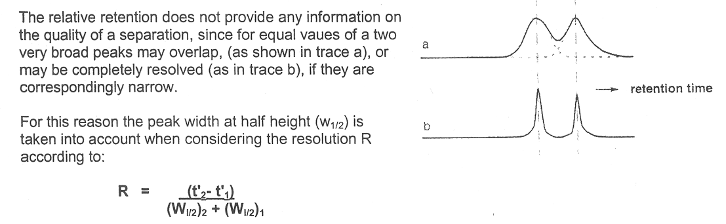
HPLC - Resolution
Resolution (R_{S}) of a column provides a quantitative measure of its ability to separate two analytes
R_{s} = ΔZ /1/2(W_{A}+W_{B})
R_{s} =

Slide 8
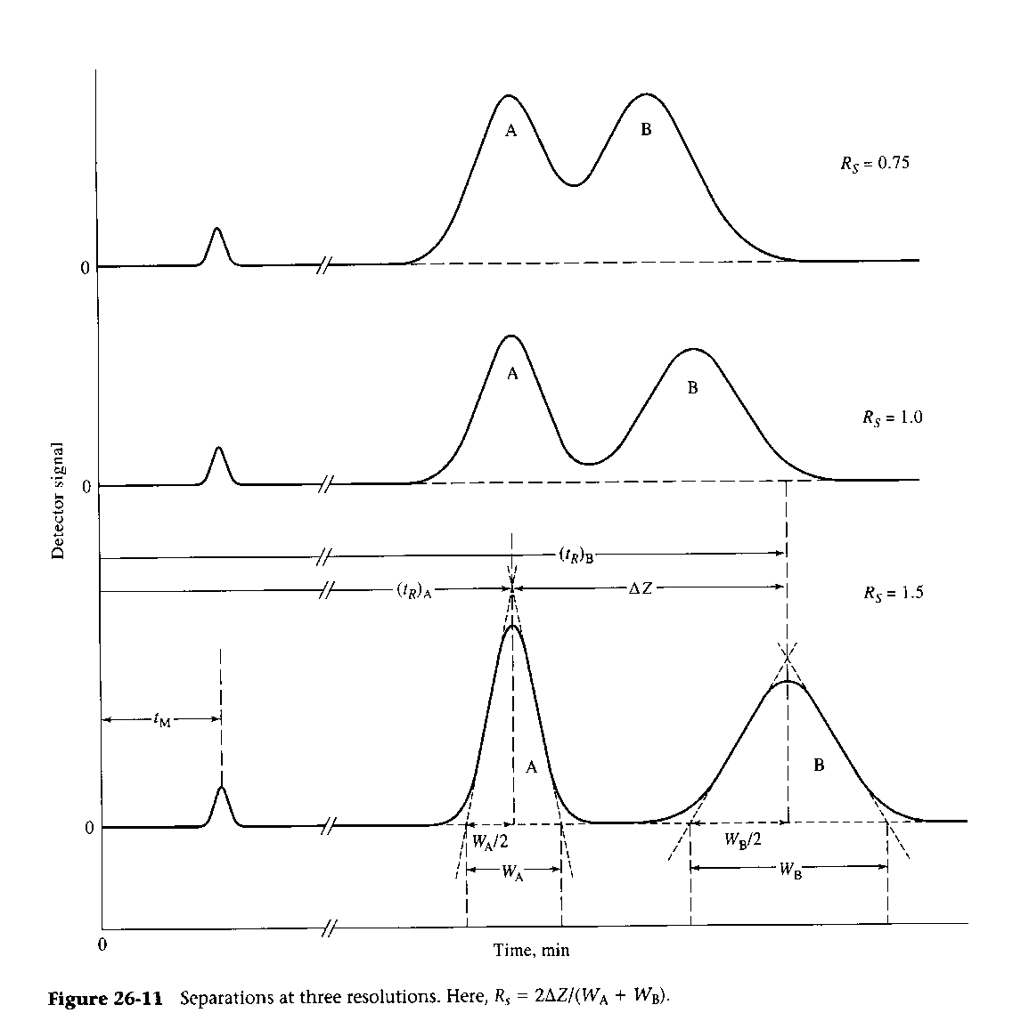

HPLC - Resolution
R_{s}
Skoog and Leary: Principals of Instrumental Analysis, 4th ed. Suanders, 1992

Slide 9
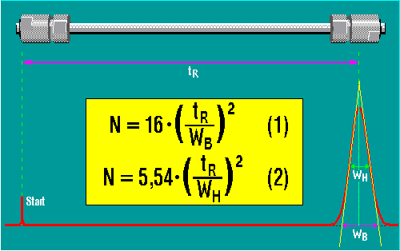
Plate Number
The theoretical plate number or N is a quantitative measure for the column efficiency
In formulas (1) or (2) the peak base width W_{B} or the half width W_{H} are compared with the retention time t_{R}

Slide 10
Plate Number
N is defined as square of ratio of retention time divided by standard deviation of the peak (σ).
Relationship using width at half height is also used to calculate N as described in USP

Slide 11
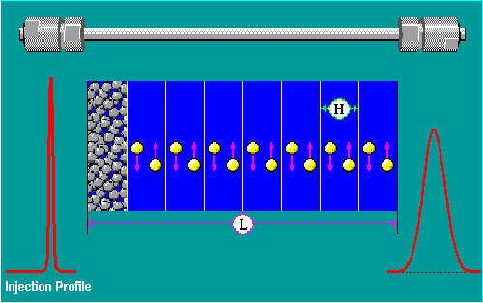
Plate Number and Plate Height
Since an efficient separation column delivers sharp peaks with narrow base widths or half widths, a better column has relatively high value of N, at equal retention time t_{R.}
The concept of the theoretical plates has its origin in the theory describing the efficiency of distillation. The concept of the theoretical plates is a useful tool to describe the efficiency of a separation column
The number of theoretical plates is proportional to the column length L. The longer a column, the more theoretical plates it has; however, the column back pressure increases.
To be able to compare separation, columns of various lengths, the theoretical plate height, H is used.
H = L/N
Well packed columns at optimum flow rate have H values 2 - 5 times the particle diameter of the carrier substance. For a column of the length L = 100 mm, packed with 5 µm material, a theoretical plate height of 10 - 25 µm results.

Slide 12
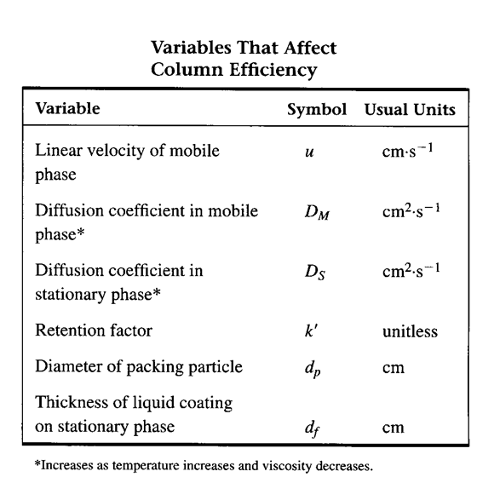
HPLC - Column Efficiency
Skoog and Leary: Principals of Instrumental Analysis, 5th ed. Suanders, 1998

Slide 13
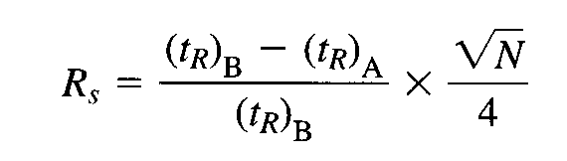
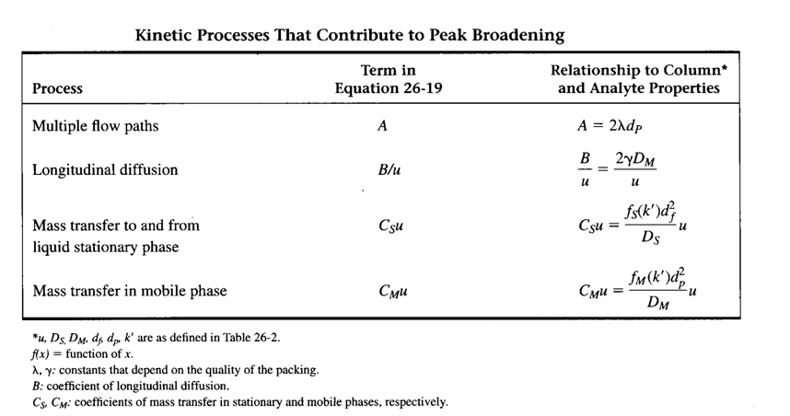
HPLC – Resolution vs Column Efficiency (N, H)
H = L / N
van Deemter Equation
H = A + B/u +(C_{s} + C_{m})u
Skoog and Leary: Principals of Instrumental Analysis, 5th ed. Suanders, 1998

Slide 14
Van Deemter (H / u) Curve
The Van Deemter Curve reflects the relationship between theoretical plate height H and the linear velocity u of the mobile phase. Since the plate height H is a measure for the band broadening of the injection peak of a substance, the path of the H(u) curve of a separation column is of great interest for determining the chromatographic conditions for practical applications. The importance of the Van Deemter curve results from the occurrence of a minimum.
H(u) = A + B/u + C.u
Theoretical plate height [mm]
The separation column has its maximum separation capacity at the minimum point. The optimum linear flow speed is approx. 2 - 3 mm/s for a particle size of 5 µm.
Optimal flow rate
Flow velocity u [mm/s]
1 = contribution of Eddy diffusion A
2 = contribution of longitudinal diffusion B/u
3 = contribution of mass transfer C.u

Slide 15
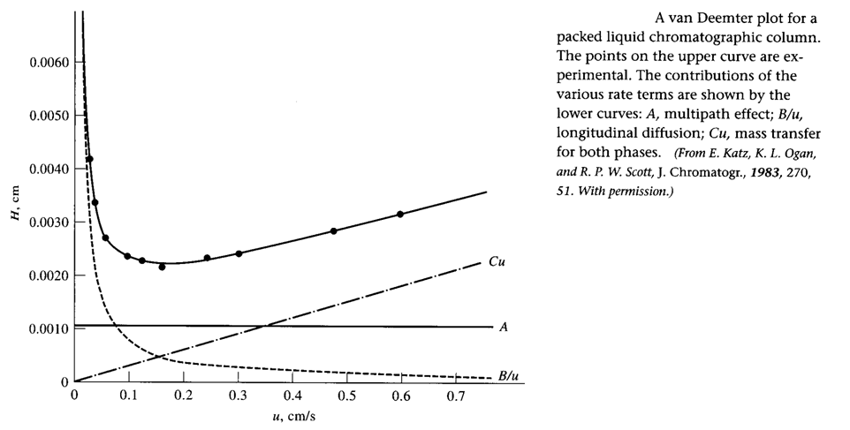
HPLC - Column Efficiency
van Deemter Equation
H = A + B/u +Cu
Skoog and Leary: Principals of Instrumental Analysis, 5th ed. Suanders, 1998

Slide 16
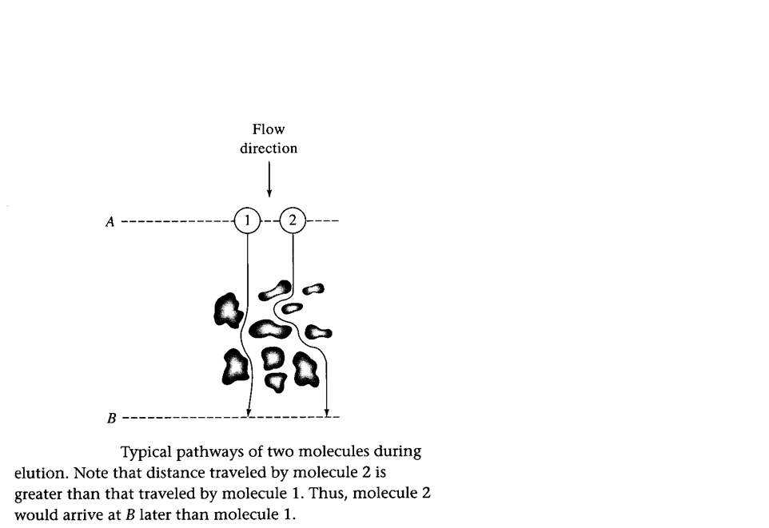
HPLC - Column Efficiency
H = A + B/u + Cu
A = 2λ d_{p}
λ depends on particle size distribution, the narrower the distribution the smaller the λ
d_{p} = particle size
Independent of mobile phase flow rate
Also known as eddy diffusion
Skoog and Leary: Principals of Instrumental Analysis, 5th ed. Suanders, 1998

Slide 17
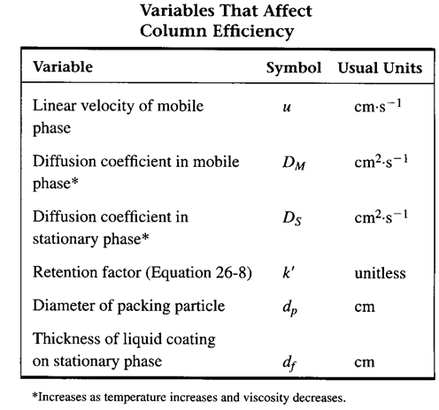
HPLC Column Efficiency
Longitudinal Diffusion (B)
H = A + B/u + Cu
B/u = 2γD_{M}/u
γ = constant depending on quality of packing
D_{M} is the mobile phase diffusion coefficient
3. Inversely related to mobile phase flow rate

Slide 18
HPLC Column Efficiency
Mass Transfer (C_{s} + C_{m})
H = A + B/u + (C_{s} + C_{m})u
C_{S} = f_{S}(k’)d_{f}² / D_{S}
C_{M} = f_{M}(k’)d_{p}² / D_{M}
D_{M} is the mobile phase diffusion coefficient
D_{S} is the stationary phase diffusion coefficient
d_{f} is film thickness
d_{p} is particle size
Directly related to mobile phase flow rate
Skoog and Leary: Principals of Instrumental Analysis,
5th ed. Suanders, 1998

Slide 19
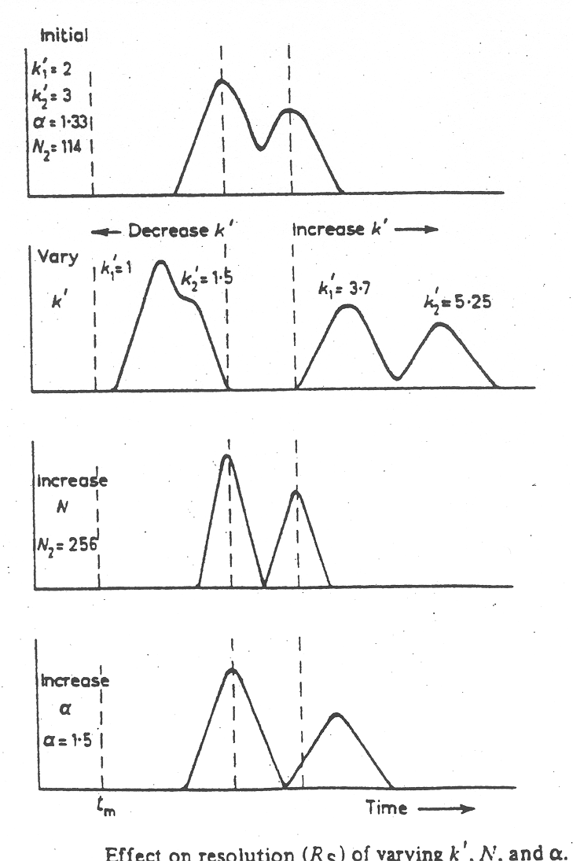
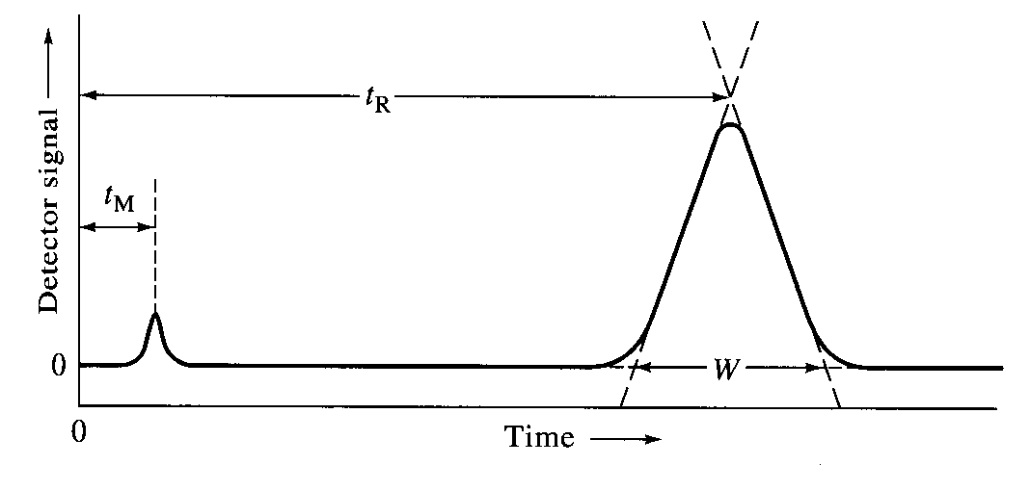
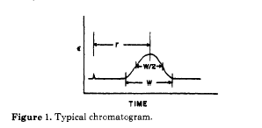
HPLC - Resolution
Theoretical Plates (N): The number of theoretical plates characterizes the quality or efficiency of a column.
N = 5.54 [(t_{R}) / w_{1/2}]² (N = 16 (t_{R}/W)²)
Skoog and Leary: Principals of Instrumental Analysis, 4th ed. Suanders, 1992

Slide 20
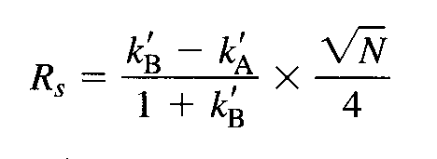
HPLC - Resolution
Theoretical Plates (N): The number of theoretical plates characterizes the quality or efficiency of a column.
N = 5.54 [(t_{R}) / w_{1/2}]²
(N = 16 (t_{R}/W)²)
Plate Height (H): The height equivalent to a theoretical plate (HEPT = H)
H = L / N
Resolution (Rs) depends on the number of theoretical plates:
R_{s} =
Skoog and Leary: Principals of Instrumental Analysis,
4th ed. Suanders, 1992

Slide 21
HPLC - Resolution
Capacity Factor (k’): Also called retention factor. Is a measure for the position of a sample peak in the chromatogram.
k’ = (t_{R1}-t_{o})/t_{o}
specific for a given compound and constant under constant conditions
A function of column and mobile phase chemistry
Primarily applicable under isocratic conditions
In general, a change in the k’ of one peak will move all peaks in the same direction.
Selectivity Factor (α): Also called separation or selectivity coefficient is defined as
α = k₂’/k₁’ = (t_{R2}-t_{o}) / (t_{R1}-t_{o})
A function of column and mobile phase chemistry
Primarily applicable under isocratic conditions
Changes in selectivity will affect different compounds in different ways.
Skoog and Leary: Principals of Instrumental Analysis, 4th ed. Suanders, 1992

Slide 22
Capacity Factor
t´_{R}
t_{R} - t₀
k´ =
=
t ⁰
t⁰
Capacity factor
If the substance is not retained by the stationary phase,
e.g. t_{R} = t_{m}, the capacity factor is k' = 0.
Small k' (k < 1) values show that the components are only retained slightly by the separation column. Their peaks are located close to the non-retained peak (k' = 0).
Experience has shown the optimum separation range to be k' values between 1 and 15. Values for k' > 5 mean long retention times with associated band broadening.

Slide 23
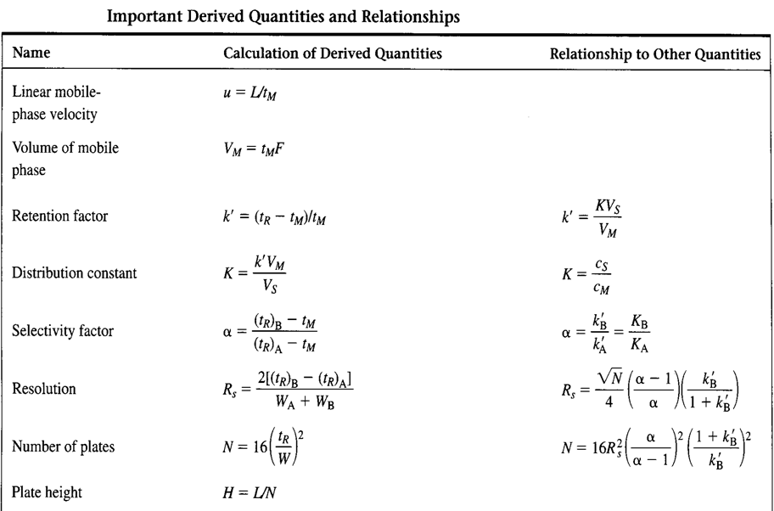
Skoog and Leary: Principals of Instrumental Analysis, 4th ed. Suanders, 1992

Slide 24
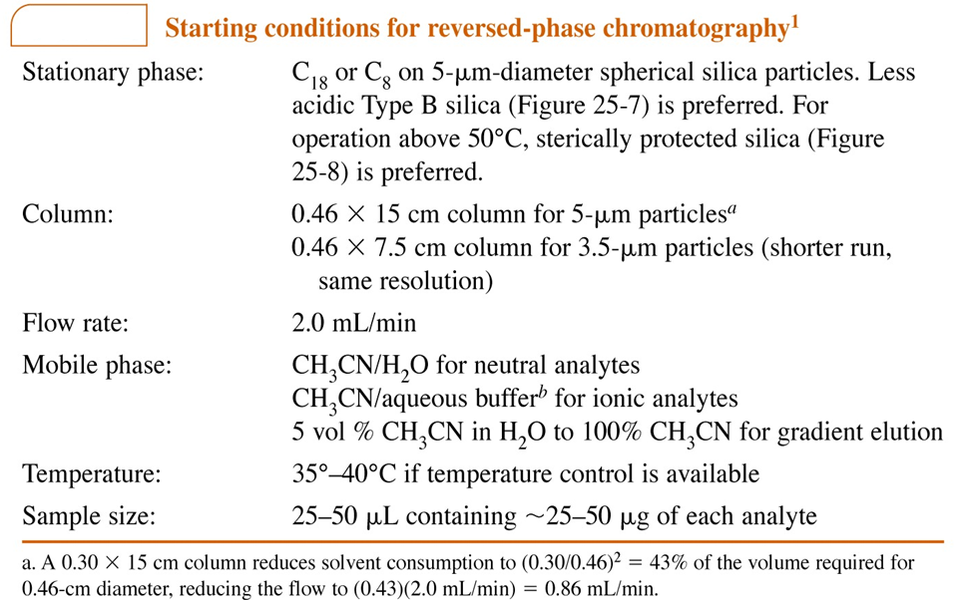

Slide 25
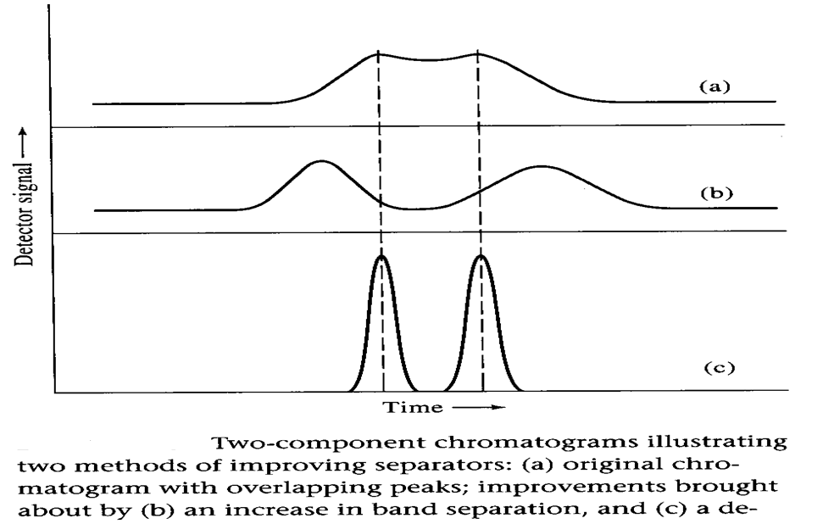
HPLC – Optimizing Separation

Slide 26
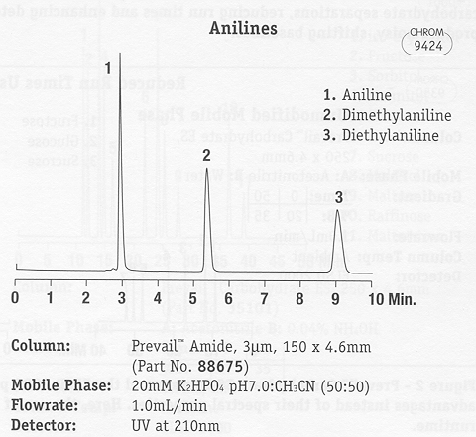
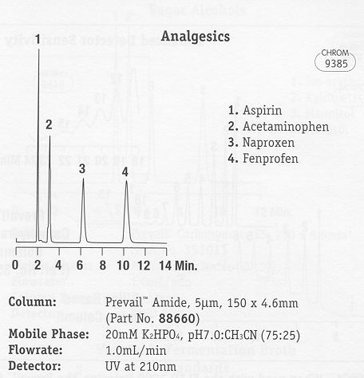
RP-HPLC - Optimization

