Slide 1
High Performance Liquid Chromatography (HPLC)
What is HPLC?
Types of Separations
Columns and Stationary Phases
Mobile Phases and Their Role in Separations
Injection in HPLC
Detection in HPLC
Variations on Traditional HPLC
Ion Chromatography
Size Exclusion Chromatography

Slide 2
The Mobile Phase in HPLC...
Must do the following:
solvate the analyte molecules and the solvent they are in
be suitable for the analyte to transfer “back and forth” between during the separation process
Must be:
compatible with the instrument (pumps, seals, fittings, detector, etc)
compatible with the stationary phase
readily available (often use liters/day)
of adequate purity
spectroscopic and trace-composition usually!
Not too compressible (causes pump/flow problems)
Free of gases (which cause compressibility problems)

Slide 3
Common Reverse Phase Solvents
Methanol
CH₃OH
• Acetonitrile
CH₃ OCN
• Tetrahydrofuran
• Water
H₂O

Slide 4
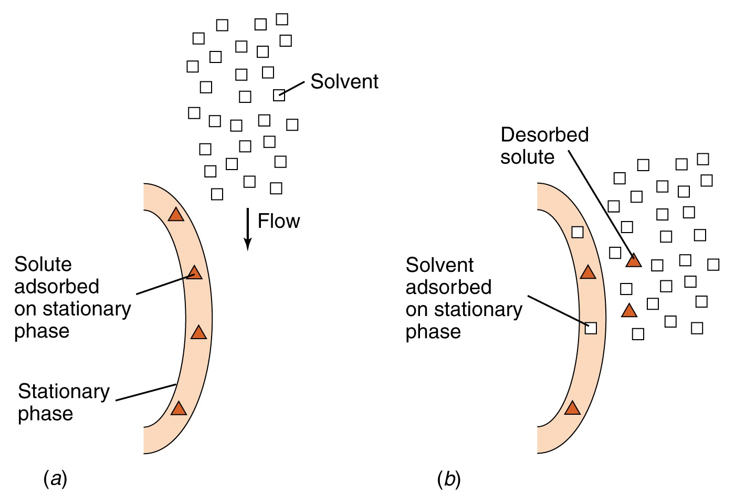

Slide 5
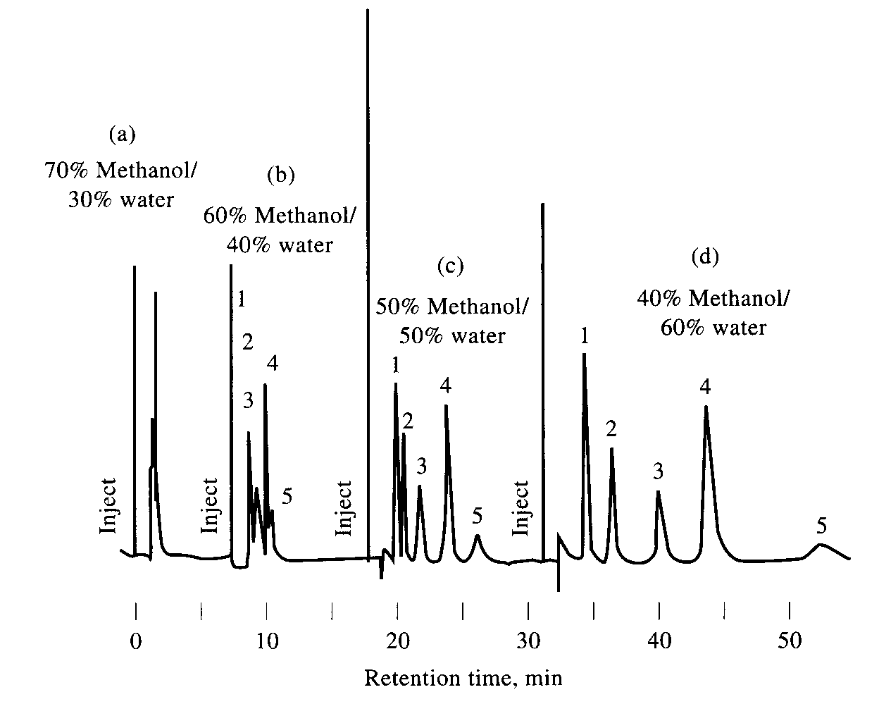
RP-HPLC – Mobile Phase vs k’

Slide 6
Polarity Index for Mobile Phases…..
The polarity index is a measure of the relative polarity of a solvent. It is used for identifying suitable mobile phase solvents.
The more polar your solvent is, the higher the index.
You want to try to choose a polarity index for your solvent (or solvent mixture) that optimizes the separation of analytes
usually the index is a starting point
the polarity of any mixture of solvents to make a mobile phase can be modeled to give a theoretical chromatogram
Usually, optimization of solvent composition is experimental
A similar number is the Eluent Strength (Eº]
Increasing eluent strength or polarity index values mean increasing solvent polarity.
Remember, the analyte(s) and samples must be mobile phase and stationary phase compatible!

Slide 7
Polarity of water > ACN > methanol > THF
e.g. Water is more polar than methanol
thus a weaker solvent in RP HPLC
i.e. Water elutes the solute slower than
methanol does. Therefore, when the
percentage of water in the mobile phase is
higher, the retention times are longer.

Slide 9
Columns
Heavy wall, glass lined metal tubing or SS tubing, withstand ↑ pressure upto 680 atm & chemical action of MP.
Interior of tubing smooth with uniform bore dia
Straight column preferred
Column end- zero void volume, Length- 10-30 cm.
Short, fast- 3-8 cm.

Slide 10
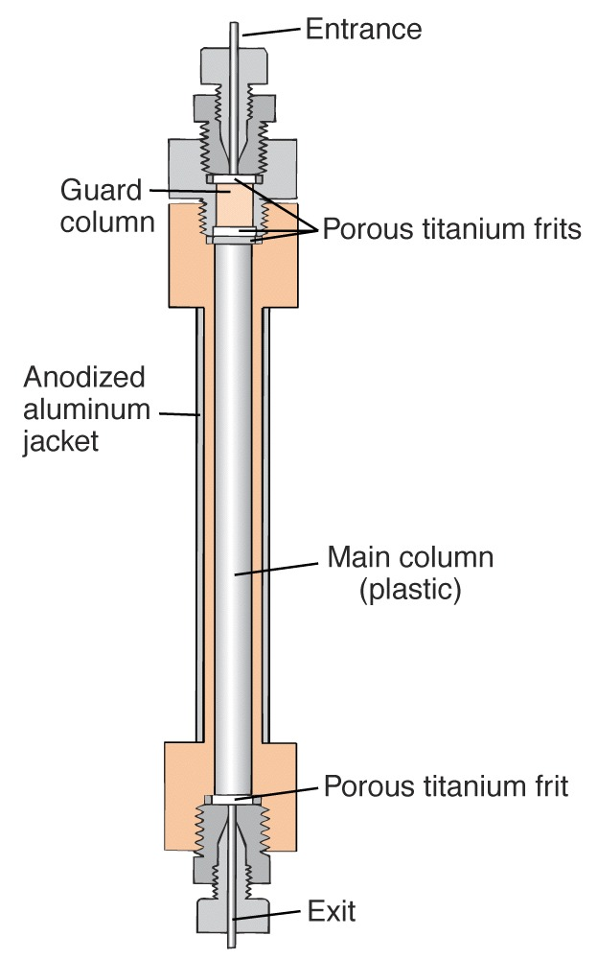
TYPICAL COLUMN

Slide 11
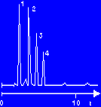
HPLC Column
Column dimension (size), particle size and pore size, stationary phase
Water/Methanol

Slide 12
HPLC Columns
Particle size Column ID Sample Load
Analytical 3 – 5 μ 0.3 − 4.6 mm ng – μg
Semi-prep 10 μ 8 – 10 mm 1 – 100 mg
Preparative 10 – 30 μ 5 – 200 mm gram scale
An HPLC column consists of a stainless steel tube which is sealed with fittings on both ends. Steel frits in the end fittings keep the packing material in the column.
Analytical columns have inner diameters of 1 - 10 mm and lengths of 25 - 250 mm. They are operated at flow rates of 60 µl - 5.0 ml/min.
In preparative chromatography columns with an inside diameter of 200 mm and a length of 600 mm are used. They are operated at a flow rate of 1750 ml/min.
To protect the actual separation column from chemical contamination, a guard column with the same packing material as the separation column is installed.

Slide 13
Guard columns or Inline Filters
To ↑ the life of analytical columns
Inserted ahead of AC
Act as physical & chemical filters
Short- 5 cm,
Contains stationary phase similar to AC
Protect AC from contaminants from MP/ from degrading sample inj valves which Results in broadening of solute peaks & degradation of separation of components.

Slide 14
Optimization of column performance
Correct choice of column
Correct choice of mobile phase
Decision on the type of mobile phase composition
constant composition = isocratic
varying composition = gradient elution
Determination of flow rate should be constant
usually it is
Decision on heating the column
heating HPLC columns

Slide 15
Gradient Elution
In Isocratic elution Sample is injected to column & mobile phase is unchanged thru out the time required for sample components to elute.
Single isocratic elution can’t separate a complex mix. In reasonable time, with good detectability. Therefore, solvent programming called gradient elution is req.
That is changing the mobile phase composition stepwise or continuously during elution.
Gradient elution- trial & error
Gives max., resolution, sensitivity.

Slide 16
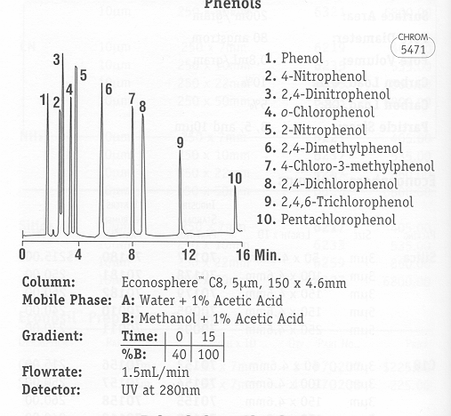
RP-HPLC – Gradient Elution

Slide 17
Derivatization
To enhance detectibility by U.V. absorption, fluorescence, electrochemistry.
Precolumn derivatization before seperation
Derivatized sample is injected
After separation post column reaction is done.
Eg. If detection sensitivity to 254nm ג in U.V. absorption is Zero or ↓. Detection can be ↑ by attaching to solute a chromophore with ↑ absorption at 254nm

Slide 18
Reagents | Reactants
N-succinimidyl 4- Nitrophenyl acetate | Amines/ Amino acids
3,5- Dinitrobenzoyl cl | Alcohols, Amines, Phenols
Formation of fluorescent derivative
Allows sensitive detection of non-fluor. Mol.
Exploits selectivity of fluorescence by allowing detection of all compounds with particular fn grps in a sample after derivatization.
Eg. 4-Bromomethyl-7-methoxycoumarin -COOH

Slide 19
Post column Reaction
Effluent from HPLC column is mixed with a reagent before it enters the detector.
A column filled with glass beads mixes effluent with reagent (added thru T valve) before passes the detector.
Post column addition of an alkaline buffer (pH – 10.4) ↑ 20 fold sensitivity of HPLC analysis for barbiturates. 2ng of drg can be detected bcos at alkaline pH the UV absorption max for barbiturates shifts to longer ג 240 nm.
If simple mobile phase is adjusted to alkaline pH- it dissolves the silica based column packing.

