Slide 1
High Performance Liquid Chromatography (HPLC)
What is HPLC?
Types of Separations
Columns and Stationary Phases
Mobile Phases and Their Role in Separations
Injection in HPLC
Detection in HPLC
Variations on Traditional HPLC
Ion Chromatography
Size Exclusion Chromatography

Slide 2
Detectors
Numerous Types
Original HPLC Detectors were common laboratory instruments such as spectrophotometers, etc.
Must be solvent -compatible, stable, etc.
Universal
respond to all analytes
Analyte Specific
respond to specific properties of analytes
Non-destructive
most
Destructive
ELSD, MS and a few others.

Slide 3
HPLC OF ANALGESICS - UV Detection
Standard Analgesics
Gradient =
0 min: 100% EtOAC (+ 0.2% HOAc)
3 min: 100% EtOAC (+ 0.2% HOAc)
5 min: 15% MeOH, 85% % EtOAc
(+ 0.2% HOAc)
8 min: 15% MeOH, 85% % EtOAc
(+ 0.2% HOAc)
10 min: 100% EtOAC (+ 0.2% HOAc)
SiO₂
Flow Rate = 1 mL/min
UV detector set at 240 nm
2.82 min
Acetaminophen
1.48 min.
Aspirin
7.11 min.
Caffeine
Analgesic | Retention Time
Acetaminophen | 2.82
Aspirin | 1.48
Caffeine | 7.11
Ibuprofen | 1.35
1.35 min.
Ibuprofen

Slide 4
HPLC OF ANALGESICS - UV Detection
Area %
Aspirin 19.5%
Acetaminophen 50.0%
Caffeine 20.5%
Excedrin ES
250 mg aspirin
250 mg acetaminophen
65 mg caffeine
Question
The peak areas of aspirin and acetaminophen are very different, even though they are present in equal amounts (250mg/tablet) in Excedrin ES.
Caffeine is present at ~ ¼ the concentration of aspirin (65 mg/tablet vs. 250 mg/tablet), but it’s peak area is greater than the peak area of aspirin.
WHY? UV Absorbance of analgesics vs UV setting of detector

Slide 5
HPLC: Peak Area vs
Detector setting
UV Max
Aspirin 225, 296 nm
Acetaminophen 248 nm
Caffeine 272 nm
Area %
Aspirin 19.5%
Acetaminophen 50.0%
Caffeine 20.5%
Detector set at 240 nm
Detector set at 254 nm
Area %
Aspirin 7.3%
Acetaminophen 81.9%
Caffeine 10.8%
Detector set
at 280 nm
Area %
Aspirin 24.8%
Acetaminophen 39.3%
Caffeine 35.9%

Slide 6
Good detectors…
Regardless of the principle of operation, an ideal LC detector should have the following properties:
Low drift and noise level (particularly crucial in trace analysis).
High sensitivity.
Fast response.
Wide linear dynamic range (this simplifies quantitation).
Low dead volume (minimal peak broadening).
Cell design which eliminates remixing of the separated bands.
Insensitivity to changes in type of solvent, flow rate, and temperature.
Operational simplicity and reliability.
It should be tuneable so that detection can be optimized for different compounds.
It should be non-destructive.

Slide 7
most common HPLC detectors:
Refractive index
UV/Vis
Fixed wavelength (no longer used)
Variable wavelength (we have one)
Diode array (we have one)
Fluorescence (Weilin Huang has one)
less common, but important
Conductivity (we used in IC)
Mass-spectrometric (LC/MS)
Evaporative light scattering

Slide 8
Standard Absorbance Detector….
Single Beam UV-VIS instrument with a flow-through cell (cuvette)
Can use any UV-VIS with a special flow cell
Extra connections lead to band-broadening if UV-VIS is far from HPLC column exit.
Usually utilize typical UV-VIS lamps and 254 nm default wavelenth
Can be set to other wavelengths (most)
Simple filter detectors no longer widely used
adjustable wavelength units are cost-effective
Non-destructive, not-universal
not all compounds absorb light
can pass sample through several cells at several different wavelengths
Usually zeroed at the start of each run using an electronic software command. You can have real-time zeroing with a reference cell.

Slide 9
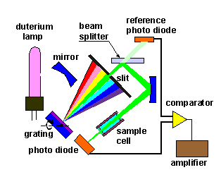
STANDARD ABSORBANCE Detector

Slide 10
Diode-array detectors
As already mentioned, a special feature of some variable wavelength UV detectors is the ability to perform spectroscopic scanning and precise absorbance readings at a variety of wavelengths while the peak is passing though the flow cell. Diode array adds a new dimension of analytical capability to liquid chromatography because it permits qualitative information to be obtained beyond simple identification by retention time.
There are two major advantages of diode array detection. In the first, it allows for the best wavelength(s) to be selected for actual analysis. This is particularly important when no information is available on molar absorptivities at different wavelengths.
The second major advantage is related to the problem of peak purity. Often, the peak shape in itself does not reveal that it actually corresponds to two (or even more) components. In such a case, absorbance rationing at several wavelengths is particularly helpful in deciding whether the peak represents a single compound or, is in fact, a composite peak.
In absorbance rationing, the absorbance is measured at two or more wavelengths and ratios are calculated for two selected wavelengths. Simultaneous measurement at several wavelengths allows one to calculate the absorbance ratio. Evaluation can be carried out in two ways:
In the first case, the ratios at chosen wavelength are continuously monitored during the analysis: if the compound under the peak is pure, the response will be a square wave function (rectangle),. If the response is not rectangle, the peak is not pure.

Slide 11
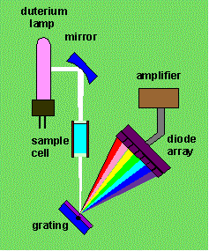

Slide 12
Refractive Index Detector
One of a very few Universal HPLC detectors. Non-destructive
Responds to analytes changing the RI of the mobile phase
requires a separate reference flow of mobile phase
Extremely temperature sensitive, usually heated
sensitive to temp changes of +/- 0.001 °C
No longer really widely used
Absorbance detectors are relatively cheap.
Useful for process work, on-line monitoring, etc.

Slide 13
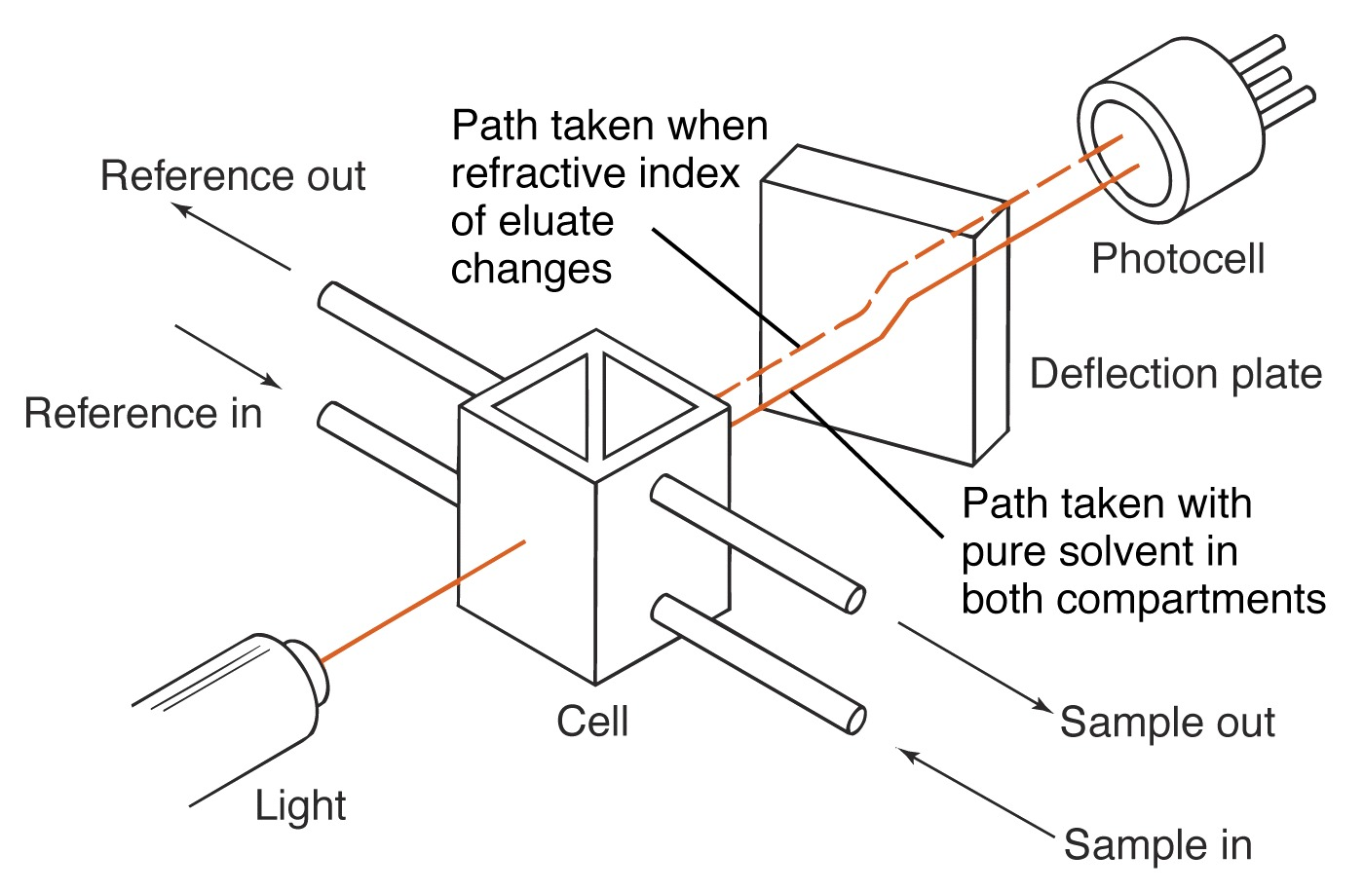
Refractive Index Detector

Slide 14
ELSD (Evaporative Light Scattering Detector)
Universal, destructive
Useful for very large molecules, and a wide linear range
Analytes are de-solvated in the detector
Molecules pass through what is essentially a large cuvette for a UV-VIS instrument
The reduction in light intensity detected (due to scattering by the analytes) is measured
The larger and more concentrated a particular molecule is, the greater the scattering. The scattered light is detected by a silicone photodiode located at a 90º angle from the laser. The photodiode produces a signal which is sent to the analog outputs for collection. A light trap is located 180º from the laser to collect any light not scattered by particles in the aerosol stream.

Slide 15
