Slide 1
HEALTH CARE DELIVERY SYSTEM
By:
Dr. Digvijay Sharma
Director
School of Health Sciences, CSJM University

Slide 2
WHAT IS HEALTH?
Health is a state of complete physical, mental, social well being and not just merely absence of a disease.
It has always been the centre of every policy issued by the government in public interest.
The health care delivery system is defined as the system of professionals working towards providing the best care facility to the population within available financial assets.
Health care delivery system of India is divided into three phases or levels which are primary, secondary and tertiary.
These systems play a vital role in development and management of policies related to health of the population.

Slide 3
HEALTH CARE DELIVERY SYSTEM
Due to the India's federalized system of government, the areas of governance and operations of health system in India have been divided between the union and the state governments.
India has a mixed health-care system, inclusive of public and private health-care service providers.
The best way to provide health care to underserved rural and urban poor is to develop effective Primary Health Care services supported by an appropriate referral system.
The recommendation for three-tiered health-care system to provide preventive and curative health care in rural and urban areas placing health workers on government payrolls and limiting the need for private practitioners became the principles on which the current public health-care systems were founded.
This was done to ensure that access to primary care is independent of individual socioeconomic conditions.

Slide 4
HISTORY
Report on the Health Survey and Development Committee, commonly referred to as the Bhore Committee Report, 1946, has been a landmark report for India, from which the current health policy and systems have evolved.
Although the first national population program was announced in 1951, the first National Health Policy of India (NHP) got formulated only in 1983 with its main focus on provision of primary health care to all by 2000.
NHP 2002 further built on NHP 1983, with an objective of provision of health services to the general public through decentralization, use of private sector and increasing public expenditure on health care overall.

Slide 5
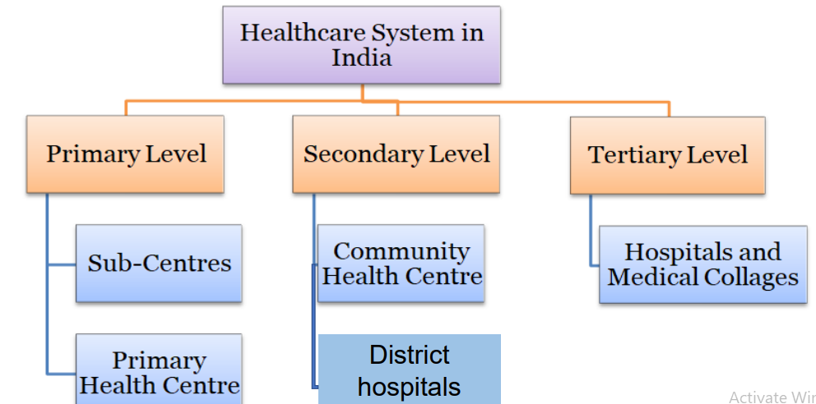
DIFFERENTIATION

Slide 6
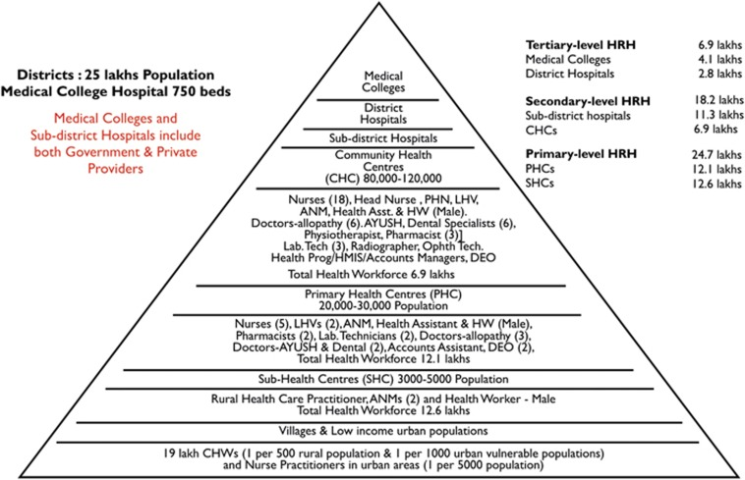

Slide 7
OBJECTIVES
To deliver proper health care in a systematic way to any individual in need of health care services
coping with the various health needs and demands of population
thereby provide health care to individuals and community with preventive and curative activities
utilizing health care workers
Together these forms a system interacting with each other, supporting and controlling each other

Slide 8
COMPONENTS
Structure of health system
Number and type of personnel and staff
Way of these personnel organized to work
Nature and extend of facility and equipment
Range of services offered
System of management and amenities
Financing
Enumeration and determination of the eligible population for these services
Governance and decision making

Slide 9
SUB CENTERS
A sub-center (SC) is established in a plain area with a population of 5000 people and in hilly/difficult to reach/tribal areas with a population of 3000, and it is the most peripheral and first contact point between the primary health-care system and the community.
Each SC is required to be staffed by at least one auxiliary nurse midwife (ANM)/female health worker and one male health worker
Under National Rural Health Mission (NRHM), there is a provision for one additional ANM on a contract basis.
SCs are assigned tasks relating to interpersonal communication in order to bring about behavioral change and provide services in relation to maternal and child health, family welfare, nutrition, immunization, diarrhea control and control of communicable diseases programs.
The Ministry of Health & Family Welfare is providing 100% central assistance to all the SCs in the country since April 2002 in the form of salaries, rent and contingencies in addition to drugs and equipment.

Slide 10
PRIMARY HEALTH CENTERS
A primary health center (PHC) is established in a plain area with a population of 30 000 people and in hilly/difficult to reach/tribal areas with a population of 20 000, and is the first contact point between the village community and the medical officer.
PHCs were envisaged to provide integrated curative and preventive health care to the rural population with emphasis on the preventive and promotive aspects of health care.
The PHCs are established and maintained by the State Governments under the Minimum Needs Program (MNP)/Basic Minimum Services (BMS) Program.
As per minimum requirement, a PHC is to be staffed by a medical officer supported by 14 paramedical and other staff.
Under NRHM, there is a provision for two additional staff nurses at PHCs on a contract basis.
It acts as a referral unit for 5-6 SCs and has 4-6 beds for in-patients.
The activities of PHCs involve health-care promotion and curative services.

Slide 11
COMMUNITY HEALTH CENTERS
Community health centers (CHCs) are established and maintained by the State Government under the MNP/BMS program in an area with a population of 120 000 people and in hilly/difficult to reach/tribal areas with a population of 80 000.
As per minimum norms, a CHC is required to be staffed by four medical specialists, that is, surgeon, physician, gynecologist/obstetrician and pediatrician supported by 21 paramedical and other staff.
It has 30 beds with an operating theater, X-ray, labor room and laboratory facilities.
It serves as a referral center for PHCs within the block and also provides facilities for obstetric care and specialist consultations.

Slide 12
FIRST REFERAL UNIT
An existing facility (district hospital, sub-divisional hospital, CHC) can be declared a fully operational first referral unit (FRU) only if it is equipped to provide round-the-clock services for emergency obstetric and newborn care, in addition to all emergencies that any hospital is required to provide.
It should be noted that there are three critical determinants of a facility being declared as a FRU: (i) emergency obstetric care including surgical interventions such as caesarean sections; (ii) care for small and sick newborns; and (iii) blood storage facility on a 24-h basis.

Slide 13
NATIONAL RURAL HEALTH MISSION
NRHM, launched in 2005, was a watershed for the health sector in India.
With its core focus to reduce maternal and child mortality, it aimed at increased public expenditure on health care, decreased inequity, decentralization and community participation in operationalization of health-care facilities based on IPHS norms.
Seeking to improve access of rural people, especially poor women and children, to equitable, affordable, accountable and effective primary health care, NRHM (2005-2012) aimed to provide effective health care to the rural population throughout the country with special focus on 18 states having weak public health indicators and/or weak infrastructure.
Within the mission there are high-focused and low-focused states and districts based on the status of infant and maternal mortality rates, and these states are provided additional support, both financially and technically.
Gradually it has emerged as a major financing and health sector reform strategy to strengthen the state health systems.

Slide 14
