Slide 1
Instrumentation and application of U.V- Vis Spectroscopy
Unit -1 part A

Slide 2
Content
Instrumentation of U.V-Vis Spectroscopy
Single beam spectrophotometer
Double beam spectrophotometer
Application of U.V-Vis Spectroscopy

Slide 3
Single beam ultraviolet spectrometers
This consists of a tungsten lamp as source of light The light radiation is focused on to a slit by using a concave mirror.
This light passes through a simple absorption filter where only the required wavelength of light passes through it falls on the sample cell where the solution to be analyze is present .
The sample or standard solution absorbs a part of the radiation and the rest is transmitted .
The intensity of the transmitted or the unabsorbed radiation is determined using a photo voltaic cell using a digital display.

Slide 4
Merits :
Simple in construction
Inexpensive
Easy to operate
Demerits:
Fluctuation
Recorder cannot be used with single beam type

Slide 5
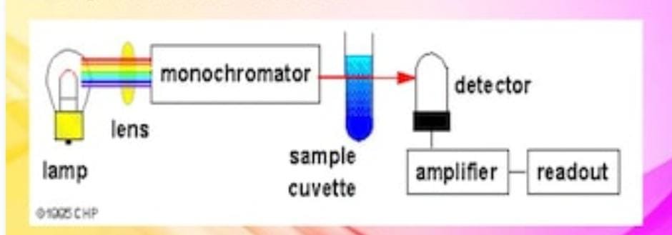
Block diagram of Single Beam u.V –Vis. Spectrophotometer

Slide 6
Double Beam UV spectrophotometer
Here the light beam after passing through a filter of monochromatic is split into sample beam and reference beam by using a beam spliter. These beam pass through sample and reference solution and fall on two detectors separately .The final read out is in the absorbance or transmittance obtained after electronic manipulation of the two detectors.
Advantages - It facilitates rapid scanning over wide lambda region.
Fluctuation are minimum.

Slide 7
Block diagram of double Beam Spectrophotometer

Slide 8
Application for UV- Visible Spectroscopy
Qualitative & Quantitative Analysis: It is the used for characterizing aromatic compounds and conjugated olefins. It can be used to find out molar conc. Of the solute under study.
Detection of Impurities: One of the most important method to detect impurities in organic solvents. Additional peaks can be observed due to impurities in the sample and it can be compared with that of standard raw material.
Structure elucidation of organic compounds: The presence or absence of unsaturation, the presence of hetero atoms like S,N,O or halogens can be determined.

Slide 9
Structural analysis of organic compounds:
Effect of conjugation : Extended conjugation shifts the lambda max to longer lambda (Bathochromatic shift) and reduction of the compound or saturation of double bonds leads to the opposite effect i.e. hypsochromic shift.
Effect of geometric isomerism: Trans isomer absorbs at longer wavelenght than cic isomers. Cis to trans conversion is bathochromic shift and hyper- chromic effect.
Alkyl substitution: shift the lambda max to longer wavelenght.
Number of rings: The addition of rings causes bathochromic shift.

Slide 10
Reference
Chatwal Gurdeep R & Anand Sham K “ Instrumental Method of Chemical Analysis” 5th edition, 2007, Published by Himalaya Publication House, page No. 2.107-2.148
Sharma Y.R & Chand K “ Elementary Organic Chemistry Organic Spectroscopy, Principle and Chemical Applications”, 4th edition 2009, Published by S.Chand & Company Ltd. Page No: 09-64
http://learnspectroscopy.blog.com
Wikipedia.org
www.molecularinfo.com

