Slide 1
INTRODUCTION TO REHABILITATION AND HISTORY
DR. DIGVIJAY SHARMA
UIHS
CSJMU, KANPUR

Slide 2
The word rehabilitation comes from latin prefix re- meaning again and habitare meaning make fit.
When something falls in to disrepair and needs to be restored to a better condition , it needs rehabilitation.
Rehabilitation is a care that can help you get back, keep , or improve abilities that you needs for daily life. These abilities may be physical, mental and cognitive.
Rehabilitation can improve your daily life and functioning.

Slide 3
WHAT IS REHABILITATION?
Rehabilitation focuses on the existing capacities of the handicapped person,and brings him to the optimum level of his or her functional ability by the combined and coordinated use of medical, social, educational and vocational measures. It makes life for the handicapped individual more meaningful, more
productive and therefore adds more life to years.
Rehabilitation may be medical or sociovocational.
Medical rehabilitation is the utilisation of medical and paramedical skills to help treat the patient.

Slide 4
DEFINITION OF HEALTH ACCORDING TO WHO –
Health is a complete physical, mental and social well-being and not merely the absence of disease and infirmity.
DEFINITION OF REHABILITATION ACCORDING TO WHO -
Rehabilitation is a set of measures that assist individuals, who experience or likely to experience disability , to achieve and maintain optimum functioning in interaction with their environments.

Slide 5
WHO NEEDS REHABILITATION
Rehabilitation is for people who have lost abilities that they need for daily life .
Injuries and trauma including burns, fractures, traumatic brain injury, spinal cord injuries.
Stroke
Severe infection
Certain birth defects and genetic disorders
Developmental disabilities
Major surgery
Side effects from medical treatment such as form cancer treatments.
Chronic pain including back and neck pain
Intesive care unit patients

Slide 6
Goals of rehabilitation
Handicapped individuals have problems with
1. Orientation: For a person with head injury or cerebral palsy, the orientation to surroundings would hamper his activities of daily living like feeding or toileting.
2. Physical independence: It is the prayer of every handicapped person that he reduces dependence on the people taking care of him.
3. Mobility: Poliomyelitis and paraplegia are conditions that severely hamper mobility and thus even day to day tasks like moving around in the house can become very challenging.
4. Occupational integration: Training and placement in a suitable job.
5.Social integration: No man is an island, and attempts must be made to integrate handicapped people into society, and not isolate them.
6.Economic self-sufficiency: The job must ensure a means of livelihood.

Slide 7
THREE PHASES OF MEDICINE
Preventive medicine is the first phase where a disease is prevented from occurring, by avoiding the interaction between agent, host and environment.
Curative medicine-the second phase focuses on attempting to cure the disease. Most doctors practice curative medicine. However there are several conditions like rheumatoid arthritis which has no cure, and others, like poliomyelitis in which the agent causing the disease has been eliminated from the host, but residual effects like paralysis still persist. Therefore, there is a need for a third phase, namely rehabilitation, which is not just medical but also a social responsibility.

Slide 8
Conti..
Rehabilitation medicine is the third phase of medical care; after preventive and curative. It is concerned with the improvement of function through the diagnosis and treatment of health conditions , reducing impairments, and preventing or treating complications of persons with disability.
There are therefore two aspects to rehabilitation-
1.Medical Rehabilitation
2.Sociovocational Rehabilitation

Slide 9
MEDICAL REHABILITATION
Importance of Physiatry : THE PHYSIATRIST
Medical and sociovocational rehabilitation is the responsibility of a team of professionals headed by a Physiatrist, the key doctor in the guidance of the rehabilitation program.
PHYSIATRISTS are physicians who specialized in physical medicine and rehabilitation . Common problems which result in residual disability needing the expertise of a physiatrists are – stroke ,neuromuscular disorders, musculoskeletal disorders, cardiopulmonary diseases, arthritis and others.
The physiatrists can help to improve a persons functional capabilities by a medical treatment . The professionals such as physical, occupational , speech therapist, psychological, social nursing , prosthesis, orthotics, engineering and vocational service.
These professionals combine and coordinate to uplift the handicapped.
The fundamental goal of rehabilitation is to add life to years , not years to life.

Slide 10
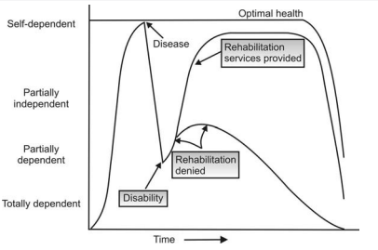
The importance of physiatry and rehabilitation services ensures functional
independence, without which the patient remains partially dependent throughout his life.

Slide 11
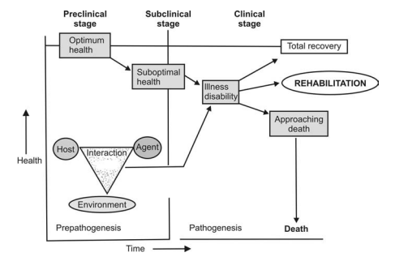
In the prepathogenesis period, the interaction between host agent and environment causes disease,[this is called epidemiological triad or triangle, the traditional model for infectious disease] which passes from the subclinical stage to the clinical manifestation of disease.

Slide 12
PREVENTIVE REHABILITATION
Prevention of disability does not start only at birth, at the onset of disease or after a primary disability occurs. Sometimes it may be done even before the child is born, by anticipating disability due to genetic defects or blood group incompatibility and can be prevented by means of genetic counseling.
For example- In Duchennes muscular dystrophy, it is possible to counsel the parents on having another child who might later display the symptoms of the disease.
It therefore follows with a fall in mortality levels there is a rise in morbidity levels. Rehabilitation deals with morbidity , it deals with quality of life.

Slide 13
LEVELS OF PREVENTION
Any health care that tries to halt a person’s slide down the slope of the health status scale is termed preventive health care and any attempt to push it up towards the peak, i.e. optimum health, is called therapeutic health care. This total spectrum is classified into three levels of prevention by the World Health Organization.

Slide 14
Primary Prevention
It is explained as a measure taken before the onset of any disease, e.g. immunization against childhood infections or chlorination of drinking water. It is designed to promote general health and improve the quality of life. It incorporates health education for bringing about awareness of health problems before it occurs. This is similar to the first phase of medicine, i.e. preventive medicine.

Slide 15
Secondary Prevention
It is a measure taken to arrest the progression of a disease while it is still in the early asymptomatic stage of the disease. It involves early diagnosis and immediate treatment, e.g. ergonomic intervention to prevent clinical symptoms in a patient with spondylosis.

Slide 16
Tertiary Prevention
It is explained as a measure taken to minimize the consequences of a disease or injury once it has become clinically manifested, e.g. prevention of pressure sores in a paraplegic by turning the patient over regularly. Tertiary prevention is an integral part of Rehabilitation Medicine.

Slide 17
S0CIOVOCATIONAL REHABILITATION-
Sociovocational rehabilitation is a team effort which aims at providing the disabled a vocation, a barrier free place to live and the right social environment to reduce his handicap.
At the heart of vocational rehabilitation ,it is the concept of the right to work.
It empowers persons – not just economically but in a more basic and meaningful sense.
It makes a person stand on his on legs. It does not bind him to a job, it set him free.

Slide 18
The catchword today is empathy not sympathy. In other words , the message that the person with disability are giving throughout the world is please accept us as we are.
There are several shining examples for this-
STEPHEN HAWKINS – Gross motor disabiity
HELEN KELLER- Visual and hearing impairment
BHAKT SURDAS AND JOHN MILTON – Visually impaired.
FRENKELIN D. ROOSEVELT- Guillain-Barre syndrome.

Slide 19
The passing of the American with disabilties act [ADA] in 1991 was a landmark in the life of the disabled in that country in India.
In India, the act passed is the [PWD] People with disabilities Act 1995.
Rehabilitaton council of India [RCI] Act passed by parliament in 1992 and it become a statutory body in 1993.

Slide 20
THANK YOU

