Slide 1
Introduction to Artificial Intelligence

Slide 2
What is AI?
Views of AI fall into four categories:
Thinking humanly | Thinking rationally
Acting humanly | Acting rationally

Slide 3
What is Artificial Intelligence?
Human-like (“How to simulate humans intellect and behavior on by a machine.)
Mathematical problems (puzzles, games, theorems)
Common-sense reasoning (if there is parking-space, probably illegal to park)
Expert knowledge: lawyers, medicine, diagnosis
Social behavior
Rational-like:
achieve goals, have performance measure

Slide 4
What is Artificial Intelligence
Thought processes
“The exciting new effort to make computers think .. Machines with minds, in the full and literal sense” (Haugeland, 1985)
Behavior
“The study of how to make computers do things at which, at the moment, people are better.” (Rich, and Knight, 1991)

Slide 5
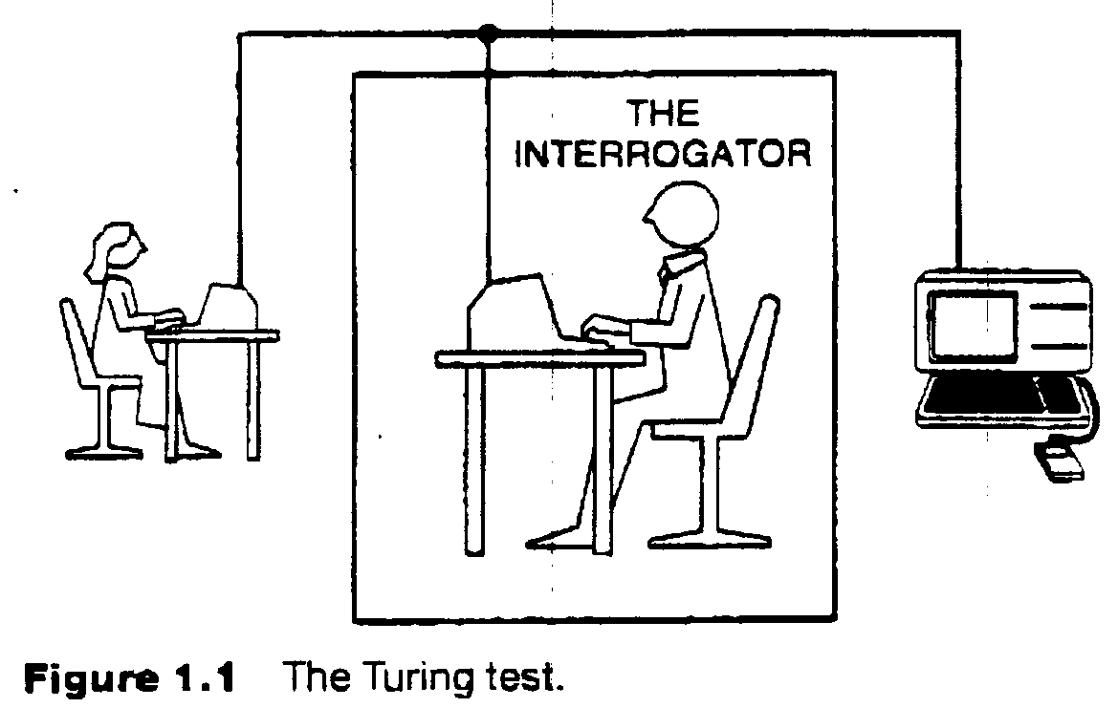
The Turing Test (Can Machine think?)
Requires
Natural language
Knowledge representation
Automated reasoning
Machine learning
(vision, robotics) for full test

Slide 6
What is AI?
Turing test (1950)
Requires:
Natural language
Knowledge representation
automated reasoning
machine learning
(vision, robotics.) for full test
Thinking humanly:
Introspection, the general problem solver (Newell and Simon 1961)
Cognitive sciences
Thinking rationally:
Logic
Problems: how to represent and reason in a domain
Acting rationally:
Agents: Perceive and act

