Slide 1
Introduction to Orthotics & Prosthetics
By:
Dr. Digvijay Sharma
Director & Professor,
School of Health Sciences,
CSJM University, Kanpur

Slide 2
Contents
Introduction to Orthotics
Introduction to Prosthesis
History
ISPO
Orthotics
Prosthetics

Slide 3
Introduction to Orthotics
The term orthotics refers to the general category of external mechanical devices worn by a user to affect the structure and function of an existing body part.
An Orthosis is an external appliance worn to restrict or assist motion or transfer load from one area of the body to another or an orthosis is a mechanical device fitted to the body to maintain it in an anatomical or functional position.
An Orthotist is a healthcare professional who designs, fabricates, fits and prepares patients for orthoses of the limbs and trunk.
A Pedorthist is the healthcare professional who designs, fabricates and fits only shoes and foot orthosis.
It may be an intervention designed to change body structures, or an intervention to support and stabilize unresponsive muscles so an activity can be performed, or an adjunct to enable participation in a life role such as work.

Slide 4
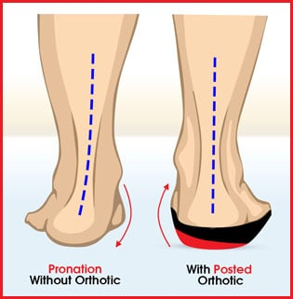
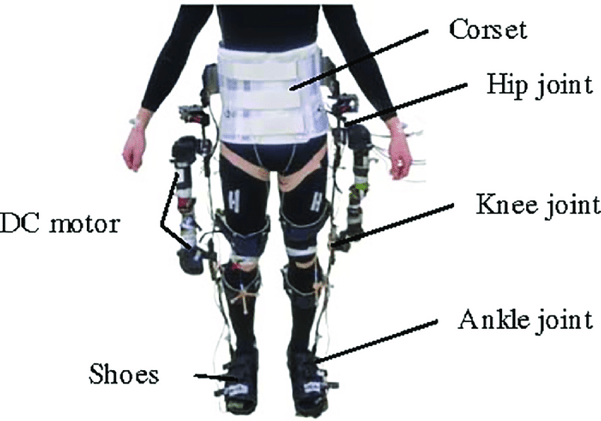
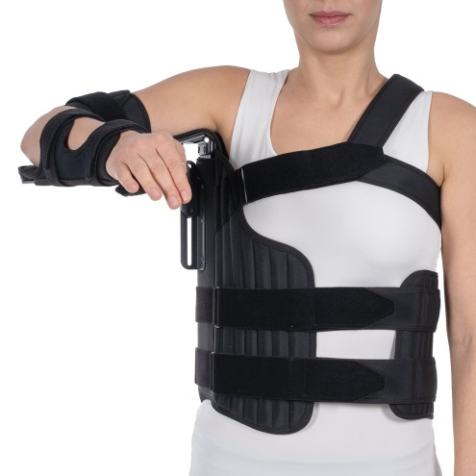
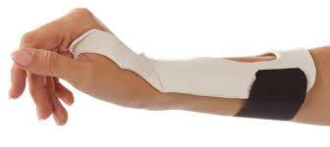
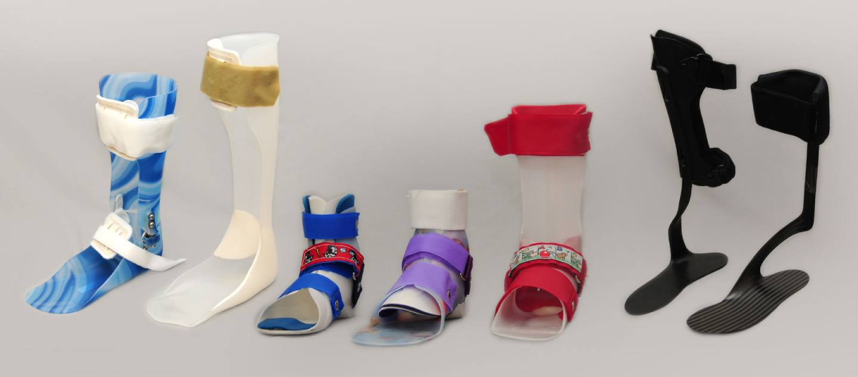
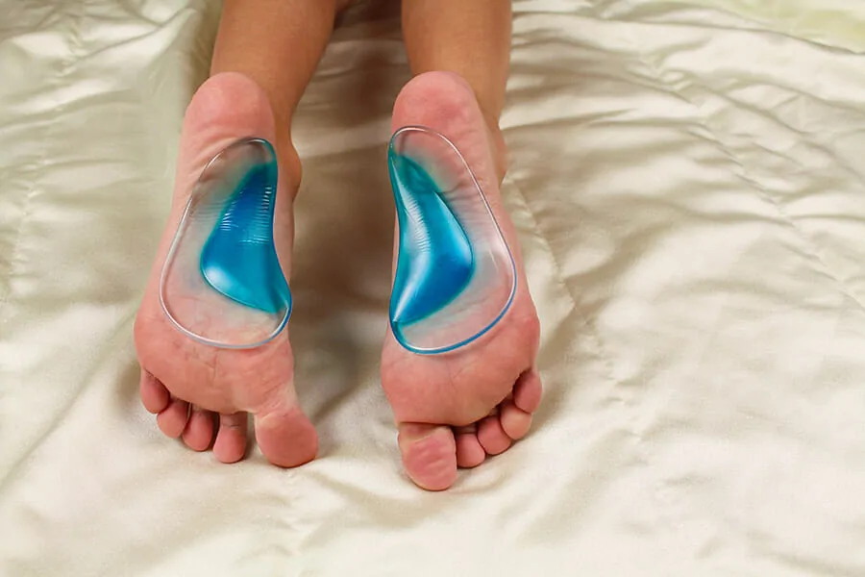
Examples of Orthosis

Slide 5
Introduction to Prosthetics
Prosthesis are the materials or parts of materials formed to compensate for an organ or an absent part of the body.
A Prosthetist is a healthcare professional who designs, fabricates and fits limb prosthesis.
Prosthesis includes all those materials which can be fitted into human body to work instead of original body parts like absence of leg below knee can be compensated by a transtibial prosthesis, etc.
Prosthesis may also include dentures, titanium femoral heads, plastic heart valves, etc.

Slide 6
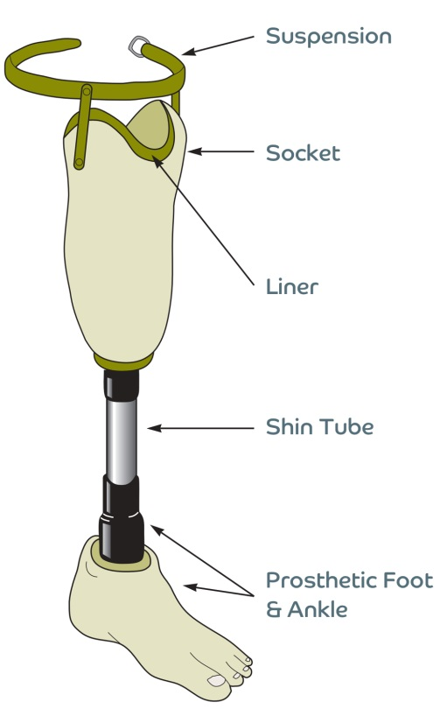
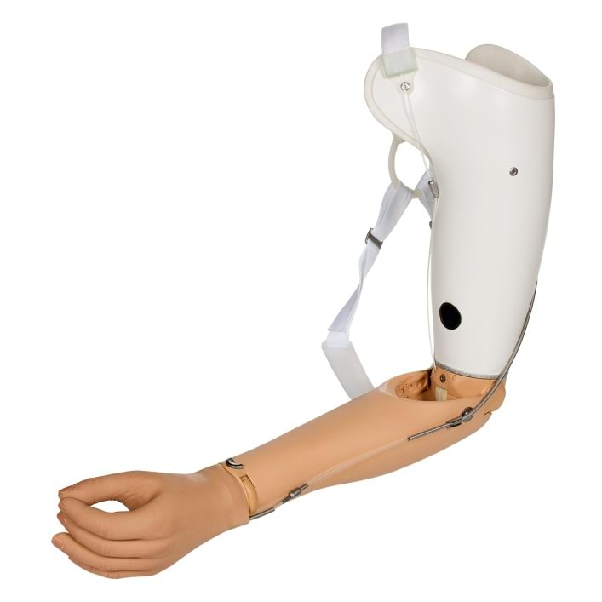
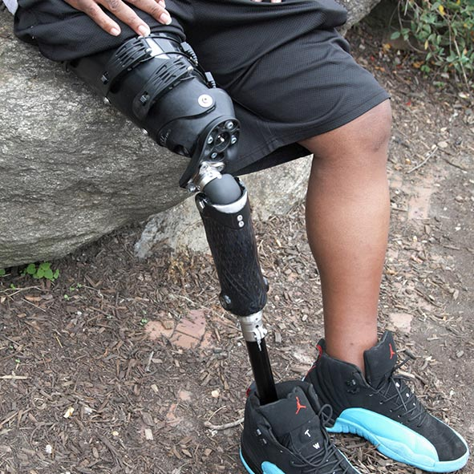
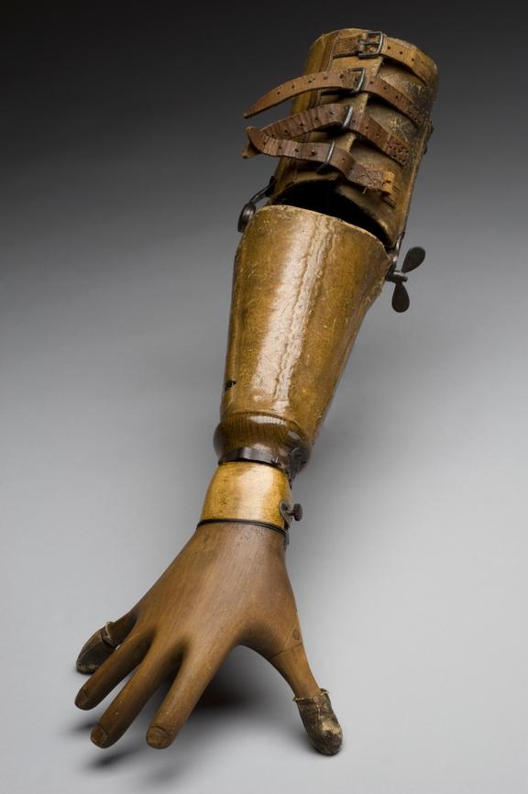
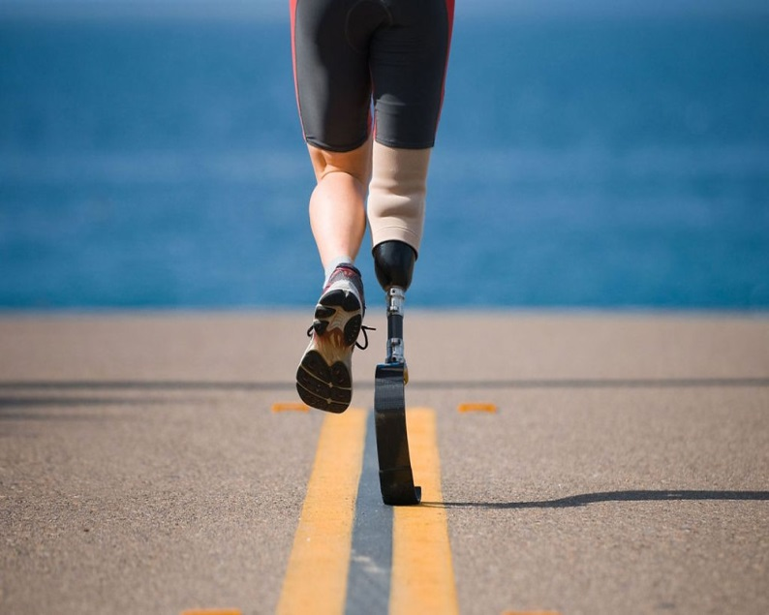
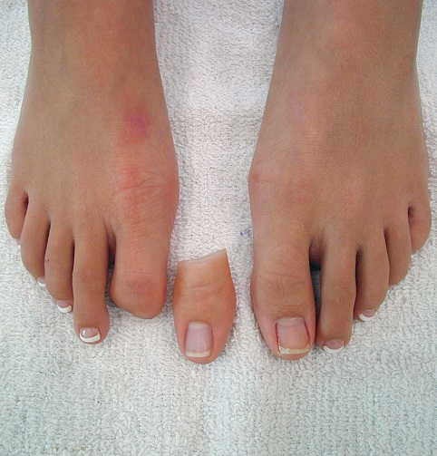
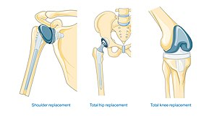
Examples of Prosthesis

Slide 7
History
Globally, prosthetics and orthotics (P&O) is a relatively young discipline within rehabilitation medicine.
The first formal university-based P&O professional preparation programs were established in the 1950s in the United States with New York University producing the first graduates with a degree in Orthotics and Prosthetics in 1965.
The first published documentation on international education of prosthetists/orthotists was from a meeting held in Denmark in 1968.

Slide 8
ISPO
The International Society for Prosthetics and Orthotics (ISPO) is a non-governmental organization that, since its establishment in the 1970s.
It has worked globally to improve the quality of life for people that use or may benefit from prosthetic and orthotic devices, as well as other assistive technology.
ISPO’s modern vision is a “world where all people have equal opportunity for full participation in society.
Prosthetics and Orthotics International has contributed to the body of knowledge regarding developments in prosthetic interface and component design, as well as to the application of biomechanical principles to prosthetics and orthotics.

Slide 9
ORTHOTICS

Slide 10
Mechanical Principle of Orthosis
The basic mechanical principle behind the usage of an orthosis is the “ Three point system of Jordon”.
This system defines the corrective and assistive forces being applied at the surface of the orthosis through skin and are transmitted to the underlying soft tissues and bones.
It states that to remain stable, body has to have one point of pressure opposed by two equal points of counter pressure in such a way that:
$$F1=F2+F3$$
The greater the distance between the force and the counter forces, the less counter force is required.
Corrective force is directed towards the angular or deformed area to be corrected with two counter forces applied at the proximal and distal areas.

Slide 11
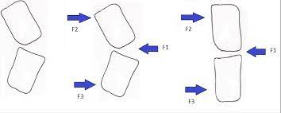
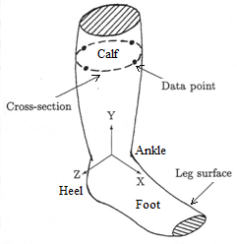
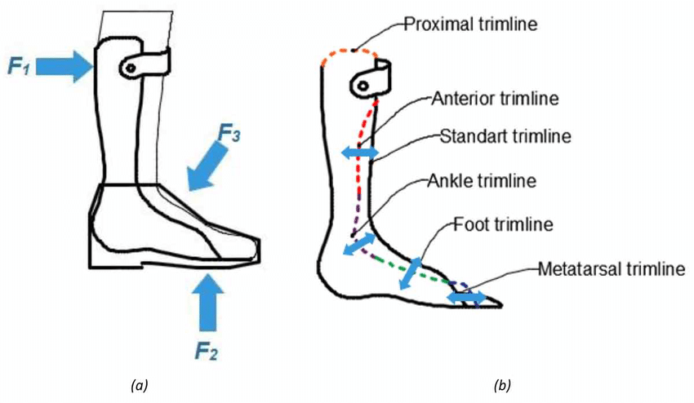
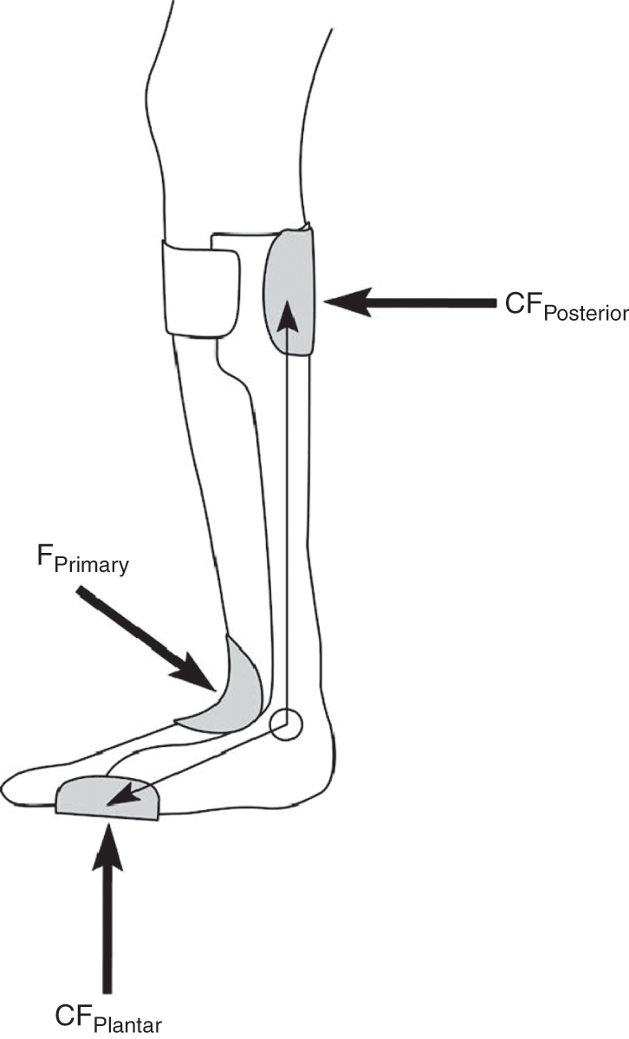

Slide 12
Other Principles of Orthosis
There are 14 biomechanical principles which govern the working of an orthosis. They are:
Use of forces- force is used to limit or assist movement. For example: Rigid orthosis prevents joint motion.
Sensation- Sensory feedbacks are decreased and proprioception should be preserved.
Correction of a mobile deformity like genu recurvatum.
It prevents the progression of a fixed deformity
Orthosis must be adjustable especially in children to combat hindrance towards their growth.
Orthosis must be simple structurally and hygienic with low maintenance.

Slide 13
8. Application of the orthosis should be simple and according to the needs of patients.
9. Orthosis must limit the painful motions.
10. Orthosis must work in line with the gravity, especially for upper limb motions and stability.
11. They should be comfortable to wear on and off.
12. Orthosis must serve a real purpose and be useful.
13. Cosmesis is an important property which must be accurately dealt in terms of orthosis.
14. The usage duration must be consulted and indicated as per requirements.
15. It should be appropriate according to function whether to limit or move the joint.

Slide 14
Biomechanics of Orthosis
Control of Rotational moments across a joint
Control of translational forces across a joint
Control of Axial forces across a joint
Control of line of Action of Ground Reaction Force
To combat the rotational, translational and axial forces orthosis surrounds the joint influenced thus called Direct factors. The fourth is Indirect Factor

Slide 15
Tissue response to Orthosis
The tissue response to orthosis can be governed by two factors:
External Factors like Pressure, shear and interface with microenvironment
Intrinsic factors like tissue compressibility and load transmission between orthosis and tissues.

Slide 16
Goals
Provide support to the joint
Stabilization of joints
Correction of deformities
Prevent weight bearing
Protection of body parts during healing
Pain relief
Provide movement

Slide 17
Indications
Hand injuries
Tendon injuries like flexors and extensors
Nerve injuries
Inflammation of joints and tendons
Burns
Rheumatoid Arthritis
Stroke
Brain injury
Paralysis
Polio
Joint instabilities

Slide 18
Contra-indications
Severe deformities
Skin infections
Inadequate muscle power
Interferes with ADLS or lifestyle
Very young or very old patients
Lack of motivation and psychological problems
Poor cognition or dependent patients

Slide 19
Disadvantages
Lack of cosmesis
Weak musculature which cannot support the orthosis or movement
Psychological dependency of patients
Reduction in bone density
Skin ulcerations and calluses

Slide 20
PROSTHESIS

Slide 21
Indications
Prosthesis are generally referred to patients in two case scenarios either there is no limb since birth or amputation of limb or a part of limb pertaining to diseases like cancer, gangrene formation, accidental cases, open communited fractures, etc.
Before prescribing a prosthesis knowledge of the residual abilities of the patient is necessary.

Slide 22
Biomechanics of Prosthesis
The basic principles behind working of an effective prosthesis include:
Pressure
Center of Mass
Ground Reaction Forces
Moments or Torque
Axial loading
Prosthetic coupling

Slide 23
Pressure
Pressure is exerted when a force directly counters overs the surface of skin.
When the area subjected to pressure is increased the amount of pressure exerted is automatically reduced.
This is used to form a prosthetic socket design to spread force over a larger area and make it feasible for the amputee to handle.
Smaller prosthetic socket may lead to pain and discomfort to the patients.

Slide 24
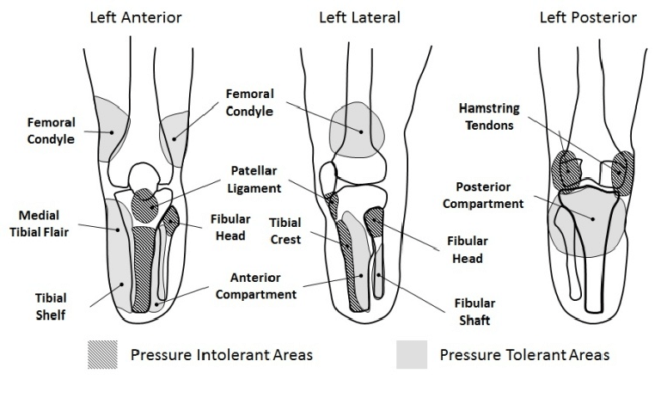
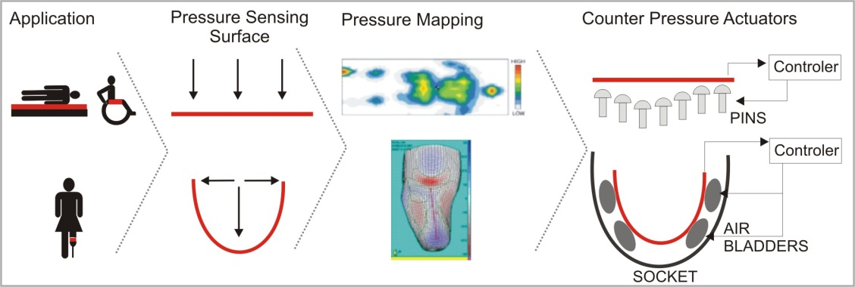

Slide 25
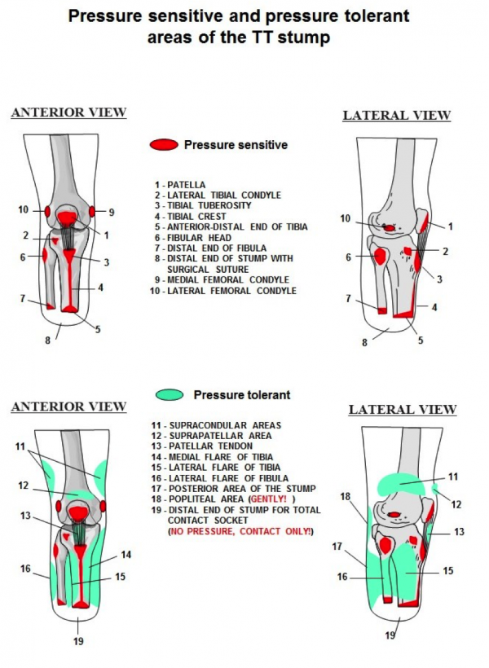

Slide 26
Center of Mass
The center of mass or center of gravity lies at the central portion of a thing or material.
In human body this COG is usually at the S2 level of the spinal cord.
In patients undergoing amputations especially lower limb amputation, this COG shifts towards the opposite side or where there is greater mass.

Slide 27
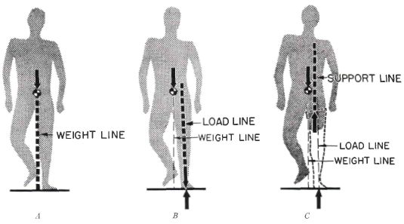
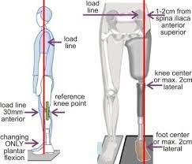

Slide 28
Ground Reaction Forces
The force exerted when a body comes in contact with the ground and which provides support to the body movements is termed as Ground Reaction Force (GFR)
Alignment of prosthesis keenly determines the amount and the nature of GFR.
This in turn causes the limb to undergo faulty movement or rotations at the line of action causing instability in the equilibrium between the forces.

Slide 29
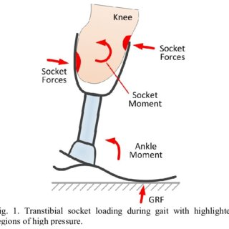
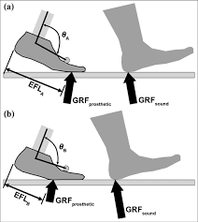
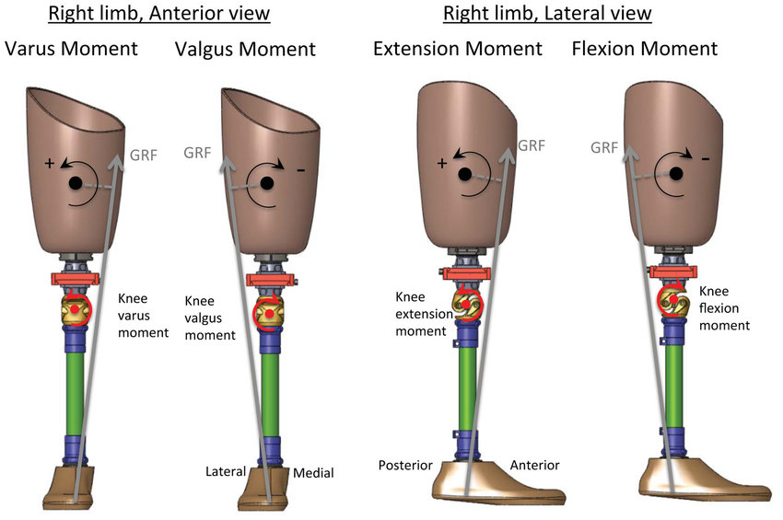

Slide 30
Torque
Forces which tend to act away from the center of gravity make the object or material rotate with the amount of force being acted upon it.
In normal humans, the forces exerted by the external environment is safely balanced by the GFR and an internally generated force system which is a resultant of the muscle opposing the torque at that particular joint.
In the case of an amputee, the muscles have lesser power to generate this internal force and sometimes there is even lack of direct control of muscles at the point of implication of force.
In this case usually the prosthesis is designed in such a way that the line on which GFR acts is transmitted to a safer angle at the level of the prosthesis where it can be counteracted or balanced.

Slide 31
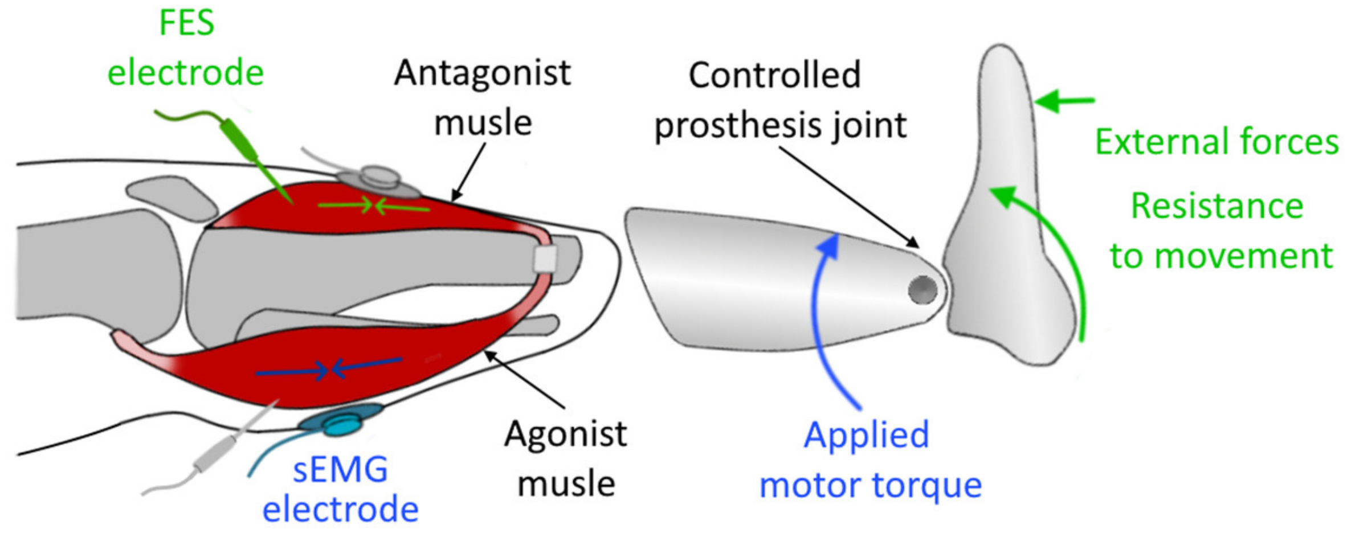

Slide 32
Axial Loading
The transmission of vertical forces along the long axis of the body is termed as Axial loading.
A prosthesis provides the mechanism of axial loading in patients with lower limb amputation.
Thus it becomes important for prosthesis to handle the force of gravity, weight of the body and tolerate this pressure without distributing it to the soft tissues of the body.
It must provide sufficient amount of counter force to resist the effect of gravity.
Thus prosthesis parts must be reliable enough to tolerate the discretion of forces at different angles.

Slide 33
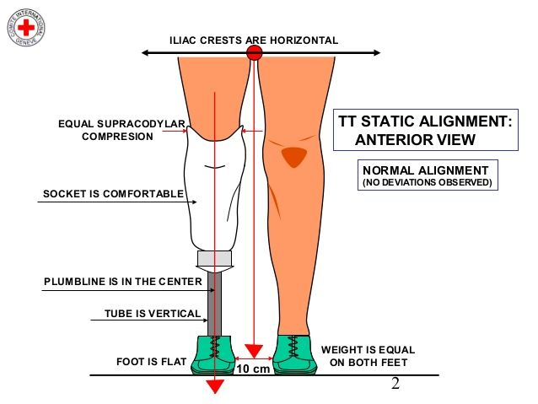

Slide 34
Thank You

