Slide 1
Introduction to VLSI Design
AMIT KATIYAR
Deptt. Of ECE UIET, CSJMU Kanpur

Slide 2
An Overview
Acronym of VLSI
  Very-Large-Scale Integration
A VLSI contains more than a million or so switching devices or logic gates
Early in the first decade of the 21st century, the actual number of transistors has exceeded 100 million
A piece of silicon (a chip) is typically about 1 centimeter on a side

Slide 3
Integrated Circuits Trends
An entire circuit is manufactured in a single piece of silicon, first appeared around 1960
At that time only a few simple gates offering primitive logic functions such as not, nand, nor etc. could be accommodated (SSI)
By 1970 MSI circuits with about a thousand transistors appeared
By 1980 LSI circuits of approximately one hundred thousand devices were possible

Slide 4
Choice of Technology
Two distinct types of technology are fabricated in silicon based upon
  BJT (Bipolar Junction Transistor)
  MOS (Metallic Oxide Semiconductor)
Since processing of these technologies is very different, it is impractical to mix them up within a chip

Slide 5
Choice of MOS and BJT
MOS logic occupies much smaller area of silicon than the equivalent BJT logic
MOS technology has a much higher potential packing density
A MOS logic circuit requires appreciably less current and hence less power than its bipolar counter part
However, bipolar circuits operate faster than MOS circuits
Even so, the speed-power product for MOS logic compares favorably with that of BJT logic

Slide 6
Choice of MOS and BJT
The structure of an MOS transistor is much simpler than that of bipolar devices and this makes manufacturing process easier
This in turn should result in fewer faults occurring in fabrication (high yield)
Dynamic logic circuits cannot be implemented in bipolar technology
Thus in terms of area, power dissipated, yield and flexibility MOS technology is superior to BJT

Slide 7
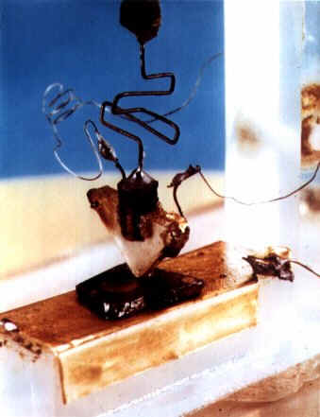
The Beginning
1947
First transistor, 1947
John Bardeen and Walter Brattain
Bell Laboratories

Slide 8
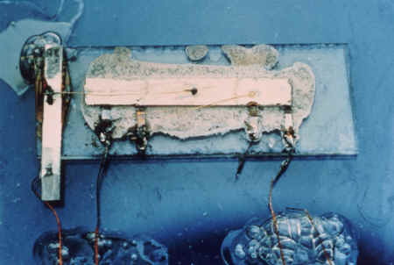
The Beginning
1958
First integrated circuit, 1958
Jack S. Kilby, Texas Instruments

Slide 9
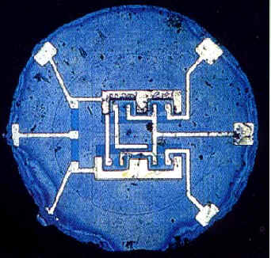
The Beginning…
1961
TI and Fairchild produced their First integrated circuit.
Dual Flip-Flop

Slide 10

The Beginning…
1965
“Moore’s Law”
The number of transistors that can be integrated on a single IC grows exponentially with time.
“Integration complexity doubles every two years”
Gordon Moore
Fairchild Corporation

Slide 11
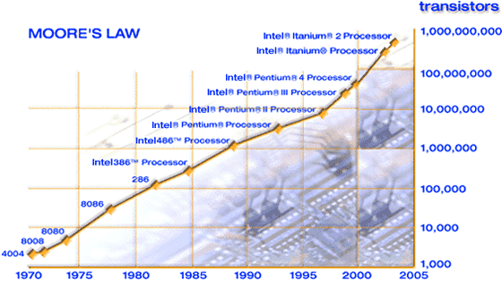
Moore’s Law
1965: Gordon Moore plotted transistor on each chip
  Fit straight line on semilog scale
  Transistor counts have doubled every 26 months
Integration Levels
SSI: 10 gates
MSI: 1000 gates
LSI: 10,000 gates
VLSI: > 10k gates
http://www.intel.com/technology/silicon/mooreslaw/

Slide 12
Corollaries
Many other factors grow exponentially
  Ex: clock frequency, processor performance

Slide 13
Modern transistors are few microns wide and approximately
0.1 micron or less in length
Human hair is 80-90 microns in diameter
Ref: http://micro.magnet.fsu.edu/creatures/technical/sizematters.html

Slide 14



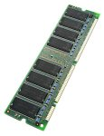




IC Products
Processors
  CPU, DSP, Controllers
Memory chips
  RAM, ROM, EEPROM
Analog
  Mobile communication,
  audio/video processing
Programmable
  PLA, FPGA
Embedded systems
  Used in cars, factories
  Network cards
System-on-chip (SoC)
Images: amazon.com
Notes:
Datapath is the “computational unit” of a processor
Digital Signal Processing (DSP) chips are used all over the place: audio, image processing, satellite applications, etc.
Memory performance always behind CPU speed, greater need for more capacity, bandwidth
Network processors: low-cost, versatile, fast designs needed for the increasing internet applications, protocols, etc.

Slide 15
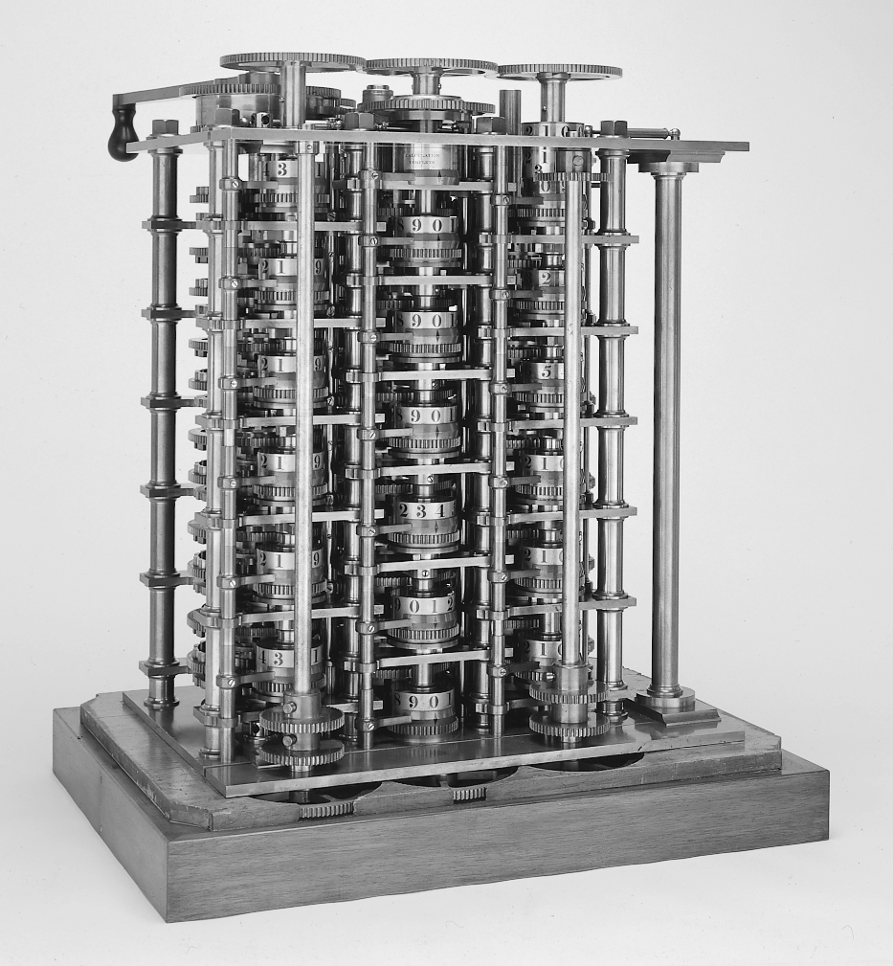
The First Computer

Slide 16
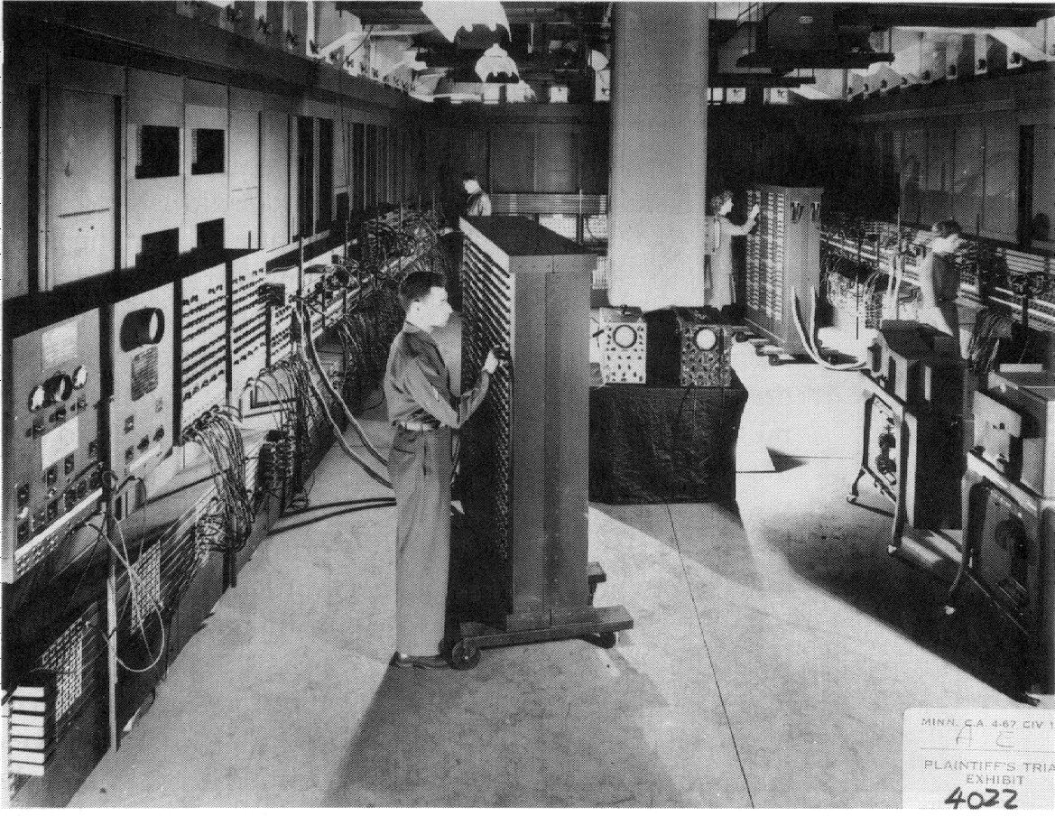
ENIAC - The first electronic computer (1946)

Slide 17
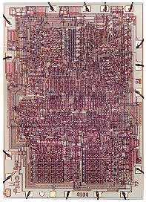
The Beginning…
1967
Intel founded to produce memory chips.
1971
Intel produced the first microprocessor on a chip, Intel 4004.
It had 2300 transistors and ran at 108 KHz
Intel 4004
L=10µm
Now everything has changed…….

Slide 18
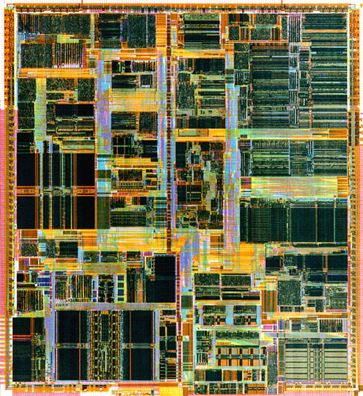
Pentium II..
1997
Intel Pentium II
Clock: 233 MHz
Number of transistors: 7.5 M
Gate Length: 0.35 µm

Slide 19
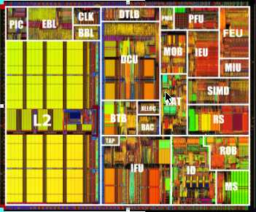
Pentium III…
Pentium® III
28M transistors / 733MHz-1Gz
L=0.25µm shrunk to L=0.18µm

Slide 20
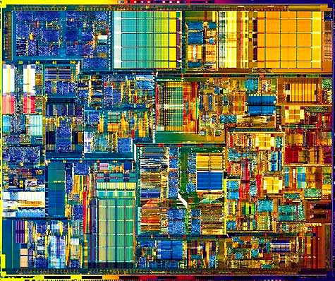
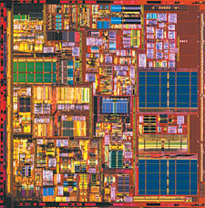
Pentium 4….
Pentium® 4
42M transistors / 1.3-1.8GHz
L=0.18µm
Pentium® 4 “Northwood”
55M transistors / 2-2.5GHz
L=0.13µm

Slide 21
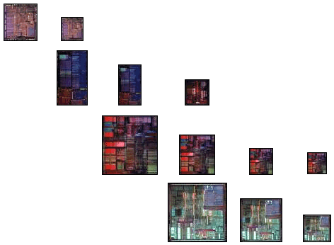
Example: Intel Processor Sizes
Silicon Process
Technology
1.5μ
1.0μ
0.8μ
0.6μ
0.35μ
0.25μ
Intel386TM DX
Processor
Intel486TM DX
Processor
Pentium® Processor
Pentium® Pro &
Pentium® II Processors
Source: http://www.intel.com/

Slide 22
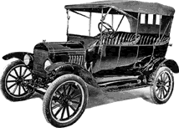

Evolution (revolution) of IC design
If the automobile industry had made the same progress as the semiconductor industry, a car would today :
  Drive at the speed of light.
  Drive years on one single tank of petrol.
  Seat 4 Lac people.
  Cost around Rupees 8.

Slide 23
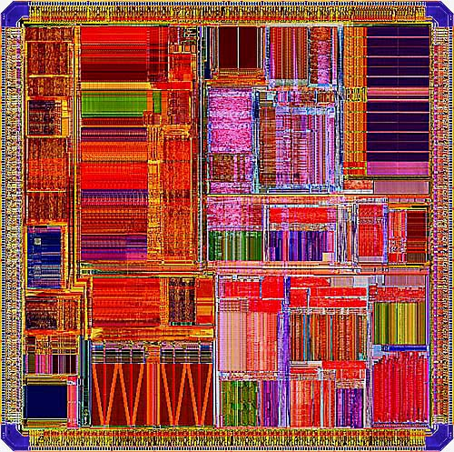
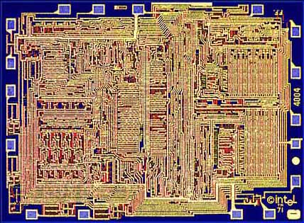
How to put together millions of transistors and make it work ?
Well chosen design methodologies
Well chosen architectures
Extensive use of power full CAD tools
Strict design management
Well chosen testing methodologies
Design re-use

Slide 24
Design Methodology
Specification
Trade-off’s
Design domains - abstraction level
Top-down - Bottom up
Schematic based
Synthesis based
Getting it right – Simulation and verification
Lower power
Design styles

Slide 25
Specification
A specification of what to construct is the first major step.
Compromise between what is wanted and what can be made
  Requires extensive experience to define best compromise
A detailed specification must be agreed upon with the system people. Major changes during design will result in significant delays.
Requirements must be considered at many levels
Specifications can (must) be
system simulations.
Specification is 1/4 - 1/3 of total
IC project !.

Slide 26
Trade offs
Integration
Tools
Technology
Packaging
Time
Schedule
Flexibility
Partitioning
Availability
Testing
Man power
Speed
Development
costs
Reliability
Chip size
Production
costs
Power

Slide 27
Design domains
Structural
Behavioral
Processor, memory
Program
ALU, registers
State machine
Cell
Module
Device, gate
Boolean equation
Transistor
Transfer function
Masks
Gate
Functional unit
Macro
IC
Geometric

Slide 28
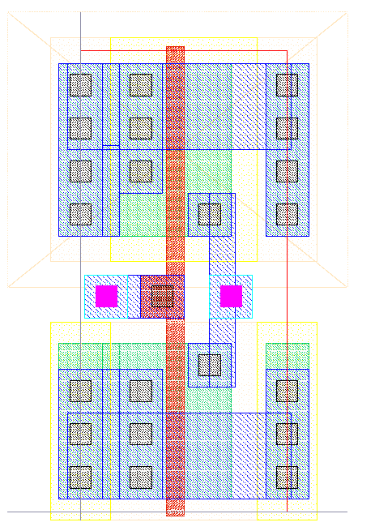
Abstraction levels and synthesis
Architectural level
Logic level
Circuit level
Layout level
For I=0 to I=15
Sum = Sum + array[I]
0
State
Behavioral level
0
0
0
Architecture
synthesis
Logic
synthesis
Circuit
synthesis
Layout
synthesis
Memory
Control
Structural level
+
Clk
(Library)
(register level)
Silicon compilation (not a big success)

Slide 29
Design Abstraction Levels
Digital Integrated Circuits
Introduction
© Prentice Hall 1995

Slide 30
Design abstraction levels

Slide 31
Top - down design
Choice of algorithm (optimization)
Choice of architecture (optimization)
Definition of functional modules
Definition of design hierarchy
Split up in small boxes - split up in small boxes - split up in small boxes
Define required units ( adders, state machine, etc.)
Floor-planning
Map into chosen technology
(synthesis, schematic, layout)
(change algorithms or architecture if speed or chip size problems)
Behavioral simulation tools

Slide 32
Bottom - up
Build gates in given technology
Build basic units using gates
Build generic modules of use
Put modules together
Hope that you arrived at some reasonable architecture
Gate level simulation tools
Comment by one of the main designers of a Pentium processor
The design was made in a typical top - down , bottom - up ,
inside - out design methodology

Slide 33
VLSI Design Cycle
System Specification
Circuit Design
Architectural Design
Physical Design
Functional Design
Fabrication
Logic Design
Packaging

Slide 34
VLSI Design Cycle
System Specification – Specification of the size, speed, power and functionality of the VLSI system.
Architectural Design – Decisions on the architecture. Such decisions can provide an accurate estimation of the system performance, die size, power consumption, etc.

Slide 35
VLSI Design Cycle
Functional Design – Identify main functional units and their interconnections. No details of implementation.

Slide 36
VLSI Design Cycle
Logic Design – Design the logic, e.g., boolean expressions, control flow, word width, register allocation, etc. The outcome is called an RTL (Register Transfer Level) description. RTL is expressed in a HDL (Hardware Description Language), e.g., VHDL and Verilog.
X = (AB+CD)(E+F)
Y= (A(B+C) + Z + D)

Slide 37
VLSI Design Cycle (5/9)
Circuit Design – Design the circuit including gates, transistors, interconnections, etc. The outcome is called a netlist.

Slide 38
VLSI Design Cycle
Component hierarchy
top
i1
xxx
i2

Slide 39
VLSI Design Cycle
Physical Design – Convert the netlist into a geometric representation. The outcome is called a layout.

Slide 40
VLSI Design Cycle
Fabrication – Process includes lithography, polishing, deposition, diffusion, etc., to produce a chip.
Packaging – Put together the chips on a PCB (Printed Circuit Board) or an MCM (Multi-Chip Module)

Slide 41
VLSI Design Cycle
System Specification
Netlist
Architectural
Design
Physical
Design
Architectural
Specification
Layout
Circuit Design
or
Logic Synthesis
Fabrication
Functional
Design
Chips
Timing & relationship
between functional units
Packaging
Logic
Design
Packaged and
tested chips
RTL in HDL

Slide 42
Physical Design Cycle
Circuit Partitioning
Floorplanning & Placement
Routing
Layout Compaction
Extraction and Verification

Slide 43
Physical Design Cycle
Circuit Partitioning – Partition a large circuit into sub-circuits (called blocks). Factors like #blocks, block sizes, interconnection between blocks, etc., are considered.
✶
→
✴

Slide 44
Physical Design Cycle
Floorplanning – Set up a plan for a good layout. Place the modules (modules can be blocks, functional units, etc.) at an early stage when details like shape, area, I/O pin positions of the modules, …, are not yet fixed.
Deadspace

Slide 45
Physical Design Cycle
Placement – Exact placement of the modules (modules can be gates, standard cells, etc.) when details of the module design are known. The goal is to minimize the delay, total area and interconnect cost.
Feedthrough
Standard cell type 1
Standard cell type 2
v

Slide 46
Physical Design Cycle
Routing – Complete the interconnections between modules. Factors like critical path, clock skew, wire spacing, etc., are considered. Include global routing and detailed routing.
Feedthrough
Type 1 standard cel1
v
Type 2 standard cell

Slide 47
Physical Design Cycle
Compaction – Compress the layout from all directions to minimize the total chip area.
Verification – Check the correctness of the layout. Include DRC (Design Rule Checking), circuit extraction (generate a circuit from the layout to compare with the original netlist), performance verification (extract geometric information to compute resistance, capacitance, delay, etc.)

Slide 48
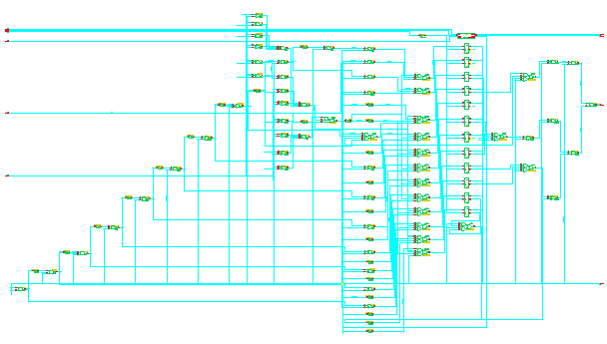
Synthesis based
Define modules and their behavior in a proper language (also used for simulation)
Use synthesis tools to generate schematics (netlists)
always @(posedge clk)
begin
if (set) coarse <= #(test.ff_delay) offset;
else if (coarse == count_roll_over)
coarse <= #(test.ff_delay) 0;
else coarse <= #(test.ff_delay) coarse + 1;
end
Only possible way to make designs with millions of gates

Slide 49
Getting it right - Simulation
Simulate the design at all levels (transistor, gate, system)
Analog simulator (SPICE) for transistor level
Digital gate level simulator for gate based design
Mixed mode simulation of mixed analog-digital design
Behavioral simulation at system/module level (Verilog, VHDL)
All functions must be simulated and verified.
Worst case data must be used to verify timing
Worst - Typical - Best case conditions must be verified
Use programming approach to verify large set of functions

Slide 50
Heterogeneity on Chip
Heterogeneity
Greater diversity of on­chip elements
  Processors
  Software
  Memory
  Analog
More transistors doing different things!
[©Keutzer]

Slide 51
Stronger Market Pressures
Time-to-market
Decreasing design window
Less tolerance for design revisions
Exponentially more complex, greater design risk, greater variety, and a smaller design window!
[©Keutzer]

Slide 52
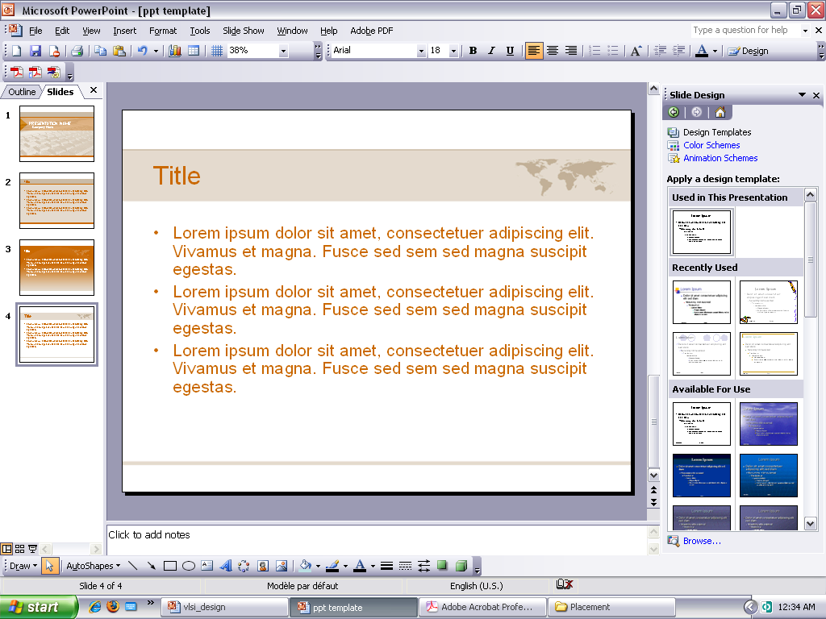
VLSI Design Styles
Full Custom
Application-Specific Integrated Circuit (ASIC)
Programmable Logic (PLD, FPGA)
System-on-a-Chip

Slide 53
Full Custom Design
Each circuit element carefully “handcrafted”
Huge design effort
High Design & NRE Costs / Low Unit Cost
High Performance
Typically used for high-volume applications

Slide 54
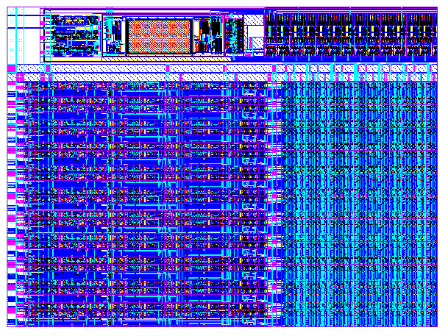
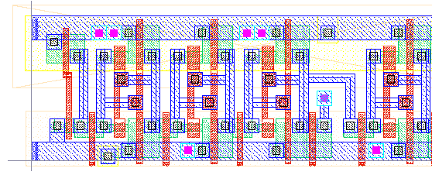
Full custom
Hand drawn geometry
All layers customized
Digital and analog
Simulation at transistor level (analog)
High density
High performance
Looong design time
Vdd
IN
Out
Gnd

Slide 55
ASIC
Constrained design using pre-designed (and sometimes pre-manufactured) components
Also called semi-custom design
CAD tools greatly reduce design effort
Low Design Cost / High NRE Cost / Med. Unit Cost
Medium Performance

Slide 56
Programmable Logic (FPGA)
Pre-manufactured components with programmable interconnect
CAD tools greatly reduce design effort
Low Design Cost / Low NRE Cost / High Unit Cost
Lower Performance

Slide 57
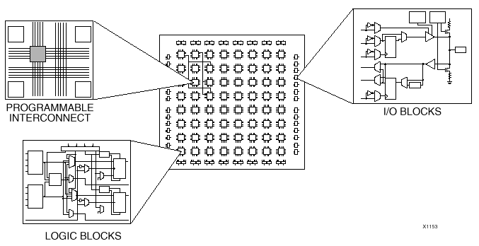
FPGA = Field Programmable Gate Array
Programmable logic blocks
Programmable connections between logic blocks
No layers customized (standard devices)
Digital only
Low - medium performance (<50 - 100MHz)
Low - medium density
Programmable
Easy and quick
design changes
Cheap design tools
Low development cost
High device cost

Slide 58
FPGA Architecture

Slide 59
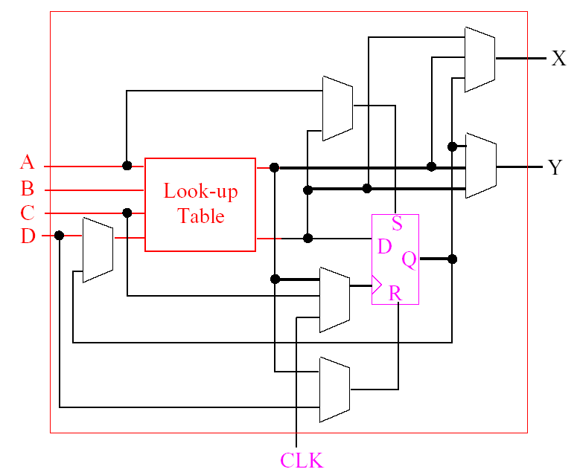
Configurable Logic Block

Slide 60
Xilinx FPGAs
XC2000 1.5k 16MHz
XC3000 7.5k 50MHz
XC4000 85k 80MHz 0.5u
SPARTAN/SPARTAN XL 40k 100MHz+ 0.35u
XC5200 16k 50MHz 0.5u
VIRTEX 1m 200MHz 0.25u
SPARTAN – II 200k 200MHz 0.25u
VIRTEX E 4m 250MHz 0.18u
SPARTAN – IIE 200k 250+ 0.25u
VIRTEX - II 8m 420MHz 0.15u
VIRTEX - II PRO 10m 420MHz 0.13u

Slide 61
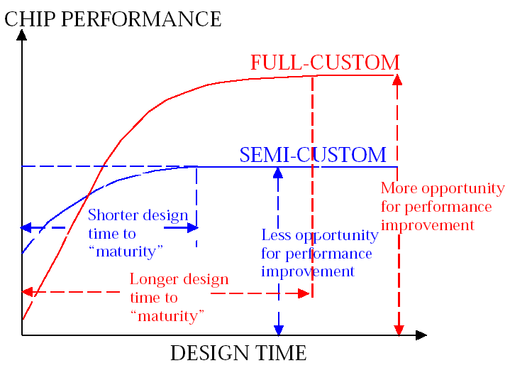

Slide 62
Design Flow
Front End Flow
Back End Flow
ASIC Flow

Slide 63
Front end flow (FPGA based design)
Functional Simulation – Active-HDL
Synthesis – Synplify-Pro (EDIF)
Place and Route – Xilinx Foundation Series (.SDF)
Timing Simulation – Active-HDL

Slide 64
Front end flow (FPGA based design)
ALTERA APEX SERIES FPGA
Functional Simulation – Active-HDL
Synthesis – Synplify-Pro (EDIF)
Place and route – Quartus (.vdo and .sdo)
Timing Simulation – Active-HDL

Slide 65
Back end flow
Circuit configuration and hand Calculation
Schematic Capture – Gateway
Functional Simulation – SmartSpice/HarmonyAMS
Physical Design – Expert
Physical Verification – Guardian-DRC/LVS
Parasitic Extraction – Hipex-NET/C/R/RC
Back Annotation – SmartSpice/HarmonyAMS

Slide 66
Techniques to reduce the complexity of IC design
Hierarchy – Divide and conquer
Regularity – Reusability – transistor level, gate level
Modularity – Debugging
Locality – ‘Time locality’ – excessive interconnect delays

