Slide 1
Chromatography
Ion Exchange Chromatography

Slide 2
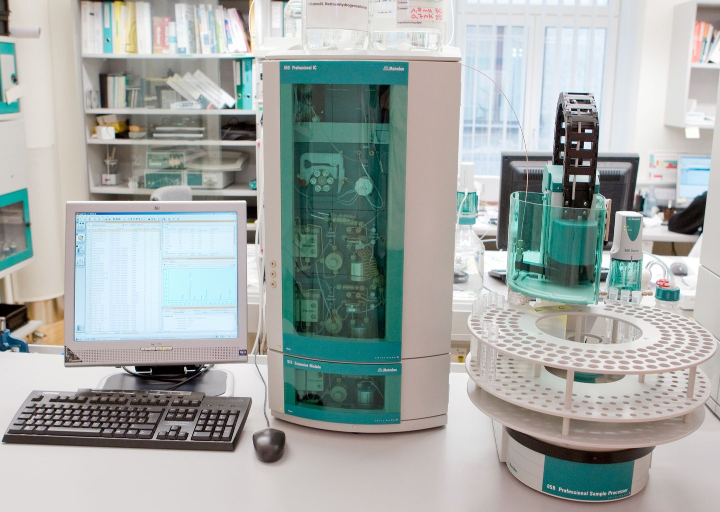
Definition
Ion-exchange chromatography (or ion chromatography) is a process that allows the separation of ions and polar molecules based on the charge properties of the molecules.
1975 by Small, Stevens and Baumann

Slide 3
ion exchange chromatography is defined
"In ion exchange chromatography separation is based on differences in the ion exchange affinities of the individual analytes.
If inorganic ions are separated and can be detected by conductivity detectors or by indirect UV detection then this is also called ion chromatography".
"Ion chromatography includes all rapid liquid chromatography separations of ions in columns coupled online with detection and quantification in a flow-through detector."

Slide 4
The following separation principles apply in ion chromatography:
• ion exchange
• ion pair formation
• ion exclusion
Chromatography methods are defined by the chief separation mechanism used. Today ion exchange chromatography is simply known as ion chromatography (IC), while ion pair chromatography (IPC) and ion exclusion chromatography (IEC) are regarded as being more specialized applications.

Slide 5
Principles Behind Cation Exchange Chromatography
How does it work?
Ion-exchange chromatography revolves around the separation of molecules (ions, polar molecules, etc.) on the basis of a difference in charge
Specifically, cation exchange chromatography is useful for the separation of positively charged species in solution
Two phases:
    Stationary phase: consists of a resin or gel matrix of covalently bound negatively charged groups
    Mobile phase: composed of a buffered aqueous solution of counter-ions (positively charged molecules) that is in equilibrium with the total charge of the resin

Slide 6
The solution to be injected is usually called a sample, and the individually separated components are called analytes
It can be used for almost any kind of charged molecule including large proteins, small nucleotides and amino acids.
It is often used in protein purification, water analysis.

Slide 7
Ion exchange chromatography retains analyte molecules based on ionic interactions.
The stationary phase surface displays ionic functional groups (R-X) that interact with analyte ions of opposite charge.
This type of chromatography is further subdivided into:
cation exchange chromatography
anion exchange chromatography.

Slide 8
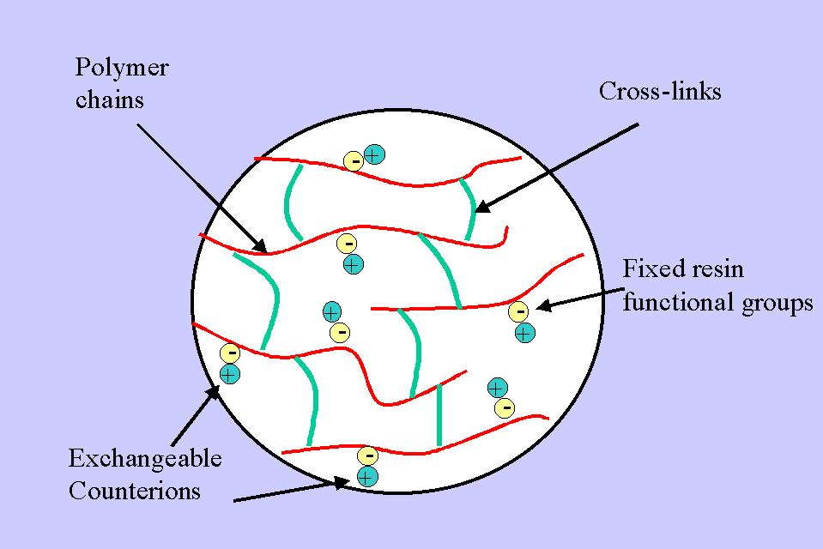
Ion Exchangers

Slide 9
Ion exchangers – Functional groups
Cation exchanger
Carboxymethyl (CM-)
Phospho
Sulphopropyl (SP-)
Anion exchanger
Aminoethyl (AE-)
Diethylaminoethyl (DEAE-)
Quaternary aminoethyl (QAE-)

Slide 10
Cation exchange chromatography
Cation exchange chromatography retains positively charged cations because the stationary phase displays a negatively charged functional group
-
+
+
-
_
+
+
-
R-X C +M B R-X M + C + B

Slide 11
Anion exchange chromatography
Anion exchange chromatography retains anions using positively charged functional group:
_
-
+
-
+
-
+
+
R-X A +M B R-X B + M + A

Slide 12
A sample is introduced, either manually or with an autosampler, into a sample loop of known volume.
The mobile phase (buffered aqueous solution) carries the sample from the loop onto a column that contains some form of stationary phase material.
Stationary phase material is a resin or gel matrix consisting of agarose or cellulose beads with covalently bonded charged functional groups.

Slide 13
Ion-Exchange Chromatography
SO
-
Na
+
3
Separation in Ion-exchange Chromatography is based on the competition of different ionic compounds of the sample for the active sites on the ion-exchange resin (column-packing).

Slide 14
Mechanism of Ion-Exchange Chromatography of Amino Acids
pH2
SO
-
Na
+
H
N
+
3
3
COOH
Ion-exchange Resin
SO
-
H
N
+
3
3
-
COO
pH4.5
Na
+

Slide 15
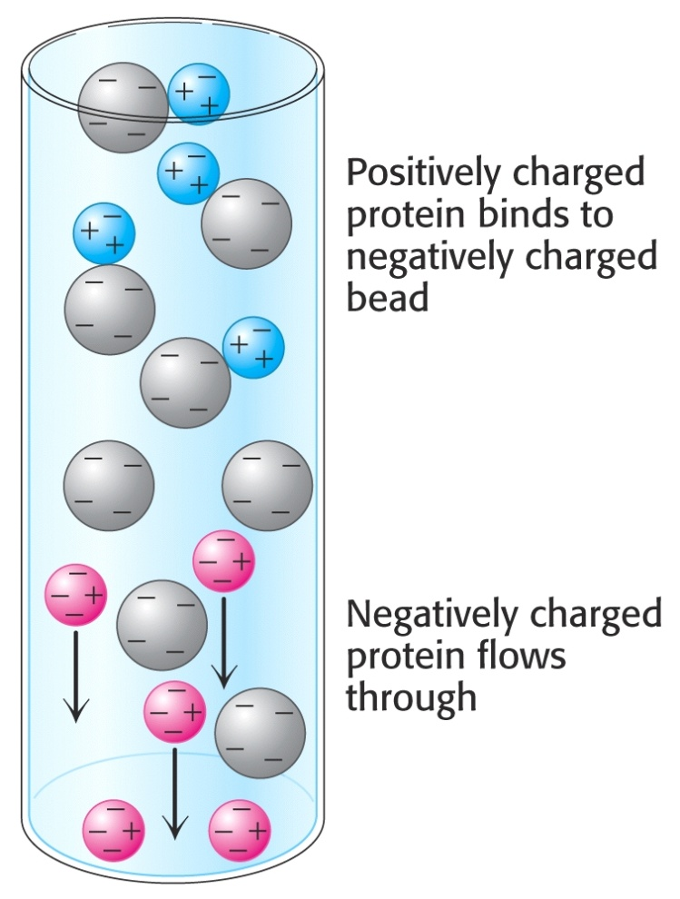
Ion-Exchange Chromatography – Separation based on charge

Slide 16
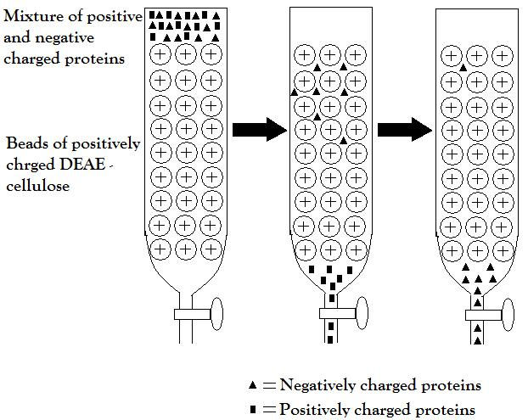
Schematic presentation of process of ion exchange separation

Slide 17
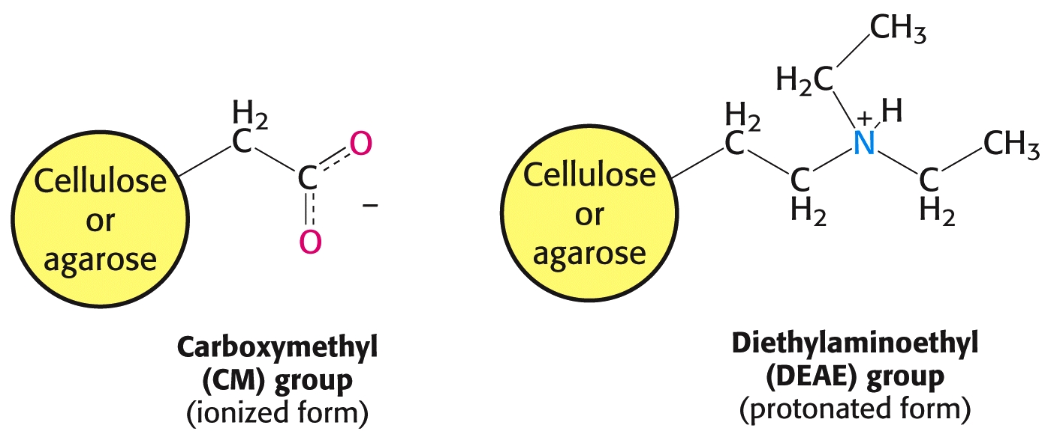
Types of ion-exchange chromatography media

Slide 18
The target analytes (anions or cations) are retained on the stationary phase but can be eluted by increasing the concentration of a similarly charged species that will displace the analyte ions from the stationary phase.
For example, in cation exchange chromatography, the positively charged analyte could be displaced by the addition of positively charged sodium ions.

Slide 19
Procedure
The analytes of interest must then be detected by some means, typically by conductivity or UV/Visible light absorbance.
A chromatography data system (CDS) is usually needed to control an IC.

Slide 20
Procedure

Slide 21
Separating proteins
Proteins have numerous functional groups that can have both positive and negative charges.
Ion exchange chromatography separates proteins according to their net charge, which is dependent on the composition of the mobile phase.

Slide 22
Affect of pH in the separation of proteins
By adjusting the pH or the ionic concentration of the mobile phase, various protein molecules can be separated.
For example, if a protein has a net positive charge at pH 7, then it will bind to a column of negatively-charged beads, whereas a negatively charged protein would not.

Slide 23
Effect of pH in the separation of proteins
Proteins are charged molecules. At specific pH, it can exist in anionic (-), cationic (+) or zwitterion (no net charge) stage.
cationic
pH =pI
anionic
pH increase
*pI isoelectric point

Slide 24
Choosing your ion-exchanger: know your proteins
Stability of proteins
stable below pI value, use cation-exchanger
stable above pI value, use anion-exchanger
Molecular size of proteins
<10,000 mw, use matrix of small pore size
10,000-100,000 mw, use Sepharose equivalent grade

Slide 25
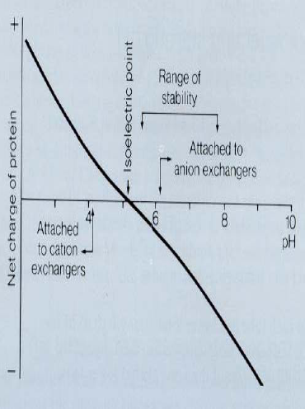
Important to consider the stability of proteins in choice of ion exchangers. Isoelectric focusing can be used to identify suitable ion-exchanger type

Slide 26
applications
Polystyrene and polyphenolic IER: Seperation of small amino acids, peptides, nucleotides, N-bases,cyclic nucleotides, organic acids : intermediates of respiration,
Cellulose IE: CM cellulose, DEAE cellulose, phosphocellulose
For Proteins, enzymes, polysaccharides, nucleic acids,
Polydextran and agarose: DEAE sephadex, CM, : Proteins, hormones, t-RNA, polysaccahraides
the analysis of aliphatic carboxylic acids and their carboxylates salts in a wide variety of complex matrixes in environmental chemistry, food chemistry, biomedical research and pharmaceutical industries

