Slide 1
Job Analysis
Dr. Gopal Singh
Department of Education
CSJM University, Kanpur

Slide 2
What is Job Analysis?
Job analysis is the process of gathering and analysing information about the content and the human requirements of jobs, as well as, the context in which jobs are performed. This process is used to determine placement of jobs. Under NU Values the decision-making in this area is shared by units and Human Resources.

Slide 3
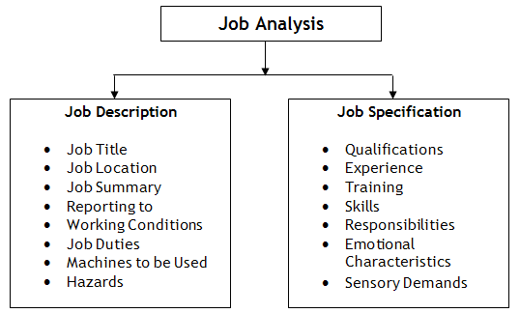

Slide 4
Criteria for Job Analysis
Skill Based
Task Based

Slide 5
Methods for Job Analysis
Interview
Observation
Questionnaire

