Slide 1
JOINT MOTIONS
BY:
DR. DIGVIJAY SHARMA
DIRECTOR
SCHOOL OF HEALTH SCIENCES, CSJMU

Slide 2
arthrokinematics
The term is used to refer movement of joint surfaces
Usually one of the joint is stable than other and serves as the base for the motion, whereas the other surface moves on this relatively fixed base
Usually three types of movements occur at the joint surfaces:
Rolling
Sliding
spinning

Slide 3
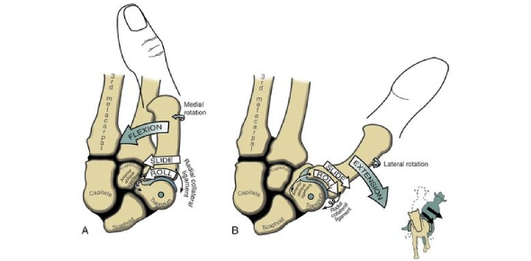
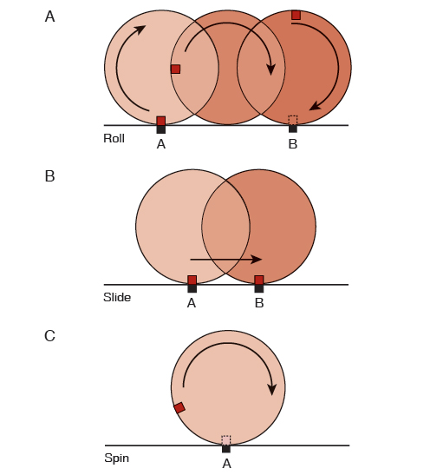
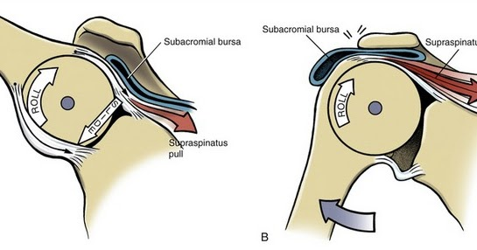

Slide 4
Rolling- it refers to the rolling of one joint surface on another, as a tire rolling on the road. Example: in the knee, the femoral condyles roll on the fixed tibial surface
Sliding- it is a pure translatory motion refers to the gliding of one component over the other as a braked wheel skits. Example: in hand, the proximal phalanx slides over the fixed end of the metacarpal
Spin- it refers to a pure rotatory motion. It refers to rotation of the movable component, as when a top spins. Example: at the elbow, head of the radius spins on the capitulum of the humerus during supination and pronation of the forearm
The types of motion that occurs at a particular joint depends upon the shape of articular surface and most joint is either ovoid or sellar type.
Ovoid joint- here one surface is concave while other is convex
Sellar joint- here each articulating surface is both convex and concave

Slide 5
When a convex surface moves on a concave surface, sliding of convex surface occurs in opposite direction while in same direction in case when concave surface slides.
Sliding is an essential component of joint motion because a bone cannot be expected to move without sliding of articular surface in appropriate direction.
Joint motions are commonly produced as a result of combination of all three movements.

Slide 6
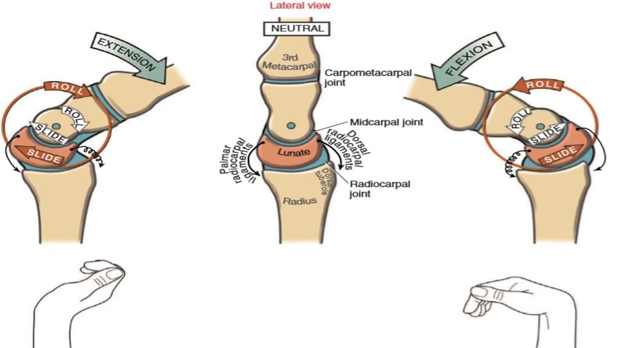

Slide 7
osteokinematics
It refers to the movement of the bones rather than the movement of the articular surfaces
The amount of motion possible at a joint is referred as anatomical or physiological range of motion because it is within the limit of anatomical structure of the joint.
The extent of anatomic range is determined by several factors such as shape of joint surfaces, the joint capsule, ligaments, muscle bulk surrounding musculotendinous and bony structures
In some joints there are limitations of range of motion by soft tissue for example knee joints other joints have both bony as well as soft tissue limitations such as humero-ulnar joint of elbow in extension.

Slide 8
A range of motion is considered pathological when joint motion either exceeds or fails to reach the normal anatomical limit
When the range of motion exceeds the normal limit the joint is called hypermobile.
It may be due to failure of either bony or soft tissue structures to limit the motion results in instability.
When the range of motion is less than the normal limit the joint is called hypomobile.
It may be due to bony or cartilaginous block, inability at the capsule, ligament or muscles to elongate sufficiently to allow a normal range of motion

Slide 9
