Slide 1
JOINT STRUCTURE & FUNCTION- ii
BY:
DR. DIGVIJAY SHARMA
DIRECTOR
SCHOOL OF HEALTH SCIENCES, CSJMU

Slide 2
JOINT CAPSULE
The joint capsule is composed of two layers:
An outer layer called Stratum fibrosum
An inner layer called Stratum synacium
The stratum fibrosum is also referred as fibrous capsule and is composed of dense fibrous tissue.
Collagen and elastin account for about 90% of dry weight while water about 70% of the wet weight
This layer is poorly vascularised but richly innervated by joint receptors
The receptors that re present in and around the joint capsule are able to detect the rate and direction of the motion, compression and tension, vibration and pressure.
The joint receptors transmit information about the status of joint to the central nervous system
The CNS interprets the information and respond by coordinating muscle activity to meet the joint stability- mobility

Slide 3
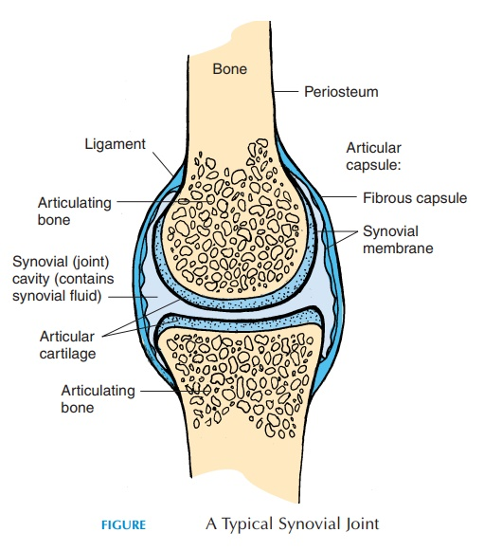
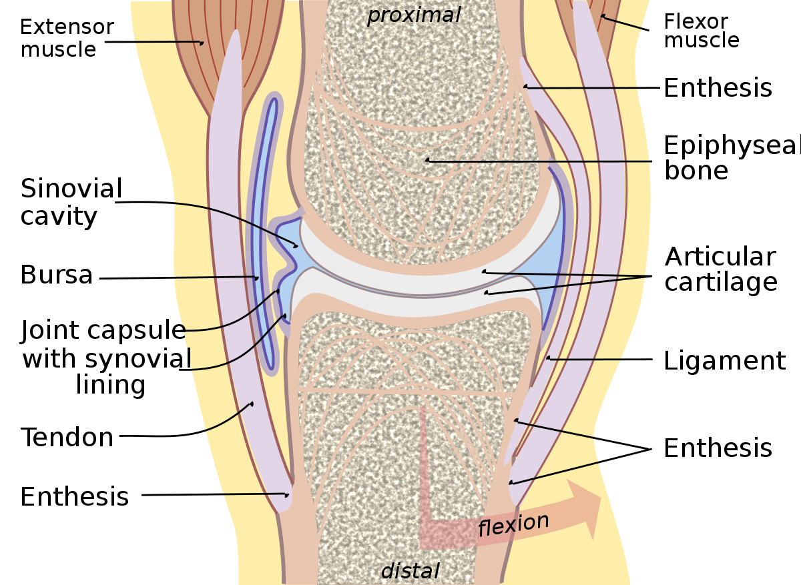

Slide 4
The inner layer is the lining tissue of the capsule.
It consists of two layers intima and sub-synovial tissue
Intima is made up of layer of cells which lines the joint space
It is made up of specialized cells known as synasiocytes, which synthesize the hyaluronic acid, a component of synovial fluid
The sub-synovial tissue lies outside the intima as a loose network which is highly vascularised but poorly innervated
It is less sensitive to pain but undergoes dilation and constriction in response to heat and cold
This layer provide support for the intima and merges with fibrous capsule on its internal surface

Slide 5
Synovial fluid
Normal synovial fluid appears as a clear, pale yellow viscous fluid that is present in small amount at all synovial joints
There is a direct exchange between vasculature of the stratum synacium and intracapsular space where nutrients can be supplied and waste products can be taken away from the joint by diffusion
The composition is similar to blood plasma except it contains hyaluronic acid and lubrician (glyco-protein)
The hyaluronate component is responsible for the viscosity of fluid and is essential for lubrication of synovial joint
Lubrication is responsible for cartilage on cartilage lubrication
The synivial fluid exhibits properties of viscous fluid that has ability to revert loads, that produce shear.
The viscosity of the synovial fluid varies inversely with the joint velocity on rate of shear
Thus synovial fluid is referred to as thircotropic
Thus increased motion of bony component leads to decrease in viscosity causes less resistance to motion while slow motion leads to increased viscosity providing more resistance

Slide 6
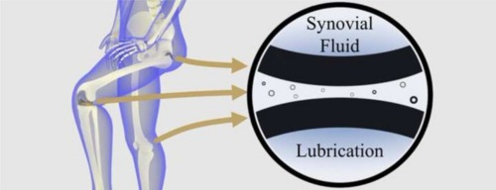
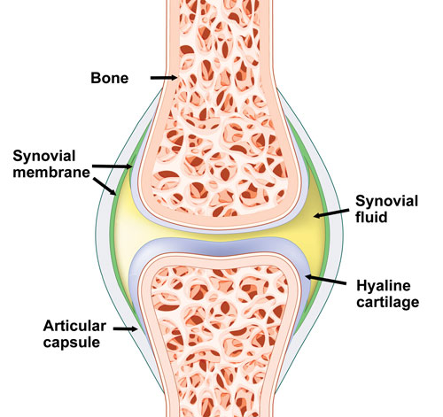
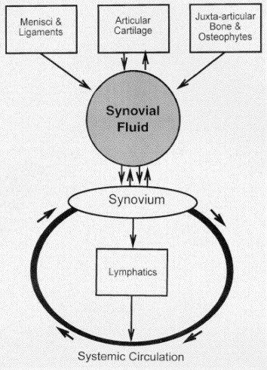

Slide 7
JOINT lubrication
There is no single model that can adequately explain the human joint lubrication and that human joints are lubricated by two or more types of lubrication.
The two basic types of lubrications are:
Boundary lubrication
Fluid lubrication

Slide 8
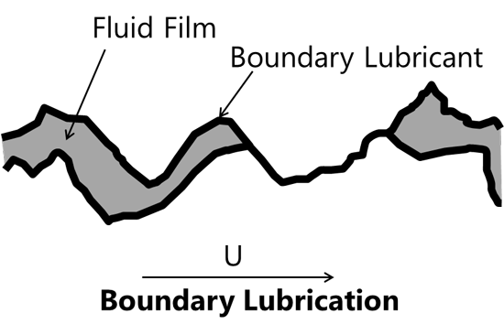
Boundary lubrication
This occurs when each weight bearing surface is located with a thin layer of large molecule that keeps opposing surface from touching each other
These molecules are composed of lubrication
This type of lubrication is considered to be most effective at low loads

Slide 9
fluid lubrication
It includes existence of a film of fluid that is interposed between the joint surfaces
The fluid lubrication include:
Hydrostatic lubrication- or weeping lubrication- it is a form of lubrication the load bearing surfaces are held apart by a film of lubricant that is maintained under pressure. Compression of articular cartilage cause the cartilage to deform and to weep fluid which forms a fluid film over the articular surface
Hydrodynamic lubrication- it is the form of fluid lubrication in which a wedge of fluid id created when non-parallel opposing surfaces slide on one another
Squeeze film Lubrication- here the pressure is created in the fluid film by movement of articular surface that are perpendicular to one another. The moving surface squeeze created by fluid viscosity keep the surface separated. This type of lubrication is suitable for high- load for short duration
Elasto-hydrodynamic Lubrication- here the protective fluid film is maintained at an appropriate thickness by elastic deformation of articular surfaces
Boosted Lubrication- the model suggests that pools of concentrated hyaluronate molecules are filtered out of synovial fluid and are trapped in the natural undulations areas of elastic deformations on the articular surfaces just as the opposing surfaces meet.

Slide 10
