Slide 1
JOINT FUNCTIONS & KINEMATIC CHAINS
BY:
DR. DIGVIJAY SHARMA
DIRECTOR
SCHOOL OF HEALTH SCIENCES, CSJMU

Slide 2
JOINT FUNCTIONS
The function of joint depends upon the structures at that particular joint.
The synarthrodial joints are simple and mainly provide stability but some amount of movement is also possible.
The diarthrodial joints are complex and they primarily provide mobility but they also does help in stability up to some extent
Generally stability must be achieved before mobility of normal function is to be maintained

Slide 3
KINEMATIC CHAINS
It is composed of a series of rigid links that are interconnected by a series of pin-centered joints
The system of joints and links are constructed in such a way that motion of one link at one joint will produce motion at all of the other joints in the system in a predictable manner.
KINEMATIC CHAINS
CLOSED KINEMATIC CHAINS
OPEN KINEMATIC CHAINS

Slide 4
CLOSED KINEMATIC CHAINS
In this chain, both the ends of the chain is fixed and the motion of one link at one joint produces motion at all other joint in a chain
For example: the joints of the lower limbs and the pelvis function as a closed kinematic chain when a person is in erect weight bearing position because lower end of the limbs are fixed on the ground and the upper end of the limbs are virtually fixed to the pelvis.

Slide 5
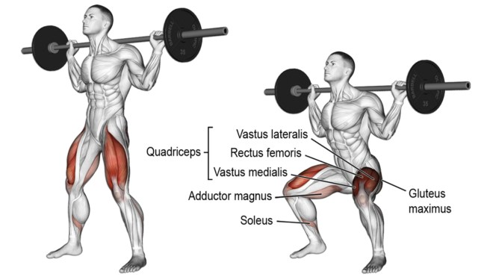
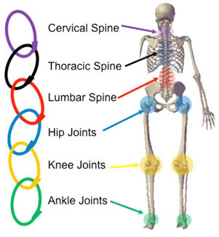
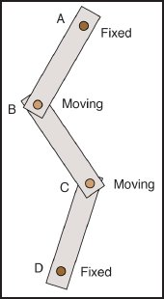
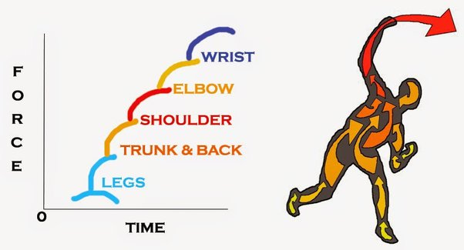

Slide 6
open KINEMATIC CHAINS
When ends of the limb or parts of the body are free to move without causing motion at another joint
The system is referred to open kinematic chain
For example: waving of hand may seem at wrist without causing movement at the other proximal and distal joints such as fingers, elbow and shoulder
In this system, motion does not occur in predictable manner because joints may function independently.

Slide 7
