Slide 1
FLUID MECHANICS (CHE-S202)
INTRODUCTION TO THE COURSE

Slide 2
Branches of Fluid Mechanics
Fluid Mechanics
Fluid Statics
(Static) (Hydrostatics/Hydraulics)
Fluid Dynamics
(Motion)
(Fluid kinematics)

Slide 3
Nature and Scope
Nature:
Mathematical (vectors, vector calculus)
Physical principles (law of conservation of- mass/ energy/angular momentum)
Scope:
Foundational
Design and operation of storage vessels
Design and operation of equipments for:
(1) Momentum transfer (fluid moving machinery -pipes, pumps, blowers, nozzles, turbine, compressors, valves etc.)
(2) Heat transfer (heat exchangers-heaters/coolers/condesers etc.)
(3) Mass transfer(separators/purifiers -distillation columns, absorbers, adsorbers, extractors etc.)
(4) Reactions (reactors-plug flow, mixed flow etc)

Slide 4
Important Topics
Basic Equation of Fluid Statics
Pressure Measurement
Mass Balance
Energy Balance (First Law of Thermodynamics)
Bernoulli’s Equation
Laminar Flow
Fluid Friction
Drag Forces
Flow Through Porous Media
Boundary Layer
Turbulent Flow
Surface Tension

Slide 5
Transport Processes
S. No. | Transported quantity | Driving Force | Basic Law | Defined property
1 | Momentum | Velocity gradient | Newton’s law of Viscosity | Viscosity
2 | Heat | Temperature gradient | Fourier’s law of conduction | Thermal conductivity
3 | Mass | Concentration gradient | Fick’s law of diffusion | Diffusivity

Slide 6
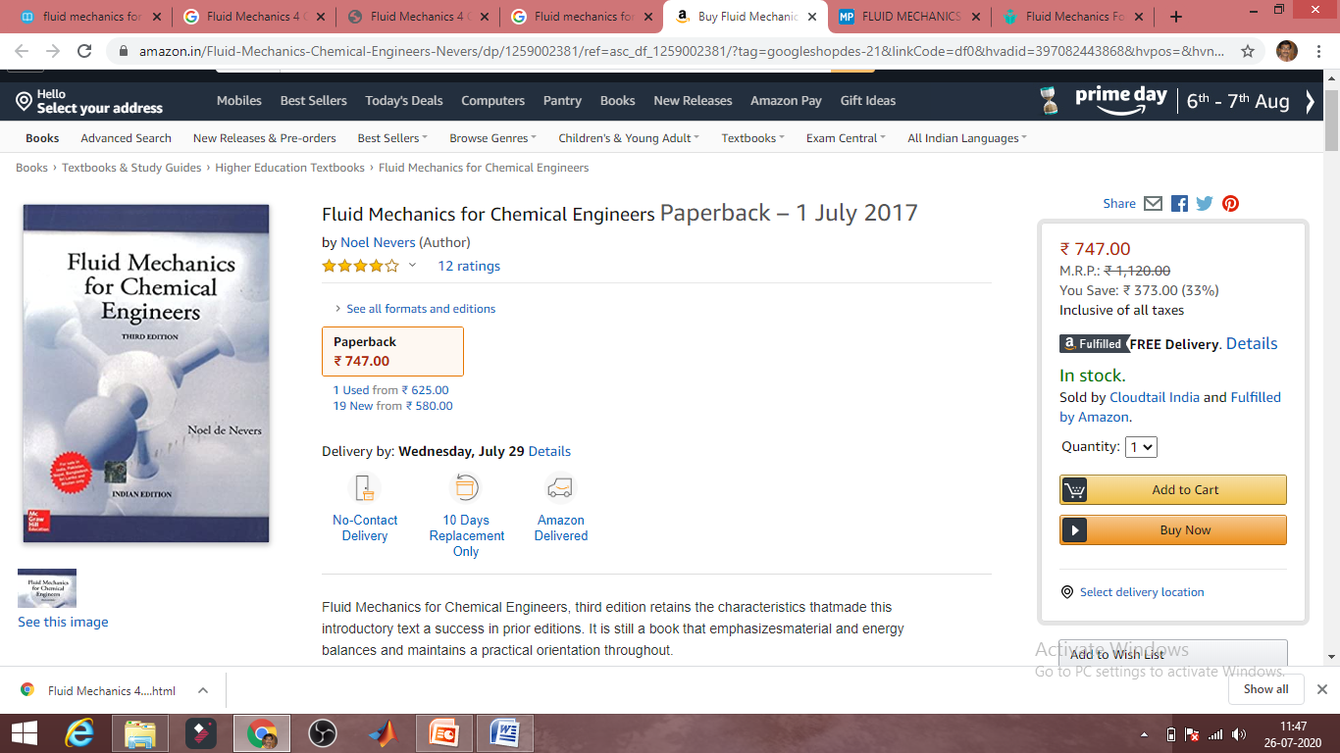
Text Book

