Slide 1
Lecture-11
Balance Equations

Slide 2
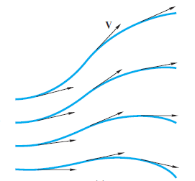
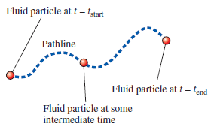
Introduction to Fluid Kinematics
Stream lines: A streamline is a curve that is everywhere tangent to the instantaneous local velocity vector.
Pathlines: Actual path traversed by fluid particle:

Slide 3
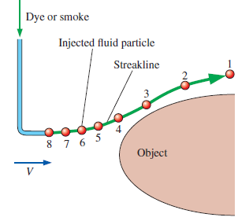
Introduction to Fluid Kinematics
Streaklines: A line formed by joining the fluid particles that have passed a fixed location over a period of time
Streaklines are the most common flow pattern generated in a physical experiment. If you insert a small tube into a flow and introduce a continuous stream of tracer fluid (dye in a water flow or smoke in an airflow), the observed pattern is a streakline.

Slide 4
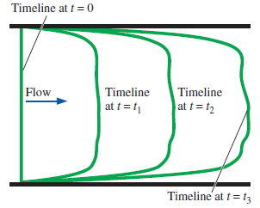
Introduction to Fluid Kinematics
Timeline: A timeline is a set of adjacent fluid particles that were marked at the same (earlier) instant in time. Timelines are particularly useful in situations where the uniformity of a flow (or lack thereof) is to be examined. Timelines can be generated experimentally in a water channel through use of a hydrogen bubble wire.

Slide 5
Difference: Streamline, Streakline, Pathline and Timeline
The streamline is convenient to calculate mathematically, while the other three are easier to generate experimentally. Note that a streamline and a timeline are instantaneous lines, while the pathline and the streakline are generated by the passage of time.
The velocity profile are shown forming timeline through experiments of a single discharge of bubbles from the wire. A pathline can be found by a time exposure of a single marked particle moving through the flow. Streamlines are difficult to generate experimentally in unsteady flow unless one marks a great many particles and notes their direction of motion during a very short time interval. In steady flow, where velocity varies only with position, the situation simplies greatly:
Streamlines, pathlines, and streaklines are identical in steady flow.

Slide 6
Basic Equations in Fluid Mechanics
Mass or material balance
(continuity equation/continuity principle)
Energy balance (First law of Thermodynamics)
Momentum (linear and angular)
(Newton’s law of motion)
Second law of Thermodynamics

Slide 7
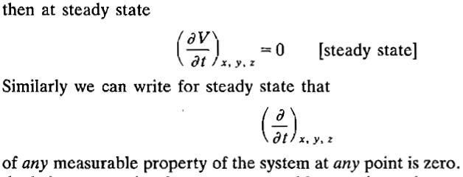
Mass Balance
General balance equation:
At steady state accumaulation is zero and creation and destruction terms are not present
Continuity equation:
For liquids density is usually constant

Slide 8
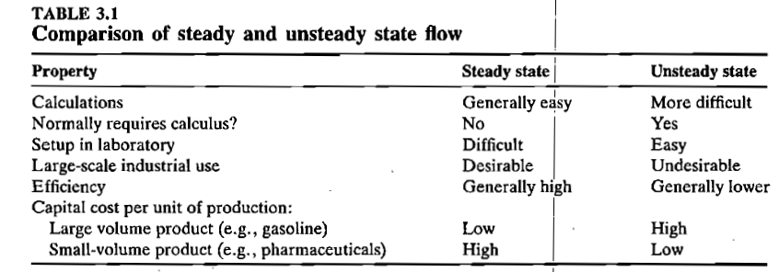
Steady and Unsteady State (Ref: de Nevers)

