Slide 1
Lecture-12
Continuity Equation and Energy Balance
11 Sept 2020

Slide 2
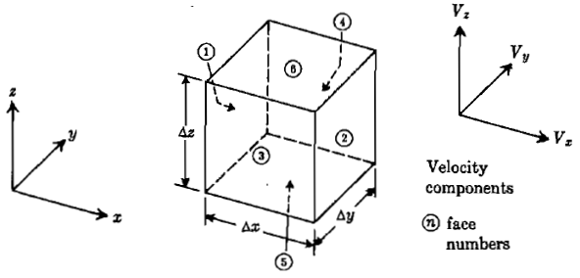
3-Dimensional Mass Balance Over Differential Fluid Element
Derivation of general form of continuity equation:

Slide 3
Derivation of general form of continuity equation:

Slide 4
Energy Balance
Forms of energy:
Internal energy (chemical bonds, molecules, atoms)
Electrostatic energy (Charged condenser)
Magnetic energy (magnet)
Surface energy (emulsions, microscopic droplets, powders)
Nuclear energy (Nuclear fission and fusion)
Potential energy (gravity, stressed spring)
Kinetic energy (motion)

Slide 5
Energy Transfer
Work:
Heat: Energy in transit due to temperature difference
Conduction (diffusional)
Covection (bulk flow)
Radiation (electromagnetic wave, nuclear radiation)

Slide 6
Energy Terms of Flowing Fluid
Internal energy per unit mass: U
Potential energy: ρgh
Kinetic energy:
Flow energy: PV
Total energy: U+PV+ ρgh+
where enthalpy H= U+PV
Total energy: H+ ρgh+

Slide 7
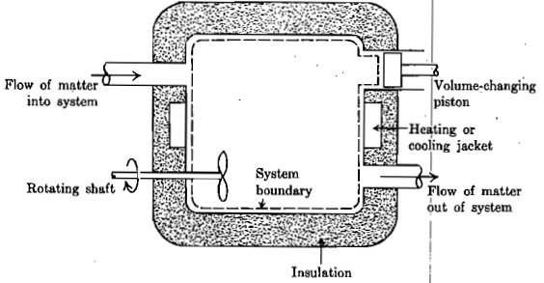
Unsteady State General Energy Balance (Ref: de Nevers)

