Slide 1
Petroleum Exploration, Production and Refining

Slide 2
Introduction
Petroleum provides a relatively cheap and convenient source of energy as compared to other fuels such as coal and electricity
India is the 22nd largest producer of petroleum in the world but 4th largest consumer in Asia- Pacific region and 15th largest consumer in the world
The occurrence of crude oil without gas is rare. On the contrary, large deposits of gas occur without oil

Slide 3
Oil is usually associated with gas in varying proportions known as gas/oil ratio depending upon its chemical nature and physical condition of its occurrence like trap, depth and temperature
The downstream products of crude oil on distillation and processing are varied and numerous. Some of the well known ones are fuel gas, petrol, LPG, naphtha, kerosene, diesel, fuel oil, lubricants, waxes and petroleum coke

Slide 4
Formation of Oil and Gas
There are two theories of the genesis of petroleum
The Organic theory
Non-Organic theory

Slide 5
Non-Organic Theory
The non-organic theory that was much prevalent earlier suggests that oil is formed by the action of water on metallic carbides or by atmospheric radioactivity or by cosmic radiation
The rare occurrence of oil is meteorites, igneous dykes and in petrozoic rocks weighs in favour of the non-organic theory

Slide 6
Organic Theory
The organic theory which is the most prevalent today, suggests that the petroleum was formed from remains of plants and animals that died millions of years ago and accumulated on ocean floors
In millions of years the sediments pile up to a great height and subsequently, pressure and temperature continueto reise in those rocks

Slide 7
Aerobic bacteria present in the ocean floor and sediments acts as scavengers and attack the organic matter
Some complex chemical process continues through various complicated stages and chemical reactions forming fats, amino acids, lipids and finally into oil and gas
Oil is produced within the temperature range of 100 to 200 degree C

Slide 8
Source rock when subjected to greater overburden pressure and temperature beyond 160 degree C for long period does not generate liquid oil but gas
Amongst different sedimentary rocks like sandstones, shales, clays and limestones, the clays are more suitable for formation of oil

Slide 9
Oil and Gas Exploration
Geological survey aims at selection and mapping of such areas which satisfy the criteria of being sedimentary rocks preferably of marine origin with the presence of anticline structures of Mesozoic , Cainozic and Paleozic periods
The analysis of surfaces samples of soil, water and oil or gas, in such cases, for detection of oil and gas is known as geochemical prospecting

Slide 10
Magnetic surveys are done by the magnetometer based on the principle that the magnetic attraction on the surface depends on the magnetic intensities of the rocks and their distance from the surface
The seismic method of oil and gas exploration involves generation of series of shock waves in the subsurfaces and picking up the reflected waves by sensitive geophones which are laid along a line on the surface

Slide 11
Drilling for Oil and Gas
The drilling equipment consist of a tall huge tower called derrick, engines, mud pumps, water tanks, draw-works and many other modules
For drilling the drill bit is rested on the earth and the engine starts, the drill which is pressed hard against the earth by the weight of the drill string above, cuts and penetrates the rock at the bottom

Slide 13
Much of the success of drilling depends on the quality of mud which is a specially prepared slurry of water, chemicals an adhesives like barytes, bentonites, xanthanite
The purpose of the mud are
Removing the cuttings to the surface
Cooling the bit
Lubricating the bit
Providing buoyancy to drill string to reduce the hook load
Retaining the side wall of the well from caving in
Allowing the gap for the instruments
Balancing the formation pressure that prevents the formation fluids from running into the well

Slide 14
Coring is done to get a factual sample of the drilled rock to know its composition
Coring may be of different types
Conventional core
Side wall core
Rubber-sleeve core
Diamond core
Wire-line core

Slide 15
Recovery of objects dropped in the hole is called Fishing
Then the well is taken over to test the presence of hydrocarbon and if found in enough quantity measures are taken for its subsequent exploitation
If the well produces oil it is called oil well, if it produces gas it is called gas well, if no oil or gas is produced the well is abandoned dry

Slide 16
LECTURE -2

Slide 17
Petroleum production and refining

Slide 18
Contents
Production of crude oil and natural gas
Methods employed to recover the remaining oil
Petroleum refining and operation
Fraction of crude oil
Vacuum distillation process
Selection of Processes for Optimization
Optimization in a Running Refinery
Map of refineries

Slide 19
Production of crude oil and natural gas
Crude petroleum is found in the void spaces of porous rock along with gas & water
The enhanced oil recovery(EOR) in two stages
Secondary recovery
Tertiary recovery
Water is injected into a series of wells in order to displace the oil to adjoining producing wells
Two major problems on using a water
It does not flush all of the oil from the pore spaces as it moves through the reservoir rock, 30 to 70% of still left in form of droplets

Slide 20
Production of crude oil and natural gas
The advancing water front by passes significant portions of the reservoir due to difficult well placements and unexpected geological configuration

Slide 21
Methods employed to recover the remaining oil
Miscible/immiscible displacement process
Miscible hydrogen displacement(LPG enriched gas & lean gas)
Carbon dioxide injection
Inert gas injection(Nitrogen, Air, etc)
Thermal recovery processes
Steam stimulation
Steam flooding(including hot water)
In-situ combustion

Slide 22
Chemical flooding processes
Surfactant/polymer injection
Polymer injection
Alkaline flooding

Slide 23
Petroleum refining and operation
By adopting various refining processes in the refineries
Crude oil are separated into a number of fractions which are suitable for various use

Slide 24
Fraction of crude oil
Methane, Ethane and Propane mixture
Liquefied Petroleum Gas (LPG)
Naphtha's/Gasoline fractions
Kerosene/Aviation Turbine Fuel (ATF)
High Speed Diesel Oil (HSD) and Light Speed Diesel Oil (LSD)
Reduced crude oil (RCO)

Slide 25
Vacuum distillation process
Reduced Crude Oil
Vacuum distillation
Light vacuum gas oil
Heavy vacuum gas oil
Vacuum residue

Slide 26
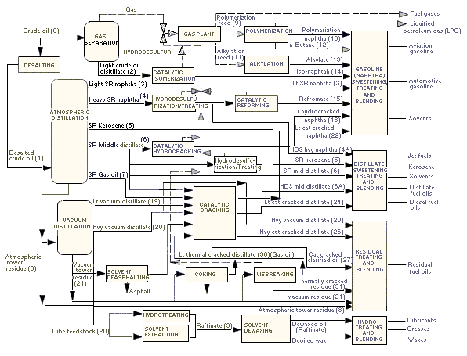

Slide 27
Selection of Processes for Optimization
Optimization is the process of determining the best possible way of selecting the processes scheme and fixing the unit capacities
Following factors would influence the decision making in the selection of processes for a refinery
Type of crude
Product slate
Product specification
Investment and operating costs
Merits/demerits of alternative processes

Slide 28
Optimization in a Running Refinery
Optimization of the operation of a running refinery is subjected to the influence of various factors
Crude mixture
Type of processing units
Demand pattern
Movement constraints
Product specifications
External streams
industrial relations

Slide 29
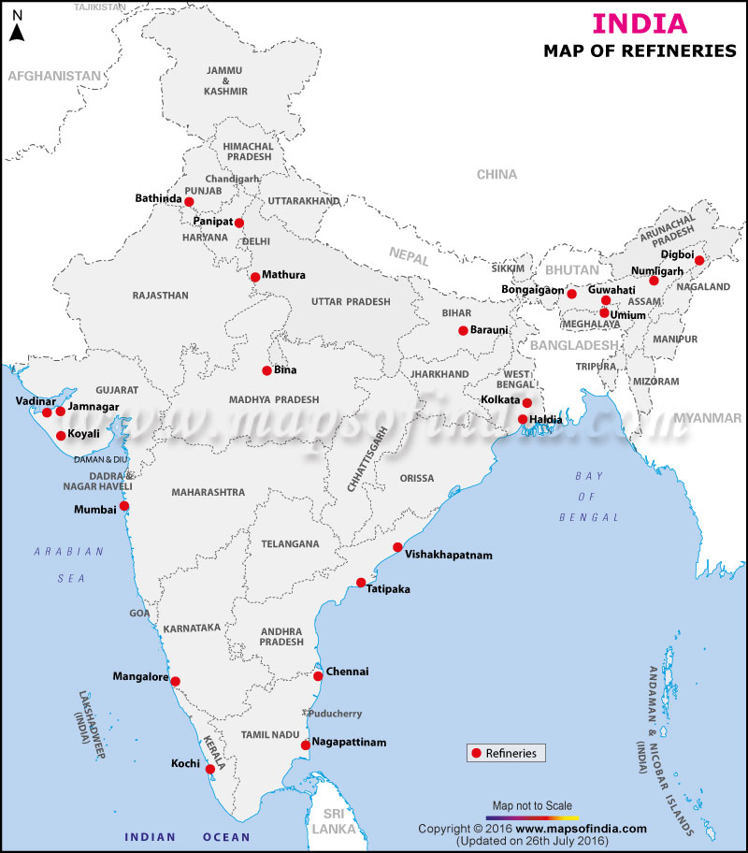

Slide 30
Thank
you

