Slide 1
Stresses and Properties Fluid
Lecture-3 (21 Aug 2020)

Slide 2
Solid and Fluids
Solids: resist the applied shear stress and come to new equilibrium state after a deformation
Fluids: can not resist shear stress permanently and start flowing after a certain amount of applied shear (undergo continuous deformation)

Slide 3
Force and Stress
Tensile (perpendicular/normal pull outward)
Compressive (perpendicular/normal press inward)
Shear (tangential/parallel to surface)
Pressure is a compressive stress
In a static or moving fluid pressure at a point is same in all directions whereas in solids it may vary in different directions

Slide 4
Properties of Fluids
Density: Density is mass per unit volume
Density is function of temperature (T) and pressure (P)
Solids and liquids have very small density changes with T and P whereas gases change density significantly
(function?)
Gas density
(R= gas constant for particular gas= R_{u} /M_{w})
Solid densities-particle and bulk densities (used for porous and particulate material)
Specific gravity: density compared with water at 4°C

Slide 5
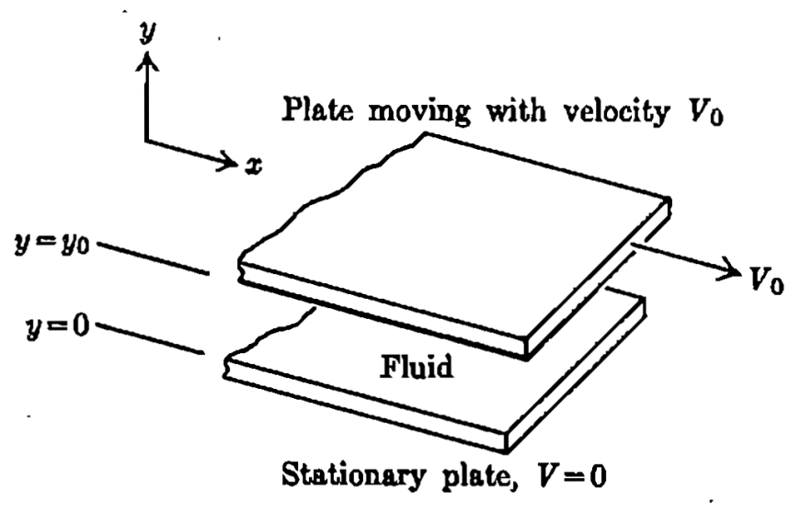
Properties of Fluids
Viscosity: resistance to flow
Newton’s law of viscosity
dv/dy is velocity gradient, shear rate, rate of strain or rate of shear deformation
Units: Ns/m², Pa.s, Poise, cP,
Viscosity is strong function of temperature
Kinematic viscosity
Units: Stokes, cSt, m²/s
Surface tension:
Force on unit length of fluid film (capillary effects)

