Slide 1
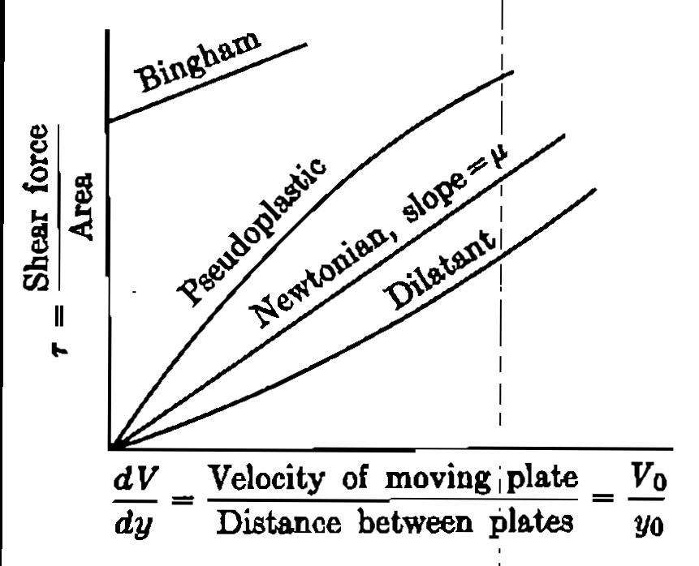
Types of Fluids
Newtonian: constant linear viscosity
Dilatant: shear rate thickening (corn starch and sand suspension in water)
Pseudoplastic: shear rate thinning (paint, polymer solutions, blood, syrup, molasses, pulp)
Bingham plastic: sudden flowing (dough, tooth paste, jellies)

Slide 2
Types of Fluids
Time dependent fluids
Thixotropic: viscosity decreases with time
Rheopectic: viscosity increases with time
Examples?

Slide 3
Conversion of Units
SI
FPS
CGS (British)
MKS

