Slide 1
Lecture-4 Basic Equation of Fluid Statics

Slide 2
Variation of Pressure in a Fluid
Pressure at a point in stationary or steadily moving fluid is same in all directions
A stationary fluid (or fluid in equilibrium) is free from all stresses
Pressure at a point inside a fluid depends only on height of fluid-column above it

Slide 3
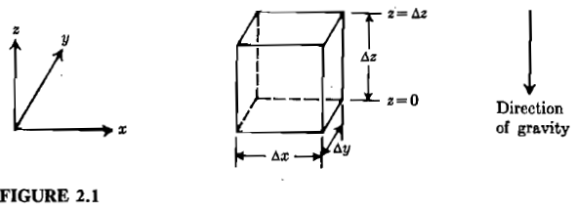
Derivation of Law of Hydrostatics

Slide 4
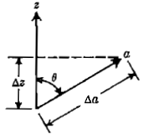
Pressure at a Point in a Fluid
If Θ=0°
Pressure at all points on a surface perpendicular to the gravity is same and this constitutes constant pressure surface (e.g. sea surface).

Slide 5
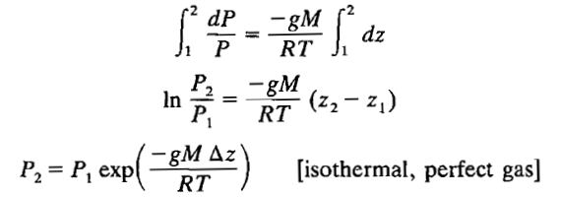
Pressure in a Liquid
Pressure in a Gas

