Slide 1
Lecture-5
CHE- S202 (FLUID MECHANICS)
Pressure Distributions in Liquids and Gases

Slide 2
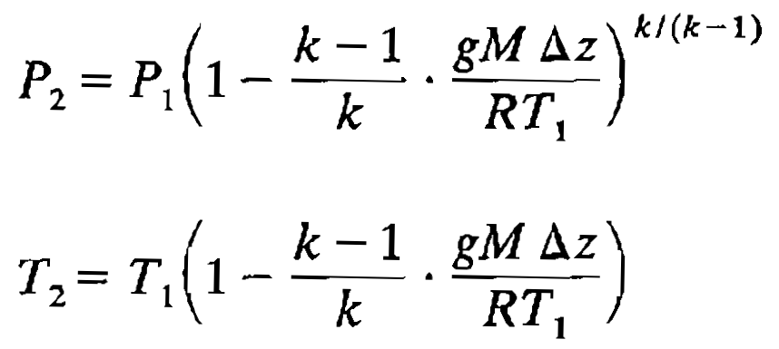
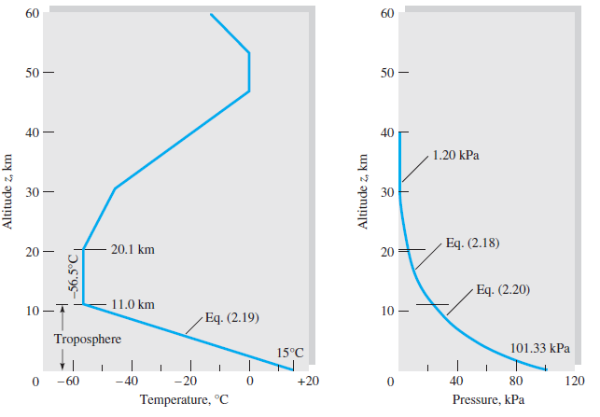
Atmospheric Pressure and Temperature
Adiabatic lapse rate
Standard atmosphere

Slide 3
Hydrostatic Force on Submerged Surface
Pressure acts normal to the surface
Static fluid exerts only pressure on the surface but moving fluid can exert pressure and shear both
For any surface
For horizontal flat surface P is constant
For vertical flat surface P varies linearly with depth

Slide 4
Pressure on Vertical Submerged Flat Surface

Slide 5
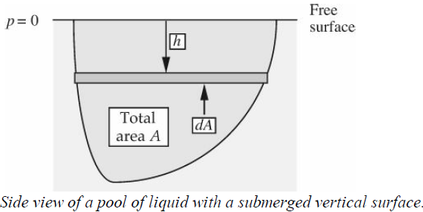
Force on Vertical Submerged Surface of Arbitrary Shape Use of Centre of Gravity (Centroid)
{h_{c} is height above centre of gravity or centroid and P_{c} is pressure at centre of pressure}
For rectangular shape with width W and height D

