Slide 1
Lecture-6
Hydrostatic Paradox, Pascal’s Laws, Pressure Distribution on Submerged Curved Surfaces and Archimedes Principle

Slide 2
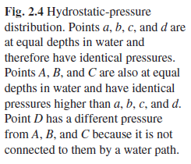
Hydrostatic Paradox and Pascal’s Law
Fig: Single container with continuous mass of fluid i.e. a, b, c, d, A, B and C are connected via same type of fluid
Principle of hydrostatics: Any two points at the same elevation in a continuous mass of the same static fluid will be at the same pressure irrespective of shape and size of container above the point

Slide 3
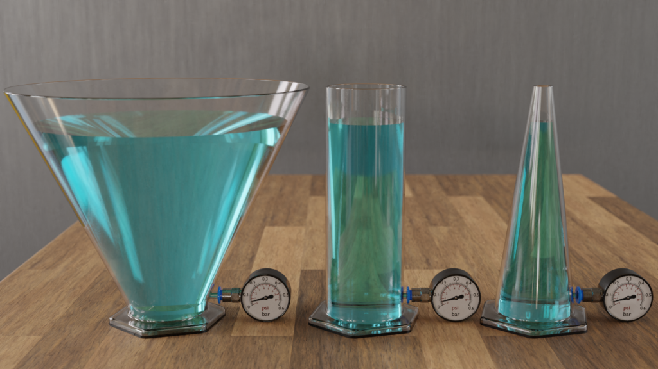
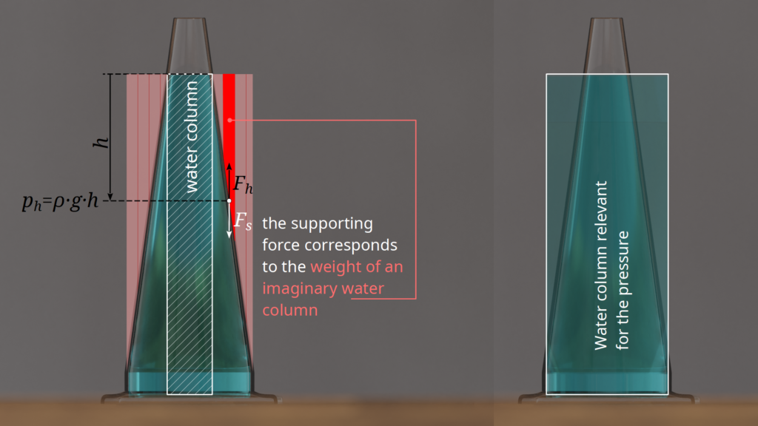
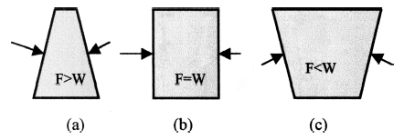
Explanation
Fig: Multiple containers having separate masses of fluid. Also (a), (b) and (c) are not connected

Slide 4
Pascal’s Law and Principle of Hydraulic Lift
Pressure change at a point in a confined fluid gets transmitted undiminished throughout the fluid

Slide 5
Force on Submerged Surfaces
Pressure at any point is proportional to depth of the point from free surface
Pressure always acts normal to surface therefore on vertical flat surface it acts in horizontal direction and on horizontal flat surface it acts in vertical direction.
On curved surfaces it is normal to all differential areas on the surface

Slide 6
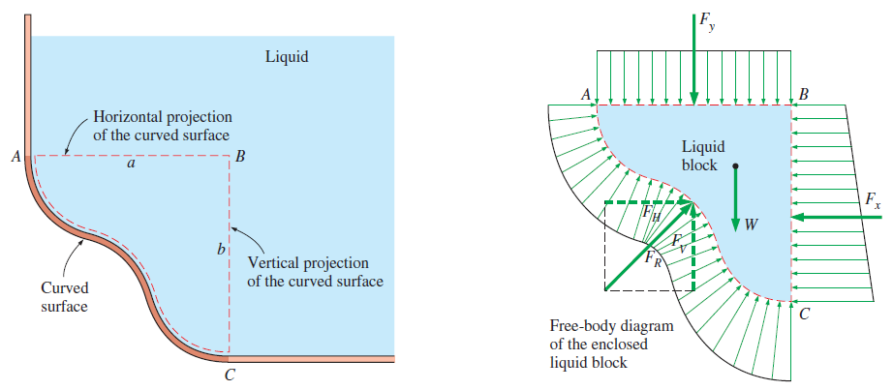
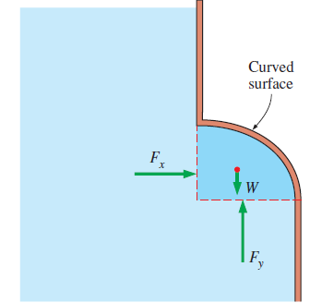
Force on Submerged Curved Surfaces
A force balance is applied for horizontal and vertical components of force on free body diagram of the liquid block formed by enclosing liquid between curved surface and two planes- horizontal and vertical passing through ends of the curve

Slide 7
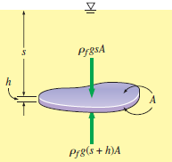
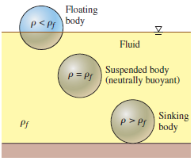
Buoyancy and Archimedes Principle

