Slide 1
Lecture-7_ 31 Aug 2020
Pressure Measurement Devices

Slide 2
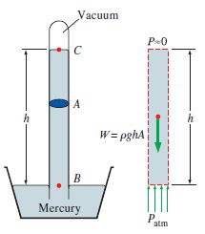
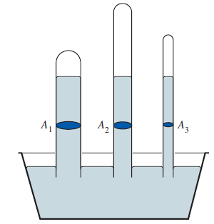
Barometer
Torricelli's tube -inverted glass tube with one end open
Height of column is independence of size and shape of tube
Standard atmospheric pressure = 760 mmHg = 760 torr =29.9 in Hg = 1.01325 bar =101.325 kPa = 14.69 psia = 1.033 kgf/cm²

Slide 3
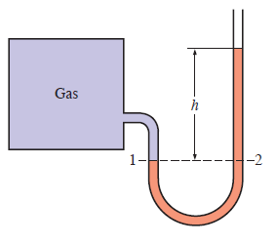
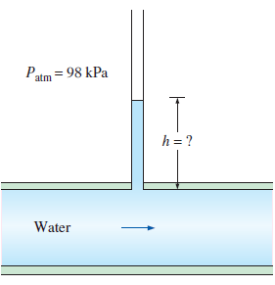
Manometers and Pressure Guages
U-Tube Liquid Filled Manometer
Straight tube piezometer

Slide 4
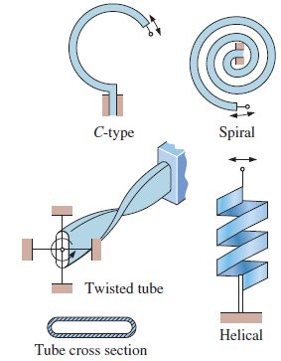
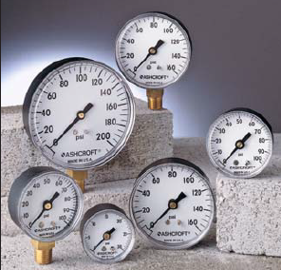
Mechanical Pressure Gages
Bourdon Tubes for Dial Type Pressure Gages

Slide 5
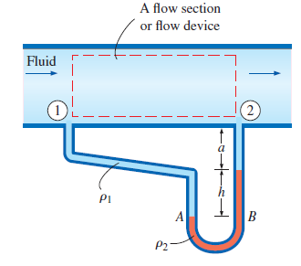
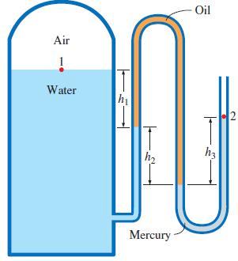
Manometry

Slide 6
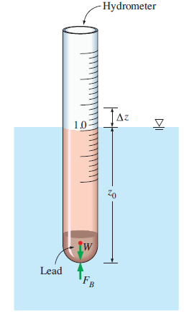
Density Measurement
Hydrometer (eg. Lactometer for milk density)
For water
Mark for water
For given liquid

