Slide 1
Lecture-8 and Tutorial -3 Lecture
Rigid Body Motion of Fluids

Slide 2
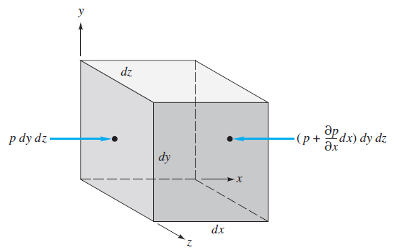
Equation of Motion (Ref: Frank M White)
Fig: The point with pressure p is located at centre of left hand side face
(for Fluid as in rigid body motion, f_{visc} absent)
(for Fluid at rest, acceleration a=0 and f_{visc} is also absent)
here g= -gj

Slide 3
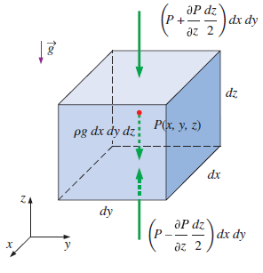
Equation of Motion: Rigid Body Motion of Fluids (Ref : Cengel)
Fig: Note the difference in orientation of axes and location of centre point with pressure p from previous geometry

Slide 4
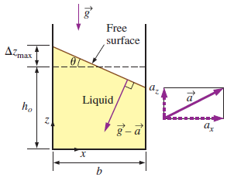
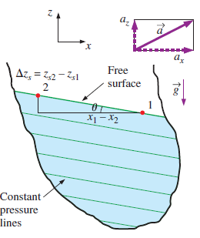
Acceleration in Straight Path
At free surface P₁=P₂
Slope tan θ=

Slide 5
Rigid Body Rotation of Fluids
Tutorail-3_ 03 September 2020

Slide 6
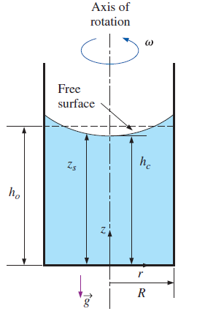
Fluid in Rotating Cylinder
We had differential expression of pressure in rectangular coordinate for linear motion as:
For rotational motion we write the similar expression in cylindrical coordinates as:
At free surface P₁= P₂, and if point 1 is taken at bottom of vessel at vertical axis of rotation (z₁=0, r₁ =0)
h_{c} is height of free surface at vertical axis of rotation of vessel

Slide 7
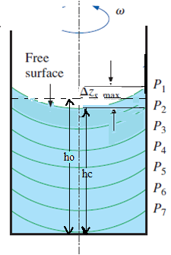
Fluid in Rotating Cylinder
Taking point 1 to be at the axis of rotation (r = 0) a height C_{1v}from bottom of the tank and at vertical axis of rotation of vessel height, and setting pressures equal (P₁=P₂), we obtain eq. of isobaric lines at height from equation
Maximum height difference is
Volume of paraboloid
Volume of fluid
Equating volume gives
Depression of free surface = h₀ - h_{c} =

