Slide 1
Lecture-9
Centrifuge and Pressure Vessel

Slide 2
Centrifuge
Rotational velocity is very high so that the paraboloid takes a shape of concentric layer of liquid
Used to separate immiscible liquids (centrifugal decanter), solids form liquid, solids from gas (cyclone separators) by generating centrifugal force more than hundred times of gravitational force.
Governing equation:
(Integral form)
Gravitational force is insignificant, therefore
Initial liquid level
ω
10ω
1000ω

Slide 3
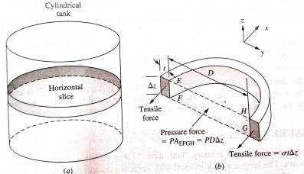
Pressure Vessel (Cylindrical)
Vertical plane cut
Fig: Cylindrical thin walled vessel
Fig: Differential horizontal slice

Slide 4
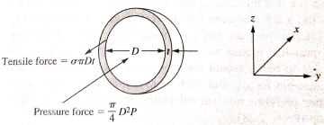
Pressure Vessel (Spherical)

