Slide 1
LEVER
BY:
DR. DIGVIJAY SHARMA
DIRECTOR
SCHOOL OF HEALTH SCIENCES, CSJMU

Slide 2
DEFINITION
A lever is a rigid bar which is capable of movement about a fixed point called a Fulcrum
Work is done when a force or effort (E) applied at one point on the lever, acts upon another force or weight (W). The perpendicular distance from the fulcrum to the effort Is called effort arm and from fulcrum to weight as weight’s arm.
There are three orders or classes of lever which is characterised by the relative positions of fulcrum, effort and weight.

Slide 3
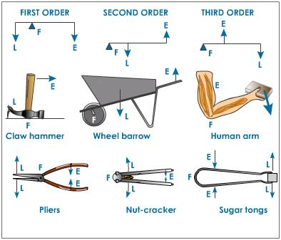

Slide 4
LEVER AND HUMAN BODY
In the body, lever is represented by a bone which is capable of movement about a fulcrum formed of an articulating surfaces at joints, the effort by the muscle’s contraction applied at the point of insertion to the bone
While the weight may be either at the COG of the part moved or the object to be lifted

Slide 5
FIRST ORDER LEVER
In this type of levers, the fulcrum is in between the effort and weight.
The length of the effort’s arm and weight’s arm may be equal or one may exceed the other in length.
There may be three cases for such levers:
Weight Arm = Effort Arm
Weight Arm > Effort arm
Weight Arm < Effort arm

Slide 6
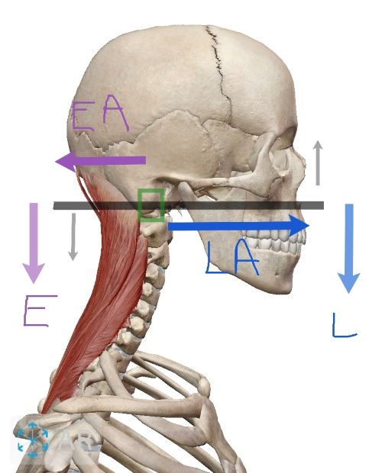
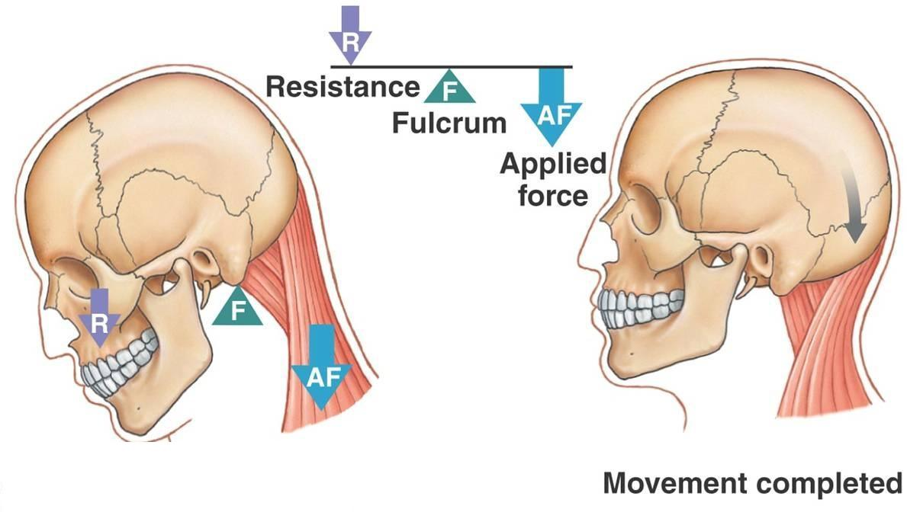
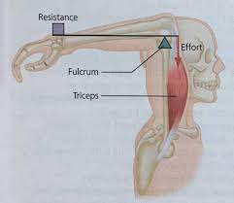
FIRST ORDER LEVER IN HUMAN BODY

Slide 7
SECOND ORDER LEVER
In this type of lever, the weight is in between the fulcrum and the effort.
Effort’s arm must therefore always exceed the weight’s arm
Effort arm > Weight arm

Slide 8
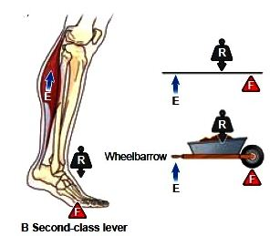
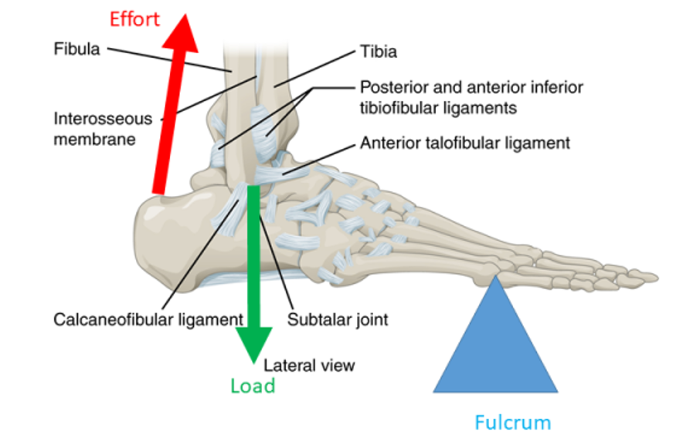
SECOND ORDER LEVER IN HUMAN BODY

Slide 9
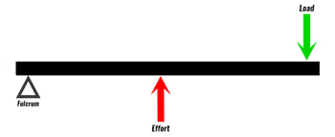
THIRD ORDER LEVER
In this type of lever, the effort is in between the fulcrum and the weight
Weight’s arm must therefore exceed the effort’s arm
Weight’s arm > Effort’s arm

Slide 10
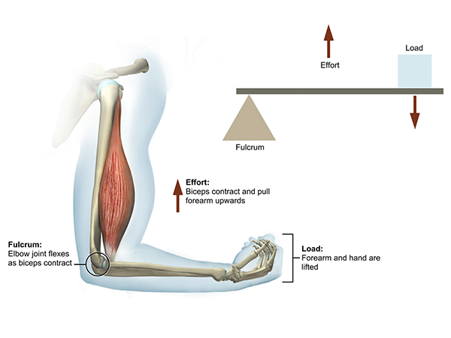
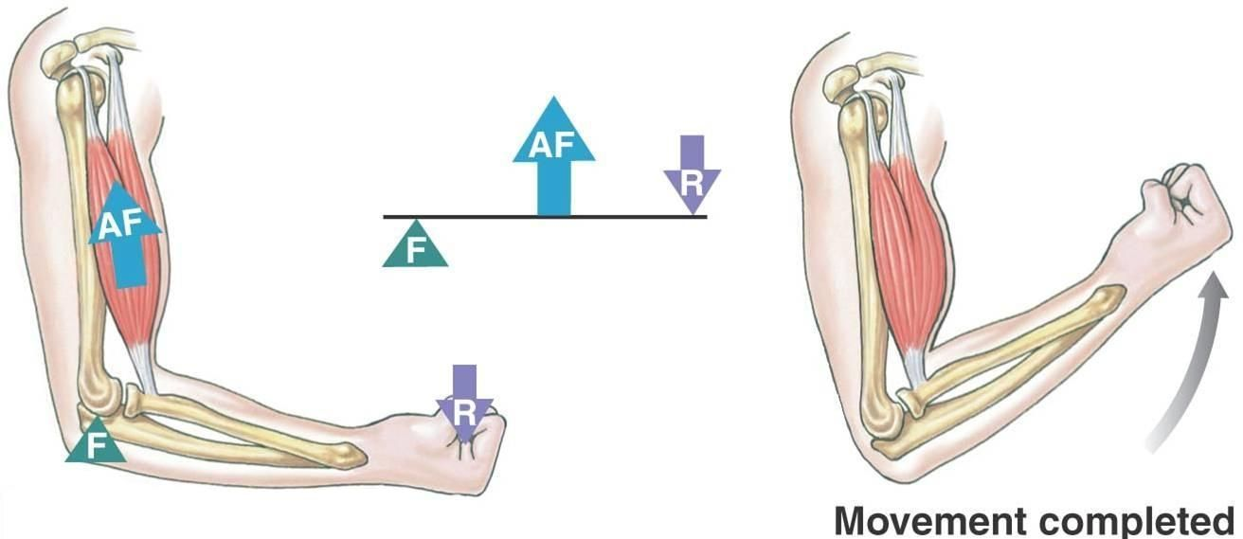
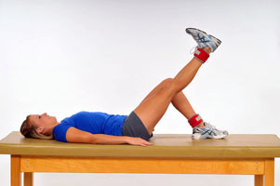
THIRD ORDER LEVER IN HUMAN BODY

Slide 11
MECHANICAL ADVANTAGE
It is the ratio of weight to the effort.
MA= Weight/ Effort
or
MA= Effort Arm/ Weight Arm
The efficacy of the levers depends upon two factors:
i. force exerted, i.e., Weight or Effort
ii. Weight’s arm or effort’s arm
The product of two factors called moment of force or Torque

Slide 12
CASE 1 MECHANICAL ADVANTAGE
When Effort’s arm = Weight’s arm
An effort of a magnitude equal to weight will require to lift.
So no advantage is gained but the machine is useful for measuring weight
For example when there is a weight of 10 kg with weight arm of 20 cm and effort of 10 kg with effort arm of 20 cm it describes a state of equilibrium
An example of this is the Common balance

Slide 13
CASE 2 MECHANICAL ADVANTAGE
When Effort’s arm > Weight’s arm
Then less effort is required to lift the object and advantage will be gained
This is known as Mechanical advantage and it is obtained in levers of 1st order when fulcrum is nearer to weight and all levers of second order
It is never seen in levers of third order
For example, when there is a weight of 10 kg with weight’s arm of 20 cm and effort of 5 kg with effort arm of 40 cm length then Mechanical advantage calculated will be approx. 2

Slide 14
CASE 3 MECHANICAL ADVANTAGE
When Effort’s arm < Weight’s arm
In this case where there is shorter effort arm then mechanical disadvantages occur
As in 1st order lever when F is nearer to effort and all lever of third order

