Slide 1
LUMBRALISATION AND SACRALISATON

Slide 2
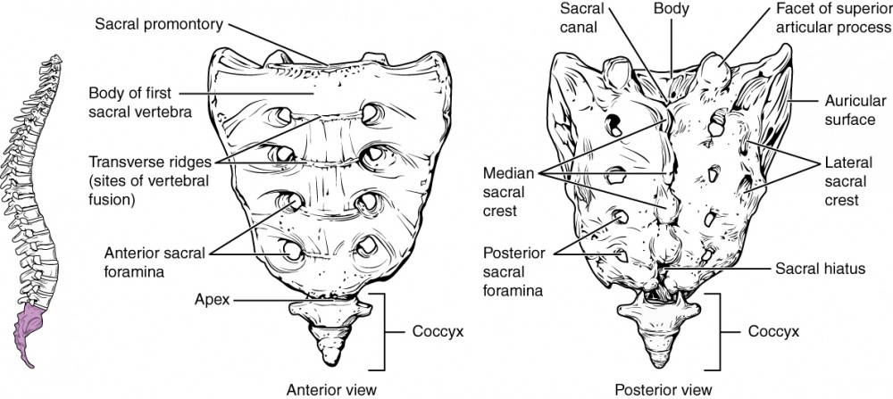
The human spine is composed of vertebra namely- Cervical spine, Thoracic, Lumbar, Sacral and the Coccyx at the lower end. There are 5 lumbar vertebrae and 5 fused sacral vertebrae, which are based in the region of middle and lower back and facilitate movements of that part.

Slide 3
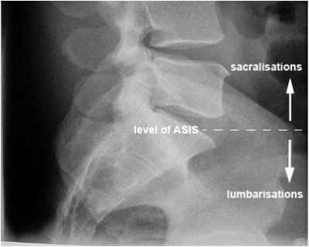

Slide 4
Lumbarisation
Lumbarisation is where the upper most segment of the sacrum is not fused. The first sacral segment is said to be lumbarised.
Lumbarisation of S1 or lumbarisation of the first sacral vertebra is a condition in which the first sacral vertebra is not completely attached to its fused sacral components but instead this first sacral vertebra appears like the other lumbar vertebrae.
It is also called as an extra vertebra, additional lumbar vertebra or transitional vertebra. It occurs due to non fusion of first and second sacral segment.

Slide 5
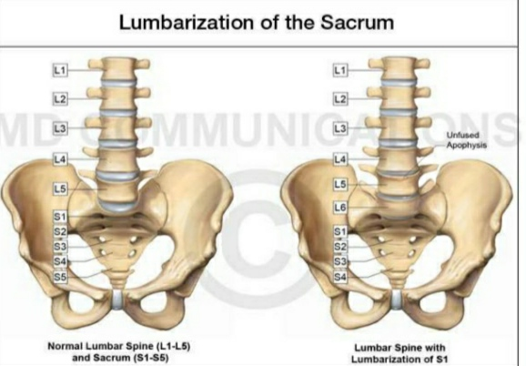

Slide 6
This lumbarisation S1 vertebra may also have a disc like the other lumbar segment or may have a disc space that remain undeveloped.
SIGNS & SYMPTOMS-
This lumbarisationS1 vertebra is not completely a fused nor does it become a normal lumbar segment.
This makes it difficult to accommodate the additional vertebral joint while performing daily tasks and may makes this vertebra more vulnerable to injury and joint irritation.
With advancing age and activities, the lumbarised first sacral vertebra can find it difficult

Slide 7
To cope and may on area that triggers pain, discomfort or may remain prone to injury.
In some cases complaints like-
Back pain
Inflammation
Swelling
Stiffness of back
Muscle spasms
Increased risk of injury
Inter-vertebral disc problems with radiculopathy.

Slide 8
Sacralisation
Sacralisation of L5 or sacralisation of fifth lumbar vertebra is a congenital anomaly, in which the lumbar vertebra, mainly its transverse process, gets fused or semi-fused with the sacrum or the ilium or to both.
This fusion can occur in one or both sides of the body.
Sacralisation leads to fusion of the L5 and S1 and the intervertebral disc between them may be.

Slide 9
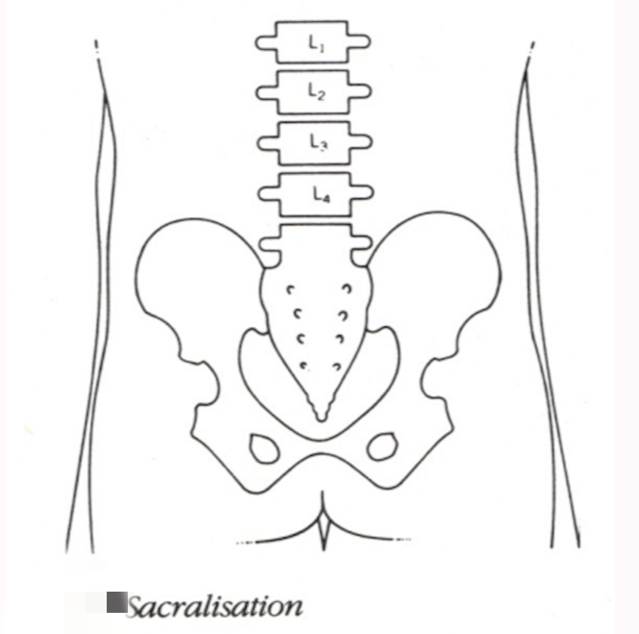

Slide 10
SIGNS & SYNPTOMS-
Some may be a symptomatic. Patients with sacralisation are prone towards back problems than those of lumbarisation.
DIAGNOSIS-
Mainly X-ray
CT Scan
MRI

Slide 11
TREATMENT-
Medication
Surgical
Rehabilitation
Medication-
NSAIDs
Steroid injection for severe pain & discomfort
Surgery-
Surgical excision surgeries are opted where the symptoms are severe.

Slide 12
Rehabilitation-
Electrical modalities
Specific treatment
Symptomatic treatment-
Spinal traction
IFT
TENS
Ultrasound therapy
SWD
LASER
Spinal corset , rest

Slide 13
Specific treatment-
Exercise regimen
Muscle strengthening
Muscle stretching
Core strengthening exercise
Manual therapy

Slide 14
THANK YOU

