Slide 1
Lagrangian method

Slide 2
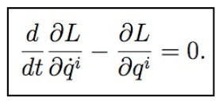
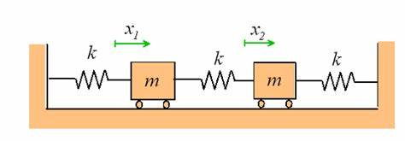
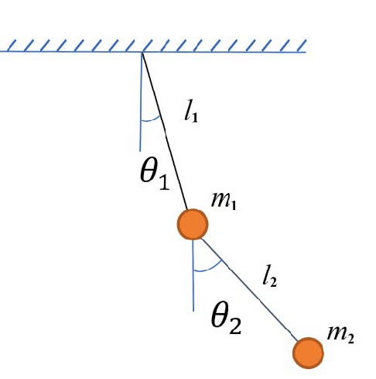
Lagrangian equation
q₁ = displacement of first mass
q₁ = x₁
q₂ = displacement of second mass
q = x₂
L = Lagrange
= T – V
T = Kinetic energy of the system.
V = Potential energy of the system.
q^{i} = Generalized coordinate.
q^{i} = Derivative with respect to time.
q₁ = angular displacement of first rod
q₁ = Ɵ₁
q₂ = angular displacement of second rod
q = Ɵ₂

Slide 3
Lagrangian equation
Using lagrangian method derive differential equation of motion for two degree of freedom spring mass system.
Find the total kinetic energy of the system ( T) .
Find the total potential energy of the system (V).
Find the Lagrange (L) = T – V
Evaluate Lagragian equation of motion.

Slide 4
Find the kinetic energy of the system ( T)

Slide 5
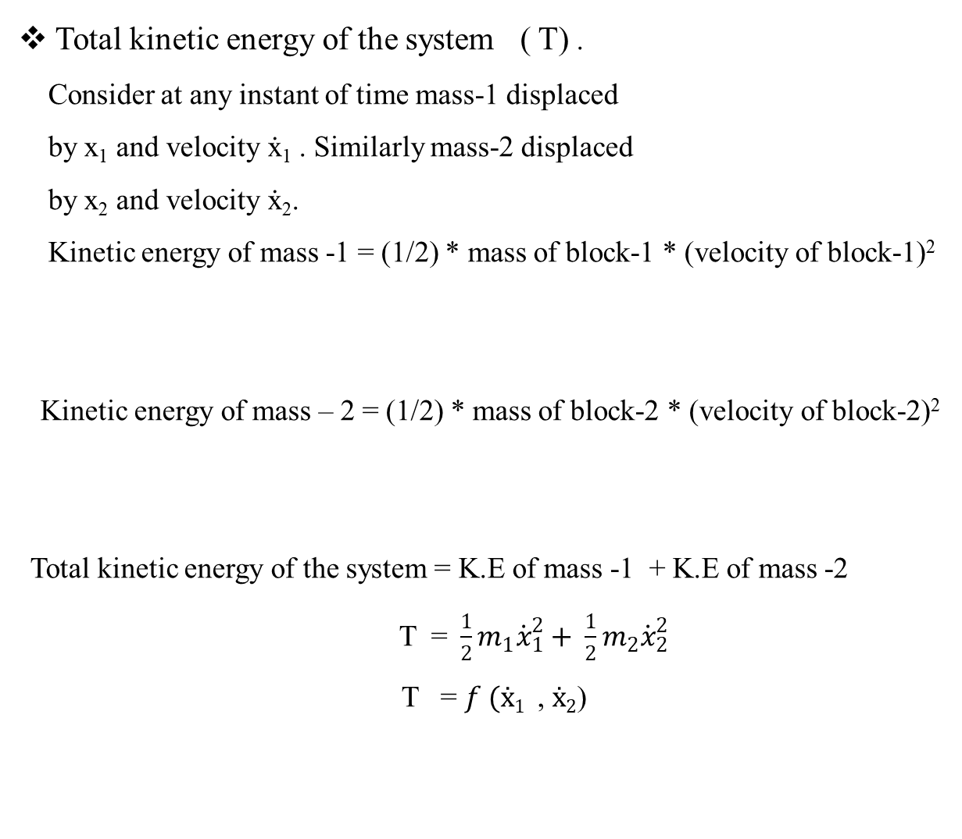
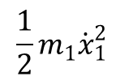
Kinetic energy of the system (T)
Total kinetic energy of the system ( T) .
Consider at any instant of time mass-1 displaced
by x₁ and velocity ẋ₁ . Similarly mass-2 displaced
by x₂ and velocity ẋ₂.
Kinetic energy of mass -1 = (1/2) * mass of block-1 * (velocity of block-1)²
Kinetic energy of mass – 2 = (1/2) * mass of block-2 * (velocity of block-2)²
Total kinetic energy of the system = K.E of mass -1 + K.E of mass -2
T = $\frac{1}{2}m_{1}{\dot{x}}_{1}^{2}+ \frac{1}{2}m_{2}{\dot{x}}_{2}^{2}$
T = $f (ẋ1$ , $ẋ2$)
=
$$\frac{1}{2}m_{1}{\dot{x}}_{1}^{2}$$
=
$$\frac{1}{2}m_{2}{\dot{x}}_{2}^{2}$$

Slide 6
Find the potential energy of the system ( V)

Slide 7
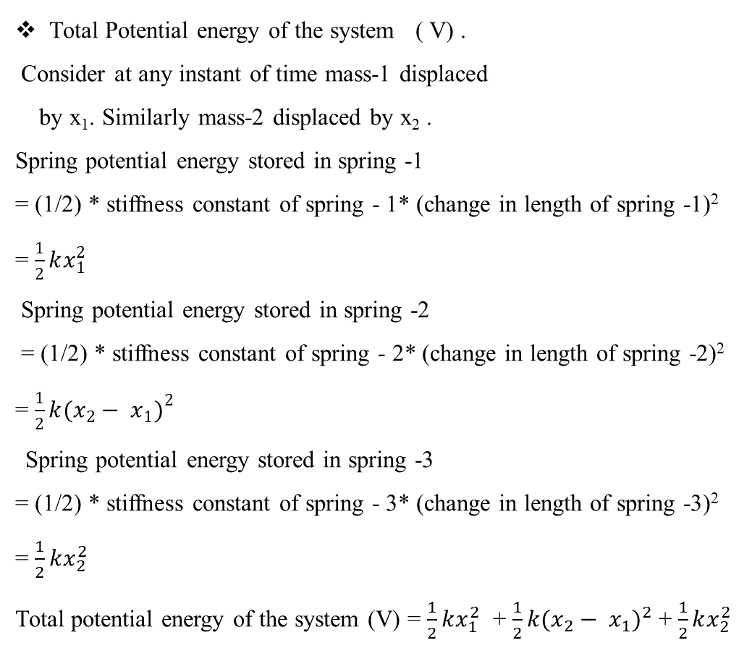
Potential energy of the system (V)
Total Potential energy of the system ( V) .
Consider at any instant of time mass-1 displaced
by x₁. Similarly mass-2 displaced by x₂ .
Spring potential energy stored in spring -1
= (1/2) * stiffness constant of spring - 1* (change in length of spring -1)²
= $\frac{1}{2}kx_{1}^{2}$
Spring potential energy stored in spring -2
= (1/2) * stiffness constant of spring - 2* (change in length of spring -2)²
= $\frac{1}{2}k{(x_{2}− x_{1})}^{2}$
Spring potential energy stored in spring -3
= (1/2) * stiffness constant of spring - 3* (change in length of spring -3)²
= $\frac{1}{2}kx_{2}^{2}$
Total potential energy of the system (V) = $\frac{1}{2}kx_{1}^{2}$ + $\frac{1}{2}k{(x_{2}− x_{1})}^{2}$ + $\frac{1}{2}kx_{2}^{2}$
(V) = $f (x1$ , $x2$)

Slide 8
Find the LaGrange (L = T - V)

Slide 9
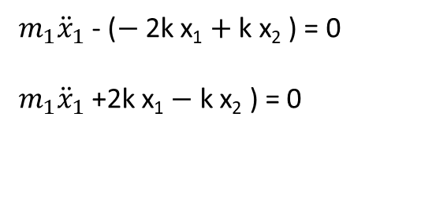
Lagrange
Lagrange (L) = T $−$ V
L = $\frac{1}{2}m_{1}{\dot{x}}_{1}^{2}+ \frac{1}{2}m_{2}{\dot{x}}_{2}^{2}$ $−$ $\frac{1}{2}kx_{1}^{2}$ $−$ $\frac{1}{2}k{(x_{2}− x_{1})}^{2}$ $−$ $\frac{1}{2}kx_{2}^{2}$
$$\frac{d}{dt}\left(\frac{∂L}{∂{\dot{x}}_{1}}\right)− \frac{∂L}{∂x_{1}}=0$$
$$\frac{d}{dt}\left(\frac{∂L}{∂{\dot{x}}_{2}}\right)− \frac{∂L}{∂x_{2}}=0$$
$\frac{∂L}{∂x_{1}}$ = 0 + 0 – k x₁ - k ($x_{2}− x_{1})$ (-1) + 0
= $−$ k x₁ $+$ k x₂ $−$ k x₁
= $−$ 2k x₁ $+$ k x₂
$\frac{∂L}{∂x_{2}}$ = 0 + 0 – 0 - k ($x_{2}− x_{1})$(1) – k $x_{2}$
= k x₁ - 2 k x₂
$\frac{∂L}{∂{\dot{x}}_{1}}$ = $m_{1}{\dot{x}}_{1}$
$\frac{∂L}{∂{\dot{x}}_{2}}$ = $m_{2}{\dot{x}}_{2}$
$\frac{d}{dt}\left(\frac{∂L}{∂{\dot{x}}_{1}}\right)$ = $\frac{d(m_{1}{\dot{x}}_{1})}{dt}$ = $m_{1}{\ddot{x}}_{1}$
$\frac{d}{dt}\left(\frac{∂L}{∂{\dot{x}}_{1}}\right)$ = $\frac{d(m_{2}{\dot{x}}_{2})}{dt}$ = $m_{2}{\ddot{x}}_{2}$
$$\frac{d}{dt}\left(\frac{∂L}{∂{\dot{x}}_{1}}\right)− \frac{∂L}{∂x_{1}}=0$$
$$\frac{d}{dt}\left(\frac{∂L}{∂{\dot{x}}_{2}}\right)− \frac{∂L}{∂x_{2}}=0$$
$m_{1}{\ddot{x}}_{1}$ - ($−$ 2k x₁ $+$ k x₂ ) = 0
$m_{1}{\ddot{x}}_{1}$ +2k x₁ $−$ k x₂ ) = 0
$m_{2}{\ddot{x}}_{2}$ - (k x₁ - 2 k x₂ ) = 0
$m_{2}{\ddot{x}}_{2}$ - k x₁ + 2 k x₂ ) = 0

Slide 10
Assignment-3
Using lagragian method derive the equation of motion for double pendulum.

