Slide 1
Land, Food, and Mineral Resources
Group 10 presentation
Mother of all plants,
Firm Earth upheld by Eternal Law,
May she be ever beneficent and gracious to us
As we tread on her.
--- Atharva Veda

Slide 2
Land, Food, and Mineral Resources
What we hope to learn from it ?
Extent of degradation
Availability of food
Evaluate Green Revolution
Methods of Organic farming
Mining menace

Slide 3
Land Resources
In India per capita land availability has declined
from 0.89 ha in 1951 to 0.3 ha in 2001. The per
capita availability of agriculture land has declined
from 0.48 ha in 1951 to 0.14 ha in 2001
(Source: Care for Earth Foundation, 05-06)
More than 40% of the farmers in India were found to be reporting poor yields not due to sub-standard seeds, irrigation problems etc. but due to degrading land quality
(Source: Centre for science and Environment)
It is estimated that 5 million tonnes of topsoil is eroded every year and 20 % of such land is so damaged that it is categorized as wasteland
(Source: TERI Year Book 2004-05)

Slide 4
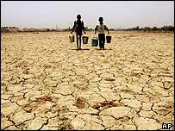
Land Resources
Status of our land
23% of usable land degraded
Causes
Deforestation
Agricultural mismanagement
Urbanization
Implications
Soil erosion
Pollution
Disturbed natural cycles

Slide 5
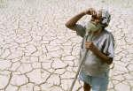
Land Resources
Other problems
Water logging
Soil salinity
Desertification
In Egypt – 90%farms affected by
waterlogging
In Pakistan – 66% irrigated land salinized
In India – 12-25%

Slide 6
Land Resources
Desertification – ‘Skin disease’
1/3 of world land affected
1/5 of world’s population threatened
Measures to check it
UN convention (1994) – 180 countries signed
Can be controlled through
Aero-seeding over shifting sand dunes
Introduction of salinity tolerant species
Early warning system

Slide 7
Land Resources
Urbanization
50% population in Urban areas
Big cities - large ecological footprints
2 mha land for waste disposal
Urban home gardens – Sao Paulo & Cuba

Slide 8
food Resources – Opening Quote
Food for thought
Only after the last tree has been cut down,
Only after the last river has been poisoned,
Only after the last fish has been caught,
Only then will you find that money cannot be eaten.
--- Native American Prophecy

Slide 9
FOOD Resources
FOOD AVAILABILITY
Food source (million tons) | Worldwide | India
Food Grains | 2000 | 210
Meat Production | 242 | 5
Fish Production | 90 | 6
FAO Report (2002)

Slide 10
FOOD Resources
Food Sources
76% of food – Food grains
17% - Grazing livestock
7% - Fisheries
Food availability for end user
2 kg per person a day
700 million – Not enough to eat
12 million – Children die of hunger

Slide 11
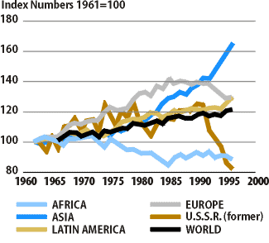
FOOD Resources
Trends in per capita food production
World Resource Institute (2000)

Slide 12
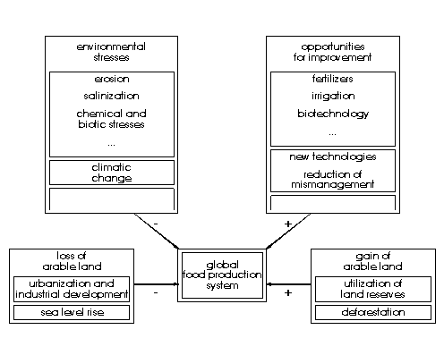
FOOD Resources
Factors affecting global food production system

Slide 13
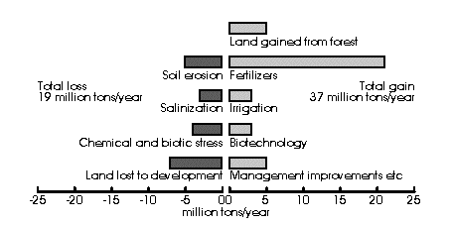
FOOD Resources
Annual loss & gain in Global food production
FAO (Projection for 2025)

Slide 14
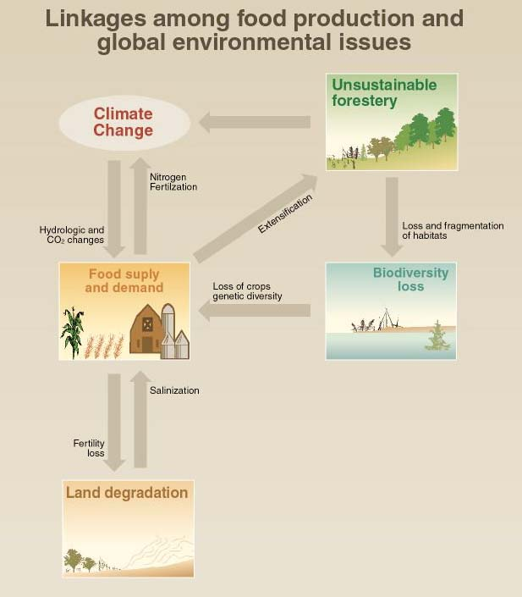
FOOD Resources
Food Production Crises

Slide 15
FOOD Resources - AGRICULTURE
Organic Farming
Non-chemical fertilizers & pesticides
agriculture
Based on crop rotation, animal and green
manure
Biological control of pests
Based on the principles of
Natural model of farming
Soil as a living system

Slide 16
FOOD Resources - AGRICULTURE
Organic Farming
Organic Farming techniques
Types | Pioneered By
Bio-dynamic | Rudolf Steiner
Bio-intensive | Cuban technique
Permaculture | Bill Mollison & David Holmgren
LEISA | Dutch farmers
No-tillage | Masanobu Fukuoka
Composting | Traditional
Vermiculture | Traditional

Slide 17
FOOD Resources - FISHERIES
Fishes come
55% from Ocean
33% from aquaculture
12% from fresh water fishing
Technologies employed
Factory trawlers
Satellite positioning
Acoustic fish finders
Spotter planes

Slide 18
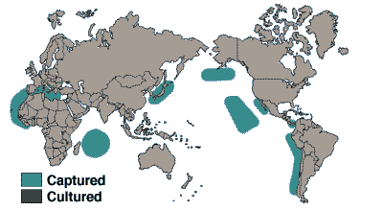
FOOD Resources - FISHERIES
Magnitude of crises in Fisheries
1972 – Peruvian Anchovy collapse
1980s & 1990s – Cod stock depleted
80% of marine fish stock exploited
Exceeded MSY for many species
Fishing down the food web

Slide 19
FOOD Resources - FISHERIES
Crises precipitated due to
Exceeding MSY
Bottom trawling – Clear cutting of forest
Luxury food & livestock feed
Heavy subsidies
Pollution of water bodies
Climate change
Destruction of mangroves & coral reefs
Adverse impact of UNCLOS

Slide 20
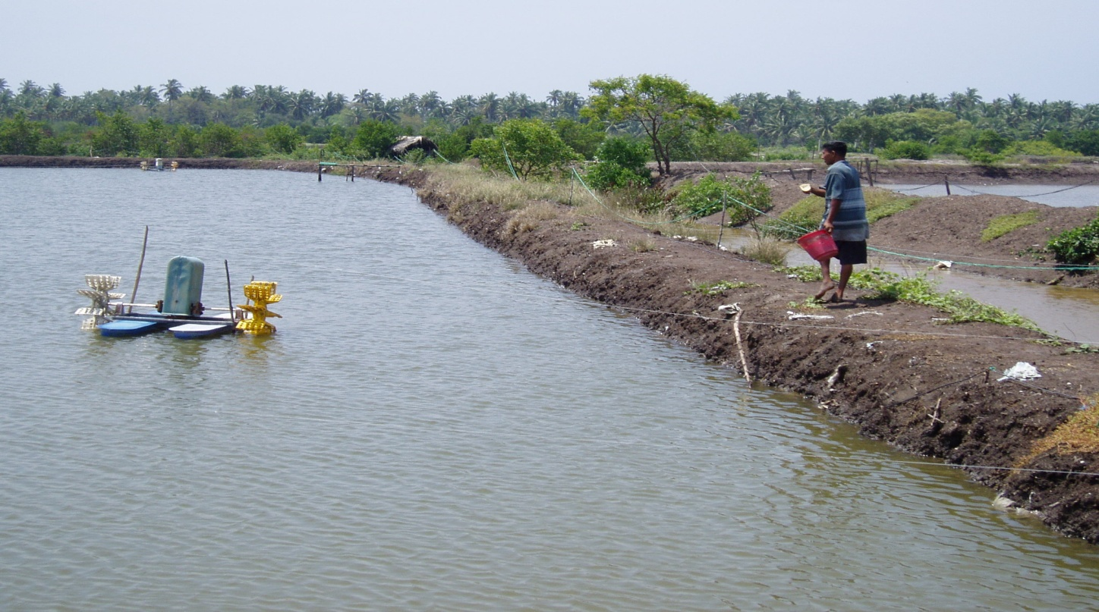
FOOD Resources - FISHERIES
Indian scenario
Current production - 6mt
Estimate MSY – 3.7mt
Inland aquaculture thriving
Coastal aquaculture halted

Slide 21
MINERAL Resources – Opening Quote
Food for thought
Anyone who believes
Exponential growth can go on forever
In a finite world is
Either a madman or an economist.
--- Kenneth Boulding

Slide 22
MINERAL Resources
Over 100 minerals are mined
Negative impacts of mining
Pollution of aquifers
Destruction of vegetation
Subsidence of land
Lowering of water table
Respiratory & other illness to workers

Slide 23
MINERAL Resources
Crisis: Mining Vs. Jal, Jangal, Jameen
Drying up of Rajasamand Lake in Rajasthan
Destruction of vegetation
Mining in Aravallis

Slide 24
What can we do
Land Resources
Afforestation
Controlled urbanization
Food Resources
Switch over to Organic farming
Saying no to mechanized trawlers
Mineral Resources
Durable products with long life
Limited mineral extraction

Slide 25
What does the muse say
BY WENDELL BERRY
Sowing the seed,
My hand is one with the Earth.
Wanting the seed to grow,
My mind is one with the light.
Hoeing the crop,
My hands are one with the rain.
Having cared for the plants,
My mind is one with the air.
Hungry and trusting,
My mind is one with the Earth.
Eating the fruit,
My body is one with the Earth.

Slide 26
GLOSSARY
Heap Leach mining – Practice, in which, rivers of cyanide are poured over huge piles of low-grade ore to extract the metal
Maximum Sustainable Yield (MSY) – The amount that can be harvested annually, leaving enough breeding stock for the population to renew itself
Per-culture – An approach to land use, which weaves together microclimate, annual and perennial plants, animals, soils, water management, and human needs into intricately connected, productive communities
LEISA – Low External Input Sustainable Agriculture

Slide 27
References
Environmental Studies
--- R. Rajagopalan
www.fao.org
--- Food & Agriculture
Organization (FAO)
www.cseindia.org
--- Center for Science & Environment (CSE)

Slide 28
PRESENTED BY
Achin Bansal (Roll No. 5)
Garima Suman (Roll No. 15)
Harendra P. S. Raghuwanshi (Roll No. 17)
Saurabh Agarwal (Roll No. 45)

