Slide 1
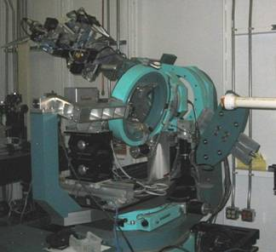
X-Ray Diffraction (XRD)
Theory and Analytical Technique

Slide 2
x-ray crystallography was discovered by Johns kaplae in 17th Century.

Slide 3
X-Ray Analysis
An electromagnetic wave of high energy and very short wavelength (between ultraviolet light and gamma ray). which is able to pass through many materials opaque to light.
study of any crystalline structure of bio molecules using x-ray
Powder diffraction analyses are a simple and inexpensive method for identifying minerals, especially fine-grained minerals

Slide 4
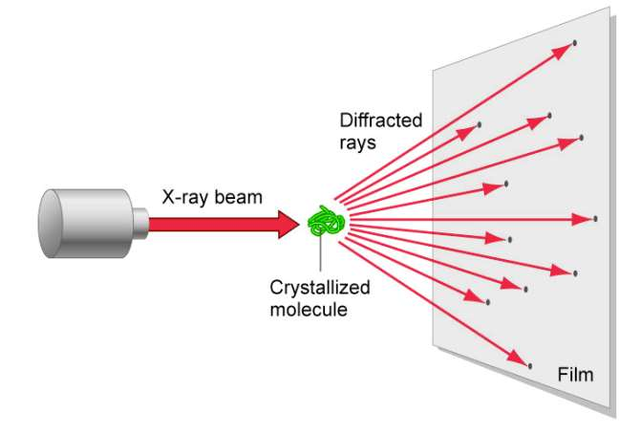
It is widely use in biological science for studying structure of biological molecule such as protein, antibiotics, fats, DNA, RNA.
PROPERTIES
1.X-ray travel in straight lines.
2.x-ray are electrically neutral.
3.x-ray are polynergetic and heterogonous.
4.x-ray are invisible ray.

Slide 5
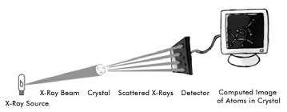
Principle
Based on principle of diffraction
1. The crystal is made to strike against x-ray beam.
2. Due to striking the atoms present in crystal diffracts the x-ray
beam into different direction.
3. The angle and intensity of this, diffraction rays is analog to
spatial arrangement of atom in crystal.
4. By studying these angle, the 3D structure of any crystal can be
determine.
5.X-rays are generated by bombarding electrons on an metallic anode.

Slide 6
INSTRUMENTATION
The instrument used in x-ray crystallography is know as x-ray diffractometer and has following part:
1. X-ray source
2. Monochromater
3. Collimator
4. Goniometer
5. Photographic plate film
6. Detector

Slide 7
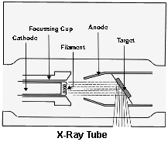
X-ray source
Common source of x-ray is an x-ray tube .
The tube is evacuated and contains a copper block with a metal target anode, and a tungsten filament cathode with a high voltage between them.

Slide 8
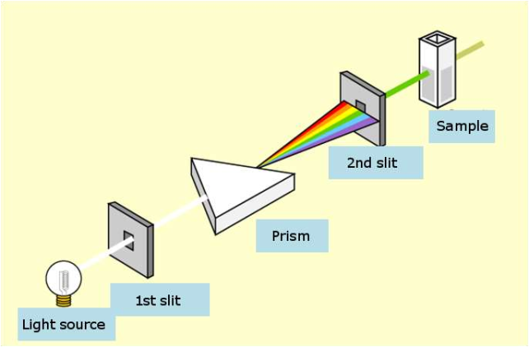
MONOCHROMATOR
Act as x-ray filter to remove unwanted rays, generally12-24 amstrong ray has been in x-ray.
Greek mono-” single", and chroma-”colour”.
Alternative way to produce an X-ray beam with a narrow wavelength distribution is to diffract the incident beam from a single crystal of known lattice dimensions. X-Ray photons of different wavelengths are diffracted from a given set of planes in a crystal at different scattering angles according to Bragg's Law. Therefore a narrow band of wavelengths can be chosen by selecting a particular scattering angle for the monochromator crystal. Crystal monochromators need to have the following properties.
1. The crystal must be mechanically strong and stable in the X-ray beam.
2. The crystal must have a strong diffracted intensity at a reasonably low scattering angle for the wavelength of the radiation being considered.
3. The mosaicity of the crystal, which determines the divergence of the diffracted beam and the resolution of the crystal, should be small.

Slide 9
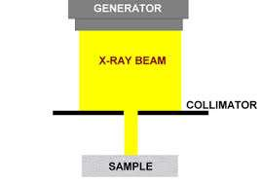
Collimator
This comprises of 2 closely packed metal plate which are 0.3mm apart from each other. The x-ray beam originate from x-ray source passes through this gap and follow single line path.
inserted in the incident- or diffracted-beam path to shape the X-ray beam
The left end of the collimator shown is mounted on the X-ray tube (or incident beam monochormator). The small yellow-colored region at the left is the part of the collimator where the size of the beam is determined.
The green region at the right is chosen to have an opening slightly larger than the region drawn in yellow. This green region removes the “parasitic” radiation.

Slide 10
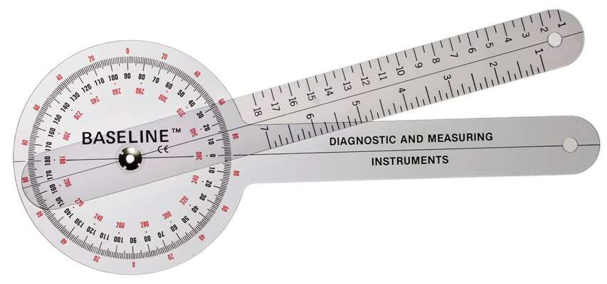
Goniometry
It is device on which crystal whose structure is to be determine has been mounted.
This device spin slowly according to crystal which is rotated on constant speed
It is between collimator and photo plate.

Slide 11
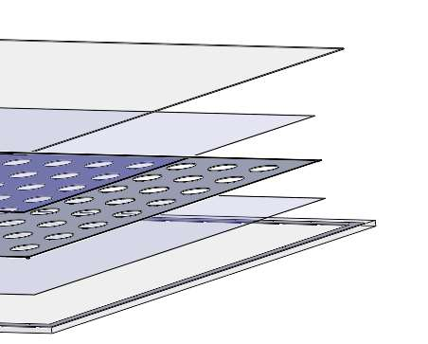
Photo plate film
capture the diffraction rays of crystal
The light-sensitive emulsion of silver salts coated on a glass plate, thinner than common window glass, instead of a clear plastic film .

Slide 12
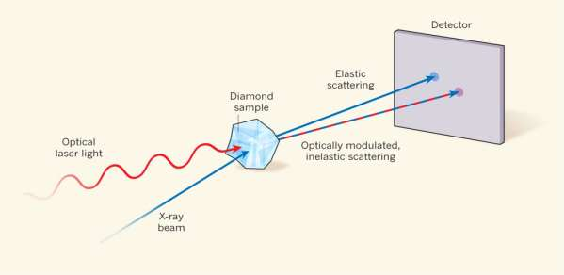
Detector
The captured data is sent to computer for further processing by detector where 3D structure of crystal gets develop.

Slide 13
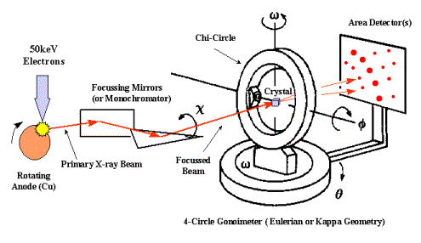
Working

Slide 18
