Slide 1
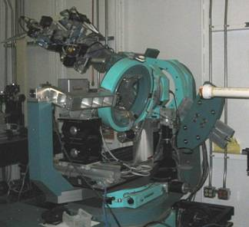
X-Ray Diffraction (XRD)
Theory and Analytical Technique

Slide 2
Bragg’s equation
W.L. Bragg considered crystals to be made up of parallel planes of atoms. Incident waves are reflected specularly (MIRROR LIKE) from parallel planes of atoms in the crystal, with each plane is reflecting only a very small fraction of the radiation, like a lightly silvered mirror.
In mirrorlike reflection the angle of incidence is equal to the angle of reflection. (a)
When the X-rays strike a layer of a crystal, some of them will be reflected. We are interested in X-rays that are in-phase with one another. X-rays that add together constructively in x-ray diffraction analysis in-phase before they are reflected and after they reflected. (b)
These two x-ray beams travel slightly different distances. The difference in the distances traveled is related to the distance between the adjacent layers.
Connecting the two beams with perpendicular lines shows the difference between the top and the bottom beams. (c)
The length DE is the same as EF, so the total distance traveled by the bottom wave is expressed by (d)

Slide 3
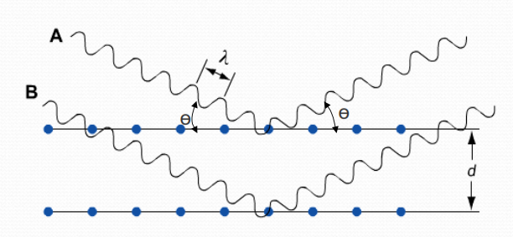
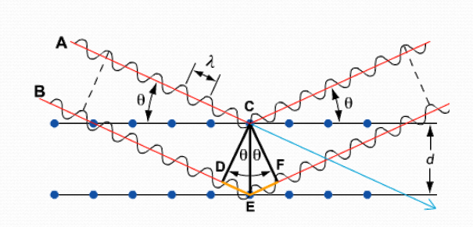
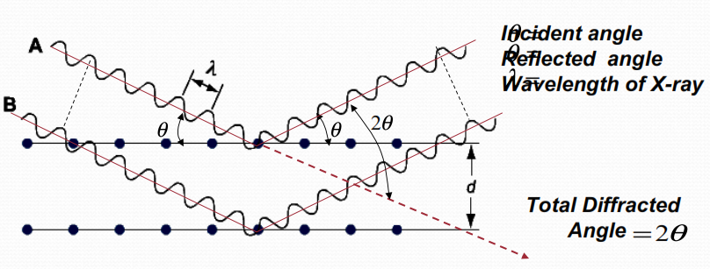
(d)
(a)
EF = d sin θ
DE = d sin θ
DE +EF = 2d sin θ
n λ=2 d sin θ
(b)
(c)

Slide 4
Bragg Equation
d is the spacing of the planes and n is the order of diffraction.
2d sinθ=λ n
Bragg reflection can only occur for wavelength λn≤2d
This is why we cannot use visible light. No diffraction occurs when the above condition is not satisfied.
The diffracted beams (reflections) from any set of lattice planes can only occur at particular angles predicted by the Bragg law.

Slide 5
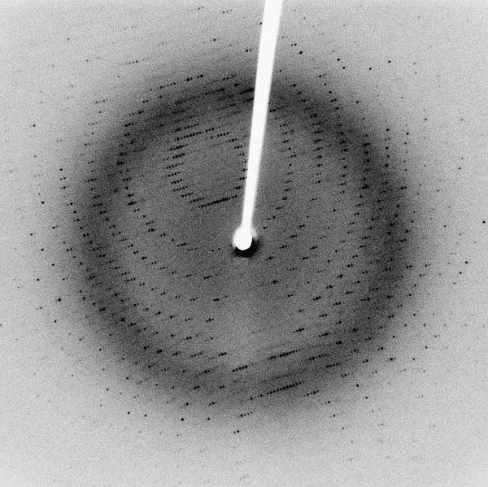
Bragg Diffraction
Diffraction from a three dimensional periodic structure such as atoms in a crystal is called Bragg Diffraction.
It is Similar to diffraction though grating.
It results from interference between waves reflecting from different crystal planes.
Constructive interference is given by Bragg's law:
Where λ is the wavelength, d is the distance between crystal planes, θ is the angle of the diffracted wave and n is an integer known as the order of the diffracted beam.
nλ = 2d sin θ
Following Bragg's law, each dot (or reflection), in this diffraction pattern forms from the constructive interference of X-rays passing through a crystal. The data can be used to determine the crystal's atomic structure.
Notes:
Following Bragg's law, each dot (or reflection), in this diffraction pattern forms from the constructive interference of X-rays passing through a crystal. The data can be used to determine the crystal's atomic structure.

Slide 6
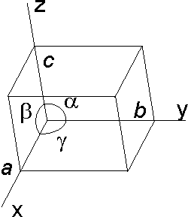
Some basic of Crystals
Crystals are solids that often have well-defined, smooth faces and straight edges. The angles between similar faces of different samples of a crystalline substance are always constant. Also it is possible to cleave some crystals along well-defined faces. These properties led Haüy and others to suggest that crystals are made of many tiny pieces that are stacked in a 3-dimensional array related by simple translation.
Many crystals are described as solids with long-range, 3-dimensional, internal order. Each unique piece of the 3-dimensional array is called a unit cell.
The shape of any unit cell is described by three vectors, a, b, and c.
These vectors lead to six parameters the three cell lengths, designated a, b, and c, and three interaxial angles, α, β, and γ. The angle α is the angle between b and c; β is the angle between a and c; and γ is the angle between a and b.

Slide 7
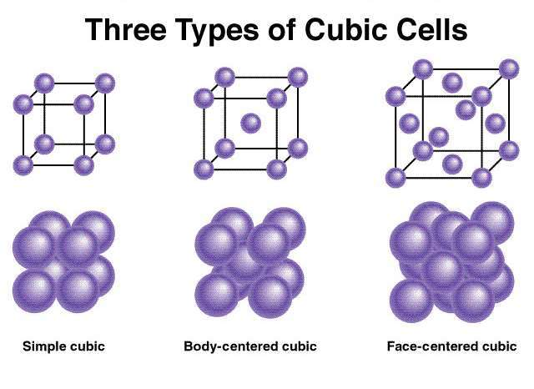
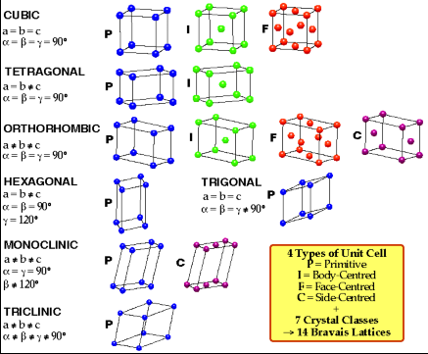
If a unit cell has the same type of atom at the corners of the unit cell but not in the middle of the faces nor in the centre of the cell, it is called primitive and given by symbol p

Slide 8
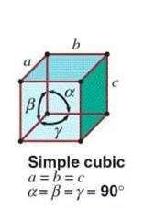
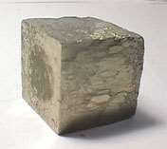
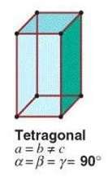
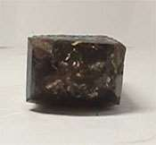
THE 7 CRYSTAL SYSTEMS
Cubic Crystals
a = b= c
α = ß = γ= 90º
Ex:-NaCl, KCl
2. Tetragonal Crystal
a = b ≠ c
α = ß = γ = 90º
Ex:-TiO2
Pyrite cube

Slide 9
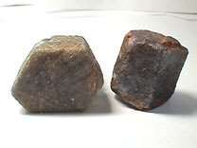
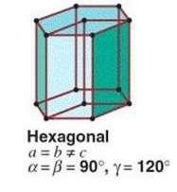
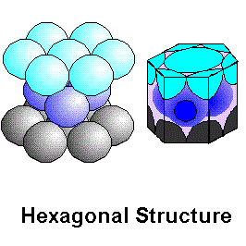
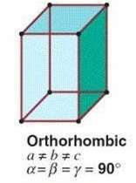
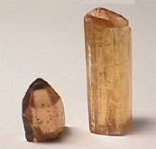
3. Hexagonal Crystals
a = b ≠ c
α= ß = 90º γ= 120º
Ex:-Mg, Zn, ZnO
4. Orthorhombic Crystals
a≠ b≠ c
α= ß= γ= 90º
Ex:-BaSO4, KNO3,
Corundum
TOPAZ

Slide 10
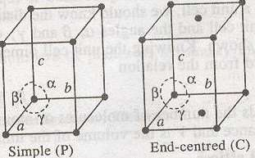
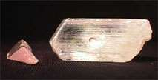
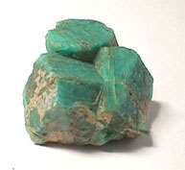
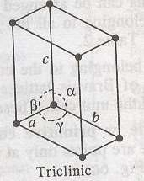
5. Rhombohedral Crystals
a = b = c
α , ß , γ ≠ 90º, Ex:-Graphite
6. Monoclinic Crystals
a ≠ b ≠ c
a≠ 90º, ß, γ = 90º
7. Triclinic Crystals
a ≠b ≠ c
a ≠ß≠γ
Tourmaline
Kunzite
Amazonite

Slide 11
APPLICATION X-RAY CRYSTALLOGRAPHY
1. Structure of crystals
2. Polymer characterisation
3. State of anneal in metals
4. Particle size determination
a) Spot counting method
b) Broadening of diffraction lines
c) Low-angle scattering
5.Applications of diffraction methods to complexes
a) Determination of cis & trans isomerism
b) Determination of
linkage isomerism
6.Miscellaneous
applications

Slide 12
1.STRUCTURE OF CRYSTALS
X-ray Diffraction Method is non-destructive and gives information on the molecular structure of the sample.
The patterns obtained of unknown compound are characteristic of the particular compounds from which the crystal was formed.
Comparing diffraction patterns from crystal of unknown composition with patterns from crystal of known compounds permits the identification of unknown crystalline compound
This method can also be used to distinguish between a mixture of crystals.

Slide 13
A. X-RAY PATTERN OF SALT NACL
B. X-RAY PATTERN OF SALT KCL
C. X-RAY PATTERN OF MIXTURE OF NACL & KCL

Slide 14
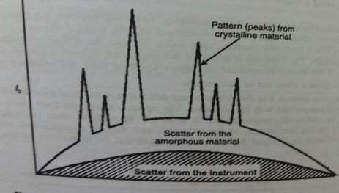
2.POLYMER CHARACTERISATION
Determine degree of crystanillity
Non-crystalline portion scatters x-ray beam to give a continuous background (amorphous materials)
Crystalline portion causes diffraction lines that are not continuous. (crystalline materials)

Slide 15
3.STATE OF ANNEAL IN METALS
A property of metals than can be determined by X-ray diffraction is the state of anneal.
Well-annealed metals are in well-ordered crystal form and give sharp diffraction lines.
If the metal is subjected to drilling, hammering, or bending, it becomes fatigued," i.e. its crystals become broken. Fatigue weakens the metal and can result in the metal breaking.
It is occasionally necessary to check moving parts for metal fatigue, such as airplane wings. This check can be done by x-ray diffraction without removing the part from its position and without weakening, it in the process of testing

Slide 16
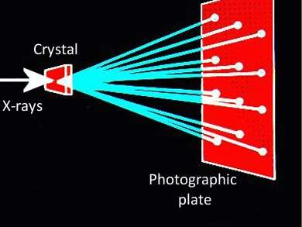
4.PARTICLE SIZE DETERMINATION A. Spot counting method:-

Slide 17
This method is used for determining size of particles larger than 5 microns.
v=V. dθ. cosθ/2n
V=volume of individual crystallite
v=total volume irradiated
n=no. of spots in diffraction ring at a Bragg angle of θ
dθ =divergence of x-ray beam & is a function of the apparatus used
By this method, it is not possible to obtain volume or size of the particle with any degree of accuracy.
Another disadvantage of this method is that spots due to strained particles are difficult to count.

Slide 19
B)Broadening Of Diffraction Lines

Slide 20
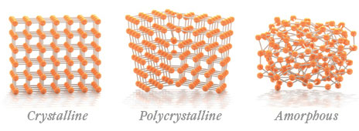

Slide 21
(C)Low-Angle Scattering
spot counting and broadening of diffraction lines both these method give a mean crystalline dimension & do not reveal anything about the distribution of particle size.
From the Bragg relation, nλ=2d sinθ, it follows that if one desire to have information about large structural features (i.e. large d values),attention should be focussed on small scattering angles, 2θ to get better resolution.

Slide 22
5.APPLICATIONS OF DIFFRACTION METHODS TO COMPLEXES
A. Determination of Cis-Trans Isomerism-X-ray diffraction study has been used to make the distinction between cis and trans isomers of a complex
B. Determination of Linkage Isomerism: By Xray
studies, it becomes possible to identify linkage Isomers of complexes.

Slide 23
MISCELLANEOUS APPLICATIONS
Soil Classification Based On Crystallinity
Analysis Of Industrial Dusts
Assessment Of Weathering &
Degradation Of Minerals & Polymers
Study Of Corrosion Products
Examination Of Tooth Enamel & Dentine
Examination Of Bone State & Tissue State
Structure Of DNA&RNA

