Slide 1
Chapter 7
Linear Programming
Chapter 7

Slide 2
Linear Programming (LP) Problems
Both objective function and constraints are linear.
Solutions are highly structured and can be rapidly obtained.
Linear Programming (LP)
Has gained widespread industrial acceptance since the 1950s
for on-line optimization, blending etc.
Linear constraints can arise due to:
1. Production limitation e.g. equipment limitations, storage
limits, market constraints.
2. Raw material limitation
3. Safety restrictions, e.g. allowable operating ranges for
temperature and pressures.
4. Physical property specifications e.g. product quality
constraints when a blend property can be calculated as
an average of pure component properties:
Chapter 7

Slide 3
5. Material and Energy Balances
- Tend to yield equality constraints.
- Constraints can change frequently, e.g. daily or hourly.
Effect of Inequality Constraints
- Consider the linear and quadratic objective functions on
the next page.
- Note that for the LP problem, the optimum must lie on one
or more constraints.
Generic Statement of the LP Problem:
subject to:
Solution of LP Problems
- Simplex Method (Dantzig, 1947)
- Examine only constraint boundaries
- Very efficient, even for large problems
Chapter 7

Slide 4
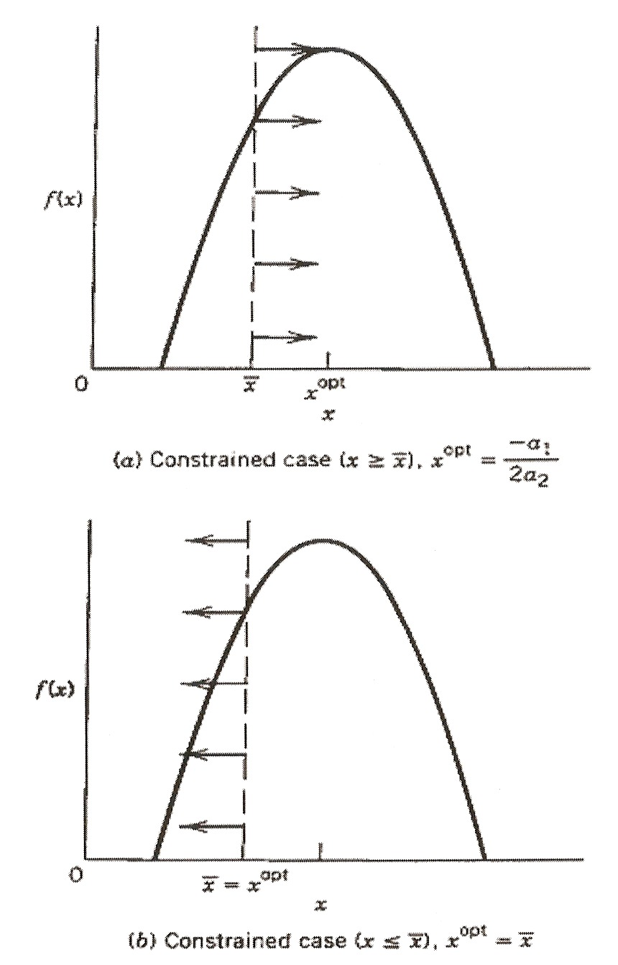
Chapter 7
Figure The effect of an inequality constraint
on the maximum of quadratic function,
f(x) = a₀ +a₁ x + a₂ x². The arrows
indicate the allowable values of x.

Slide 5
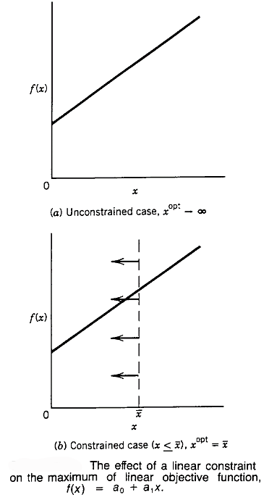
Chapter 7

Slide 6
x₁
x₃
Chapter 7
x₄
x₅
x₆
x₂
Refinery input and output schematic.

Slide 7
Chapter 7

Slide 8
Solution
Let x₁ = crude #1 (bbl/day)
x₂ = crude #2 (bbl/day)
Maximize profit (minimize cost):
y = income – raw mat’l cost – proc.cost
Calculate amounts of each product
Produced (yield matrix):
gasoline x₃ = 0.80 x₁ + 0.44 x₂
kerosene x₄ = 0.05 x₁ + 0.10 x₂
fuel oil x₅ = 0.10 x₁ + 0.36 x₂
residual x₆ = 0.05 x₁ + 0.10 x₂
Income
gasoline (36)(0.80 x₁ + 0.44 x₂)
kerosene (24)(0.05 x₁ + 0.10 x₂)
fuel oil (21)(0.10 x₁ + 0.36 x₂)
residual (10)(0.05 x₁ + 0.10 x₂)
Chapter 7

Slide 9
So,
Income = 32.6 x₁ + 26.8 x₂
Raw mat’l cost = 24 x₁ + 15 x₂
Processing cost = 0.5 x₁ + x₂
Then, the objective function is
Profit = f = 8.1 x₁ + 10.8 x₂
Constraints
Maximum allowable production:
0.80 x₁ + 0.44 x₂ < 24,000 (gasoline)
0.05 x₁ + 0.10 x₂ < 2,000 (kerosene)
0.10 x₁ + 0.36 x₂ < 6,000 (fuel oil)
and, of course, x₁ > 0, x₂ > 0
Chapter 7

Slide 10
Graphical Solution
Plot constraint lines on x₁ – x₂ plane.
Determine feasible region (those values
of x₁ and x₂ that satisfy maximum allowable
production constraints.
Find point or points in feasible region that
maximize f = 8.1 x₁ + 10.8 x₂; this can be
found by plotting the line 8.1 x₁ + 10.8 x₂ = P,
where P can vary, showing different profit
levels.
Chapter 7

Slide 11
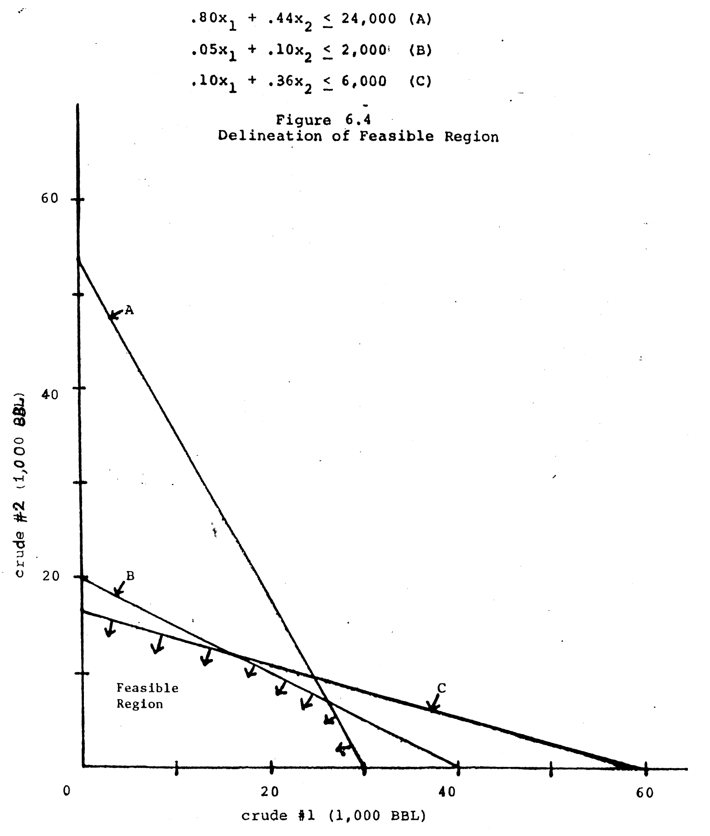
Chapter 7

Slide 12
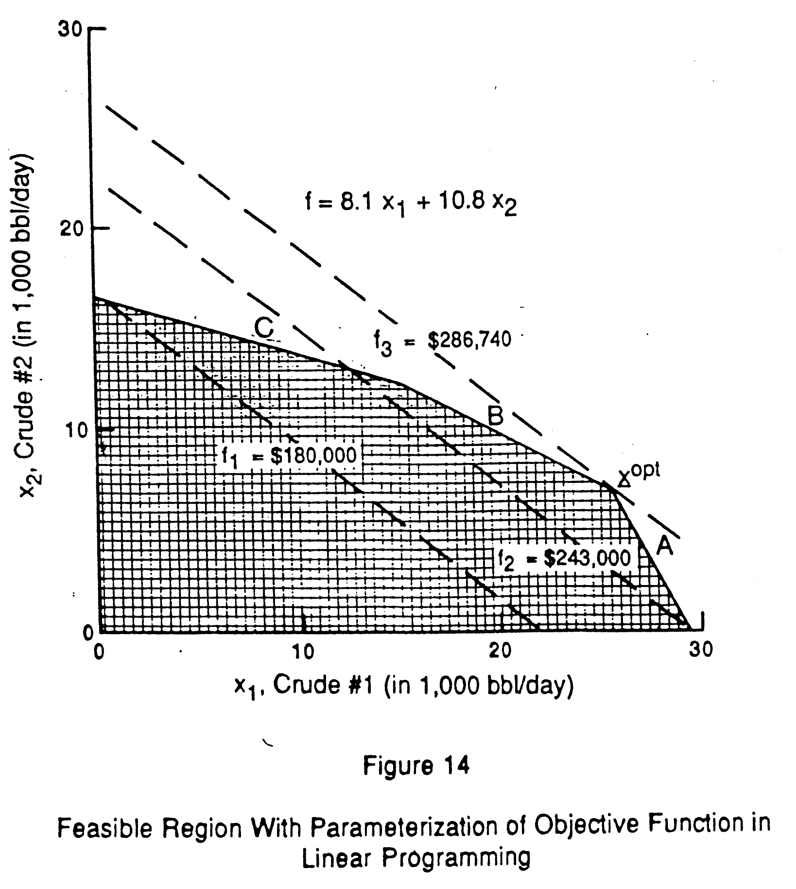
Chapter 19

Slide 13
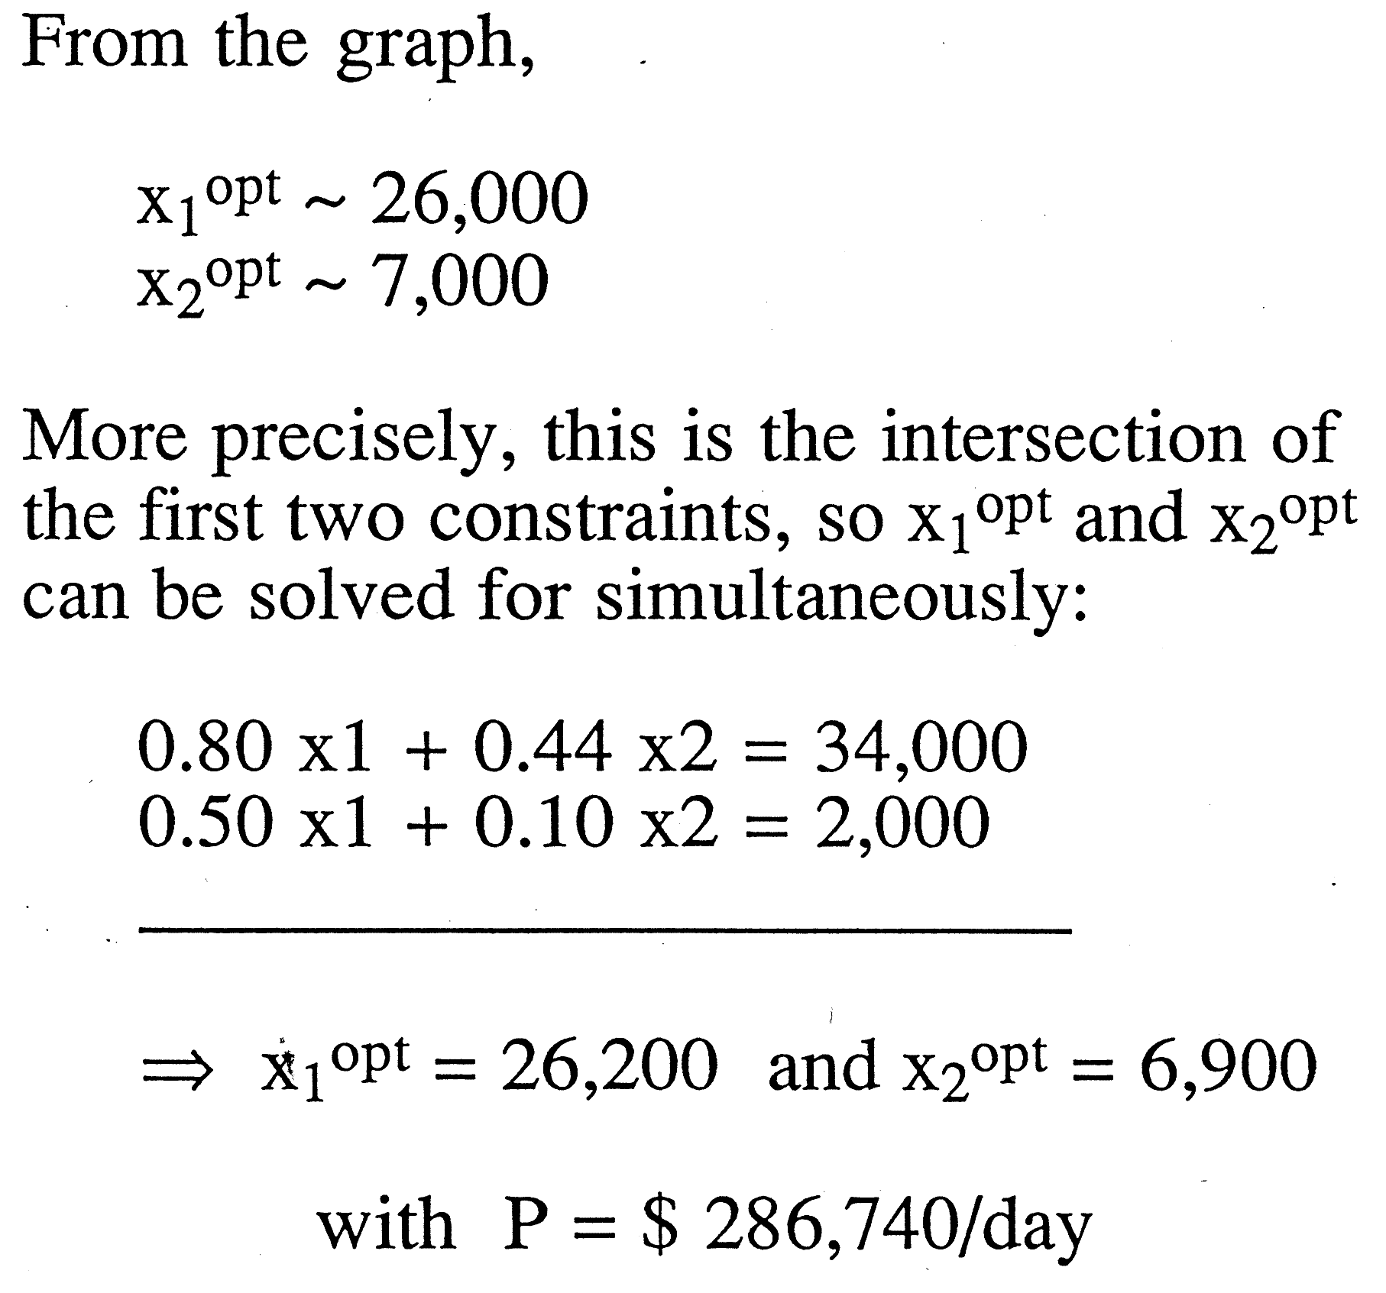
Chapter 19

Slide 14
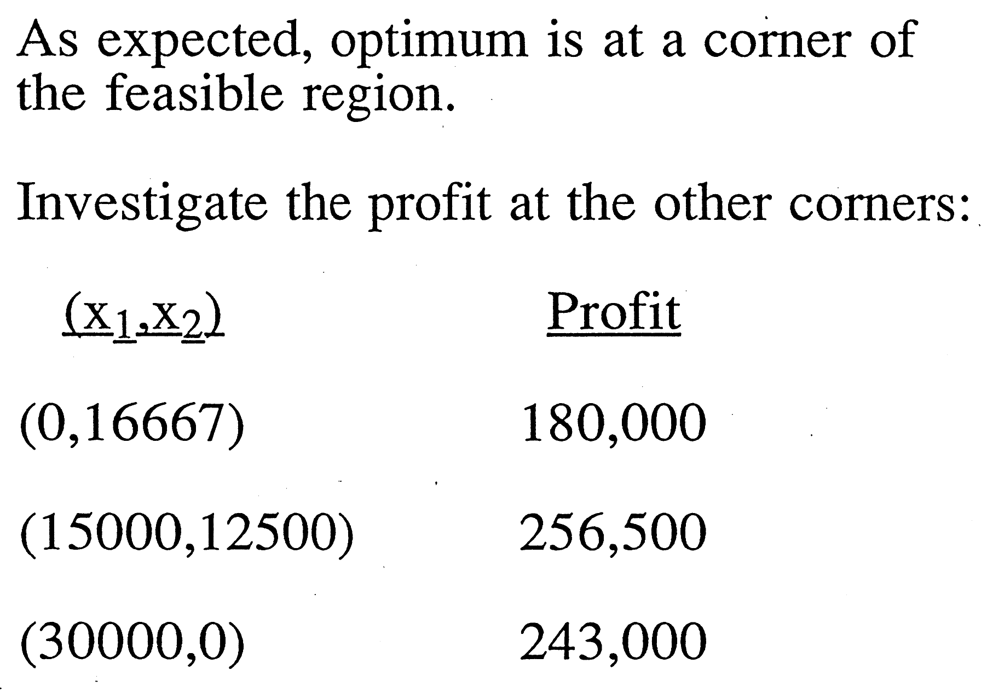
Chapter 19

Slide 15
Chapter 7

Slide 16
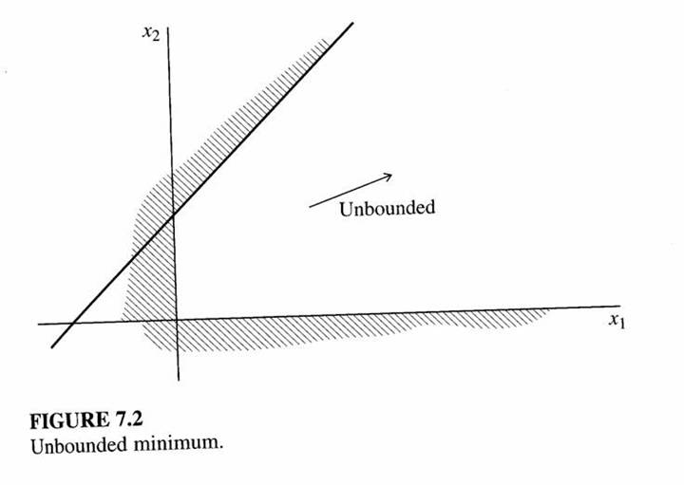
Chapter 7

Slide 17
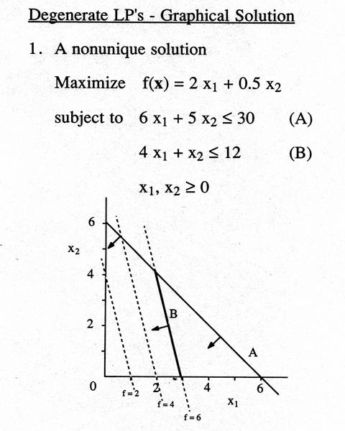
Chapter 7

Slide 18
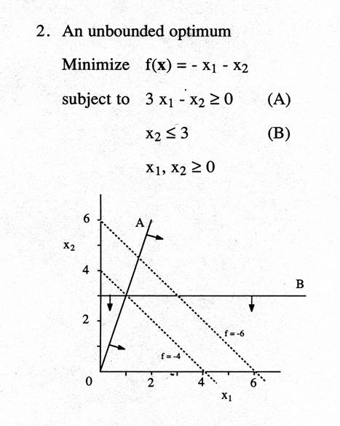
Chapter 7

Slide 19
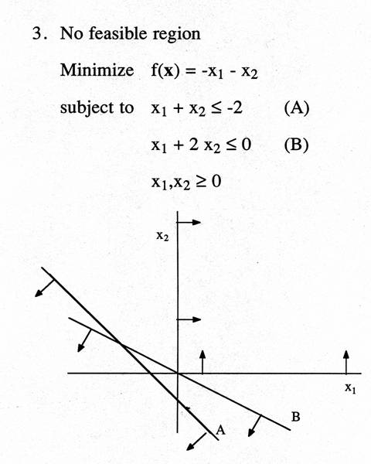
Chapter 7

Slide 20
Chapter 7

Slide 21
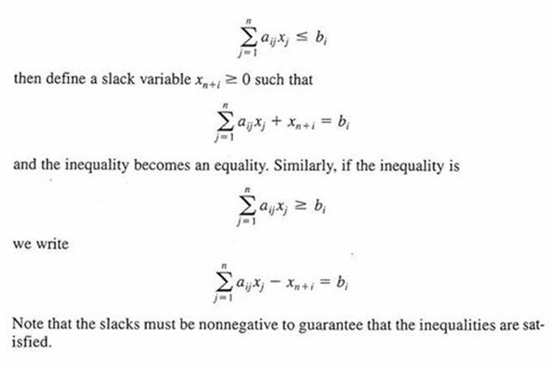
Convert inequalities to equalities using slack variables
Chapter 7

Slide 22
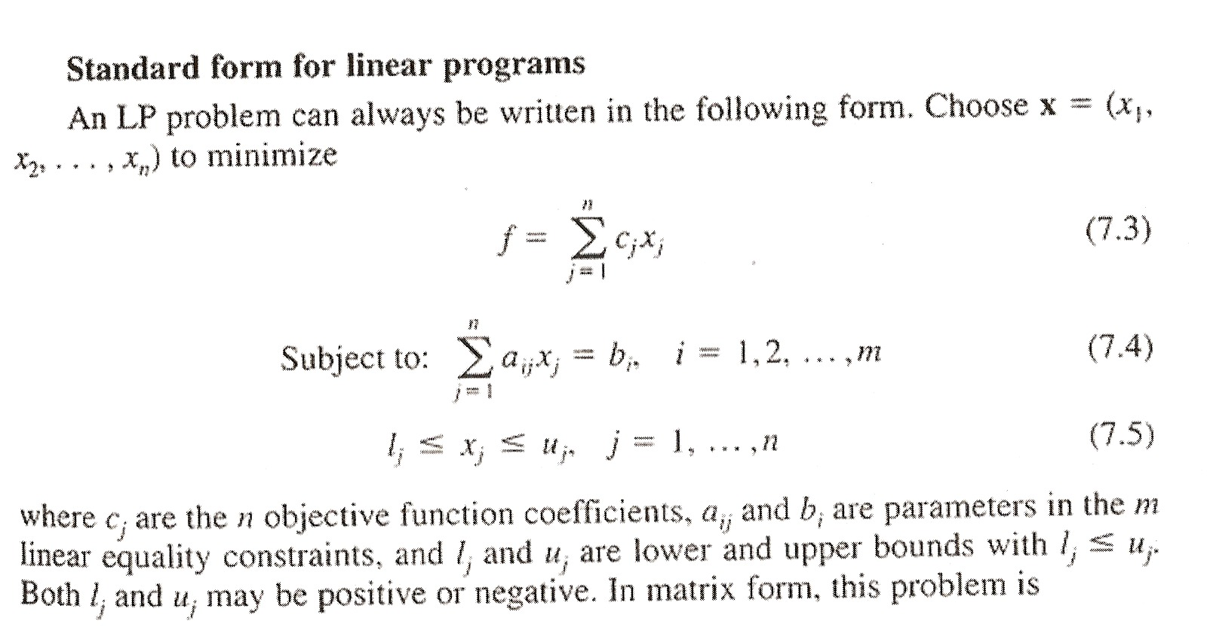
Chapter 7
Minimize: f = c^{T}x (7.6)
Subject to: Ax = b (7.7)
and I < x < u (7.8)

Slide 23
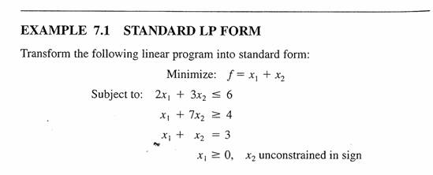
Chapter 7

Slide 24
DEFINITION 1: A feasible solution to the linear programming
problem is a vector x = (x₁, x₂, …., x_{n}) that satisfies all
constraints and bounds (7.8).
DEFINITION 2. A basis matrix is an m x m nonsingular matrix
formed from some m columns of the constraint matrix A.
DEFINITION 3. A basic solution to a linear program is the
unique vector determined by choosing a basis matrix, and
solving the resulting system of equations for the remaining
m variables.
DEFINITION 4. A basic feasible solution is a basic solution
in which all variables satisfy their bounds (7.8).
DEFINITION 6. An optimal solution is a feasible solution
that also minimizes f in Equation (7.6).
Chapter 7

Slide 25
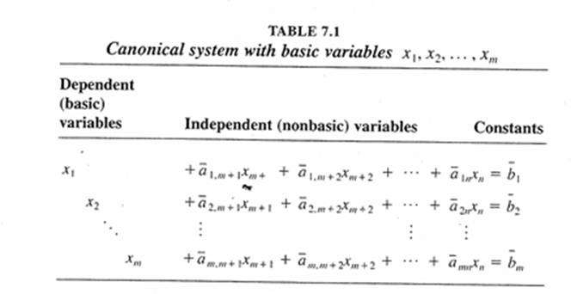
Chapter 7

Slide 26
Slack variables
refinery example: 2 variables r = 2
3 constraints p = 3 (3 slacks)
n = r + p = 5 total variables
m = q + p = 3 total constraints (q = 0 = no. equality constraints)
3 eqns / 5 unknowns set 2 variables = 0
Chapter 7
(could have infinite # soln’s
If variables can assume any value)
basic feasible sol’n
set (n – m) variables = 0 non-basic
m variables ≠ 0 basic
(constraint intersections)

Slide 27
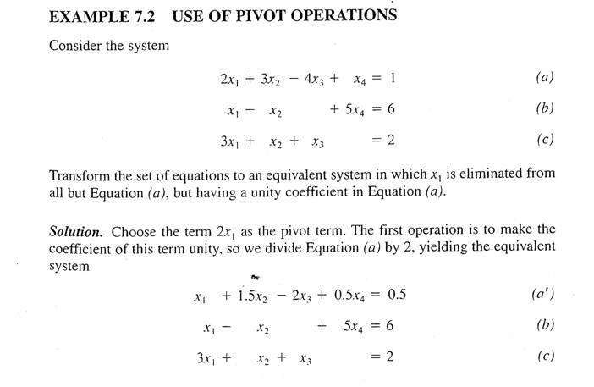
Chapter 7

Slide 28
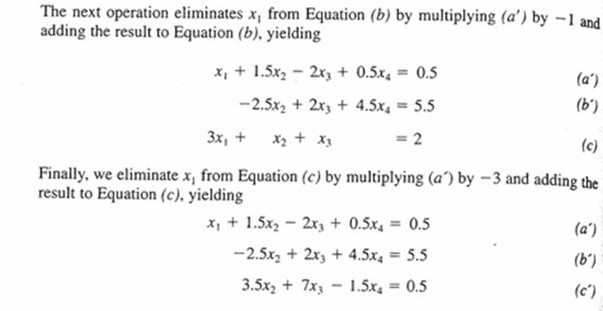
Chapter 7

Slide 29
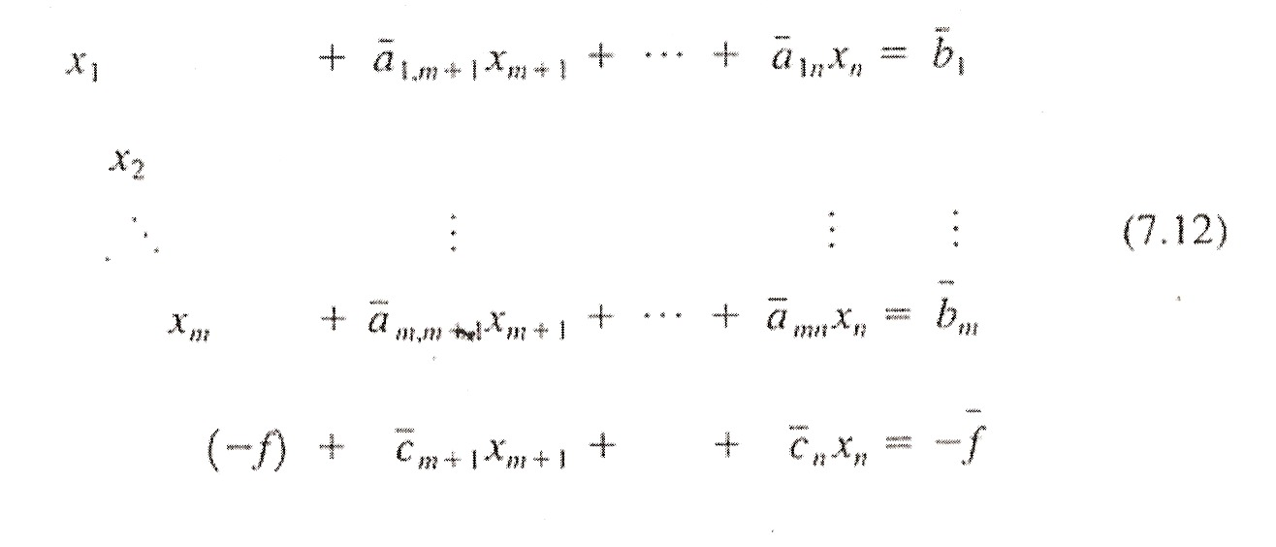
In initiating the simplex algorithm, we treat the objective function
As just another equation, that is,
(7.11)
The basic variables are the first m, that is x₁ … x_{m} and –f.
Find values of x₁ > 0, x₂ > 0, . . . . X_{n} > 0 and min f satisfying
Chapter 7

Slide 30
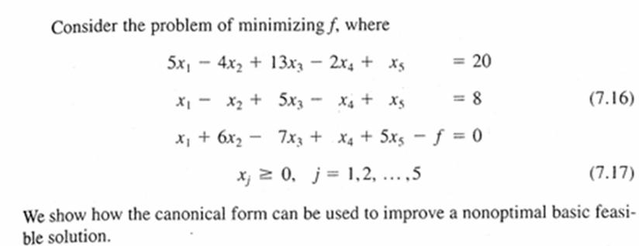
Chapter 7

Slide 31
Assume that we know that x₅, x₁, -f can be used as basic
variables. We can pivot successively on the terms x₅ (first
equation) and x₁ (second equation)
Chapter 7

Slide 32
Reduced cost coefficient = -24 (< 0): not optimal
Increasing x₃ causes f to decrease
f = 28 -24 x₃ (7.21)
Maximum value of x₂ ? Check constraints (x₂ = x₄ = 0)
x₃ = 5 -3x₃
x₁ = 3 -2 x₃ (7.22)
Chapter 7

Slide 33
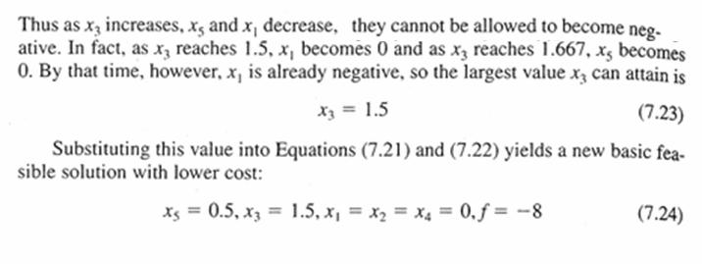
Chapter 7
Is f optimal ? x₃ replaces x₁ as a basic variable using pivot transformation.

Slide 34
(7.25)
Chapter 7
(7.26)

Slide 35
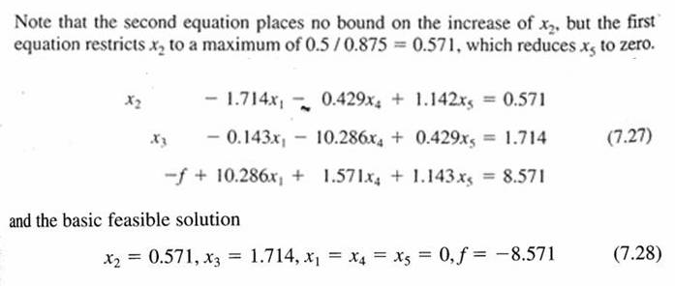
Chapter 7

Slide 36
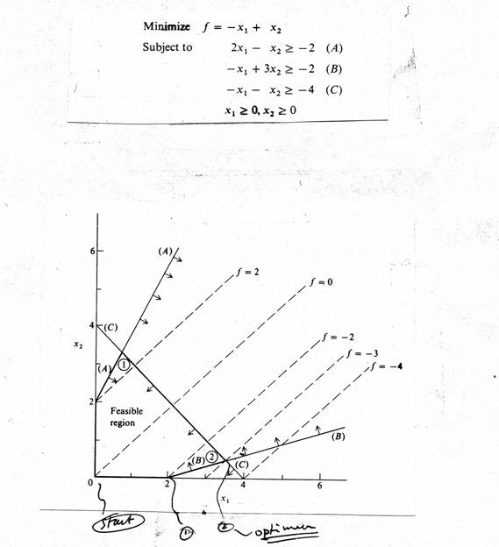
Chapter 7

Slide 37
add slacks
start at
which variable when increased will improve obj. fcn more?
Chapter 7
How far can be increased?
constraint (1) no limit
(2)
(3)
(see Figure of feasible region)
calculate new basic feasible sol’n and repeat above analysis – iterate until
obj. fcn cannot be improved further (row operations)

Slide 38
Sensitivity Analysis
• How does the value of the optimum solution change when coefficients in the obj. fcn. or constraints change?
• Why is sensitivity analysis important?
Coefficients and/or limits in constraints may be poorly known
Effect of expanding capacity, changes in costs of raw materials or selling prices of products.
• Market demand of products vary
• Crude oil prices fluctuate
Sensitivity information is readily available in the final Simplex solution. Optimum does not have to be recomputed.
Chapter 7

Slide 39
Sensitivity Analysis (Constraints)
Shadow price: The change in optimum value of obj. fcn. per unit change in the constraint limit.
Final Set of Equations of Refinery Blending Problem
x₃ = 0 x₄ = 0
x₅ + 0.14 x₃ – 4.21 x₄ = 896.5
x₁ + 1.72 x₃ – 7.59 x₄ = 26,207
x₂ – 0.86 x₃ + 13.79 x₄ = 6,897
f – 4.66 x₃ – 87.52 x₄ = -286,765
Chapter 7
↑
gasoline
constraint
↑
kerosene
constraint

Slide 40
Sensitivity Analysis
Chapter 7
Which constraint improves obj. fcn. more
(when relaxed)?
Shadow
prices
• Δ = 1 bbl (x₃ = -1) $4.66 Δf = 4.66 Δx₃
(x₄ = -1) $87.52 Δf = 87.52 Δx₄
• No effect of fuel oil (x₅); x₅ ≠ 0 Inactive constraint

Slide 41
Sensitivity Analysis
gasoline capacity is worth $4.66/bbl
kerosene capacity is worth $87.52/bbl
fuel oil capacity is worth $0/bbl←No effect
Capacity limit in original constraints * shadow
prices
4.66 (24,000) + 87.52 (2,000) = 286,880
Same as $286,740 Duality (roundoff)
Chapter 7

Slide 42
Sensitivity Analysis (Obj. Fcn.)
From final tableau
Chapter 7
Crude oil prices change (Coeff. in obj. fcn.)
Max. profit = 8.1 x₁ + 10.8 x₂
$1.00
↓
9.1 x₁
or
11.8 x₂
x₁ profit coefficient.

Slide 43
Duality
One dual variable exists for each primal constraint
One dual constraint exists for each primal variable
• The optimal solution of the decision variables (i.e., the Dual Problem) will correspond to the Shadow Prices obtained from solution of the Primal Problem.
• Commercial Software will solve the Primal and Dual Problems.
i.e., it provides sensitivity information.
Chapter 7

