Slide 1
MOTION
BY:
DR. DIGVIJAY SHARMA
DIRECTOR
SCHOOL OF HEALTH SCIENCES, CSJMU

Slide 2
DESCRIPTION OF MOTION
Kinematics includes the set of concepts that allows us to describe the displacement.
There are five kinematic variables that fully describe the motion, or the displacement, of a segment:
(1) the type of displacement (motion),
(2) the location in space of the displacement,
(3) the direction of the displacement of the segment,
(4) the magnitude of the displacement, and
(5) the rate of change in displacement (velocity) or the rate of change of velocity (acceleration).
Translatory and rotary motions are the two basic types of movement

Slide 3
TRANSLATORY MOTION
Translatory motion (linear displacement) is the movement of a segment in a straight line.
In true translatory motion, each point on the segment moves through the same distance, at the same time, in parallel paths.
pure translatory movements are rare.
A specific example of such imposed motion is the anterior drawer test for anterior cruciate ligament (ACL) integrity at the knee
Every segment is linked to at least one other segment, and most human motion occurs as movement of more than one segment at a time.
In fact, translation of a body segment rarely occurs in human motion without some concomitant rotation (rotary motion) of that segment (even if the rotation is barely visible).

Slide 4
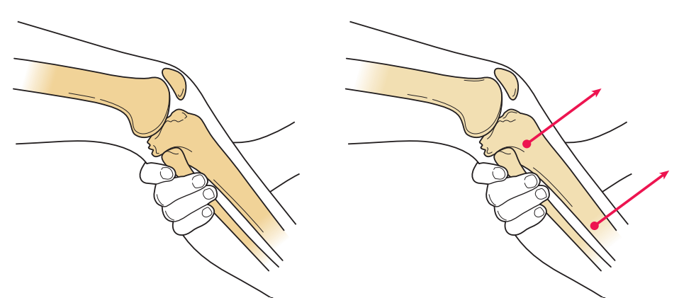
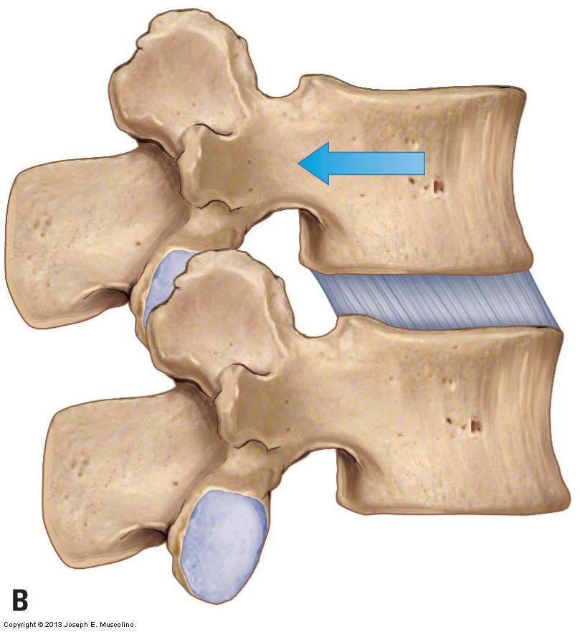
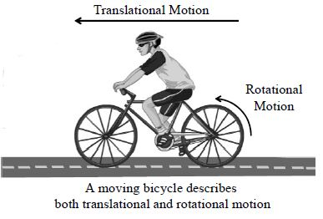
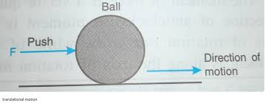

Slide 5
ROTATORY MOTION
Rotary motion (angular displacement) is movement of a segment around a fixed axis (center of rotation [CoR]) in a curved path.
In true rotary motion, each point on the segment moves through the same angle, at the same time, at a constant distance from the center of rotation.
True rotary motion can occur only if the segment is prevented from translating and is forced to rotate about a fixed axis. This does not often happen in human movement.
In actuality, none of the body segments move around truly fixed axes; all joint axes shift at least slightly during motion because segments are not sufficiently constrained to produce pure rotation.

Slide 6
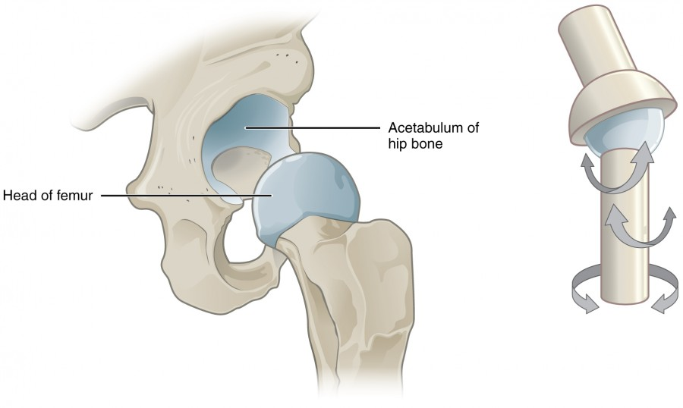
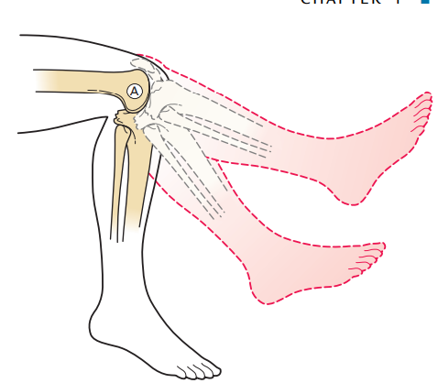
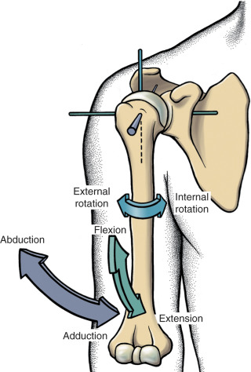
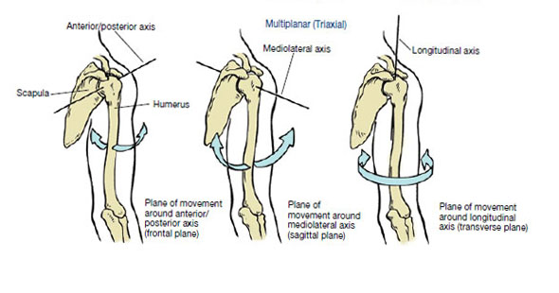
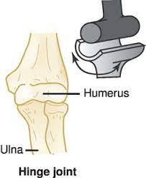

Slide 7
GENERAL MOTIONS
When non-segmented objects are moved, combinations of rotation and translation (general motion) are common.
If someone were to attempt to push a treatment table with swivel casters across the room by using one hand, it would be difficult to get the table to go straight (translatory motion); it would be more likely to both translate and rotate. When rotary and translatory motions are combined, a number of terms can be used to describe the result.
Curvilinear (plane or planar) motion designates a combination of translation and rotation of a segment in two dimensions. The axis around which the segment appears to move in any part of its path is referred to as the instantaneous center of rotation (ICoR), or instantaneous axis of rotation (IaR).
Three-dimensional motion is a general motion in which the segment moves across all three dimensions. Just as curvilinear motion can be considered to occur around a single distant center of rotation, three-dimensional motion can be considered to be occurring around a helical axis of motion (HaM), or screw axis of motion

Slide 8
NEWTON’S LAW OF INERTIA
Newton first law of Inertia states that “ an object will remain at rest or in uniform motion unless acted on by an unbalanced force.”
It is also called as Law of Equilibrium can be restated as “for an object to be in equilibrium, the sum of forces applied to that object must be equal to zero.”
Inertia is the property of any object that resist both the initiation of motion and change in motion

Slide 9
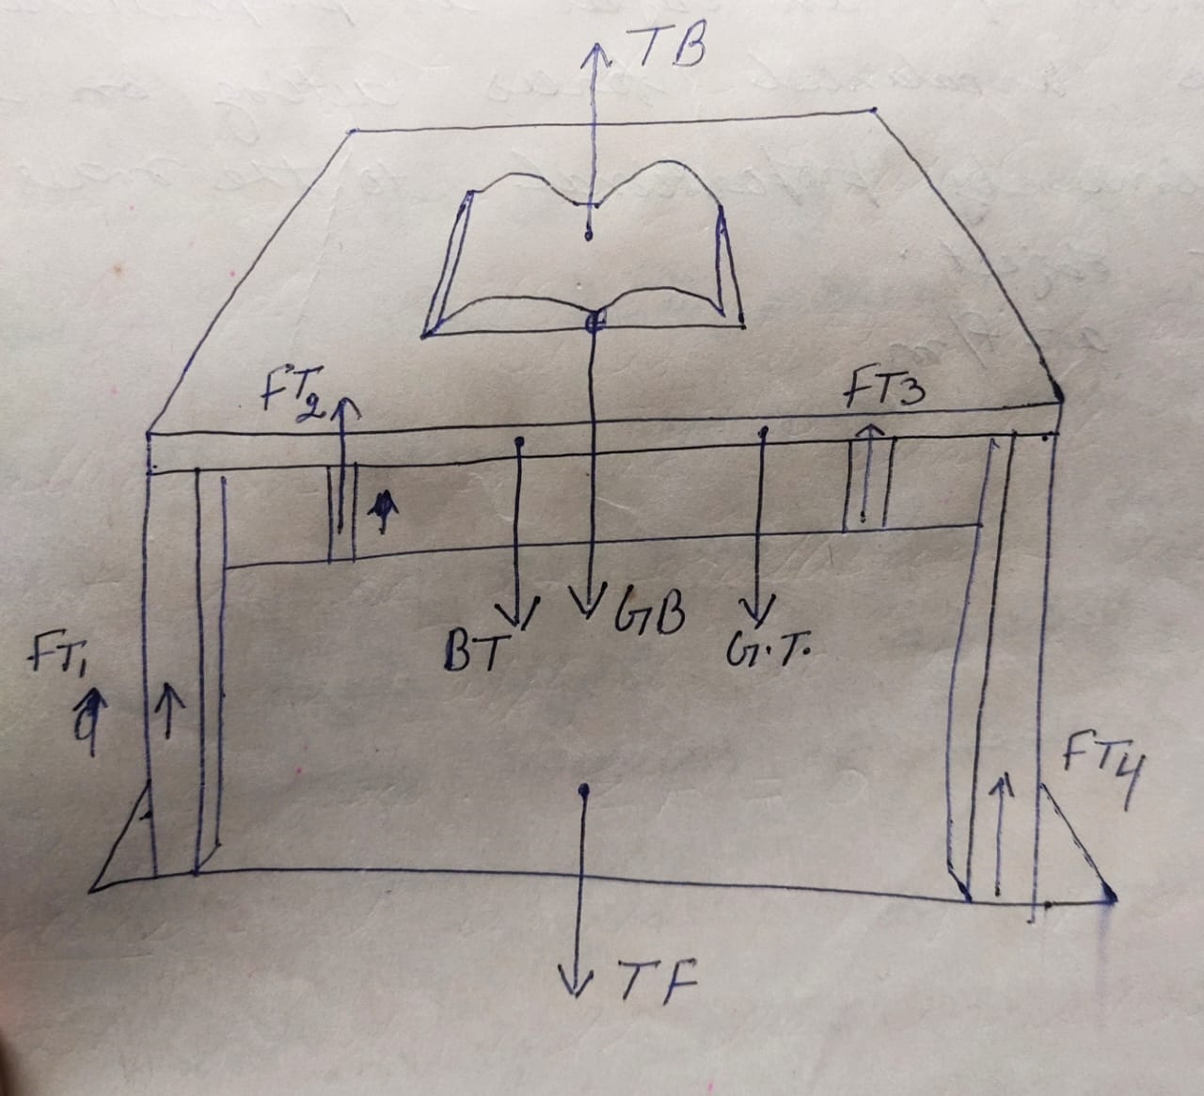
DETERMINING EQUILIBRIUM
For example: Book resting on the table
TB= GB
BT+GT (Linear force system)= FT (FT1+FT2+FT3+FT4)
TF= it does not have direct influence on the equilibrium of table because any force that have a point of application on an object can contribute to the equilibrium of that object.

Slide 10
NEWTON’S LAW OF ACCELERATION
It states that the acceleration of an object is proportional to the unbalanced forces acting on it and inversely proportional to the mass of that object.
It is the second law of Newton
a= F/m

Slide 11
NEWTON’S LAW OF REACTION
It is also called Newton’s third law
It states that for every action there is an equal and opposite reaction
In other words we can say that when an object applies a force to the second object, the second object must simultaneously apply an equal force in magnitude and opposite force in direction to the first object.
These two forces on the two contacting objects constitute an Interventional Pair or Action-reaction forces

