Slide 1
MUSCULAR FUNCTIONS
BY:
DR. DIGVIJAY SHARMA
DIRECTOR
SCHOOL OF HEALTH SCIENCES, CSJMU

Slide 2
Muscle tension
The most important characteristic of a muscle is its ability to develop tension and to exert a force on the bony lever.
The lever may be:
Passive tension
Active tension

Slide 3
Passive tension
Passive tension refers to tension develop in the passive non-contractile components of the muscle
Contractile components of the muscle
It develops in the parallel elastic component is created by lengthening the muscle beyond the slack length of the tissues
The total tension that develops during an active contraction of a muscle is a combination of the non-contractile (Passive) tension added to the contractile (active) tension

Slide 4
active tension
It refers to tension developed by the contractile elements of the muscle
Active tension in a muscle is initiated by cross bridge formation and movement of thin filament over thick filament

Slide 5
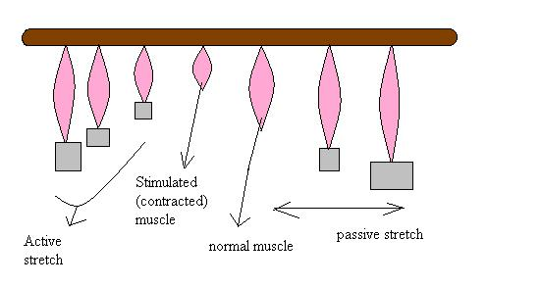
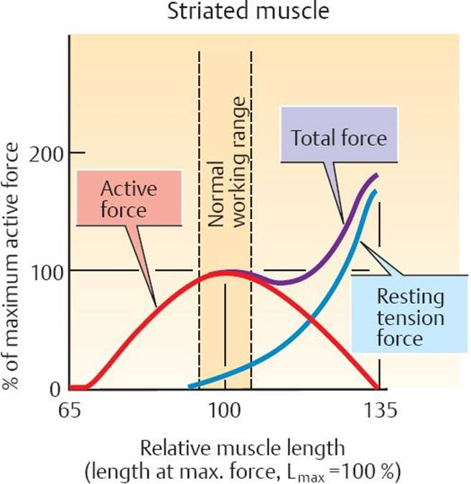
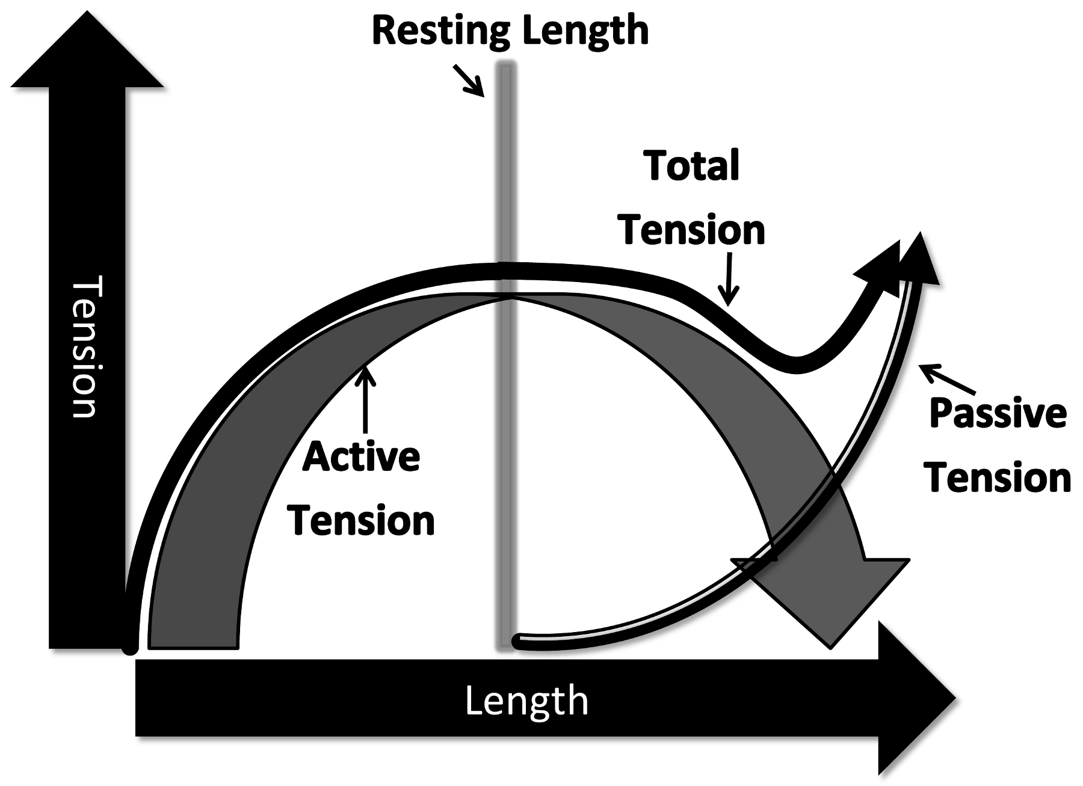

Slide 6
Factors affecting active tension
Size of motor unit- larger unit produces greater tension
Number and size of muscle fibre in a cross- section of the muscle- the larger the cross section the greater the tension
Number of motor unit firing- the greater the number of motor units firing in a muscle greater the tension
Frequency of firing of a motor unit- greater the frequency, the greater the tension
Sarcomere length- the closer the optimal length, the greater the amount of isometric tension that can be generated

Slide 7
6. Fibre arrangement- a pennate fibre arrangement gives a greater number of muscle fibre and therefore a greater amount of tension is generated than in a parallel muscle
7. Type of muscle contraction- an isometric contraction can develop greater tension than a concentric, eccentric contraction can develop greater tension than an isometric contraction.
8. Speed- as the speed of the shortening increases, tension decreases in concentric contraction. As the speed of active lengthening increases, tension in an eccentric contraction increases

