Slide 1
MUSCULAR STRUCTURE
BY:
DR. DIGVIJAY SHARMA
DIRECTOR
SCHOOL OF HEALTH SCIENCES, CSJMU

Slide 2
MUSCULAR STRUCTURE
Mainly three types of fibres are found in human skeletal muscles
These are:
Type I or Slow twitch oxidative fibres
Type II a or Intermediate fibres or fast twitch red fibres or fast twitch oxidative glycolytic fibres
Type II b or fats twitch fibres or fast twitch glycolytic or fats twitch white fibres
They can be distinguished from each other histo-chemically, metabolically, morphologically and mechanically.

Slide 3
CHARACTERISTICS OF MUSCLE FIBRES
CHARACTERS | TYPE I | TYPE II a | TYPE II b
DIAMETER | SMALL | INTERMEDIATE | LARGE
MUSCLE COLOR | RED | RED | WHITE
CAPILLARY | DENSE | DENSE | SPARSE
MYOGLOBIN CONTENT | HIGH | INTERMEDIATE | LOW
SPEED OF CONTRACTION | SLOW | FAST | FAST
RATE OF FATIGUE | SLOW | INTERMEDIATE | FAST
MOTOR UNIT SIZE | SMALL | INTERMEDIATE TO LARGE | LARGE
AXON CONDUCTION VELOCITY | SLOW | FAST | FAST

Slide 4
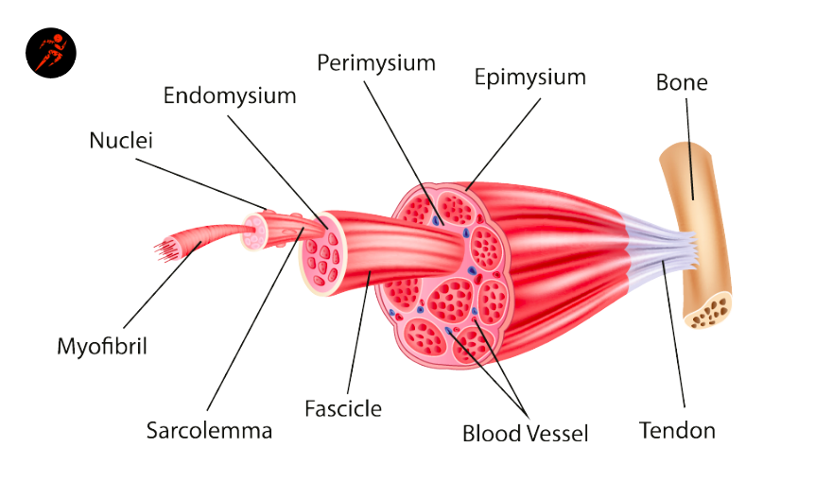
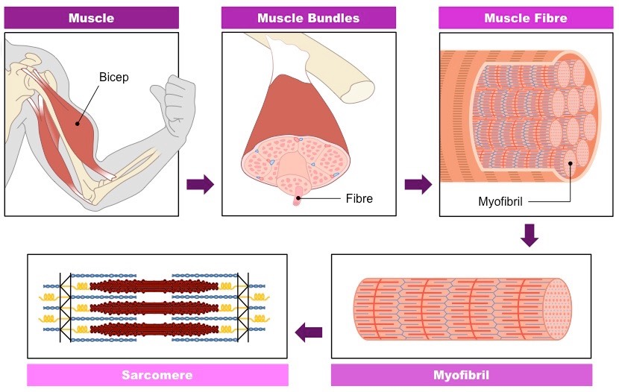
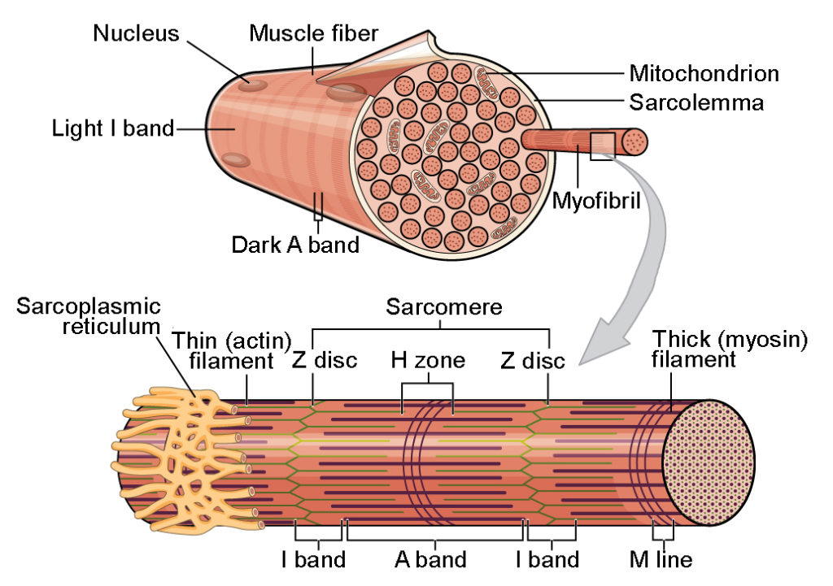
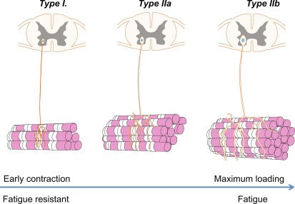

Slide 5
TONIC AND PHASIC MUSCLES
Characteristics used to differentiate between tonic and phasic muscles are of the following:
CHARACTERISTICS | TONIC MUSCLE | PHASIC MUSCLE
FIBRE TYPE | HIGH PROPORTION OF SLOW OXIDATIVE FIBRE | HIGH PROPORTION OF FAST GLYCOLYTIC FIBRE
FIBRE ARRANGEMENT | PENNIFORM | PARALLEL
LOCATION | DEEP AND CROSSES ONE JOINT | SUPERFICIAL AND CROSSES MORE THAN ONE JOINT
FUNCTION | STABILITY | MOBILITY
ACTION | EXTENSION, ABDUCTION, EXTERNAL ROTATION | FLEXION, ADDUCTION, INTERNAL ROTATION

Slide 6
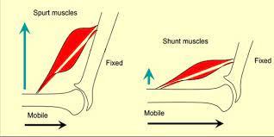
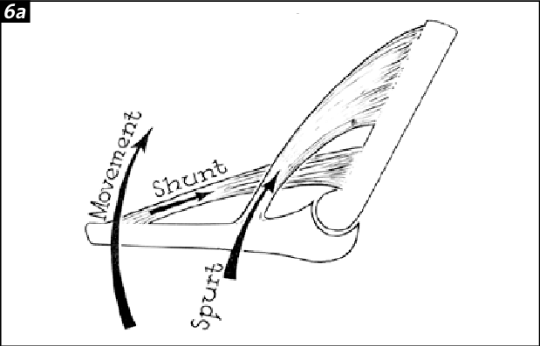
SPURT MUSCLES
SPURT muscles have a proximal point of attachment i.e., far from joint axis and the distal attachment i.e., close to the joint axis
These muscles have a relatively large rotatory component than translatory component at all points in the range

Slide 7
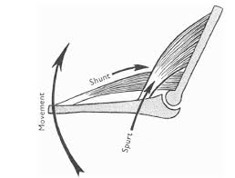
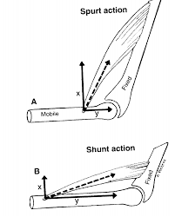
SHUNT MUSCLES
SHUNT muscles have a proximal attachment close to a joint axis and distal attachment far away from the joint axis
These muscles help to maintain joint stability since they have a large translatory component
When muscle action is reversed spurt muscle may act like shunt muscle and vice-versa

Slide 8
MUSCULAR CONNECTIVE TISSUE
Muscle and muscle fibres like other soft tissues in the body are supported and surrounded by connective tissue.
The sarcolemma of individual muscle fibres are surrounded by connective tissue called endomysium and groups of muscle fibres are caused by connective tissue called perimysium
The endomysium and perimysium are continuous with outer connective tissue sheath called epimysium, which envelopes the entire muscle.
Continuation of the outer sheath forms the tendon that attach each end of the muscle to the bony components.

Slide 9
Tendons are attached to bones by sharply fibres which become continuous with the periosteum
Other connective tissue associated with the muscles are fascial (deep and superficial) aponeurosis and sheaths
All connective tissue in a muscle is interconnected and constitutes passive elastic component of a muscle.
The connective tissues that surround the muscle and sarcolemma plus other structures (i.e., nerve and blood vessels) form the parallel elastic component of a muscle
When a muscle lengthens or shortens, these tissues also lengthens or shortens because they function in parallel to the muscle contractile unit.

Slide 10
