Slide 1
Micro And Macro Economics
Dr. Pooja Singh,
Asst. Prof. Department of Economics,
School of Arts ,Humanities And Social Sciences,
Chhatrapati Shahu Ji Maharaj University, Kanpur

Slide 2
Micro Economics
Micro And Macro Economics
Micro economics The prefix 'micro' is derived from Greek word 'mikros', meaning small.
“Micro economics studies the economic behavior of individual economic units and individual economic variables.”
The study of economic behavior of the households, firms and industries forms the subject- matter of micro economics.

Slide 3
Micro And Macro Economics
Micro economics is concerned with economic activities of individual economic units as consumers, resource owners and business firms.
It explains how these individuals as consumers or households, as resource owners and as producers play their part in the working of the whole economic system.
It revolves around the interaction of consumers and producers in markets.

Slide 4
Thus micro economics deals with
Micro And Macro Economics
Determination of product prices
The allocation of resources among various firms and industries.
It deals with the action and interaction of individual markets-product and factor markets.
Determination of factor prices and their quantities in the individual markets

Slide 5
Merits of Micro economics-
Micro And Macro Economics
Micro economics helps in understating the operation of a free enterprise economy.
It helps the government in establishing the correct policies.
It helps in search of efficient employment of resources.
It helps the producer to achieve maximum productivity with existing resource.
It is useful in foreign trade
It helps businessman to make the policies for future
It also helps in understanding the complicating problems by formulating models

Slide 6
Limitations of Micro Economics-
Micro And Macro Economics
Micro economics does not give us the overview of all pictures of working of economy
The result which is predicted by microeconomics is not applicable universally
Micro economics analysis useful only for full employment situation.
Micro economics gives accurate result only in free enterprise system.

Slide 7
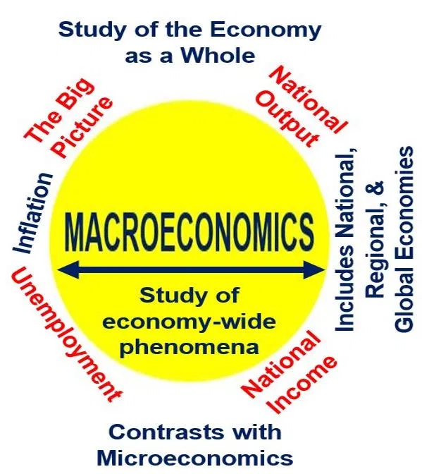
Macro Economics
Micro And Macro Economics
The prefix 'macro' is derived from the Greek word 'makros' meaning, 'large'.
Macro economics is the study of the economy as a whole.
Macro economics " deals with the functioning of the economy as a whole.

Slide 8
Thus macro economics deals with
Micro And Macro Economics
National income
and Output
General price level
Balance of trades and balance of payments
External value of money
Saving and investment
Employment and economic growth

Slide 9
Importance of Macro Economics-
Micro And Macro Economics
The variable in the macroeconomics can be measured statistically and its effect and functioning on the economy can be found out.
Macroeconomics help government to find solution to economic problem.
Macroeconomics helps us to understand the problem of unemployment and to make the solution to it.

Slide 10
Micro And Macro Economics
It helps to measure the overall performance of the national economy in regard of economic growth, national income and price level etc.
It helps in understanding the distribution patterns
It helps in evolution of resources and potentiality of the economy
It helps in finding solution to monetary problem of the economy.

Slide 11
Limitations of Macro Economics-
Micro And Macro Economics
Macroeconomics does not give result in accurate form.
The generalization pattern is used in the study of macro analysis and not the individual study.
There is a distrust over the study of macro analysis

Slide 12
Micro And Macro Economics
Sr. No… | Micro | Macro
 | It is the study of an individual entities such as individuals, households, firms ,industry ,etc in short term. | It is the study of economy as whole or its aggregate .
2. | It does not give the overall picture of working of an economy | It gives the complete or overall picture of economy
3. | Its result is not being used universally | Its information derived is useful universally
4. | Understanding microeconomics helps a great deal in individual decision making i.e., managerial decision-making. | Macro economics study is vital in the formulation and execution of economic policies by government.
5. | Its main tools are demand and supply to particular commodity | Its main tools are aggregate demand and aggregate supply of economy as whole.

Slide 13
References-
Micro And Macro Economics
Dewett,K.K.Modern Economic Theory.
Mithani,D.M.Managerial Economics.
Dwivedi, D.N. (2001). Macroeconomics: theory and policy.
-Dr. Pooja Singh, Asst. Prof., Department of Economics, School of Arts Humanities And Social Sciences, Chhatrapati Shahu Ji Maharaj University, Kanpur

Slide 14
Micro And Macro Economics

