Slide 1
Microprocessor (CSE Department)
Er. S. M. Tiwari

Slide 2
8085 INTRODUCTION
The features of INTEL 8085 are :
It is an 8 bit processor.
It is a single chip N-MOS device with 40 pins.
It has multiplexed address and data bus.(AD0-AD7).
It works on 5 Volt fdc power supply.
The maximum clock.
It provides 74 instructions with 5 addressing modes. requency is 3 MHz while minimum frequency is 500kHzdifferent

Slide 3
8085 INTRODUCTION
It provides 16 address lines so it can access 2^16 =64K bytes of memory.
It generates 8 bit I/O address so it can access 2^8=256 input ports.
It provides 5 hardware interrupts:TRAP, RST 5.5, RST 6.5, RST 7.5,INTR.
It provides Acc ,one flag register ,6 general purpose registers and two special purpose registers(SP,PC).
It provides serial lines SID ,SOD.So serial peripherals can be interfaced with 8085 directly.

Slide 4
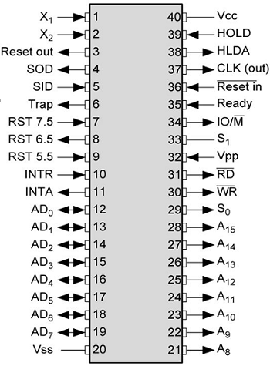
8085 PIN DIAGRAM

Slide 5
8085 PIN DESCRIPTION
Some important pins are :
AD0-AD7: Multiplexed Address and data lines.
A8-A15: Tri-stated higher order address lines.
ALE: Address latch enable is an output signal.It goes high when operation is started by processor .
S0,S1: These are the status signals used to indicate type of operation.
RD¯: Read is active low input signal used to read data from I/O device or memory.
WR¯:Write is an active low output signal used write data on memory or an I/O device.

Slide 6
8085 PIN DESCRIPTION
READY: This an output signal used to check the status of output device. If it is low, µP will WAIT until it is high.
TRAP: It is an Edge triggered highest priority , non mask able interrupt. After TRAP, restart occurs and execution starts from address 0024H.
RST5.5,6.5,7.5:These are maskable interrupts and have low priority than TRAP.
INTR¯&INTA:INTR is a interrupt request signal after which µP generates INTA or interrupt acknowledge signal.
IO/M¯:This is output pin or signal used to indicate whether 8085 is working in I/O mode(IO/M¯=1) or Memory mode(IO/M¯=0 ).

Slide 7
8085 PIN DESCRIPTION
HOLD&HLDA: HOLD is an input signal .When µP receives HOLD signal it completes current machine cycle and stops executing next instruction. In response to HOLD µP generates HLDA that is HOLD Acknowledge signal.
RESET IN¯: This is input signal. When RESET IN¯ is low µp restarts and starts executing from location 0000H.
SID: Serial input data is input pin used to accept serial 1 bit data .
X1X2 :These are clock input signals and are connected to external LC,or RC circuit. These are divide by two so if 6 MHz is connected to X1X2, the operating frequency becomes 3 MHz
VCC&VSS: Power supply VCC=+ -5Volt& VSS=-GND reference.

Slide 8
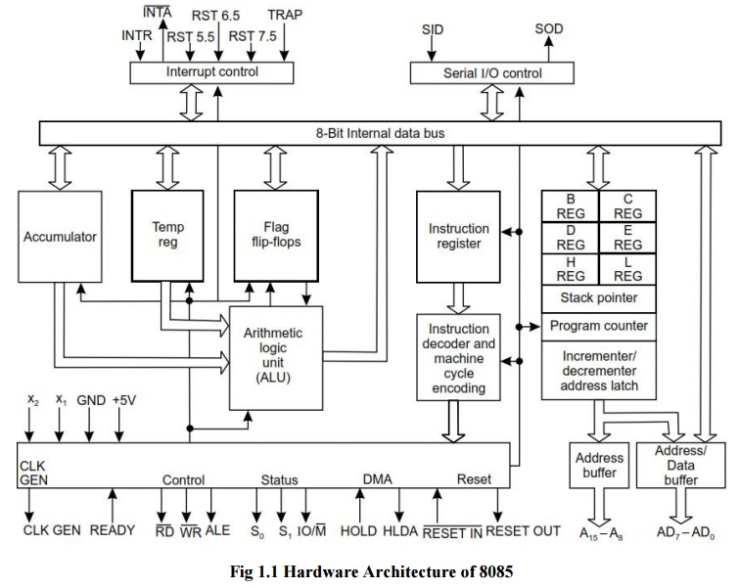
8085 ARCHITECTURE

Slide 9
Arithmetic and Logical group
Accumulator: It is 8 bit general purpose register.
It is connected to ALU.
So most of the operations are done in Acc.
Temporary register: It is not available for user
All the arithmetic and logical operations are done in the temporary register but user can’t access it.
Flag: It is a group of 5 flip flops used to know status of various operations done.
The Flag Register along with Accumulator is called PSW or Program Status Word.

Slide 10
Flag Register
S | Z | X | AC | X | P | X | CY
S: Sign flag is set when result of an operation is negative.
Z: Zero flag is set when result of an operation is 0.
Ac: Auxiliary carry flag is set when there is a carry out of lower nibble or lower four bits of the operation.
CY: Carry flag is set when there is carry generated by an operation.
P: Parity flag is set when result contains even number of 1’s.
Rest are don’t care flip flops.

Slide 11
Functional Register
Temporary registers (W,Z):These are not available for user. These are loaded only when there is an operation being performed.
General purpose:There are six general purpose registers in 8085 namely B,C,D,E,H,L.These are used for various data manipulations.
Special purpose :There are two special purpose registers in 8085:
SP :Stack Pointer.
PC:Program Counter.

Slide 12
Functional Register
Stack Pointer: This is a temporary storage memory 16 bit register. Since there are only 6 general purpose registers, there is a need to reuse them .
Whenever stack is to be used previous values are PUSHED on stack and then after the program is over these values are POPED back.

Slide 13
Functional Register
Program Counter: It is 16 bit register used to point the location from which the next instruction is to be fetched.
When a single byte instruction is executed PC is automatically incremented by 1.
Upon reset PC contents are set to 0000H and next instruction is fetched onwards.

Slide 14
INSTRUCTION REGISTER & DECODER
Instruction register:When an instruction is fetched , it is executed in instruction register.This register takes the Opcode value only.
Instruction decoder: It decodes the instruction from instruction register and then to control block.

Slide 15
Timing and Control Unit
Timing and control:This is the control section of microprocessor. It accepts clock input . It provides timing and control signal to the microprocessor to perform operations.
Control Signals: READY, RD WR, ALE
Status Signals: S0, S1, IO/M
DMA Signals: HOLD, HLDA
RESET Signals: RESET IN, RESET OUT

Slide 16
INTERRUPT CONTROL
It controls the interrupt during a process. When a microprocessor is executing a main program and whenever an interrupt occurs, the microprocessor shifts the control from the main program to process the incoming request.
It accepts different interrupts like TRAP INT5.5, 6.5, 7.5and INTR.

Slide 17
SERIAL I/O CONTROL
It is used to accept the serial 1 bit data by using SID and SOD signals and it can be performed by using SIM & RIM instructions.
It controls the serial data communication by using SID (Serial input data) and SOD (Serial output data).

Slide 18
INSTRUCTIONS SET OF 8085
DATA TRANSFER GROUP
MOV Rd, Rs.(Move data from Rs to Rd).
Example:
MOV C,B. Move the content of register B to C.
Initially After execution
B=10H. B=10H.
C=20H. C=10H.
Flags Affected :No flags affected.
Addressing mode: Register.

Slide 19
DATA TRANSFER GROUP
MOV Rd, M (Move data from Memory to Rd).
Example:
MOV C,M. Move the content of Memory i.e. “H or L” to C.
Suppose the Data at memory pointed By HL pair at C200H is 10H.
Initially After execution
H=C2,L=00,C=30H H=C2,L=00,C=10H.
Flags Affected :No flags affected.
Addressing mode: Indirect.

Slide 20
DATA TRANSFER GROUP
LXI Rp,16 bit .(Load 16 bit data to Register pair Immediate).
Example:
LXI SP, C200H. (Load Stack pointer with C200H).
Initially After execution
SP=C800H SP=C200H.
Flags Affected :No flags affected.
Addressing mode: Immediate

Slide 21
DATA TRANSFER GROUP
XCHG (Exchange the data from HL pair to DE pair)
Example : XCHG
Initially After execution
H=20H,L=30H, H=40H,L=70H.
D=40H,E=70H. D=20H,E=30H.
Flags Affected :No flags affected.
Addressing mode: Register.

Slide 22
DATA TRANSFER GROUP
Example:Write a program to exchange contents of memory location D000H to D001H
LDA D000H Load Acc with data from D000
MOV B,A Move the data to B
LDA D0001H Load Acc with data from D001
STA 2000H Store Acc data at D000
MOV A,B Move B’s data to A
STA 2001H Store data from D000 to D0001
RST1 Stop.

Slide 23
ARITHMETIC GROUP
ADD R (ADD register content with Acc and result in A ).
Example:
ADD C. (ADD the content of C with A).
Suppose the Data at C register is 10H.
Initially After execution
. C= 10H ,A=10H A=20H,C=10H.
Flags Affected :All flags are modified.
Addressing mode: Register

Slide 24
ARITHMETIC GROUP
ADI Data(ADD immediate data with Acc and result in A ).
Example:
ADI 30H. (ADD 30H with A).
Initially After execution
A=20H, A=50H.
Flags Affected :All flags are modified.
Addressing mode: Immediate.

Slide 25
ARITHMETIC GROUP
ADC R (ADD register content with Acc and carry and result in A ).
Example:
ADC C. (ADD the content of C with A with carry).
Suppose the Data at C register is 10H and carry is 01H.
Initially After execution
. C= 10H ,A=10H A=21H,C=10H.
Flags Affected :All flags are modified.
Addressing mode: Register

Slide 26
ARITHMETIC GROUP
SUB R (Subtract register content from Acc and result in A ).
Example:
SUB B. (Subtract the content of B from A ).
Suppose the Data at B register is 10H .
Initially After execution
. B= 10H ,A=20H A=10H,B=10H.
Flags Affected :All flags are modified.
Addressing mode: Register

Slide 27
ARITHMETIC GROUP
SUI Data(Subtract immediate data from Acc and result in A ).
Example:
SUI 30H. (Subtract 30H from A).
Initially After execution
A=80H, A=50H.
Flags Affected :All flags are modified.
Addressing mode: Immediate

Slide 28
ARITHMETIC GROUP
DAD Rp (Add specified register pair with HL pair)
DAA (Decimal adjust accumulator
(This instruction is used to store result in BCD form.If lower nibble is greater than 9 ,6 is added while if upper nibble is greater than 9,6 is added to it to get BCD result.)
INR R (Increment register content by 1 ).

Slide 29
ARITHMETIC GROUP
INX Rp (Increment register pair content by 1 ).
Example:
INX SP (Increment the content of Stack pointer pair by 1).
INX B. (Increment the content of BC pair by 1).

Slide 30
LOGICAL GROUP
ANA R (Logically AND register content with Acc and result in A ).
ANI Data (Logically AND immediate data with Acc and result in A ).
ORI Data (Logically OR immediate data with Acc and result in A ).
XRA R (Logically XOR register content with Acc and result in A ).

Slide 31
LOGICAL GROUP
CMP R (Compare register content with Acc and result in A ).
CPI Data (Compare immediate data with Acc ).
RLC (Rotate accumulator left ).
RAL (Rotate accumulator left with carry ).
RRC (Rotate accumulator right ).
RAR (Rotate accumulator right with carry ).

Slide 32
BRANCH GROUP
JMP address(Unconditional jump to address)
Example:
JMP 2000H.
After this instruction the Program Counter is loaded with this location and starts executing and the contents of PC are loaded on Stack.

Slide 33
BRANCH GROUP
Conditional Jump Instructions.
JC (Jump if Carry flag is set)
JNC (Jump if Carry flag is reset)
JZ (Jump if zero flag set)
JNZ (Jump if zero flag is reset)
JPE (Jump if parity flag is set)
JPO (Jump if parity odd or P flag is reset )
JP (Jump if sign flag reset )
JM (Jump if sign flag is set or minus

Slide 34
STACK AND MACHINE CONTROL
PUSH Rp.(Push register pair contents on stack).
Example:
PUSH H. (Move the content of HL pair on Stack).
POP Rp.(Pop register pair contents from stack).
Example:
POP D(POP the content of DE pair from Stack).
XTHL (Exchange HL register pair contents with top of stack).
Example:
XTHL(Exchange top with HL pair).

Slide 35
ADDRESSING MODES OF 8085
Immediate addressing:
Immediate data is transferred to address or register.
Example:
MVI A,80H. Transfer immediate data 80H to accumulator.
Register addressing:
Data is transferred from one register to other.
Example:
MOV A, B :Transfer data from B register to accumulator.
Direct addressing:
Data is transferred from direct address to other register or vice-versa.
Example:
LDA 2000H .Transfer contents from 2000H to Acc

Slide 36
ADDRESSING MODES OF 8085
Indirect addressing:
Data is transferred from address pointed by the data in a register to other register or vice-versa.
Example:
MOV A, M: Move contents from address pointed by M to Acc.
Implied addressing:
These doesn’t require any operand. The data is specified in Opcode itself.
Example: RRC: Rotate accumulator right

