Slide 1
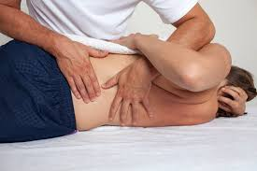
Mobilization- In general, they are passive, skilled manual therapy techniques applied to joints and related soft tissues at varying speeds and amplitudes using physiological or accessory motions for therapeutic purposes.

Slide 2
GRADES OF MOBILIZATION
Grade I – small amplitude movement at the beginning of the available range of movement
Grade II – large amplitude movement at within the available range of movement
Grade III – large amplitude movement that moves into stiffness or muscle spasm
Grade IV – small amplitude movement stretching into stiffness or muscle spasm
**A 5th grade is possible but further training will be required to perform safely**

