Slide 1
NATURALISM
Session (2022-23)
Director
Prof. Meeta Jamal
Department of Education D.W.T College Kanpur
Presented By
Shiv Charan Patel
Reg. No. PHD202300003037
C.S.J.M University Kanpur

Slide 2
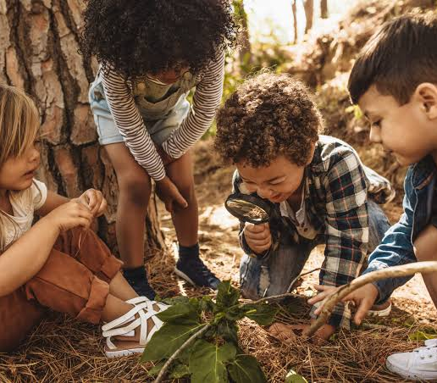
School of Philosophy Naturalism

Slide 3
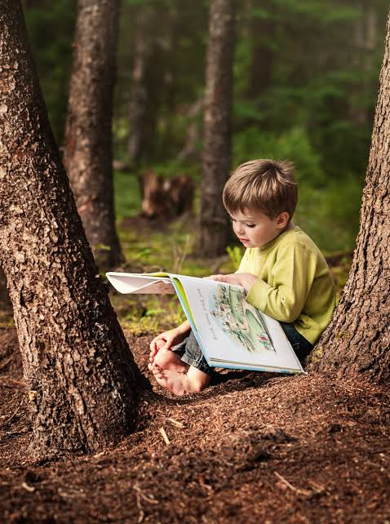
Contents
INTRODUCTION
DEFINITION OF NATURALISM
PROTAGONIST OF NATURALISM
NATURALISM IN EDUCATION
FORMS OF NATURALISM
CHARACTERISTICS OF NATURALISTIC EDUCATION
NATURALISM AND AIMS
NATURALISM AND CURRICULUM
NATURALISM AND METHODS OF TEACHING
NATURALISM AND TEACHER
NATURALISM AND DISCIPLINE
NATURALISM AND SCHOOL
DEMERITS OF NATURALISM
MERITS OF NATURALISM

Slide 4
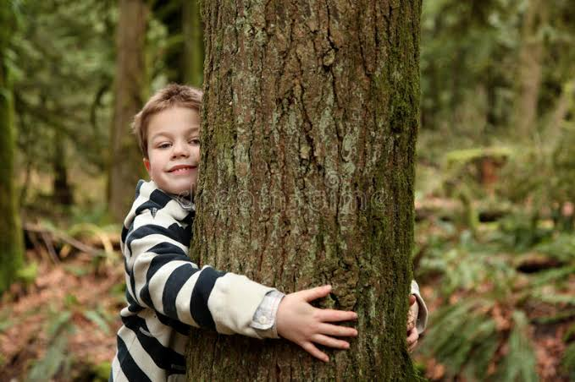
Introduction
Nature is everything , there is nothing beyond it.
Nature is also termed as materialism.
Man should investigate the truth of nature by scientific methods with all his capacities and resourcefulness.
It doesn't believe in sentimentalism, spiritualism and supernaturalism.
It emphasis on the nature in every field of education.
It gave importance to the matter and physical world.

Slide 5
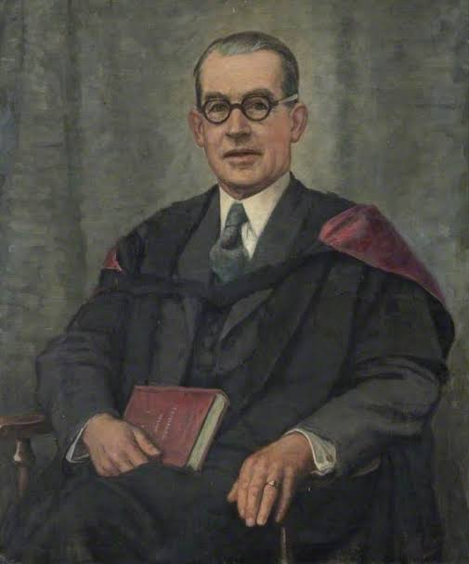
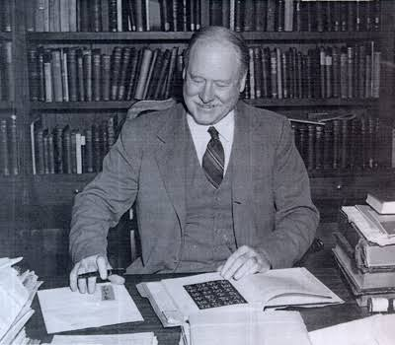
Definition of Naturalism
“Naturalism is a loosely applied in educational theory to systems of training that are not dependent on schools and books but on the manipulation of the actual life of the educated.” ………………………………………….….By J.S.ROSS
“ Naturalism is not science but an assertion about science , more specifically it is the assertion that scientific Knowledge is final , leaving no Room for extra scientific or philosophical knowledge.”................................................................................By R.B.PERRY
“ Naturalism is metaphysics which cosiders nature as the whole of reality . It excludes what is supernatural or the other world.”.........................................................……….……………………..By Hocking

Slide 6
Protagonist of Naturalism
Aristotle
Comte
Hobbes
Bacon
Darwin
Lamarck
Huxley
Herbert Spencer
Bernard Shaw
Samual Butler
Rousseau
Rabindranath Tagore

Slide 7
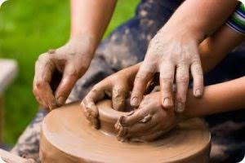
Naturalism In Education
In the field of education , naturalism means the development of the child according to his inherent nature.
According to Naturalism, the external laws of nature should co-operate with the internal nature of the child for his full natural development.

Slide 8
Forms of Naturalism
Physical :- It explains human activities and experiences in terms of material objects and natural laws.It lays more stress on the external material phenomena than the conscious man. Physical naturalism with great stress on physical science has not got much importance.
Mechanical:- According to it this universe is a huge lifeless machine which gets its form through matter and motion . Man is considered as a mere part of this huge machine which is set in motion through a external stimuli and forces of nature.Has given rise to modern psychology of behaviourism importance of conditioned responses.
Biological:- Based upon Darwin theory of education uphold that heredity has a powerful influence on the nature and temperament of an individual being.Biological naturalism emphasizes the development of man’s natural impulses, natural propensities and inborn tendencies.

Slide 9
Characteristics Of Naturalism Education
Back to Nature
Opposition to bookish Nature
Progressive
Negative Education
Central position of the Child
Freedom of the Child
Emphasis on the training of senses

Slide 10
Back To Nature : - “All the things are good as they come from the hands of the author of the nature, every where they degenerate in the hands of the nature.
Opposition to Bookish Nature:-According to “ROUSSEAU” We give too much importance to words. We produce by chattering education , education chatters only.If you are all the time teaching morals only to the child you will make him a fool . If your mind is always giving instructions to the child , then his mind will become useless. Whatever the child learns in the play ground is four times more useful than what he learns in the classroom.
Progressive:-Nature wills that children should be children before they are men.If we seek to pervert the order , we shall produce fruits without ripeness and flavours.- “ROUSSEAU”
Negative Education;- According to “ J.S.ROSS” A negative Education does not mean a time of idleness far from it. It does not give the virtue but protects from vice - versa. It does not inculcate truth , it protects from error. It disposes the child to take the path that will lead him to truth when he has reached it, and goodness, when he has acquired the faculty of recognizing and loving it.

Slide 11
Central Position Of the Child:-
According to “ ROUSSEAU” Give me a 12 years old boy who does not know anything . By 15years of age, I will teach him so much as other children read in 15 years of early life . The only difference will be that your student remembers only Knowledge and my student will be able to use it in practical life.
Freedom Of the Child:-
God makes all thing good , man meddles with them and they become evil.
- “ROUSSEAU”
Emphasis On the Training Of Senses:-
Senses are the gateways of the Knowledge. For effective learning adequate sensory experiences should be provided to the child.Education should prepare the way for reason by the Proper exercises of senses.

Slide 12
Naturalism And Aims
To perfect the human machine
Attainment of presents and future happiness
Preparation for struggle of life
Adaption to environment
Improve of racial gains
Natural development
Autonomous Development

Slide 13
Naturalism And Curriculum
Naturalists regard religious education as useless. According to them curriculum should consist of subjects and items which reflect the inborn tendencies and natural interests, natural activities , individual differences and sex problems of children so that they develop their individually naturally and normally . As such curriculum should contain , games,sports , physical , culture , biology , physics , nature study , language , history , geography and other allied subjects .
“ Herbert Spencer” a staunch Naturalist advocates “ complete living aim” of education and to achieve this aim , curriculum should contain physiology , biology , physical culture , chemistry , arithmetic , home - science and other scientific subjects as main subjects whereas language , literature , art , and other cultural subjects as subsidiary subjects.

Slide 14
Naturalism And Methods Of Teaching
In the field of Methodology , naturalism has made very significance contribution. In the traditional system of education , the same type of education was imparted to a group of individuals at a time . Naturalistic education opposed this traditional system and advocated the system of developing inherent tendencies by providing conducive experiences and the children inbibing knowledge by their own efforts , observations and experimentation.
Learning by doing.
Learning by experiences.
Learning by play as the bases of teaching.
Book reading is unpsychological.
Observation , Play-way Method , Heuristic Method.
Dalton plan , Montessori Methods & Other Constructive activities.
To engage in activities & experiences which are joyful & interesting.

Slide 15
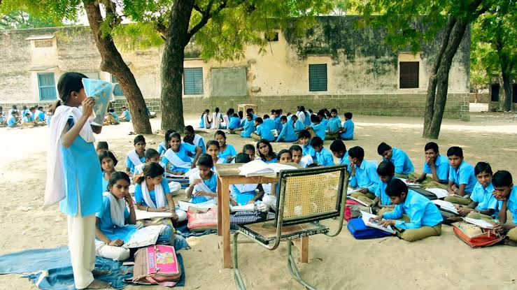
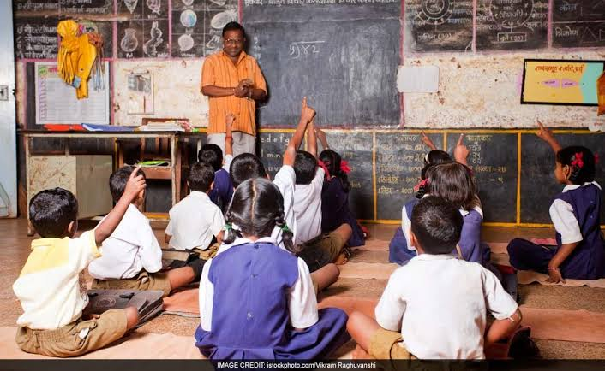
Naturalism And Teacher
“ROUSSEAU” thought the child as pure inherently. His natural development takes place only when he is allowed to develop freely without any hindrance interference from outside . Naturalists do not like that children should be tight in class by teachers who are spoiled by the artificial atmosphere of society . To them, Nature is the only supreme teacher , in whose close contact the child develops normally and naturally . In the process of education , the place of child is more important and central than the teacher . The teacher should not impose upon the child any thing under his own authority or supremacy . The teacher should so sympathetically and affectionately behave towards the child that he feels full freedom to develop himself according to his natural qualities , interests and capacities . The teacher is only to set the stage and allow the child to act freely according to his inherent capacities and the teacher is only to act as a sympathetic observer and guide.

Slide 16
Naturalism And Discipline
In the field of discipline also, Naturalists depend upon nature and consequences.
According to them nature will punish the child if he contravens the law of nature and thus he will learn by the consequences as of his own actions.
Thus, no body should interfere in this process of Nature.
“HERBERT SPENCER” Opines - “ WHEN A CHILD FALLS OR RUN ITS HEAD AGAINST THE TABLE , IT SUFFERS A PAIN, THE REMEMBERENCE OF WHICH TENDS TO MAKE IT MORE CAREFULL, AND BY REFLECTION OF SUCH EXPERIENCES, IT IS EVENTUALLY DISCIPLINED INTO PROPER GUIDENCE OF ITS MOVEMENTS.”

Slide 17
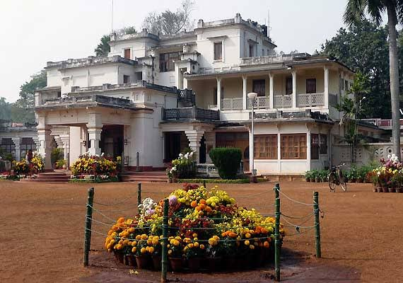
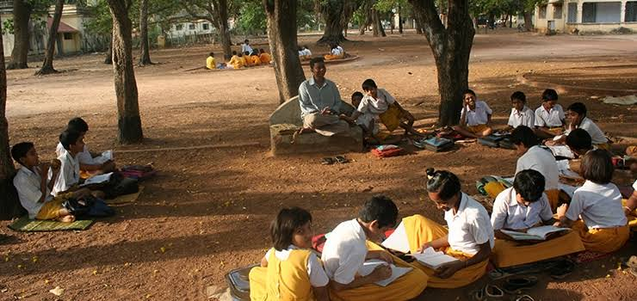
Naturalism And School
According to Naturalists , school environment should be completely free , flexible and without any rigidity .
There should not be any fixed time table and no forcing from above the readymade dozes of knowledge into the minds of children.
Nature will do all the planning and processing for the natural Development of children .
Nature itself structures all the free and desired experiences and also develops feeling of self- learning and self- discipline .
The TAGORES VISHWA BHARTI is model of such free school where children are given Free full freedom to plan their own interests and natural tendencies .
These creative and self creative activities go to develop the character and personality of the individual through self- discipline and freedom to experiment.
All modern and progressive schools adopt this concept of self - discipline to promote self - Development.

Slide 18
Merits And Demerits Of Naturalism
Merits
Development of Child psychology.
Scientific study of society and sociology.
Emphasis on experience - Centred Curriculum.
Important contribution in the field of methods of teaching.
Opposition to repression in the field of discipline.
Demerits
One - sided and unsatisfying aims of education.
Emphasis on present needs.
Ignores books.
Undue emphasis on physical education.
More importance to scientific subjects in curriculum.
Unlimited freedom of child .
No importance to teacher.
Anti - social.
Unappealing principle of Discipline by Natural consequences.

Slide 19
Conclusion
To sum up , it is regarded as the outstanding philosophy of education , as it gives important place to the child in the entire educative process by providing freedom for his natural development.
It is rightly said to be harbinger of progressive education.
Naturalism is naturo- centric.
According to this philosophy only material universe or nature alone is real.

Slide 20
References
Gaur, A.K. (n.d). Education Philosophy. 1st Ed. Alok Prakashan. 61-73.
Lal, R.B. (2018). Philosophical and Sociological Foundations of Education. R. Lal Book Depo. 170-182.
Odh, L.K. (2009). Philosophical Perspective of Education. Rajasthan Hindi Granth Academy. 19-33.
Saxena, N.R. S. (2002). Philosophical and Sociological Foundations of Education. R. Lal Book Depo. 207-219.

