Slide 1
Normal Microbial Flora of Human Body

Slide 2
Normal flora
Also called “indigenous microbiota”
Diverse group of microbial population that every human being harbors on his/her skin and mucous membranes
Sites - gastrointestinal tract (GIT), respiratory tract, genitourinary tract & skin

Slide 3
Normal Flora
Resident Flora
Life-long members of the body’s normal microbial community
Closely associated with a particular area, when disturbed re-establish themselves
Do not cause harm; rather can be beneficil

Slide 4
Transient Flora
Microorganisms that inhabit the body surface or mucous membranes temporarily for a short interval
Many are potential pathogens, e.g. pneumococcus and meningococcus in nasopharynx
Can be easily eliminated by following proper hand hygiene and other infection control practices
In hospitals, patients may acquire resistant organisms as transient flora from the healthcare workers and hospital environment
- MRSA in nose and skin

Slide 5
MICRO BIOLOGY OF NORMAL FLORA
Almost constant for an area of the body at a given age
Normal flora acquired soon after birth and persist till death
Their presence depends upon:
Local temperature, moisture, pH
Presence of certain nutrients and inhibitory substances
Environmental flora
Immune status of the individual
Anatomical site: Skin or mucosa


Slide 6
Composition: Predominantly bacteria & some fungi
Total population of normal flora - about 10¹⁴ bacteria; which is more than total number of cells (10¹³) present in human body
Anaerobes > aerobes
Anaerobic/aerobic bacteria varies depending upon the body site

Slide 7
GIT - predominant site
Commonest normal flora - Bacteroides fragilis; among aerobes - Escherichia coli

Slide 8
Anatomical Site | Total bacteria/ gm or ml | Anaerobic/ Aerobic Ratio | Anaerobic Normal flora (common) | Aerobic Normal flora (common)
Mouth |  |  |  | Predominant- | Less predominant-
Saliva | 10⁸–10⁹ | 1:1 | Anaerobic cocci Actinomyces Fusobacterium Bifidobacterium P.melaninogenica Spirochetes | Viridans streptococci | ---
Tooth surface | 10¹⁰–10¹¹ | 1:1
Gingiva | 10¹¹–10¹² | 10³:1
Nasopharynx |  |  |  | Predominant- | Less predominant-
 |  |  | Prevotella species Anaerobic cocci, Fusobacterium | Streptococci (α and non-hemolytic) Neisseria (non-pathogenic species) Diphtheroids, Staphylococcus epidermidis | Haemophilus, Meningococcus, pneumococci, Staphylococcus aureus, Gram-negative rods, Yeasts
GIT |  |  |  | Predominant- | Less predominant-
Stomach | 0–10⁵ | 1:1 | Lactobacillus | Helicobacter pylori
Jejunum/ileum | 10⁴–10⁷ | 1:1 | Anaerobic cocci Bacteroides fragilis Fusobacterium Bifidobacterium Prevotella Clostridium | Enterobacteriaceae and other Gram-negative rods, Enterococci, Streptococci (α and non hemolytic) | Diphtheroids Candida albicans and other yeasts Staphylococcus aureus
Terminal ileum & colon | 10¹¹–10¹² | 10³:1
Female genital tract |  |  |  | Predominant- | Less predominant-
Vagina | 10⁷–10⁹ | 10:1 | Anaerobic cocci Lactobacillus Prevotella Bifidobacterium Clostridium | Corynebacterium species, Lactobacillus species, Streptococci (α and non hemolytic) Neisseria (non-pathogenic species) | Enterococci, Enterobacteriaceae & other Gram-negative rods, S.epidermidis, Candida albicans and other yeasts
Skin |  |  |  | Predominant- | Less predominant-
 | 10²–10³ | 3:2 | Propionibacterium Anaerobic cocci | Staphylococcus epidermidis Diphtheroids Micrococcus species Neisseria (Non-pathogenic species) Streptococci (α and non hemolytic) | Staphylococcus aureus , Candida species, Acinetobacter species

Slide 9
Beneficial Effects of Normal Flora
Prevent colonization of pathogen: compete for attachment sites or for essential nutrients
Synthesize vitamin: Vitamin K and B complex
Waste produced antagonize other bacteria:
Fatty acids and peroxides
Lactic acid: Lactobacilli in vagina of adult females maintain acidic pH
Bacteriocin: antibiotic-like substances that can inhibit or kill other bacteria

Slide 10
Beneficial Effects of Normal Flora
Immune stimulation
Development of lymphatic tissues: e.g. Peyer’s patches in intestine
Stimulate antibody production: that cross-react with pathogens having related or shared antigens and prevent their entry
Complement activation: endotoxins liberated by the gram-negative normal flora → trigger alternative complement pathway

Slide 11
Beneficial Effects of Normal Flora
Prevent allergic diseases (Hygiene hypothesis):
- Lack of early childhood exposure to symbiotic microorganisms (e.g. gut flora or probiotics), infectious agents and parasites increases susceptibility of the individual to allergic diseases by suppressing the natural development of the immune system

Slide 12
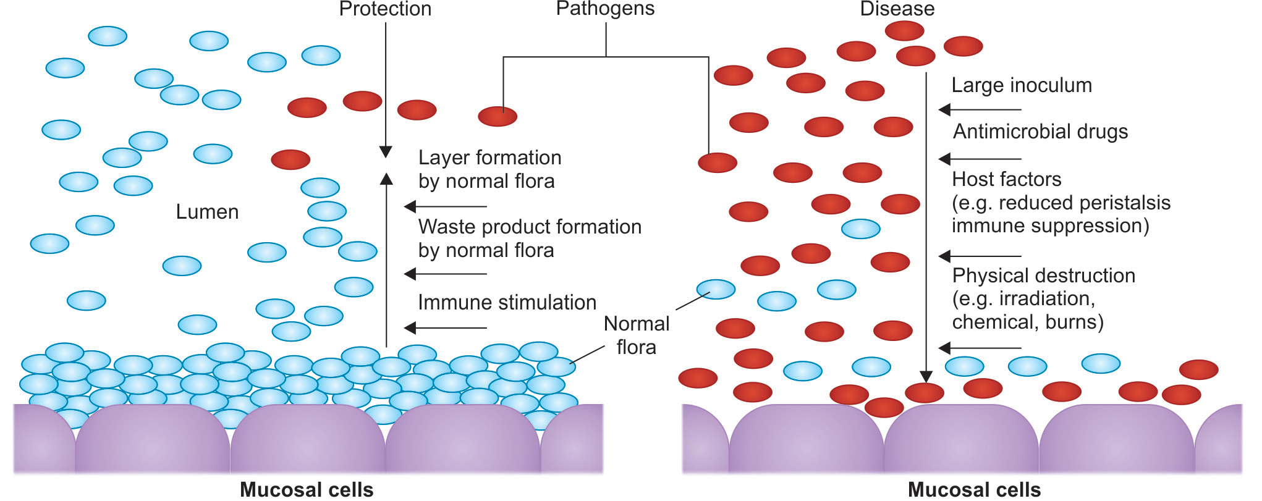
Beneficial Effects of Normal Flora

Slide 13
Disturbed Normal Flora Promote Infection
Mechanisms by which the normal flora is disturbed:
Injudicious use of broad spectrum antimicrobial agent: suppress the normal flora & permit pathogen to take the upper hand and cause infection - Clostridioides difficile causing pseudomembranous colitis
Host factors - immune suppression, reduced peristalsis → promote pathogen to grow
Physical destruction of the normal flora: irradiations, chemicals, burns

Slide 14
Disturbed Normal Flora Promote Infection
Inoculum size of entering pathogen is high then it can dominate over the normal flora
Minor trauma in mouth (e.g. by dental procedure, chewing or vigorous brushing) → entry of small numbers of bacteria (e.g. viridians streptococci) transiently into bloodstream →bacterial endocarditis

Slide 15
Harmful Effects of Normal Flora
May be agents of disease: endogenous disease
When the host immunity is lowered e.g. Gram negative organisms colonizing the respiratory tract → pneumonia
Entry into wrong site or tissue (e.g. blood, sterile body cavities)→ disease (E.coli, intestinal commensal → UTI)
Transfer to susceptible hosts: pathogens that colonize the upper respiratory tract (meningococcus, pneumococcus) can produce disease in susceptible hosts

Slide 16
Harmful Effects of Normal Flora
Bacterial synergism: Bacterial vitamins and growth factors may promote the growth of the potential pathogens
Contribute to the drug resistance of pathogens: normal flora produce enzymes such as beta lactamases which destroy the beta lactam antibiotics
Competition for host nutrients

Slide 17
Diseases produced by Normal Flora
Diseases produced by normal flora | Anatomical site from which the flora is transferred
Urogenital infections including UTI | E.coli, Klebsiella, Proteus
Endocarditis | Oral flora (Streptococcus viridans)
Dental caries and periodontal disease | Oral flora (Streptococcus mutans)
Peritonitis, abdominal infection | Intestinal flora
Pneumonia | Transient respiratory flora
Septicemia | From any site

Slide 18
Probiotics
Definition: As live microorganisms (part of normal flora) which, when administered in adequate amounts, confer a health benefit to the host
Indication: when normal intestinal flora is suppressed
Commercially available probiotics contain:
Bacillus coagulans
Bifidobacterium longum
Lactobacillus acidophilus
Saccharomyces boulardii

Slide 19
Uses of Probiotics
Gastroenteritis due to any cause
Antibiotic-associated diarrhea
Lactose intolerance
Irritable bowel syndrome and colitis
Necrotizing enterocolitis
Helicobacter pylori infection
Reducing serum cholesterol level by breaking down bile in the gut, thus inhibiting its reabsorption

Slide 20
Uses of Probiotics
Reducing blood pressure (by producing ACE inhibitor-like peptides during fermentation)
Immune function restoration and preventing infections
Modulate inflammatory and hypersensitivity responses
Bacterial vaginosis - restoring the acid pH of vagina by lactic acid producing bacteria

Slide 21
Prebiotics
Dietary nondigestible fibers which when administered, stimulate the growth and activity of commensal microorganisms and thereby exert beneficiary effect to the host indirectly

Slide 22
REFRENCES
Text Book Of Medical Microbiology by Ananth
Narayan Paniker
Text Book Of Medical Microbiology by D R Arora
Text Book Of Medical Microbiology by A S Sastry
Text Book Of Medical Microbiology by Baweja
Text Book Of Medical Microbiology by Satish Gupte

