Slide 1
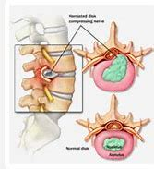
PIVD
Prolapsed Intervertebral Disc

Slide 2
PIVD Introduction
The spine consists of many vertebrae they are roughly circle and in between each vertebrae is a disc ( intervertebrae disc ) , the discs are constructed with strong rubber like tissue that allows a spine to become fairly flexible .

Slide 3
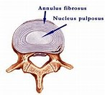
It lies between adjacent vertebrae in the vertebral column . A disc includes a stronger fibrous outer part (annulus fibrosis )... a soft jelly like middle part known as nucleus pulposes , disc behave as a shock absorber.

Slide 4
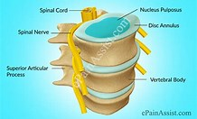
Defination-
a spinal disc prolapse is a condition in which tear in the outer fibrous ring that is annulus fibrosis which allows the soft central portion that is nucleus pulposes to buldge out beyond the damaged outer ring .

Slide 5
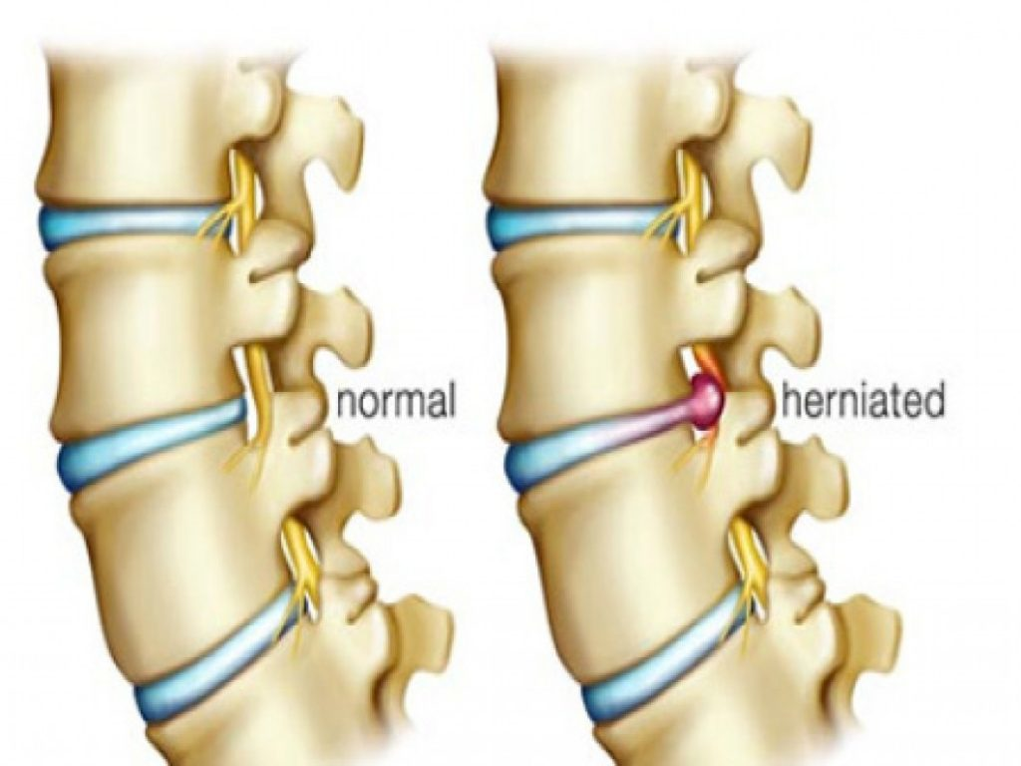
Diagram of IVD

Slide 6
Stages of PIVD
There are four stages of PIVD –
1) Bulging disc
2) Protrusion
3) extrusion
4) sequestrization

Slide 7
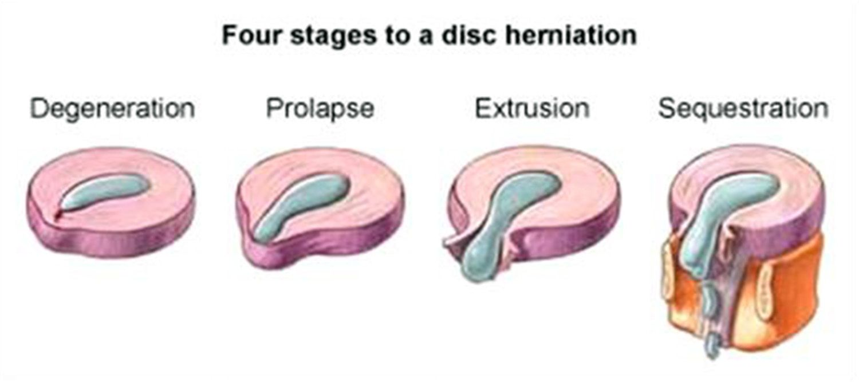
STAGES

Slide 8
Bulging disc
This is a early stage in which the disc is stretched and doesn’t return to its normal shape when pressure is relieved , it retains a slight buldge at one site of the disc in the nucleus pulposes is slipping outwards into the disc fibre but not out of the disc.

Slide 9
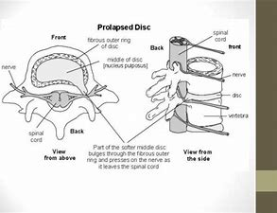
Protrusion
At this stage the bulge is very prominent and the soft jelly that is nucleus pulposes is slipped out to the inner edge of outer fibre , barely held in by the remaining disc fibre.

Slide 10
Extrussion
In this stage the nucleus pulposes has completely spilled out of the disc and now protruding out of the disc fibres.

Slide 11
Sequestrization
Here some of the nucleus pulposes is breaking off away from the disc into the surrounding area..causing symptoms or repercussions at an entirely different level of the spine .

Slide 12
PATHOLOGY
Tears are almost posterolateral in nature owing to the presence of the posterior longitudinal ligament (PLL) in the spinal canal... Ligaments of the spine are anterior longitudinal ligament ,posterior longitudinal ligament , ligamentum flavum , supraspinal ligament .. This tear in the disc ring may result in the release off inflammatory chemical mediators which may directly results in severe pain .

Slide 13
Disc herniation
Disc herniation which can occur to any part of the spine which can irritate the near by nerve ..a condition in which the outermost layer of of the annulus fibrosis but are in still contact but can bulge when the disc is underpressure.

Slide 14
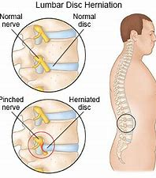
Epidimiology
Lumbar disc herniation occurs 15 times more often then cervical disc herniation , cervical disc are affected 8% of the time and thoracic only 1-2% of time .
4.8% males and 2.5% females older than 35 experiences more .

Slide 15
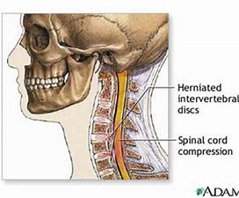
Location
in lumbar region it is 95% in L4 and L5 and L5 –s1
In cervical region C5 and C6 –C7 is the second most common site .
In thoracic region accounts for only 0.15% to 4.0% cases

Slide 16
etiology
Heavy mannual labour.
Repitative lifting and twisting
Postural stress
Obesity
Poor and inadequate strength of trunk
Sitting for `long hours
Occupational activities
Increasing age –the disc is more lightly to devlop a weakness with increased age .
Participation in sports for example : weight lifting , javenile thr

Slide 17
Pathology
There is sequence of changes in the disc which leads to its prolapse and the changes are
1) Nucleus degeneration : softening of the nucleus and its fragmentation , weakening and disintigeration of the posterior part of the annulus .
2) Nucleus displacement : when annulus becomes weak the nucleus tends to bulge through the defect protrusion and then nucleus comes out of the annulus fibrosis and lies under the posterior longitudinal ligament but has not loss contact with parental disc( extrussion )these are the displacement that occur.

Slide 18
PATHOLOGY
3) stage of fibrosis: this is a stage of repair , this begans along side of degeneration than the residual nucleus pulposes becomes fibrosed the extruded nucleus pulposes become flattened fibrosed and finally undergoes calcification .

Slide 19
Sign and symptoms
Lumbar Region :
1) severe low back pain
2) pain radiating to the buttocks leg and feet
3) pain may become worse with coughing , sneezing , straining and laughing
4) muscle spasm
Tingling and numbness in legs and feet
Muscle weakness or atrophy in later stage ( loss of bowel and bladder control in case of cauda equina syndrome .

Slide 20
SIGN AND SYMPTOMS
Cervical region :
1) arm muscle weakness
Deep pain near or over the shoulder blade on the affected side
2) increased pain when bending neck and turning head to the side ..spasm may also occur
3) burning pain radiating to the shoulder upper arm , forearm and rarely in head and fingers
4) tingling ( a pin and needle sensation ) or numbness in arm .

Slide 21
Investigations :-
1) X-ray of lumbosacral spine findings are
a) narrowed disc spaces
b) loss of lumbar lordosis
c) compensatory sceolosis
2) CT scan of lumbar spine –outline of soft tissue , bulging out disc
3) MRI of lumbar spine : intervertebral disc protrussion
2) compression of nerve root.

Slide 22
Examination :-
1) Posture : the patient stands with a rigid flattened lumbar spine the whole trunk is shifted forward . The trunk is tilted to one side .
2) movements : the patient is unable to bend forward muscle spasm in paraspinal muscle ( posterior compartment spine )
3) tenderness : diffused tenderness in the lumbosacral lies on localized tenderness in the midline or lateral to the spinous process.

Slide 23
TEST
4) Straight leg raising test (SLRT )it is of two types active straight leg raising test (ASLRT ) and passive straight raising test (PSLRT ) this test indicates the nerve root compression . It can be performed unilaterall

Slide 24
TEST
5) lasegue test : modified form of SLRT degree of variation .
6) Slump test : it is a neurological test or orthopaedic test .
7) neurological examination : it would reveal a motar weakness , sensory loss of reflex corresponding to the affected nerve roots .
8) ULTT/ LLTT must be done for proper diagnosis.

Slide 25
Differential diagnosis :-
A prolapsed disc is a common cause of low back pain sometimes back pain may be associated with sciatic pain .. Caution must be taken during diagnosis process and should not misguide with other disease like ankylosing spondylities , vascular insufficiency , or spinal tuberculosios ( pott’s spine ).

Slide 26
Treatment :-
1) conservative treatment ,
2) physiotheraphy treatment ,
3) operative treatment .

Slide 27
Conservative treatment :-
Rest and anti inflammatory and analgesics .
Continue bed rest and traction for first two weeks may lessen the herniation .
Rest on hard bed is necessary for not more than 2-4 days .

Slide 28
Physiotheraphy treatment :-
Physiotheraphy plays a vital role in the management of PIVD .
There are three phase
Acute phase
Subacute phase
Chronic phase

Slide 29
MANAGEMENT
Acute phase : rest is recomended as posture and activity modification by avoiding flexed posture, sitting for very longer duration , bending activities
Local support :-- as corset that is lumbo sacral belt etc.. These measure will enhance and stop reinjury to the herniated disc.
Short period of walking at regular intervals .

Slide 30
MANAGEMENT
Spinal extension exercises are beneficial in early treatment of disc related sign and symptoms.
Soft tissue Manipulation ( massage ) to lessen the local muscle spasm and induces relaxation .

Slide 31
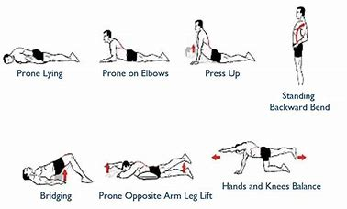
EXERCISE

Slide 32
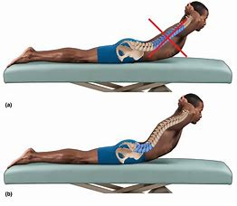
Correct pattern of spinal extension

Slide 33
Subacute Phase :-
Usually acute symptoms reduction in 6- 10 days .
The exercises of acute phase must be performed .
Nerve mobility exercises.
Isometrics of extensars of spine ,
Pelvic rocking exercise – can be achieved in supine ,sitting position that is cat and camel execise ( bird and dog position ) .
Patient should be encouraged to perform aerobic activities walking ,swimming , with patient tolerance .

Slide 34
MANAGEMENT
Chronic phase :- hamstring stretching
Stretching and adaptability exercising – stretching from the lumbar erector spinae and soft tissues posterior towards the spine that is knee to chest exercise.
Core strengtening exercises assist in relieving back pain .. The bridging exercise to strengten the core muscles.
Strengtening exercises – opposite arm and leg extension exercises on balancing or stabilizing exercises ( knee to chest exercises).
All exercises must be performed in gentle way .

Slide 35
SURGICAL MANAGEMENT
Operative Treatment are :-
1) Fenestration
2) Laminotomy
3) hemi – Laminectomy
4)Laminectomy

Slide 36
Precautions :-
Avoid bending ,
Lifting ,
Prolonged sitting .
Soft mattress should be used,
Heavy objects must not be carried .
Thank you..

