Slide 1
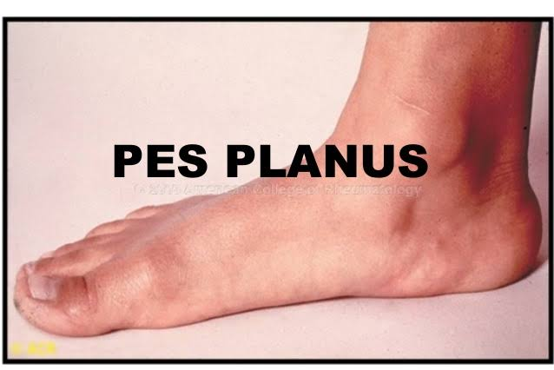
PES PLANNUS (FLAT FOOT)

Slide 2
INTRODUCTION
A foot deformity opposite to pes cavus.
The medial longitudinal arch of the foot is dropped downward,thereby, there is a loss of the spring action causing excessive stress over the whole foot during every step.

Slide 3
CAUSES
Pott’s fracture,crushed injury to the calcaneum,laxity of ligaments,bony ankylosis result in a rigid flat foot remaining flat even during non-weight bearing sometimes,there are spasmodic reflex contractions of the peronei
(For example rheumatoid arthritis and tuberculosis).
This is known as spasmodic flat foot.

Slide 4
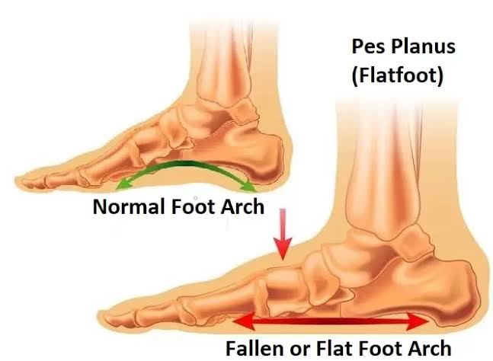
Foot Analysis

Slide 5
SYMPTOMS
Except for the spasmodic variety,it is usually pain free.
Later on weight bearing becomes painful.
TREATMENT:-
For children younger than 3 years,initial stage C and E heel shoes with medial arch support, and arch support in the foot wear should be used at home.
Custom prothesis for age group between 3 and 10 year.
At late stage, they will need well-moulded orthosis.

Slide 6
PHYSIOTHERAPY
Strengthening and endurances exercises to the intrinsics (in warm water ).
Corrective gait training with orthosis and bearing weight on the lateral border of the foot without orthoses.
Repetitive toe curling even with shoes on (it provides resistance).
SURGERY:-
Rarely performed procedures:-
Modified Hook-MILLER’S procedure
Durban’s flat foot plasty
Triple arthrodesis

