Slide 1
Proprioceptive neuromuscular facilitation

Slide 3
Indications of PNF –
-Improve joint ROM
-Increase extensibility of muscle tendon unit and periarticular connective tissue
-Return normal neuromuscular balance between muscle groups
-Reduce compression on joint surfaces
-Reduce injuries

Slide 6
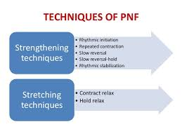

Slide 7
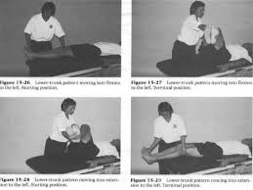

Slide 8
