Slide 1
PROSTHESIS

Slide 2
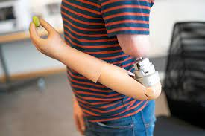
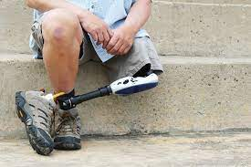
INTRODUCTION
Used to replace a missing limb or provide functions of an absent limb.
Replaced organ must be functional and cosmetically ideal.
It must perform it’s purpose.
Must be easy to maintain.
It must be comfortable for the patients and easy to don on or don off.
Person fabricating a prosthesis for patients is termed as Prosthetist.

Slide 3
CONSIDERATIONS FOR PROSTHESIS
REASONS
LEVEL OF AMPUTATION
CAUSE OF AMPUTATION
SHAPE OF STUMP
EXPECTED FUNCTION
MOTIVATION AND COGNITION
VOCATION AND HOBBY
COSMESIS
FINANCIAL BACKUP

Slide 4
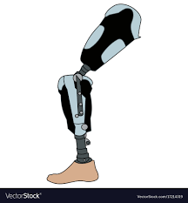
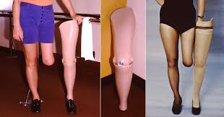
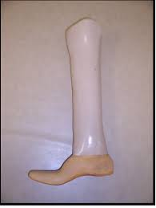
CLASSIFICATION
EXOSKELETON
Consists of outer laminated shell which provides the structural strength and weight transference of the body.
Whole prosthesis provides cosmetic appearance of the amputee limb.
Reference is taken from the other normal limb.
High density Polyethylene used.

Slide 5
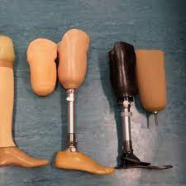
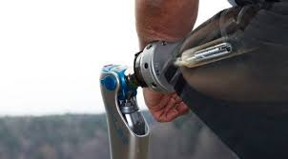
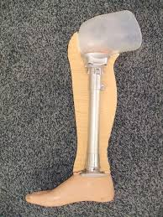
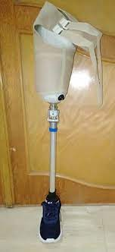
ENDOSKELETON
Modern in design
Inner endoskeleton (pylon) made of metal or carbon fibre provides structural integrity.
Internal modular component provides weight bearing.
Cosmetic appearance is provided by the shaped foam covers slipped over the modular components.
The foam cover is not very durable and needs to be replaced with time.

Slide 6
COMPONENTS OF PROSTHESIS
Socket: Supports the body weight; holds the stump; relief of overpressure from sensitive areas; design varies with level, size, shape and contour of the stump.
Terminal Device: most significant component; both function and cosmesis; in upper limb it is the hand and in lower limb it is the foot
Body: earlier made of wood; nowadays high density polyethylene used in exoskeletons; absorb shock; permit sports activities.
Suspension and Harness: In upper limb suspension is by figure-of-eight harness and controls of terminal device; In lower limb suspension is by Silesian band and suspension cuff.
Cosmetic Component: Used to satisfy psychological and cosmetic loss; gives shape and contour; replaces soft tissues.

Slide 7
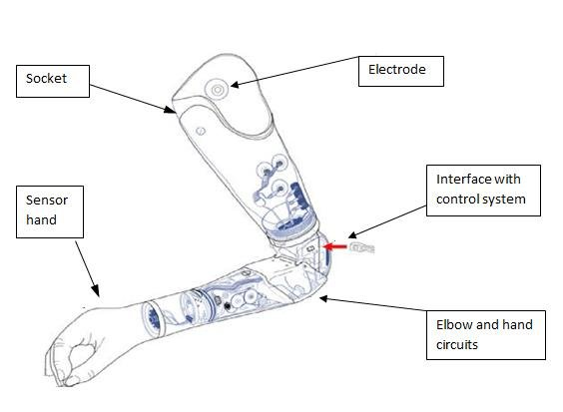
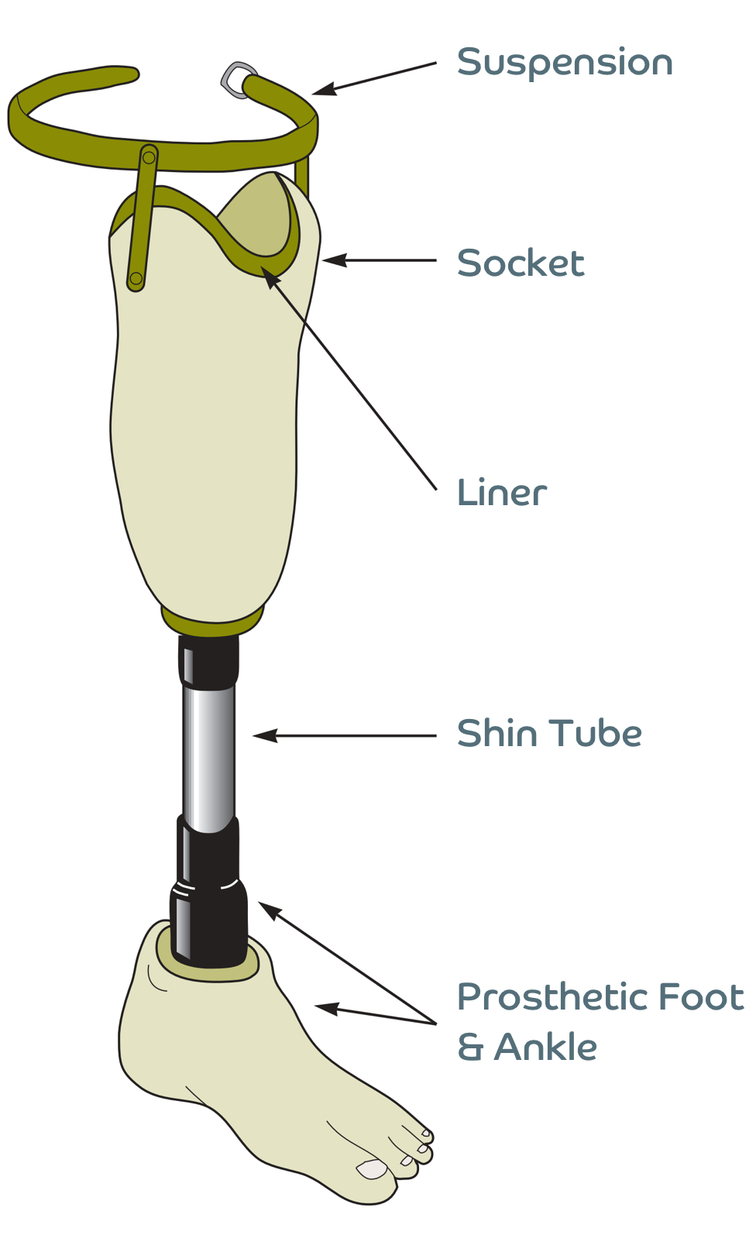
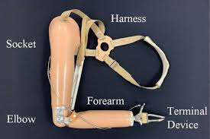
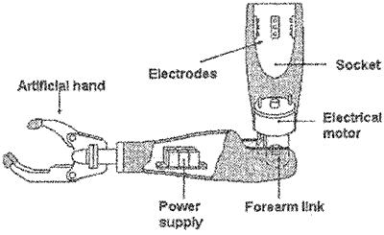

Slide 8
PARTS OF U/L PROSTHESIS
Plastic Laminate Socket: stump is inserted into the socket; comfortable fit between the stump and the socket; wrist unit is fixed onto the distal end of the forearm piece; The Muenster type of socket was designed to fit short below elbow stumps.
Harness: attached directly to the socket; provides stable support to the prosthesis; provides attachment for control cables; helps control terminal devices.
Bowden Cable: Movements are transmitted by the Bowden’s cable attached to terminal device and elbow unit; require intense practice and control before the prosthesis can be operated.
Terminal Devices: functional or mechanical hand attached through cables; only thumb, index and middle finger form the 3-jaw chuck pinch; classified into cosmetic hands, body powered hooks and hands which can be either Voluntary opening or voluntary closing types, externally powered hooks and hands like myoelectric.
Dorrance Hooks: used to grasp objects with just enough force that it does not break; voluntary closing devices are less popular than voluntary opening devices; Voluntary opening has 2 hooks maintained in closed positions and voluntary closing have hooks wide apart.

Slide 9
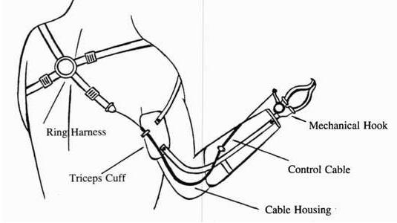
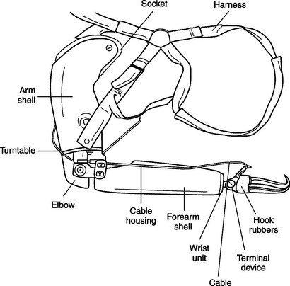
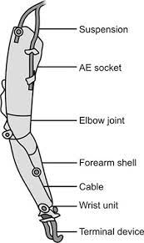
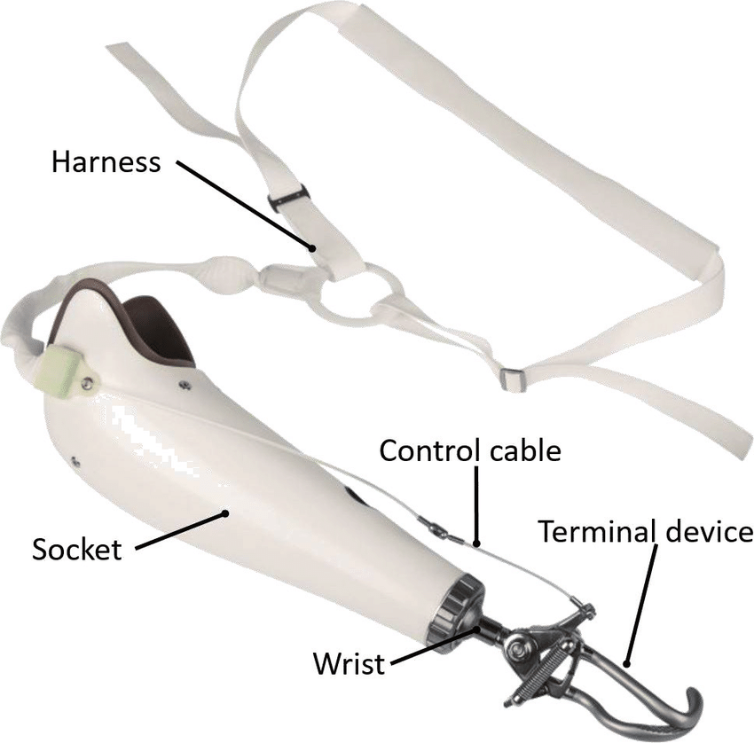
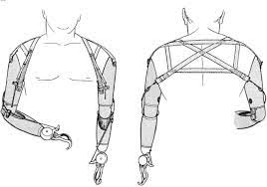

Slide 10
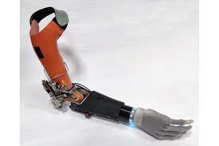
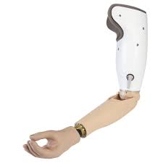
ABOVE ELBOW PROSTHESIS
It has an upper arm unit, below elbow unit connected by elbow joint.
Cable control system is called the Bowden dual control cable system, because it controls the movements of both elbow and terminal devices.
Stump socks are worn by patients to absorb perspiration, provide warmth and to enhance comfort and fit of the socket.
Very often a unilateral AE amputee chooses to use a cosmetic hand without function.

Slide 11
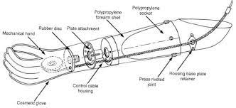
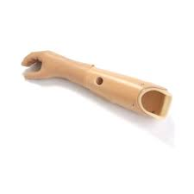
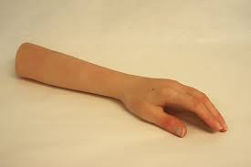
BELOW ELBOW PROSTHESIS
Same as above elbow prosthesis except for elbow unit and dual control cables.
Anatomical elbow present
Cable system operates the mechanical terminal devices
More convenient than above elbow prosthesis

Slide 12
MYOELECTRIC PROSTHESIS
Uses signals or potentials from muscles through electromyography within a person’s stump.
Control of the motor regulates the extent or speed of the prosthesis such as elbow flexion or extension, or opening and closing of the fingers of the terminal devices.
It uses natural muscle stimuli, less energy expenditure, decreased body movements to control prosthesis, provides more mobility pinch force and cosmetic appearance than body powered prostheses.
The basic disadvantages include that it is very expensive, need servicing on regular basis, battery needs to be recharged regularly, lack of proprioceptive feedback, cannot control fine rhythmic and fine movements, poor motor control, dysfunctional in water, it is heavy, needs skilled technical backup to repair.

Slide 13
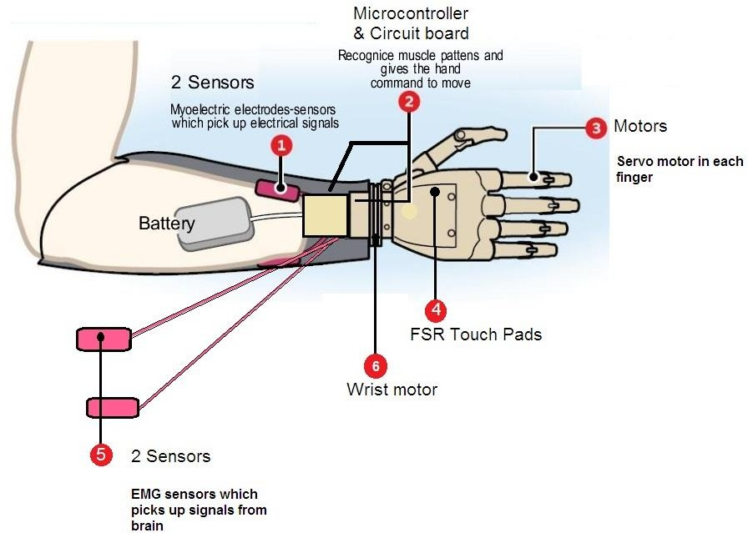
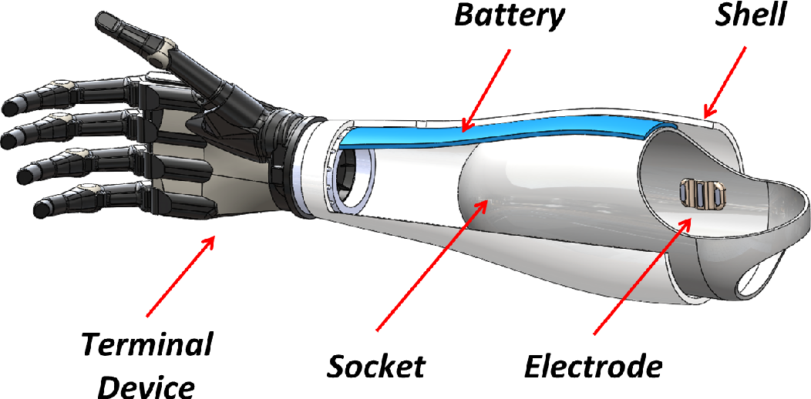
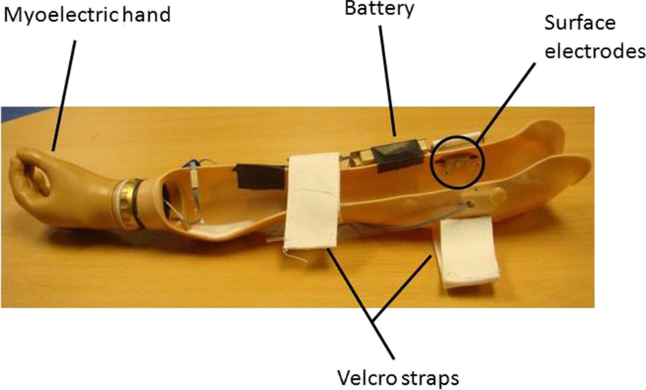
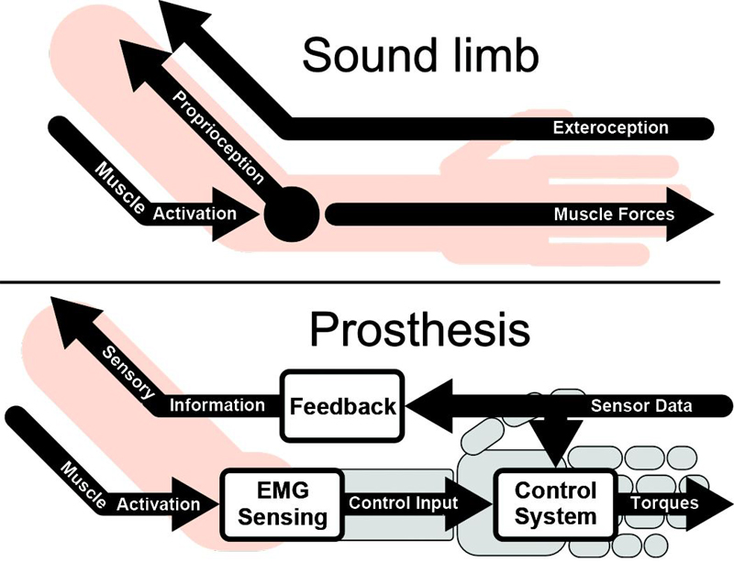

Slide 14
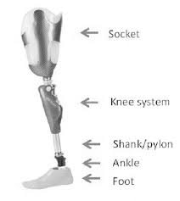
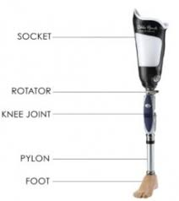
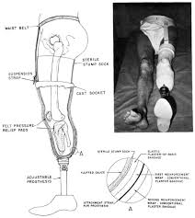
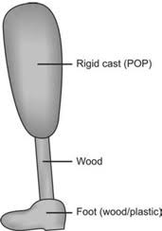
PARTS OF L/L PROSTHESIS
Socket construction: individually constructed for every patient.
Body of Prosthesis: emphasis is on the stability, weight bearing and light weight of the extremity; exoskeleton is made up of resin, HDPE, willow wood, etc; endoskeleton is made up of metal alloy pylons.
Foot: ideally performs the planterflexion, dorsiflexion, inversion and eversion; absorbs shock; provides stable base of support; stimulates muscle activity.

Slide 15
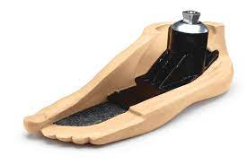
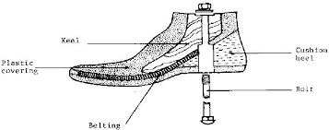
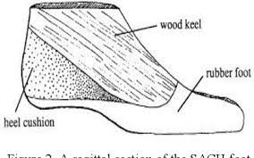
SOLID ANKLE CUSHION HEELS (SACH)
It is a non articulated device with a solid wood or aluminium heel, a sponge rubber heel and a moulded cosmetic forefoot.
Mild hyperextension of the rubber toe and the forefoot is possible in late stance and push off phases.
Can be used only with shoes since shape of the toes are not discernable.

Slide 16
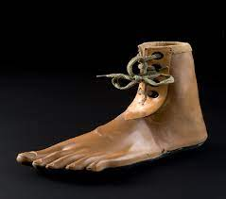
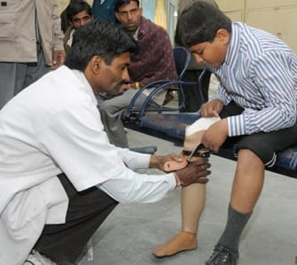
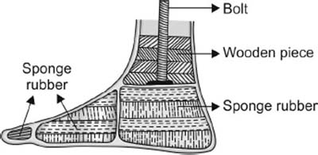
JAIPUR FOOT
Cheaper alternative of the SACH foot
Developed at the SMS Medical college Jaipur by Prof P K Sethi and team
Provides barefoot walking
Foot and ankle assembly is made up of uncured rubber material
Exterior is made up of waterproof durable material for field works.
Raw material is locally available.

Slide 17
SYME’S PROSTHESIS
Syme’s amputation provides a weight-bearing surface at the distal end, the heel, along the shaft of the tibia
A window is cut along the medial wall of the socket to allow the bulbous end, created by the tibial condyles, to slide down to the end bearing part of the prosthetic foot.
The medial window also reduces the mechanical strength of the prosthesis.
The design is exoskeletal, but the weight is born distally.
The closed, expandable socket Syme prosthesis was developed for modified Syme amputation.
Conventional Syme’s Prosthesis: It provides full weight bearing on the distal end of the stump. An amputee can walk even without prosthesis in case of emergency like going to toilet in the night. However for a female, it is cosmetically not acceptable since it is bulky.
PTB Syme’s Prosthesis: When the heel pad is not sufficient or in cases of sensory impairment at the end of the stump, then partial weight is taken on the patellar tendon as in a conventional PTB socket.

Slide 18
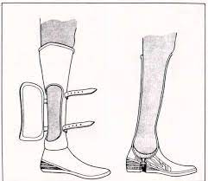
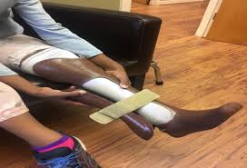
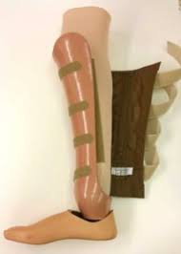
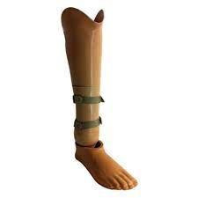
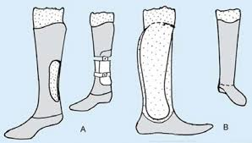

Slide 19
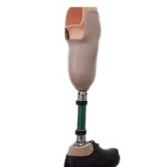
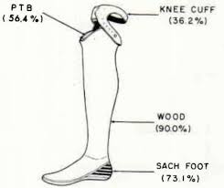
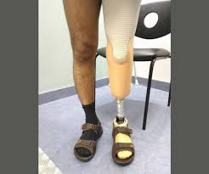
BELOW KNEE PROSTHESIS FOR TRANSTIBIAL AMPUTATION
The prosthesis is sometimes called PTB prosthesis
The patellar tendon bearing (PTB) socket is the standard transtibial socket.
Areas of relief from pressure include the head of the fibula, the distal ends of both the tibia and the fibula, and the shin.
Most PTB prostheses are constructed with a soft-liner made of polyethylene foam or silicone gel that acts an interface between the residual limb and the hard socket.
The liner absorbs some of the compressive and shear forces generated during ambulation, thus cushioning and protecting the stump.
There is medio-lateral knee stability

Slide 20
ABOVE KNEE PROSTHESIS FOR TRANSFEMORAL AMPUTATION
Quadrilateral Socket: It was developed in the late 1950s; named for its four walls; Most of the weight is borne along the posterior wall; Anterior Wall rises about 5 cm above the height of the posterior wall; lateral wall is as high as the anterior wall; Medial Wall is vertical and prevents medial movement of the residual limb within the socket, especially during stance.
Suspension Mechanism: The Silesian band is a soft strap of leather that is attached to the lateral socket wall, encircles the pelvis, and connects with a strap on the anterior wall. The Silesian band aids suspension and provides some control of rotation; The pelvic belt provides some medio-lateral stability in patients whose weight fluctuates widely. It is made of metal and leather and encircles the pelvis. There is a hip joint which connects it to the supero-lateral aspect of the socket.
Knee Joints: The knee joint is aligned in the prosthesis with the client’s knee in extension; knee control mechanisms can be divided into Constant friction, Stance control, Polycentric knee, fluid controls and manual locking; Multiaxis knee joints are usually four bar linkage systems. They are polycentric axis knees; The manual lock knee provides absolute stance phase control as the knee remains locked and stiff in extension throughout the gait cycle.

Slide 21
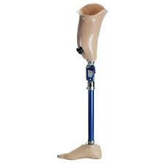
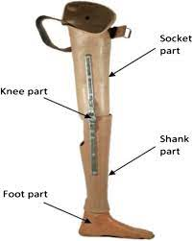
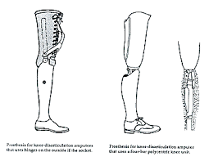
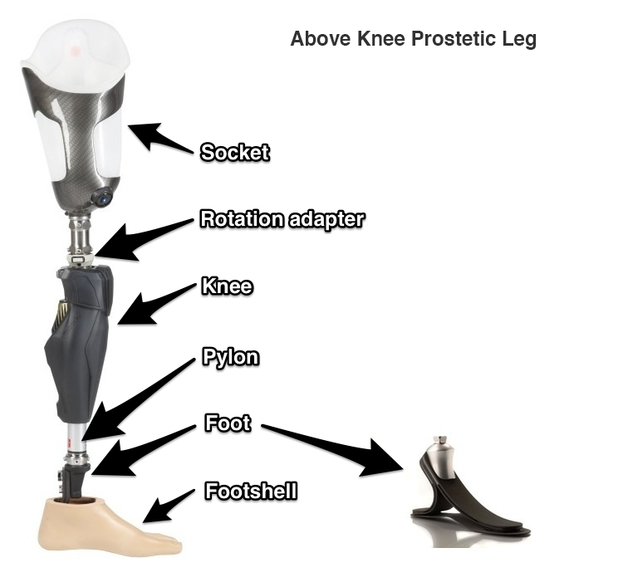
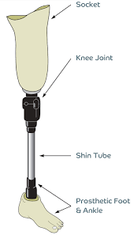

Slide 22
PROSTHESIS FOR HIP DISARTICULATION
In Trans-pelvic amputation
Rejection rate of this prosthesis is high, as the cadence is slow and requires great energy.
Wearers find the prosthesis heavy and uncomfortable.
The hip disarticulation socket is made of plastic, encloses the ischial tuberosity for weight bearing and covers the iliac crest for stability in swing phase.
The trans-pelvic socket is similar except that it must include the contralateral iliac crest for proper stabilization and suspension.
Any knee joint can be used in the hip disarticulation prosthesis.
Any of the prosthetic feet can be used with these prostheses.

Slide 24
PT MANAGEMENT
Physiotherapy interventions are needed in both the phases of prosthetic use, i.e., before prescribing prosthesis and after prescribing prosthesis.
Before prescribing prosthesis is becomes very important to not only prepare the patients mentally about the prosthesis but also to make the remaining musculature strengthen to provide stability and movement to the prosthesis.
Pre prosthetic management includes counseling of patients, training of patients for the type of prosthesis being prescribed, taking care of the stump, ADL training of individuals within their ability ranges and, strengthening of the opposite extremity or the core to provide strength during weight transference.
Post Prosthetic training includes balance training, gait training, stump care- management, ADL training, vocational training and, in some cases use of assistive devices like crutches, walkers, etc.

