Slide 1
PSYCHOLOGICAL ASPECT OF REHABILITATION

Slide 2
Contents
Introduction to Rehabilitation Psychology
History of Rehabilitation psychology
India and Rehabilitation Psychology
Indications for Rehabilitation Psychology
Models of Rehabilitation Psychology
Facilitators and Barriers of Psychological Rehabilitation
Aspects of Psychological Rehabilitation
Role of physiotherapist in Rehabilitation Psychology

Slide 3
Introduction
“Rehabilitation Psychology is a specialty area of psychology aimed at maximizing the independence, functional status, health, and social participation of individuals with disabilities and chronic health conditions overall and specifically with gaining and advancing with employment”
OR
“Rehabilitation psychology is a specialty area within psychology that focuses on the study and application of psychological knowledge and skills on behalf of individuals with disabilities and chronic health conditions in order to maximize health and welfare, independence and choice, functional abilities, and social role participation”
OR
“ A rehabilitation psychology is that particular stream of physical medicine which deals with the psychological aspects like cognition mental health, mood, emotions, affection, disgrace, anxiety and other experiences which an individual or an athlete undergoes in day to day life”
Knuth A, Ross-Stewart L, Brent C, Salerno R. Psychological Aspects of Rehabilitation as Perceived by Physical Therapists. J Phy Fit Treatment & Sports. 2018; 2(1): 5555
M Sarada Menon; Psychosocial Rehabilitation; NIMHANS Journal; 14(4) 1996; 29-305

Slide 4
Introduction
Deals with assessment and treatment may include the following areas: psychosocial, cognitive, behavioral, and functional status, self-esteem, coping skills, and quality of life.
Rehabilitation psychologists provide clinical services in varied healthcare settings, including acute care hospitals, inpatient and outpatient rehabilitation centers, assisted living centers, long-term care facilities, specialty clinics, and community agencies.
A rehabilitation psychologist addresses that psychosocial factors, in relation to patients’ experience of pain, may explain why some patients are unable to make a full recovery.
Knuth A, Ross-Stewart L, Brent C, Salerno R. Psychological Aspects of Rehabilitation as Perceived by Physical Therapists. J Phy Fit Treatment & Sports. 2018; 2(1): 5555
M Sarada Menon; Psychosocial Rehabilitation; NIMHANS Journal; 14(4) 1996; 29-305

Slide 5
History
Rehabilitation came into existence after the World Wars and because of their soldiers and activists working that time.
Medicine has always been keen on findings solutions to problems which not only last long but also consider rehabilitation in the centre stream of treatment line.
Psychological aspects of rehabilitation is said to have been originated and conceptualized in 1960s and 1970s.
Along with rehabilitation taking mainstream into treatment psychological aspects have been illustrated as important parameter by the World Health Organization.
Previously, psychological rehabilitation was provided by doctors and nurses along side main medications.
Present scenario has resulted in an increase of these therapies being provided by professional psychiatrists, physiotherapists, occupational therapists and sometimes vocational therapists.
Worldwide, these services are being rendered by specialized Psychological therapists but many countries have incorporated dealing of such patients under Sports Rehabilitation Specialists.
Knuth A, Ross-Stewart L, Brent C, Salerno R. Psychological Aspects of Rehabilitation as Perceived by Physical Therapists. J Phy Fit Treatment & Sports. 2018; 2(1): 5555
M Sarada Menon; Psychosocial Rehabilitation; NIMHANS Journal; 14(4) 1996; 29-305

Slide 6
Detailed History at a Glance
There was a mental hospital at Dhar, near Mandu, in Madhya Pradesh, established by Mohammed Khilji in the 15thcentury between 1436 –1469 A.D.
In 1929, The Indian Association for Mental Hygiene was founded by Dr. Barkeley Hill. Subsequently The Indian Psychiatric Society (IPS) was established on 7thJanuary 1947 by a group of Indian Psychiatrists.
In 1960, the first day care centre for the mentally ill was established by the All India Institute of Mental Health, Bangalore.
The ALMA ATA declaration was proclaimed in 1970, the 7thcomponent was the promotion of mental health through primary health care system in the community
In 1982, National Mental Health Programme (NMHP) was inceptioned by the Government of India. It was a landmark in the field of psychosocial rehabilitation.
In 1985, the community based rehabilitation programme was launched by the United Nations.
In 1986, World Association for Psychosocial Rehabilitation (Indian Chapter) (WAPR -IC) was established by Dr. Sarathamenon at Madras.
In December 1995, People With Disability Act (Equal opportunity, Protection of rights, Full participation) was enacted by the Government of India and was implemented in February 1996.
In 1954, the involvement of family in the psychiatric treatment was initiated by Dr. Vidya sagar, at Amritsar Hospital in Punjab.
In 1960s,the Mental Health Centre was started at Christian Medical College Hospital at Vellore, Tamil Nadu.
In 1964, the first voluntary organisation for the persons with mentally illness was established by a group of people at Bangalore, called Medico Pastoral Association (MPA).
In 1999, National Trust Act was enacted and implemented by the Government of India. This act for persons with autism, cereparal palsy, mental retardation and multiple disabilities
Knuth A, Ross-Stewart L, Brent C, Salerno R. Psychological Aspects of Rehabilitation as Perceived by Physical Therapists. J Phy Fit Treatment & Sports. 2018; 2(1): 5555
M Sarada Menon; Psychosocial Rehabilitation; NIMHANS Journal; 14(4) 1996; 29-305

Slide 7
India and Rehabilitation Psychology
In India, rehabilitation psychologists render their services through various modes.
Psychiatric rehabilitation in India is in dynamic growth since the 1990s.
Three sectors which hire the most amount of these personnel in India include Hospital sector, NGOs and community initiatives.
Organized and financed government aided Psychosocial rehabilitation centres are still scarce and 60% of them remained on papers only.
NHRC report of 1999 states that 63% hospitals had a general rehabilitation service for all the aspects of rehabilitation throughout the country.
Well known NGOs in India like Medical Pastoral Association in Bangalore, Richmond Fund Society, Schizophrenia Research Foundation (SCARF) at Chennai, etc. are providing not only residential facilities but vocational facilities at their centres.
25+ day care centres work all over India with majority of them being in South India.
Training of skilled professionals for jobs in this sector is usually taken up by the Rehabilitation Council of India in association with the Indian Psychiatric Society, Indian Association of Social Psychology, World Association of Psychosocial Rehabilitation, etc.
Knuth A, Ross-Stewart L, Brent C, Salerno R. Psychological Aspects of Rehabilitation as Perceived by Physical Therapists. J Phy Fit Treatment & Sports. 2018; 2(1): 5555
M Sarada Menon; Psychosocial Rehabilitation; NIMHANS Journal; 14(4) 1996; 29-305

Slide 8
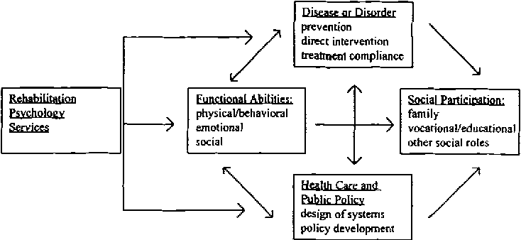
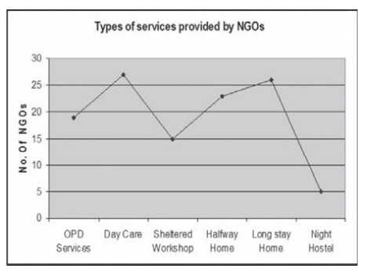

Slide 9
Indications
Why should I seek Psychological Rehabilitation?
Chronic illness
Prolonged Hospitalization
Amputation
Mental disabilities
Lack of social life
Prolonged isolation
Knuth A, Ross-Stewart L, Brent C, Salerno R. Psychological Aspects of Rehabilitation as Perceived by Physical Therapists. J Phy Fit Treatment & Sports. 2018; 2(1): 5555
M Sarada Menon; Psychosocial Rehabilitation; NIMHANS Journal; 14(4) 1996; 29-305

Slide 10
Models
Working of a psychological rehabilitation is conceptualized to be assertive to four main models, which are:
Integrated model by Liberman
Impairment, Disability and Handicap model
Stress, Vulnerability Coping and Competence Model
Biopsychosocial Model
Knuth A, Ross-Stewart L, Brent C, Salerno R. Psychological Aspects of Rehabilitation as Perceived by Physical Therapists. J Phy Fit Treatment & Sports. 2018; 2(1): 5555
M Sarada Menon; Psychosocial Rehabilitation; NIMHANS Journal; 14(4) 1996; 29-305

Slide 11
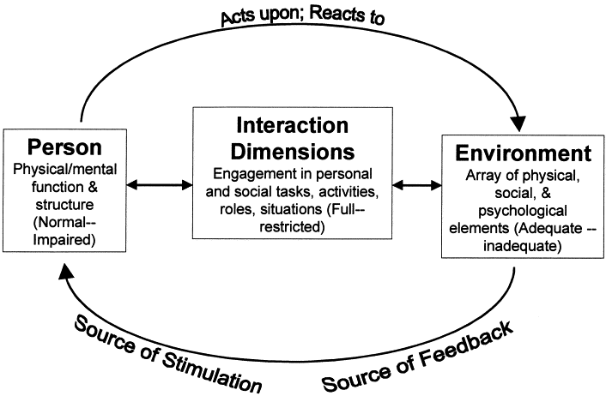
ICIDH Model for Psychiatric Rehabilitation
Knuth A, Ross-Stewart L, Brent C, Salerno R. Psychological Aspects of Rehabilitation as Perceived by Physical Therapists. J Phy Fit Treatment & Sports. 2018; 2(1): 5555
M Sarada Menon; Psychosocial Rehabilitation; NIMHANS Journal; 14(4) 1996; 29-305

Slide 12
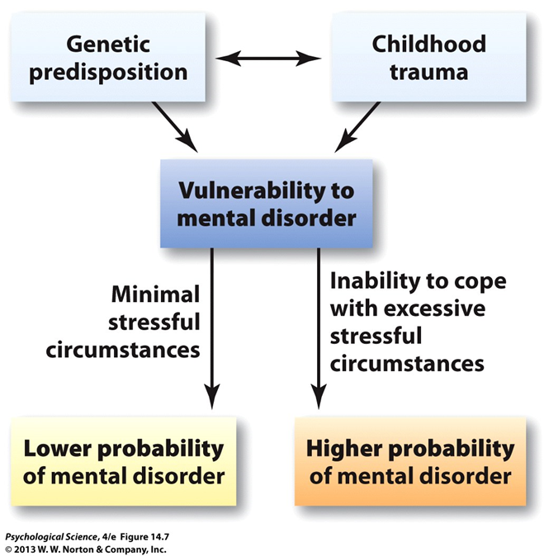
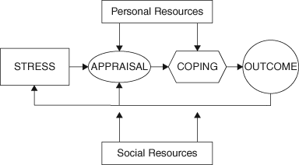
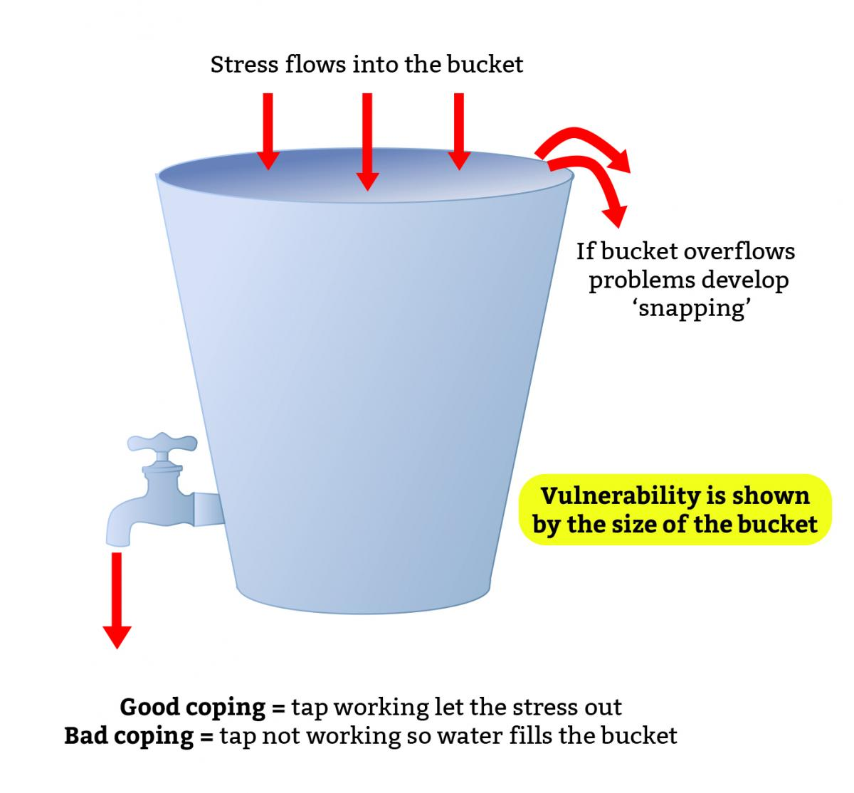
Stress, Vulnerability Coping and Competence Model
Knuth A, Ross-Stewart L, Brent C, Salerno R. Psychological Aspects of Rehabilitation as Perceived by Physical Therapists. J Phy Fit Treatment & Sports. 2018; 2(1): 5555
M Sarada Menon; Psychosocial Rehabilitation; NIMHANS Journal; 14(4) 1996; 29-305

Slide 13
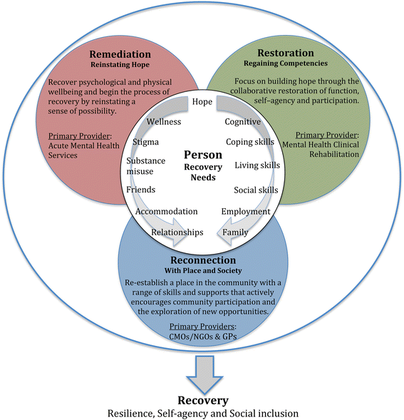
Integrated Approach

Slide 14
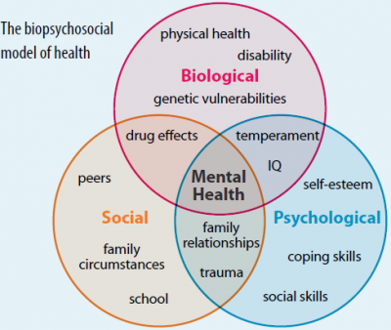
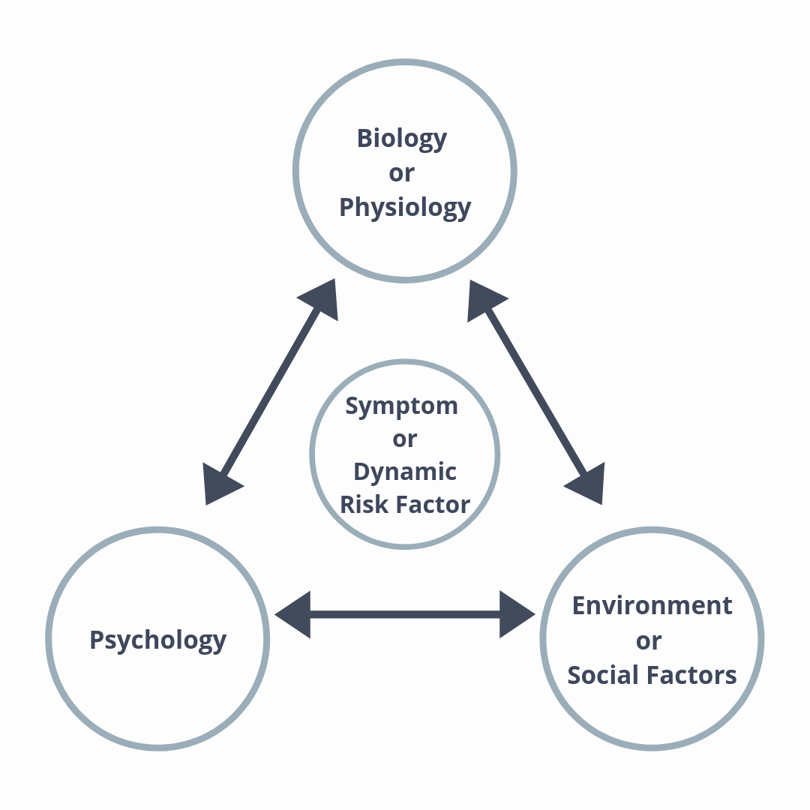
Bio-psycho-social Model
Knuth A, Ross-Stewart L, Brent C, Salerno R. Psychological Aspects of Rehabilitation as Perceived by Physical Therapists. J Phy Fit Treatment & Sports. 2018; 2(1): 5555
M Sarada Menon; Psychosocial Rehabilitation; NIMHANS Journal; 14(4) 1996; 29-305

Slide 15
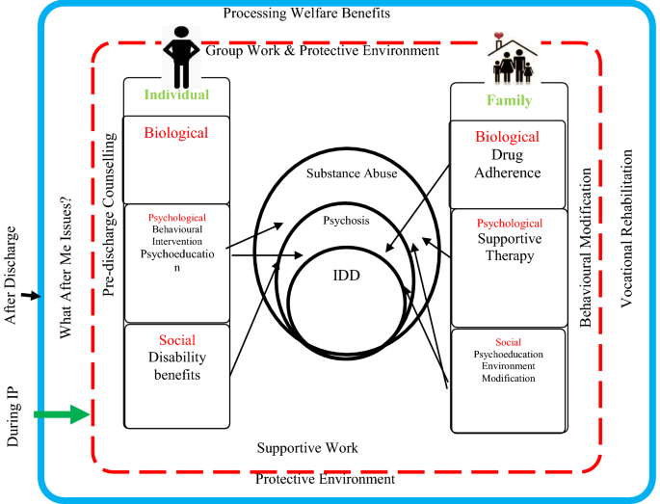

Slide 16
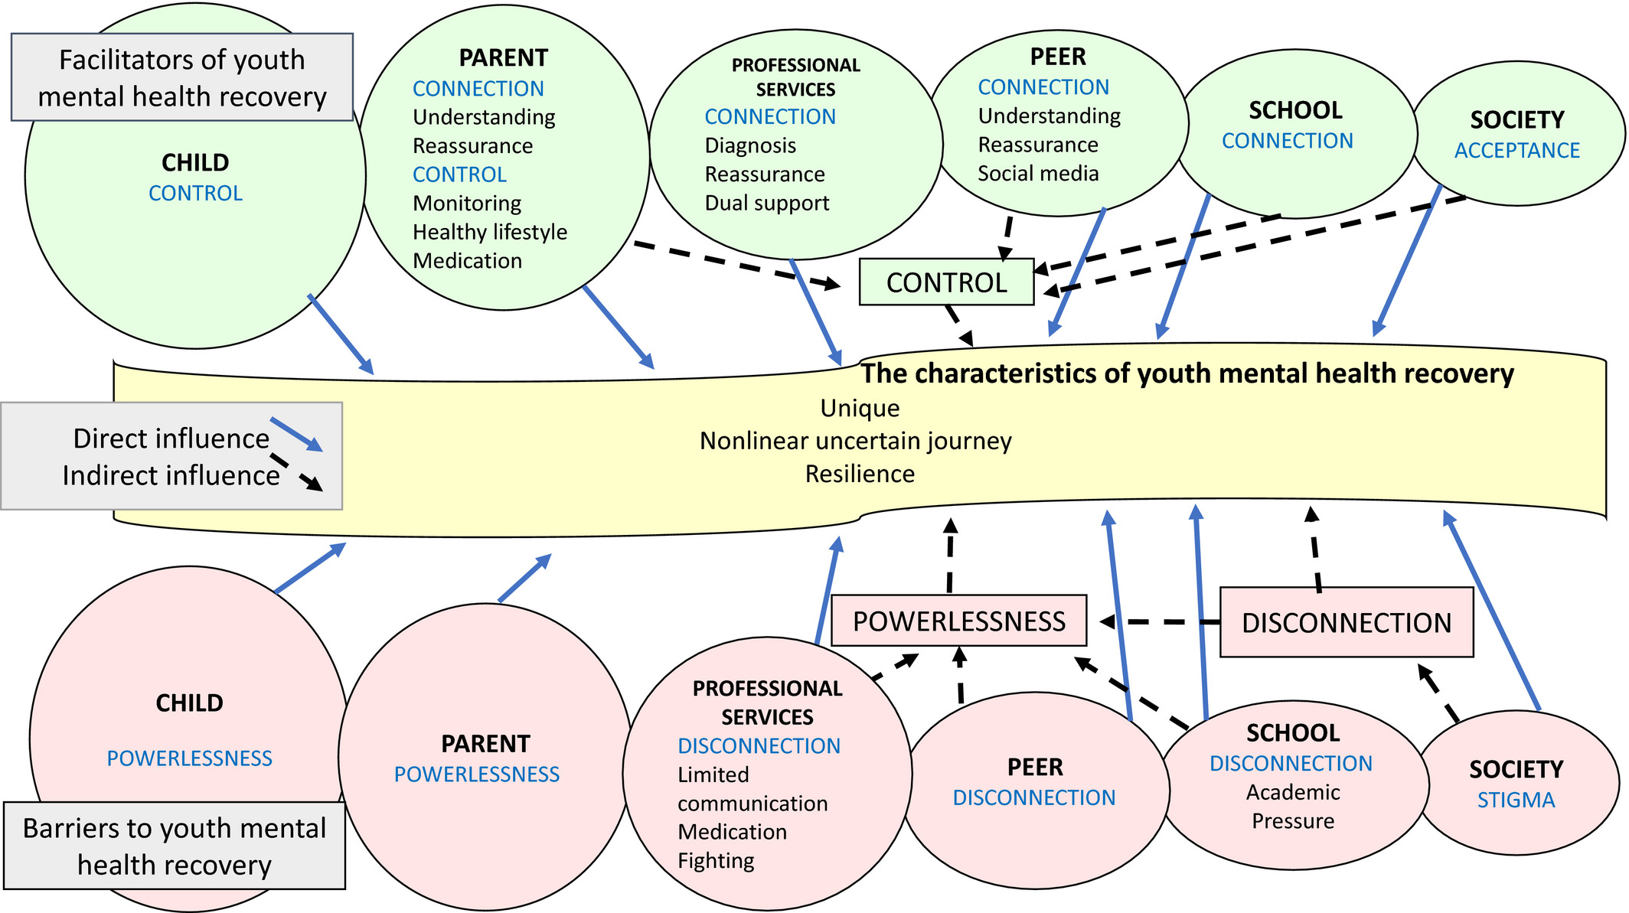
Facilitators and Barriers
Knuth A, Ross-Stewart L, Brent C, Salerno R. Psychological Aspects of Rehabilitation as Perceived by Physical Therapists. J Phy Fit Treatment & Sports. 2018; 2(1): 5555
M Sarada Menon; Psychosocial Rehabilitation; NIMHANS Journal; 14(4) 1996; 29-305

Slide 17
Aspects of Psychological Rehab
Treatment strategies often used with patients requiring psychological rehabilitation include:
Cognitive therapies
Cognitive Behavioural Therapy (Most recent therapy devised)
Skill training (considered as elementary in psychological rehabilitation)
Knuth A, Ross-Stewart L, Brent C, Salerno R. Psychological Aspects of Rehabilitation as Perceived by Physical Therapists. J Phy Fit Treatment & Sports. 2018; 2(1): 5555
M Sarada Menon; Psychosocial Rehabilitation; NIMHANS Journal; 14(4) 1996; 29-305

Slide 18
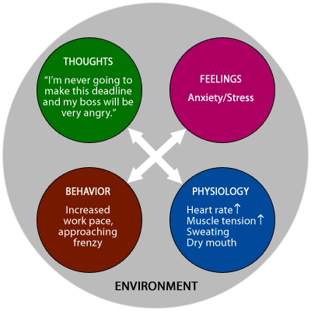
Cognitive Therapies
Transcranial Direct Current Stimulation (tDCS)
Cognitive training
Cranial electrical stimulation (CES)
Counselling
Group Psychotherapy
Brain storming
Knuth A, Ross-Stewart L, Brent C, Salerno R. Psychological Aspects of Rehabilitation as Perceived by Physical Therapists. J Phy Fit Treatment & Sports. 2018; 2(1): 5555
M Sarada Menon; Psychosocial Rehabilitation; NIMHANS Journal; 14(4) 1996; 29-305

Slide 19
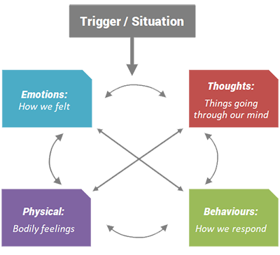
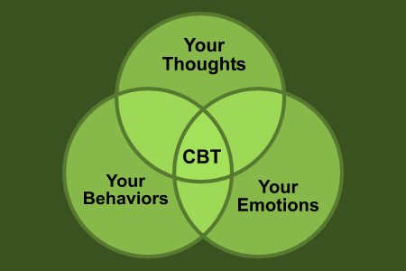
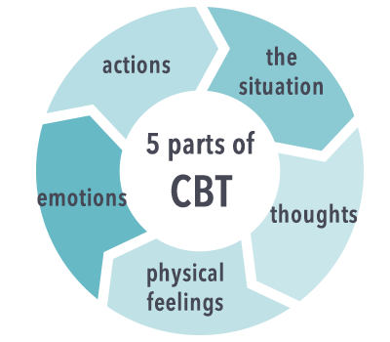
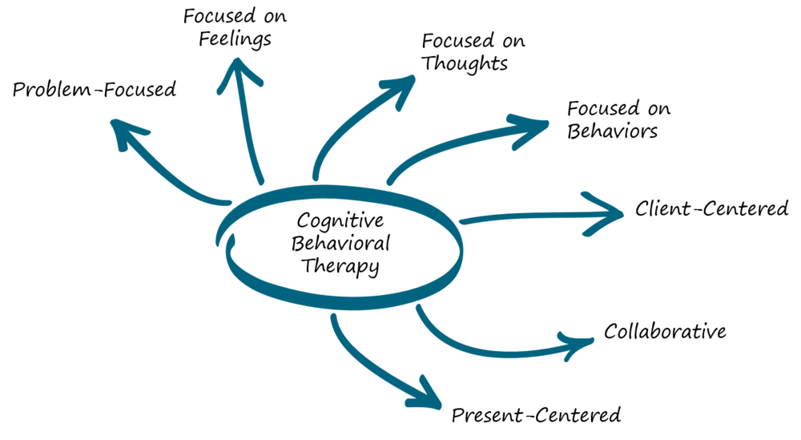
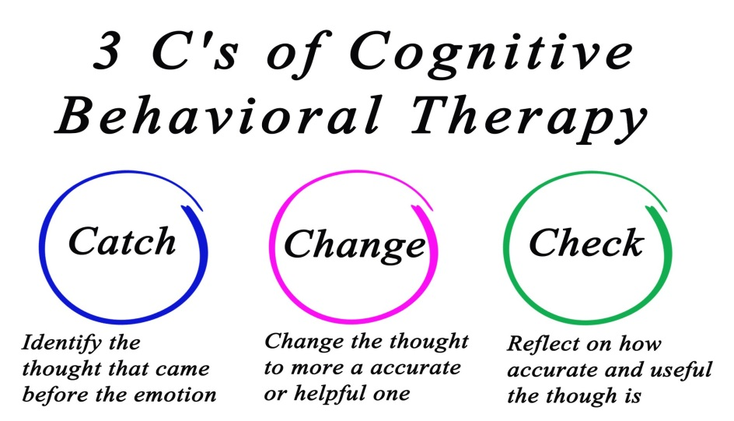
Cognitive Behavioural Therapy (CBT)
Knuth A, Ross-Stewart L, Brent C, Salerno R. Psychological Aspects of Rehabilitation as Perceived by Physical Therapists. J Phy Fit Treatment & Sports. 2018; 2(1): 5555
M Sarada Menon; Psychosocial Rehabilitation; NIMHANS Journal; 14(4) 1996; 29-305

Slide 20
Skill training
Problem
Patient’s problem should be identified in terms of Behavioural deficits and social problems.
Inventory of Assests
Strengths and capabilities of patients must be identified
Therapy Alliance
Build rapport with patient and show empathy instead of judgemental
Goal setting
Establish realistic positive and attainable goals
Rehearsal
Behavioural rehearsal is critical element in training skills
Reinforcement
Positive reinforcements should be build in at each and every step
Shaping
Breaking of short term goals into long term goals which sound attainable and realistic
Prompting
Giving directional prompts or cues to patients with every desired behaviour
Modelling
Therapist demonstrated desirable behavioural patterns at different or desired situations.
Homework
Assignments and home-works allotment for general behavioural skills to develop
Knuth A, Ross-Stewart L, Brent C, Salerno R. Psychological Aspects of Rehabilitation as Perceived by Physical Therapists. J Phy Fit Treatment & Sports. 2018; 2(1): 5555
M Sarada Menon; Psychosocial Rehabilitation; NIMHANS Journal; 14(4) 1996; 29-305

Slide 21
Role of PTs
Physical therapists’ are considered to be in an optimal position to treat the psychosocial and physical factors accompanying the rehabilitation process.
Sports medicine has comprehensively examined the relationship between thoughts, feelings, and behaviors in regards to the psychological and behavioral responses of injury and recovery.
An extensive amount of research in the field of sports medicine has investigated the psychosocial impact of athletic injuries.
It is suggested that medical professionals, such as physical therapists, should provide psychological support during athlete rehabilitation, be able to effectively implement psychosocial interventions, and have the ability to recognize when referral is appropriate.
Knuth A, Ross-Stewart L, Brent C, Salerno R. Psychological Aspects of Rehabilitation as Perceived by Physical Therapists. J Phy Fit Treatment & Sports. 2018; 2(1): 555579

Slide 22
Role of PTs
Good rapport and communication have been associated with greater adherence to the rehabilitation program, increased motivation, and better recovery.
When used in conjunction, the integrated model of psychological response and the bio-psychosocial model of sport injury rehabilitation provide a broader framework of the psychological and social factors impeding the rehabilitation program than the one originally outlined by Engel.
It is evident that physical therapists need to address both physical and psychological aspects of their patients.
Knuth A, Ross-Stewart L, Brent C, Salerno R. Psychological Aspects of Rehabilitation as Perceived by Physical Therapists. J Phy Fit Treatment & Sports. 2018; 2(1): 555579

Slide 23
Thank You

